Slide 1




A 1.9 s pulsar in the direction of the old open cluster NGC 6791
刘小金 北京师范大学文理学院
Collaborators:
Rahul Sengar (AEI), Matthew Bailes (Swinburne)
Ralph Eatough (NAOC), Jianping Yuan (XAO), Na Wang (XAO)
Lu Zhou (Wuhan U.), He Gao (BNU), Zong-Hong Zhu (BNU)
Xing-Jiang Zhu (BNU)

Slide 2

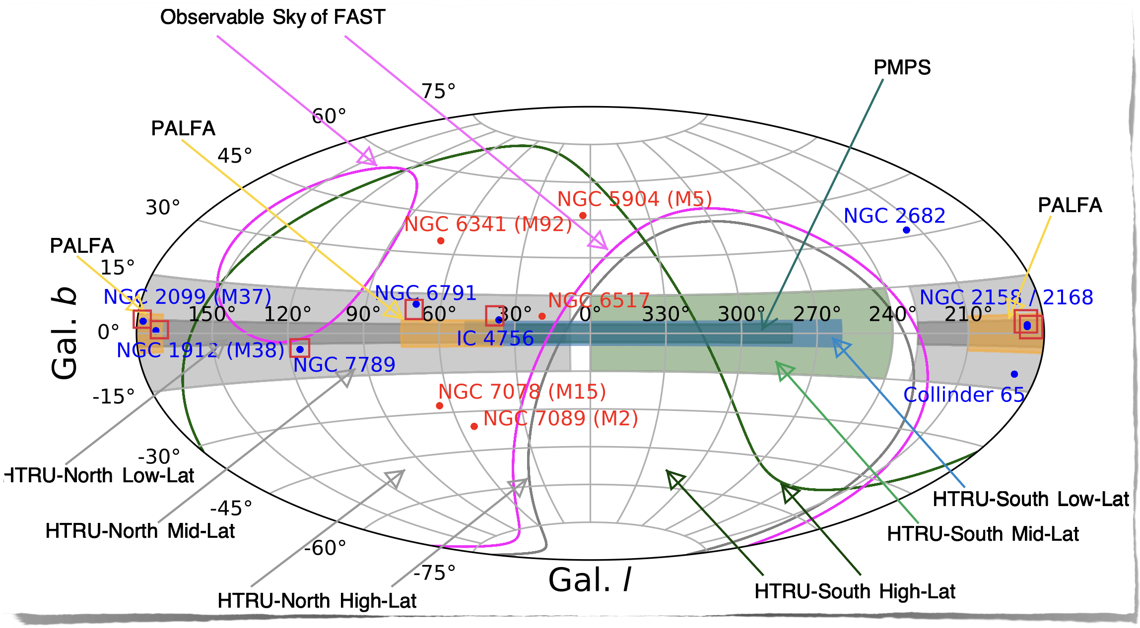





Survey of seven open clusters
7 open clusters on the Galactic plane (Gb < 10°)
tint = 30 or 60 min, 20 hours in total

Slide 3


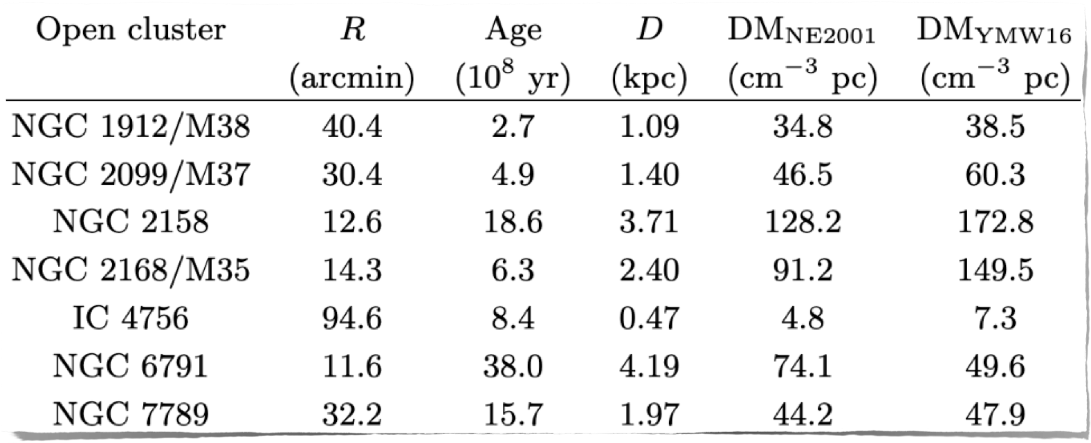






Survey of seven open clusters
19-beam, snapshot/on-off modes
12 - 40 arcmin
0.5 – 5 kpc
0.3 - 4 Gyr
4 − 200 pc/cm³

Slide 4
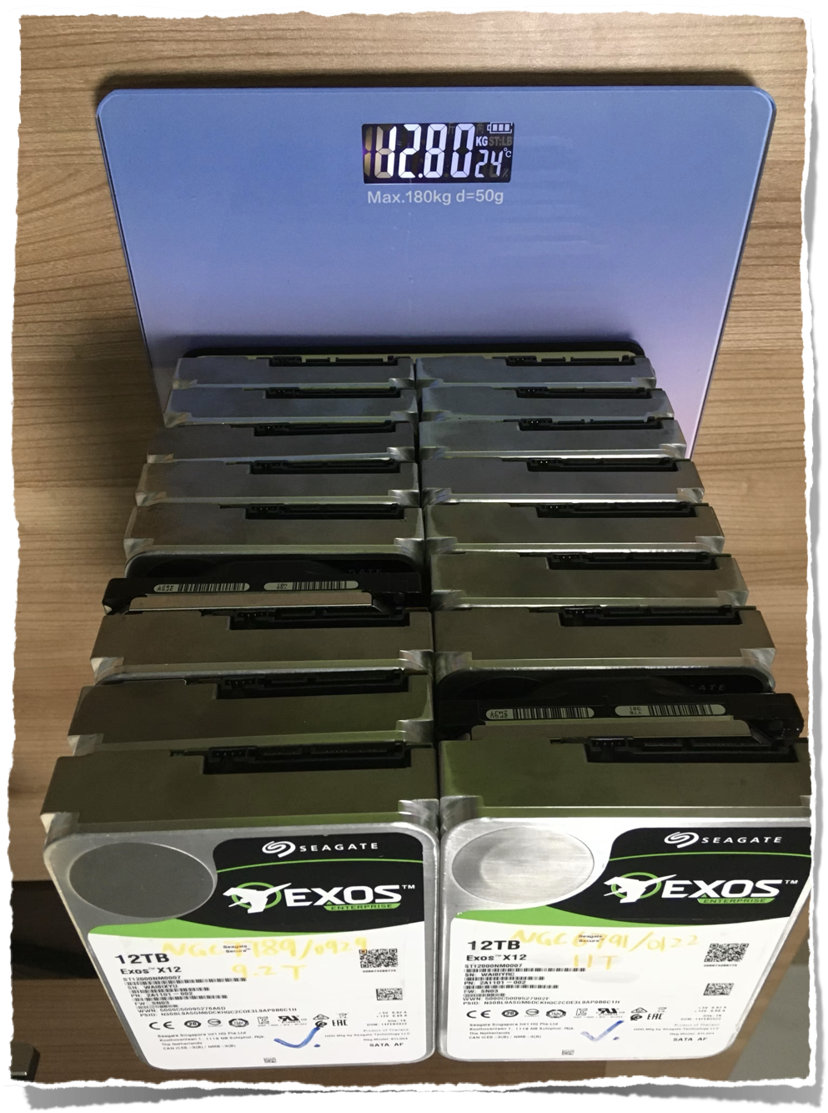

Data reduction
Data: 2 pols, 49 μs, 4096 chans, 19 beams
∼ 200 TB
Reduce data size with digital
12.8 kg
8-bit -> 2
1/16 original size
⎬
4096-chan -> 2048
200 TB > 13
2-pol -> 1
Drawback:
Only a few percent decrease in S/N
Verified with J1837 in the direction of IC 4756

Slide 5
Pulsar search
Find RFIs with Presto
Find common birdies in 3 adjacent-beams: sigpyproc
de-disperse
run on GPU
FFT search
⎬
PEASOUP
⎬
accel. search
faster than CPU
DM range: 2 - 600 pc/cm³
⎬
acc range: [-1, 1] m/s²
3x10⁷ candidates
S/NFFT floor: 5.2
# of pulsars < 10

Slide 6
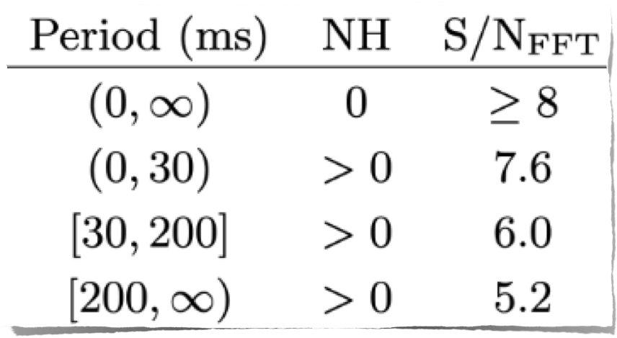






Sifting and folding candidates
Sift candidates using period, NH, S/NFFT
de-disperse, fold candidates with dspsr
⎬
reject if small folding S/N
optimize period, dm, acc with pdmp
inspection

Slide 7
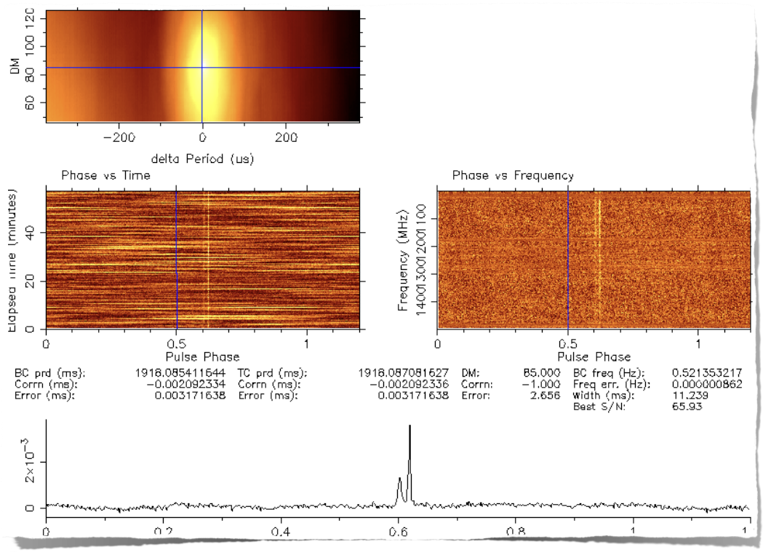
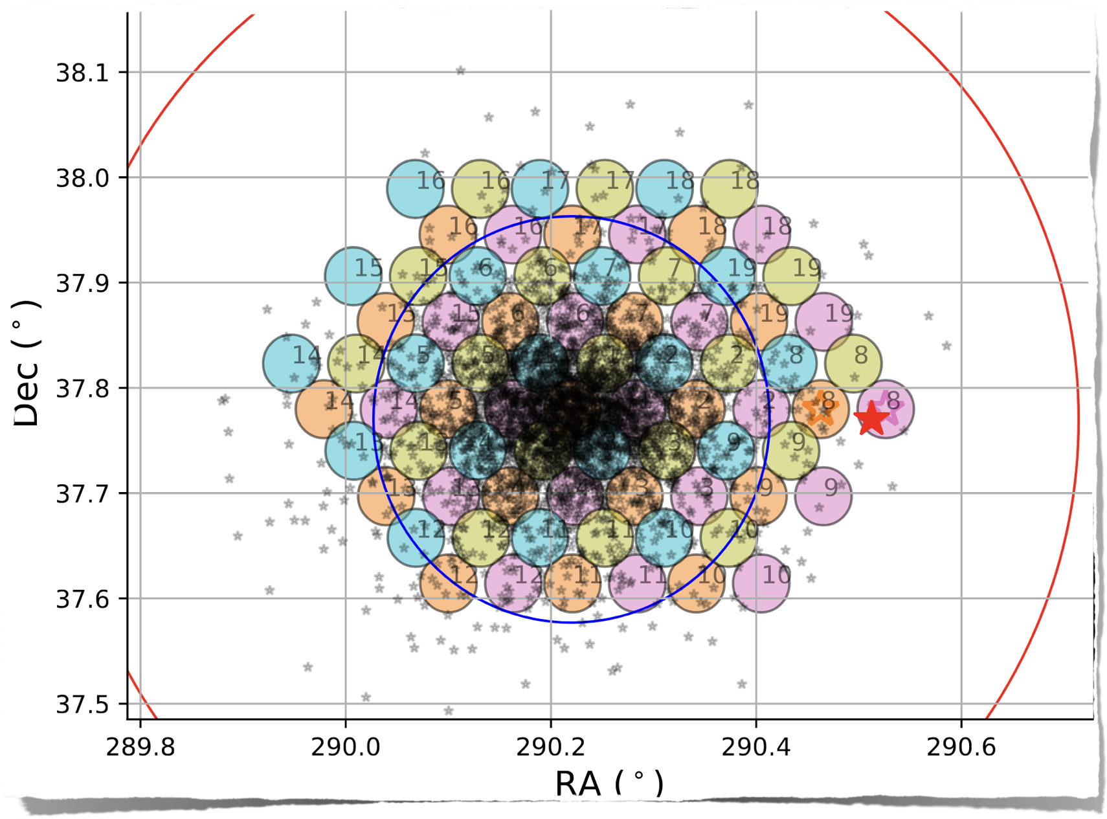



Pulsars!
J1922+37
NGC 6791
1.9 s, 85 pc/cm³
tidal radius
Jacobi radius

Slide 8
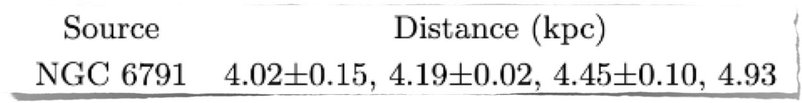



Associated or not?
Likely associated
Unlikely associated
More robust ways:
D from Long-baseline interferometry, low flux density
Proper motion of J1922+37 from timing ∼ 10 years
More PSRs with similar DM in the region ← Globular cluster case

Slide 9
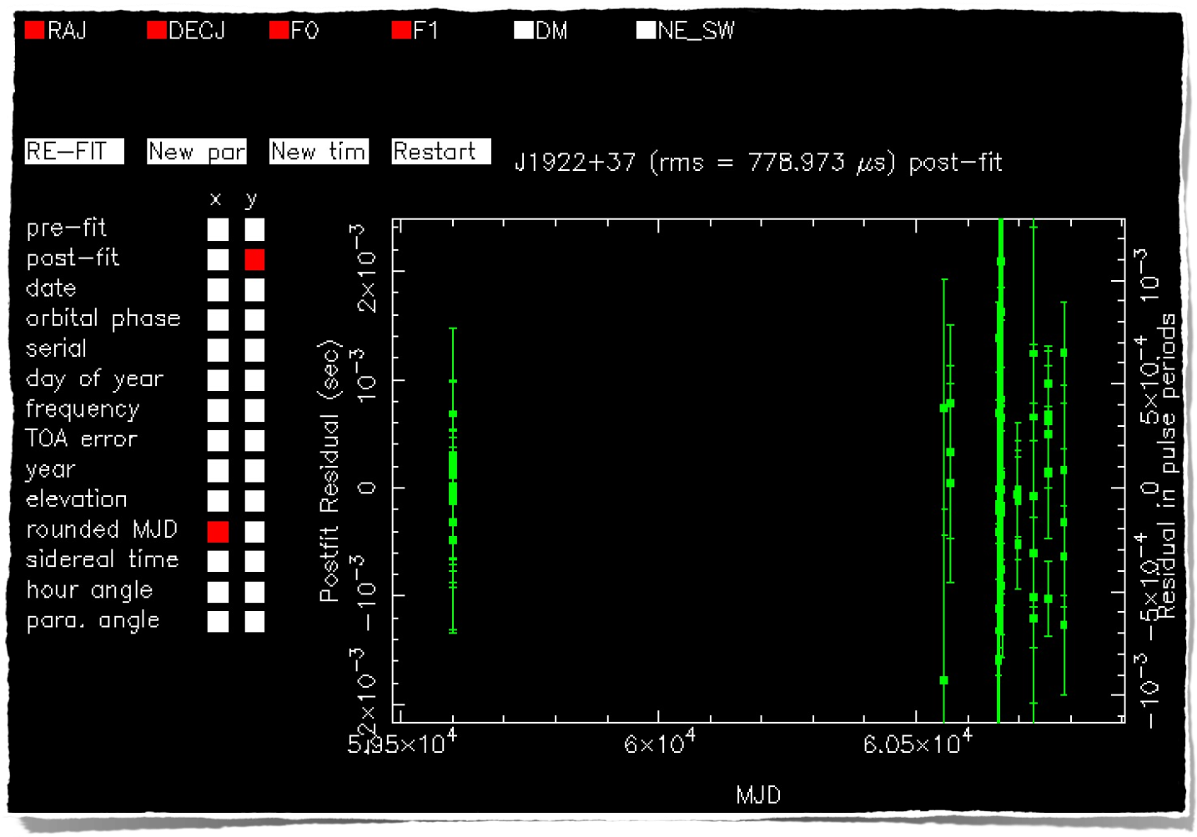
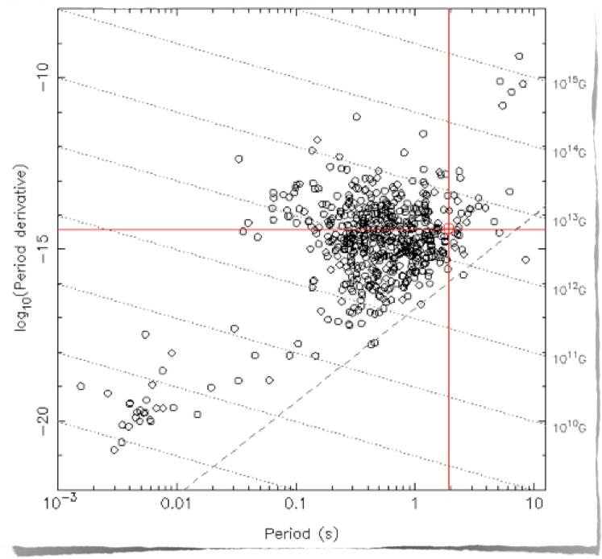

Pulsars! J1922+37
7.8 Myr
3x10¹² G
isolated pulsar

Slide 10
Association and formation theory
If associated, there are challenges to formation theory
Age problem
J1922+37: 7.8 Myr << NGC6791: 4 Gyr
Kick problem
Vescape >> Vkick, would have escaped
But similar systems have been observed
M15K (1.9 s), M15L (3.8 s) in globular cluster M15
CXO J1647 at Westerlund 1 within half-light radius

Slide 11
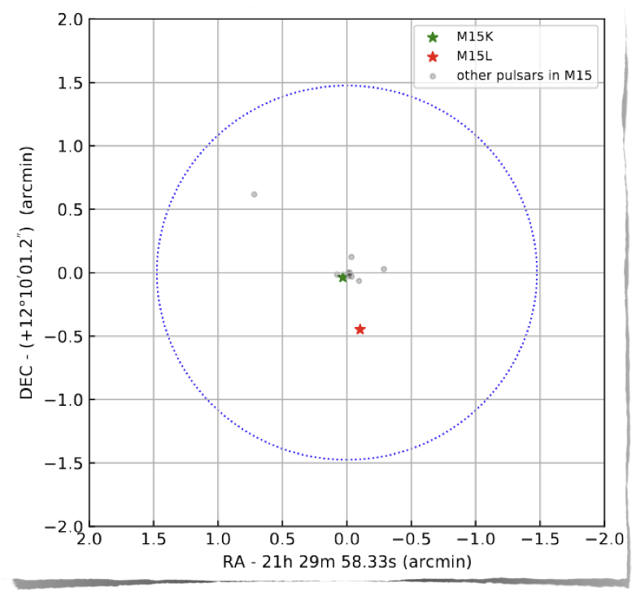
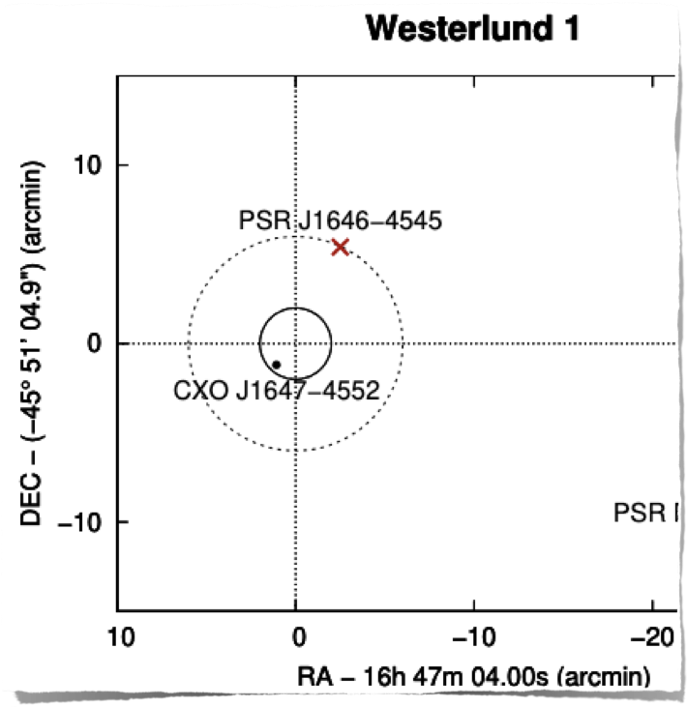

Association and formation theory
M15K (1.9 s), M15L (3.8 s) in globular cluster M15
CXO J1647 at Westerlund 1 within half-light radius
Pica+ 2024
Zhou+ 2024

Slide 12
Summary
Survyed 7 OCs with FAST, searched with PEASOUP
Discovered a new isolated pulsar J1922+37, P = 1.9 s
J1922+37 is in the direction of NGC 6791, has some chance of association based on d_DM
Roubust confirmation: finding more pulsars with similar DM
If associated, new evidence for alternative formation channel

Slide 13

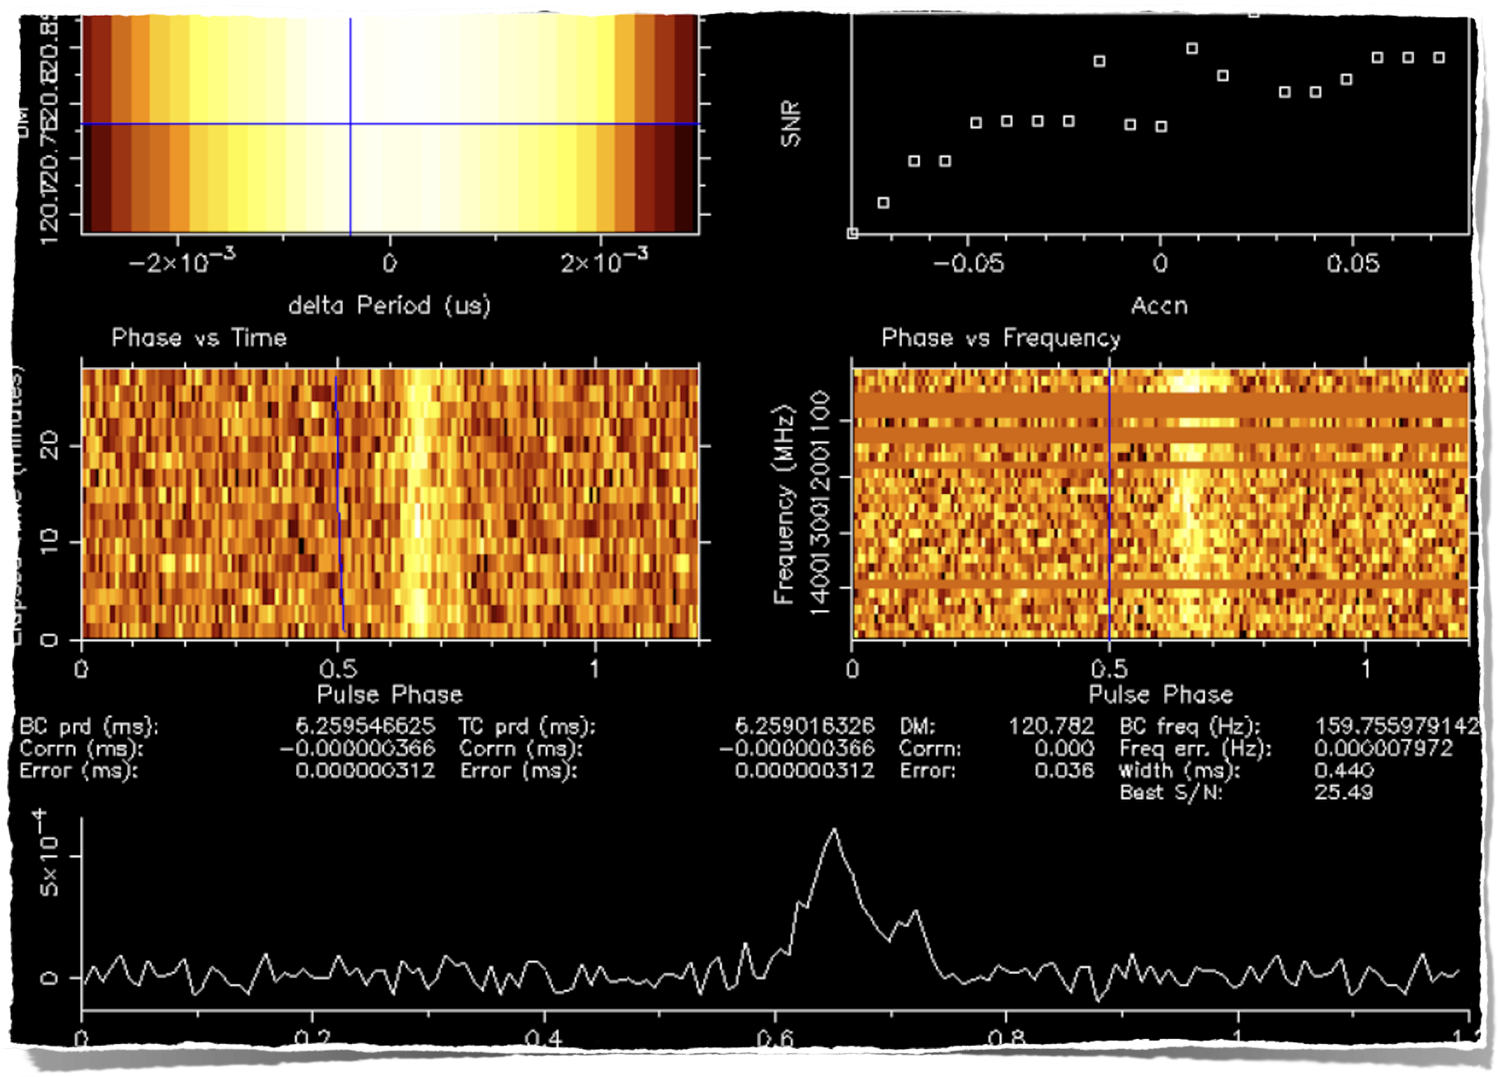
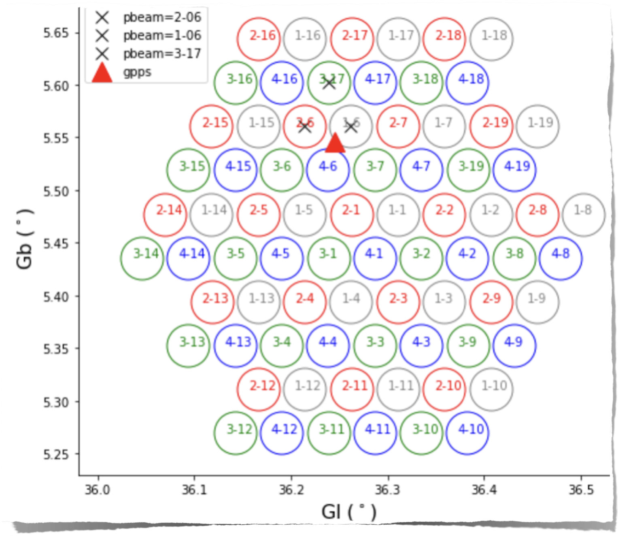

Pulsars!
6.25 ms, 120 pc/cm³
Consistent with J1835+0534g found by GPPS in P, DM
In the direction of IC 4756, but >> cluster DM (50 – 80)
Association unlikely

