Slide 1
A Mysterious Emission Features of An Exotic Pulsar—A Long Awaited Radiation
SKA Pulsar Science Symposium (SPSS) 2025
Speaker:
阿布都加怕尔·如苏力 (Abdujappar Rusul)
J. P. Yuan, Z. G. Wen, Ali Esamdin, Xiao-Ping Zheng, Michael Kramer
Collaborators:
Kashi University
Xinjiang Astronomical Observatory, Chinese Academy of Sciences,
Central China Normal University
Jodrell Bank Centre for Astrophysics, School of Physics and Astronomy, University of Manchester, Manchester, UK.
From:
July 2-4, 2025, Qingdao University of Technology (QUT), Qingdao, ShanDong China

Slide 2
Content
1. A simple overview of pulsar emission
2. An Exotic Pulsar -The classical intermittent pulsar PSR B1931+24
3. A Long-Awaited Radiation - Weak emission from PSR B1931+24
4. A Long-Awaited Radiation - Changing pulse profile
5. A Long-Awaited Radiation - Dyssynchronous nonuniform emission
6. A Long-Awaited Radiation – A state-transition
7. A Long-Awaited Radiation - Pulse flux distribution and dwarf pulses
8. Discussions & Conclusion

Slide 3
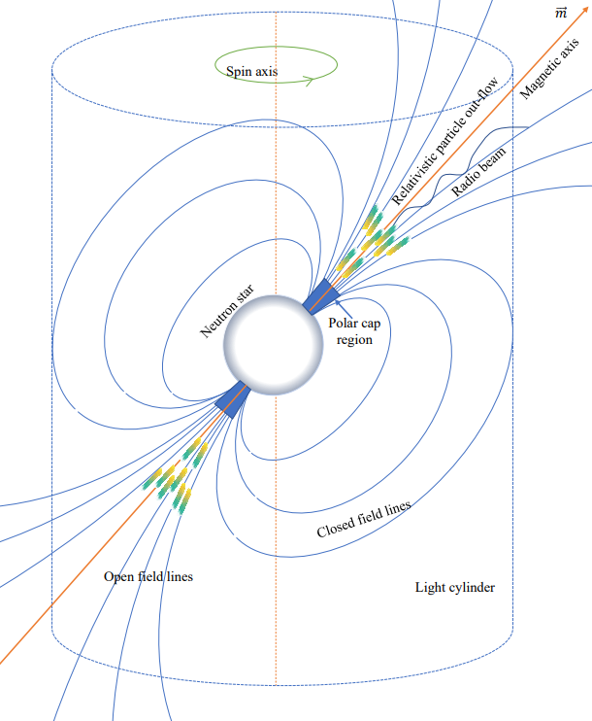
A Simple overview of pulsar emission
Observations:
Pulsars are fast rotating neutron stars, which have extremely strong magnetic fields ((Hewish et al., 1968).
General theory:
The rapid rotation, combined with the strong magnetic fields, create powerful electromagnetic effects (Goldreich & Julian, 1969) .
Observations:
From radio to gamma ray etc. (Lorimer & Kramer, 2012)).
In radio band: Mode changing, nulling, intermitting, drifting sub-pulses etc.
A few models:
Polar cap (SCLF, vacuum gap, annular gap), Outer-gap, Current sheet etc. (Sturrock, 1971)(Ruderman & Sutherland, 1975)(Cheng et al., 1986) (Qiao et al., 2004) (Contopoulos, 2018)
Acceleration of charged Particles, pair-creation and the subsequent emissions.
Toy model of pulsar magnetosphere and its polar cap emission

Slide 4
A Simple overview of pulsar emission
Observations:
Pulsars are fast rotating neutron stars, which have extremely strong magnetic fields ((Hewish et al., 1968).
General theory:
The rapid rotation, combined with the strong magnetic fields, create powerful electromagnetic effects (Goldreich & Julian, 1969) .
Challenge:
If there is no evidence of a significant change in magnetic field and/or rotation period within one or few spins of rotation, how could we explain the prolonged intermittent emission behavior of intermittent pulsars?
The general theory gets wrong or there must be emission which might be too weak to be detected.
Toy model of pulsar magnetosphere and its polar cap emission

Slide 5
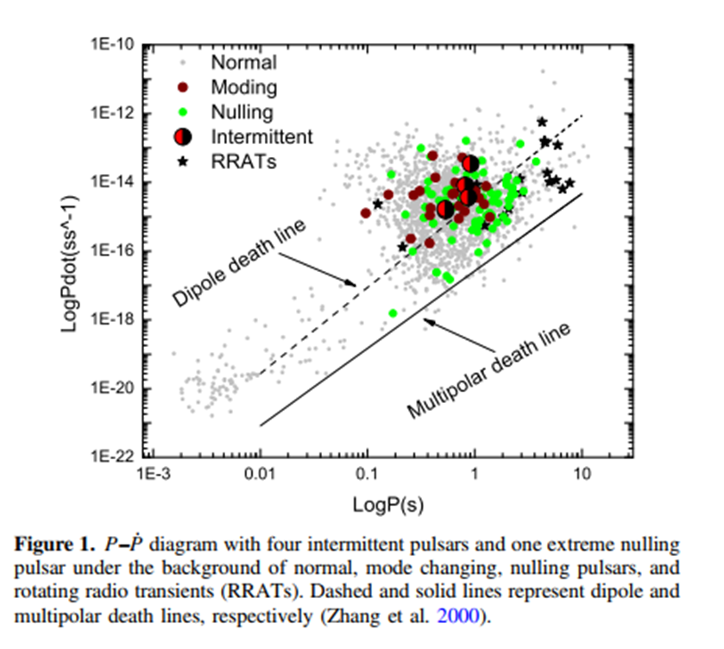
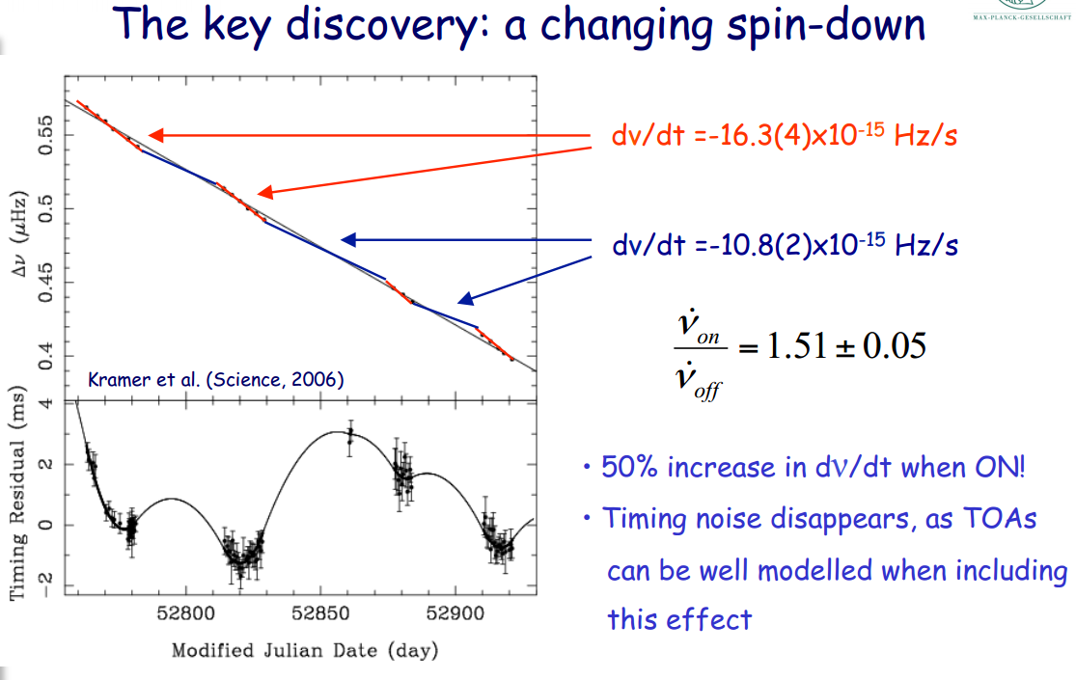
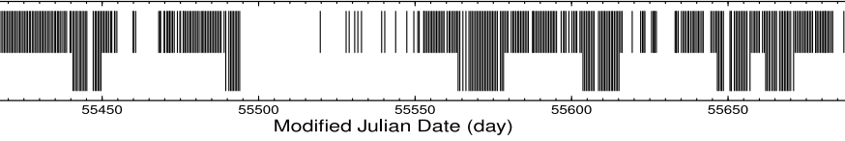
An Exotic Pulsar - The classical intermittent pulsar PSR B1931+24
(Rusul et al., 2021)
Kramer et al. (science, 2006)
The general theory gets wrong or there must be emission which might be too weak to be detected.
Unfortunately, Parks, Lovell, and Mark II Telescopes at Jodrell bank did not detect any significant emission from the “off’ state of PSR B1931+24 until recently (20 years)
A month
off
on
A week
Young et al. MNRAS, 2013

Slide 6
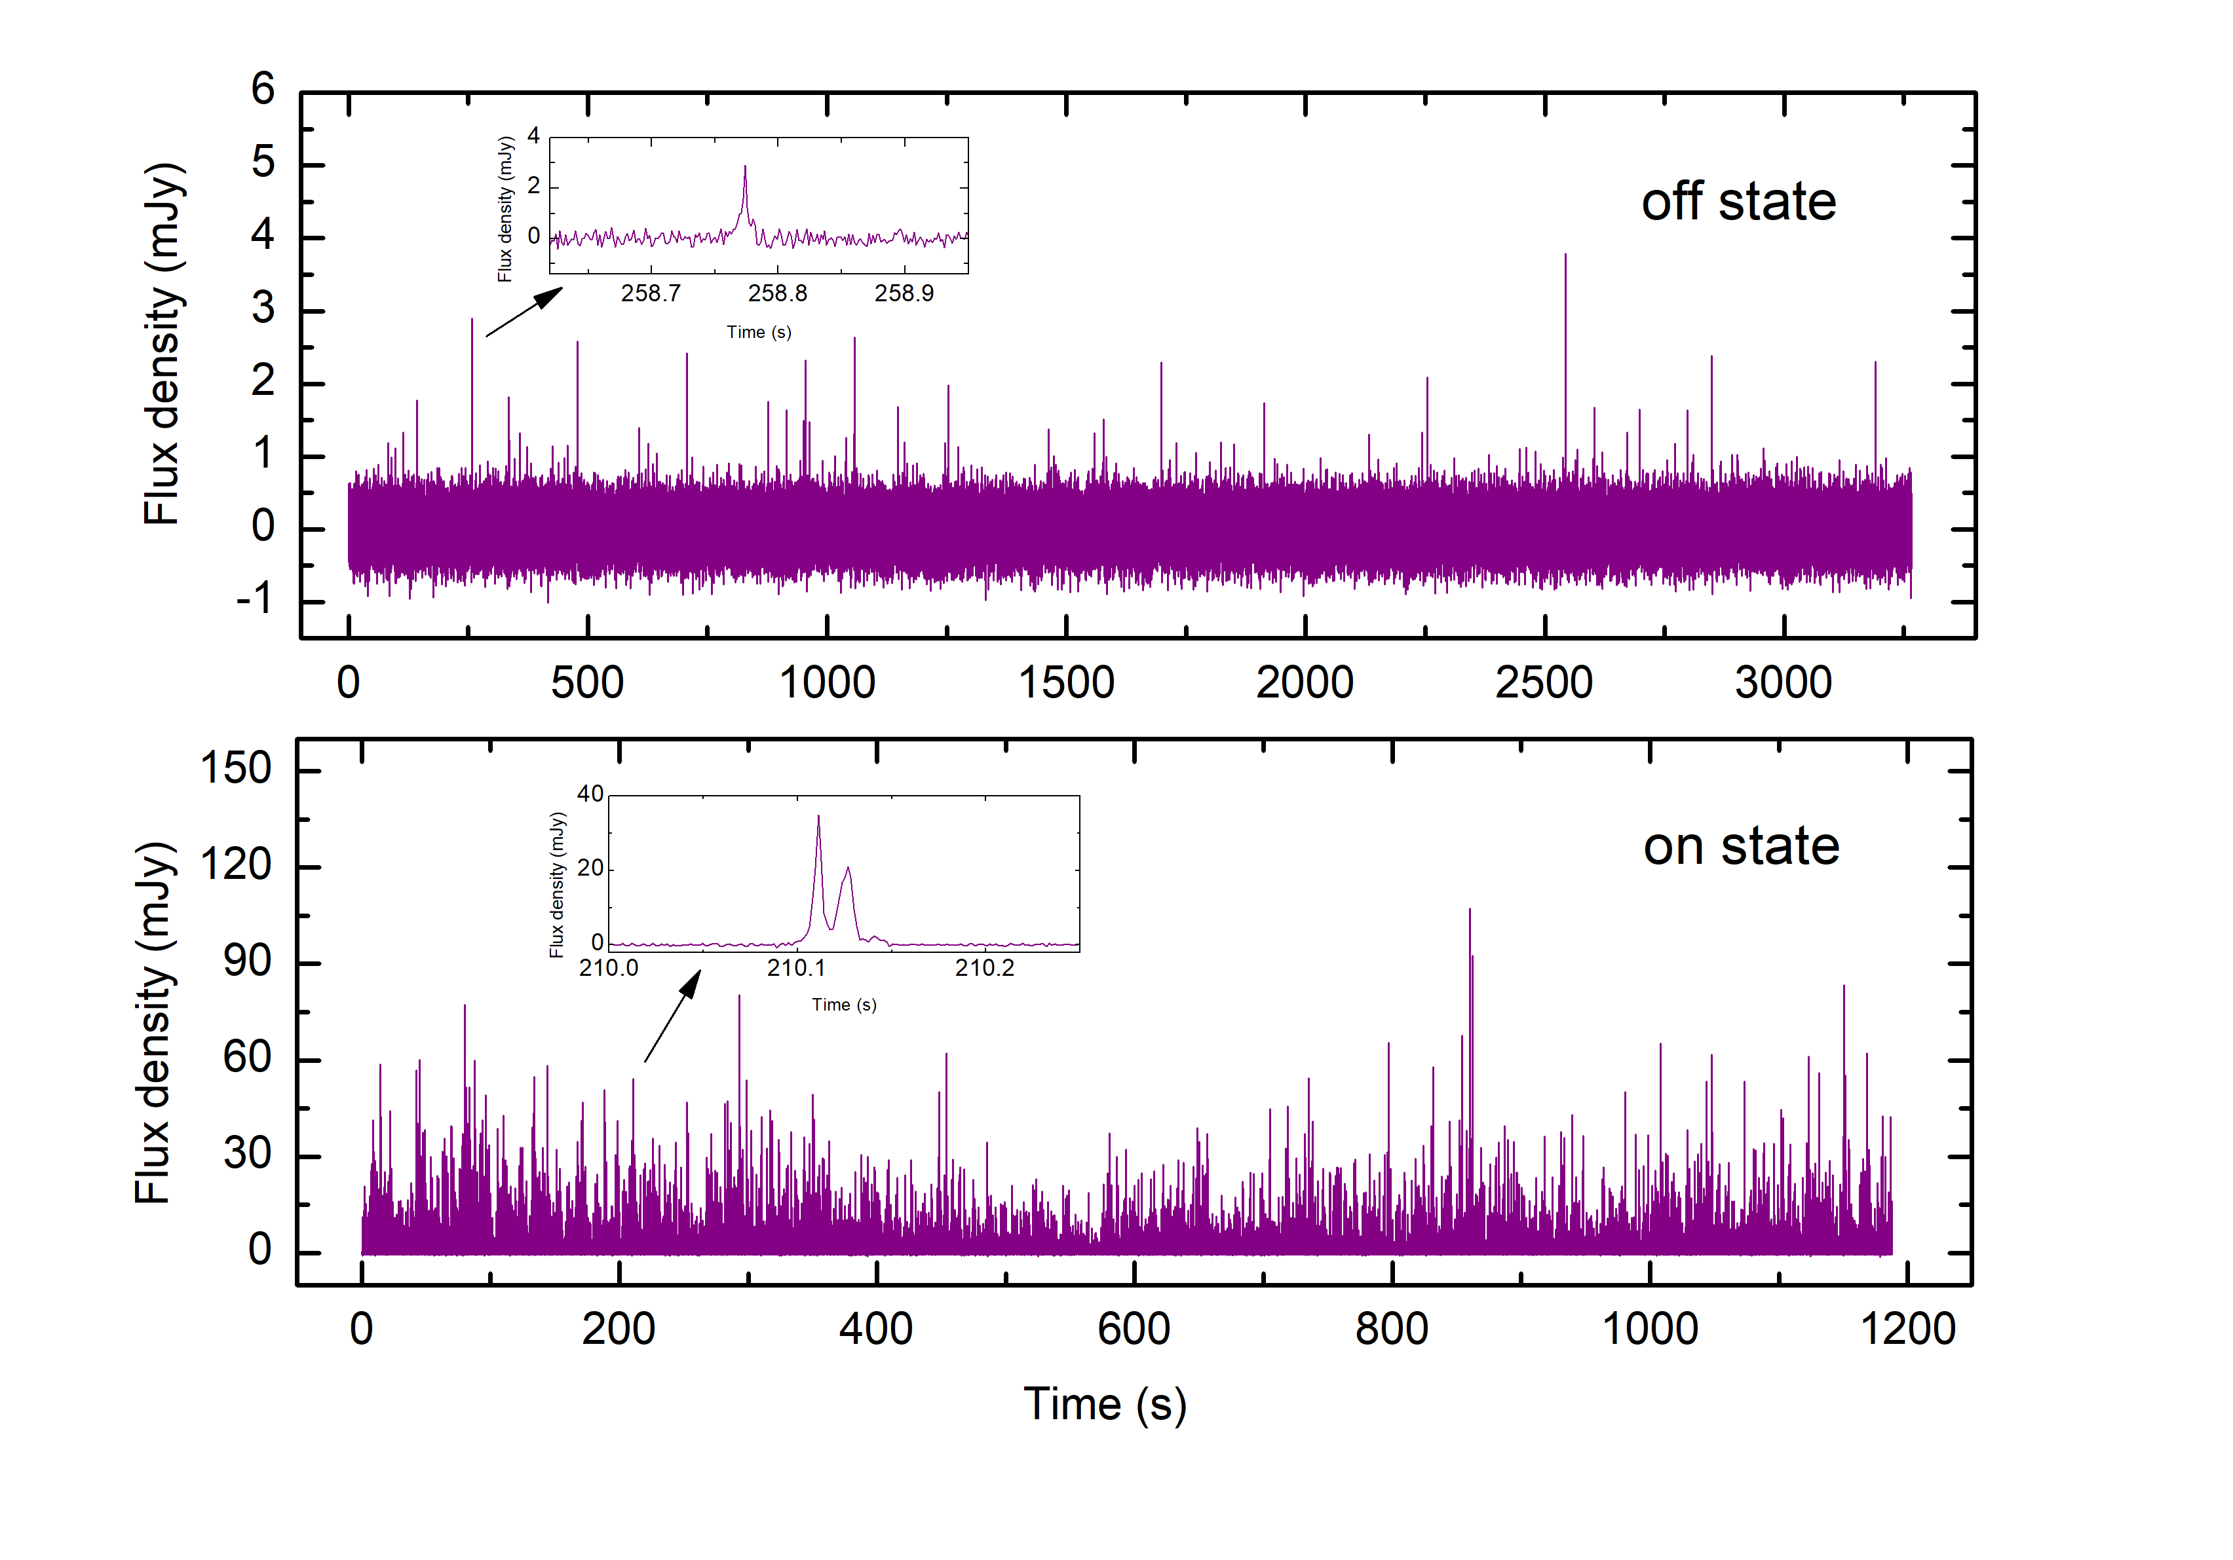
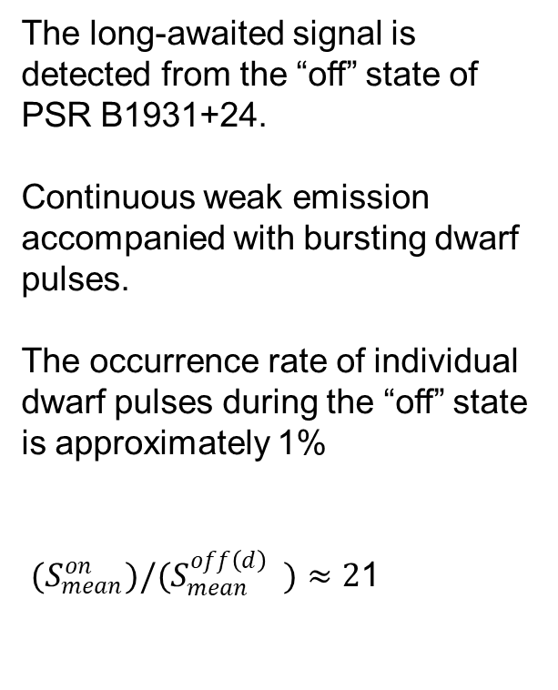
A Long-Awaited Radiation - Weak emission from PSR B1931+24
Fortunately, unprecedented sensitivity of the FAST (NAN et al., 2011) (Jiang et al., 2020) enable us to detect the unseen
The long-awaited signal is detected from the “off” state of PSR B1931+24.
Continuous weak emission accompanied with bursting dwarf pulses.
The occurrence rate of individual dwarf pulses during the “off” state is approximately 1%
$(S_{mean}^{on})/(S_{mean}^{off\left(d\right)} )≈2$1
Fig. 1. The single pulse time series of PSR B1931+24.

Slide 7
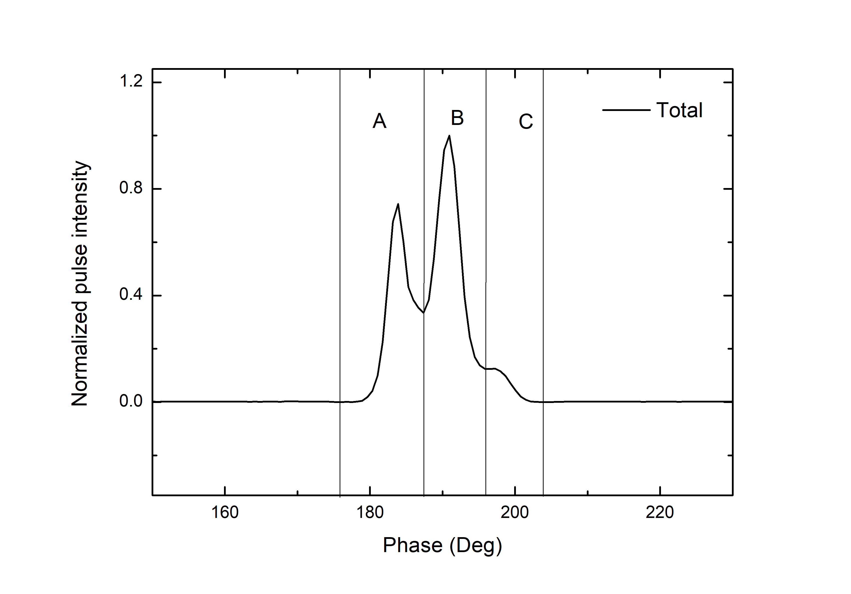
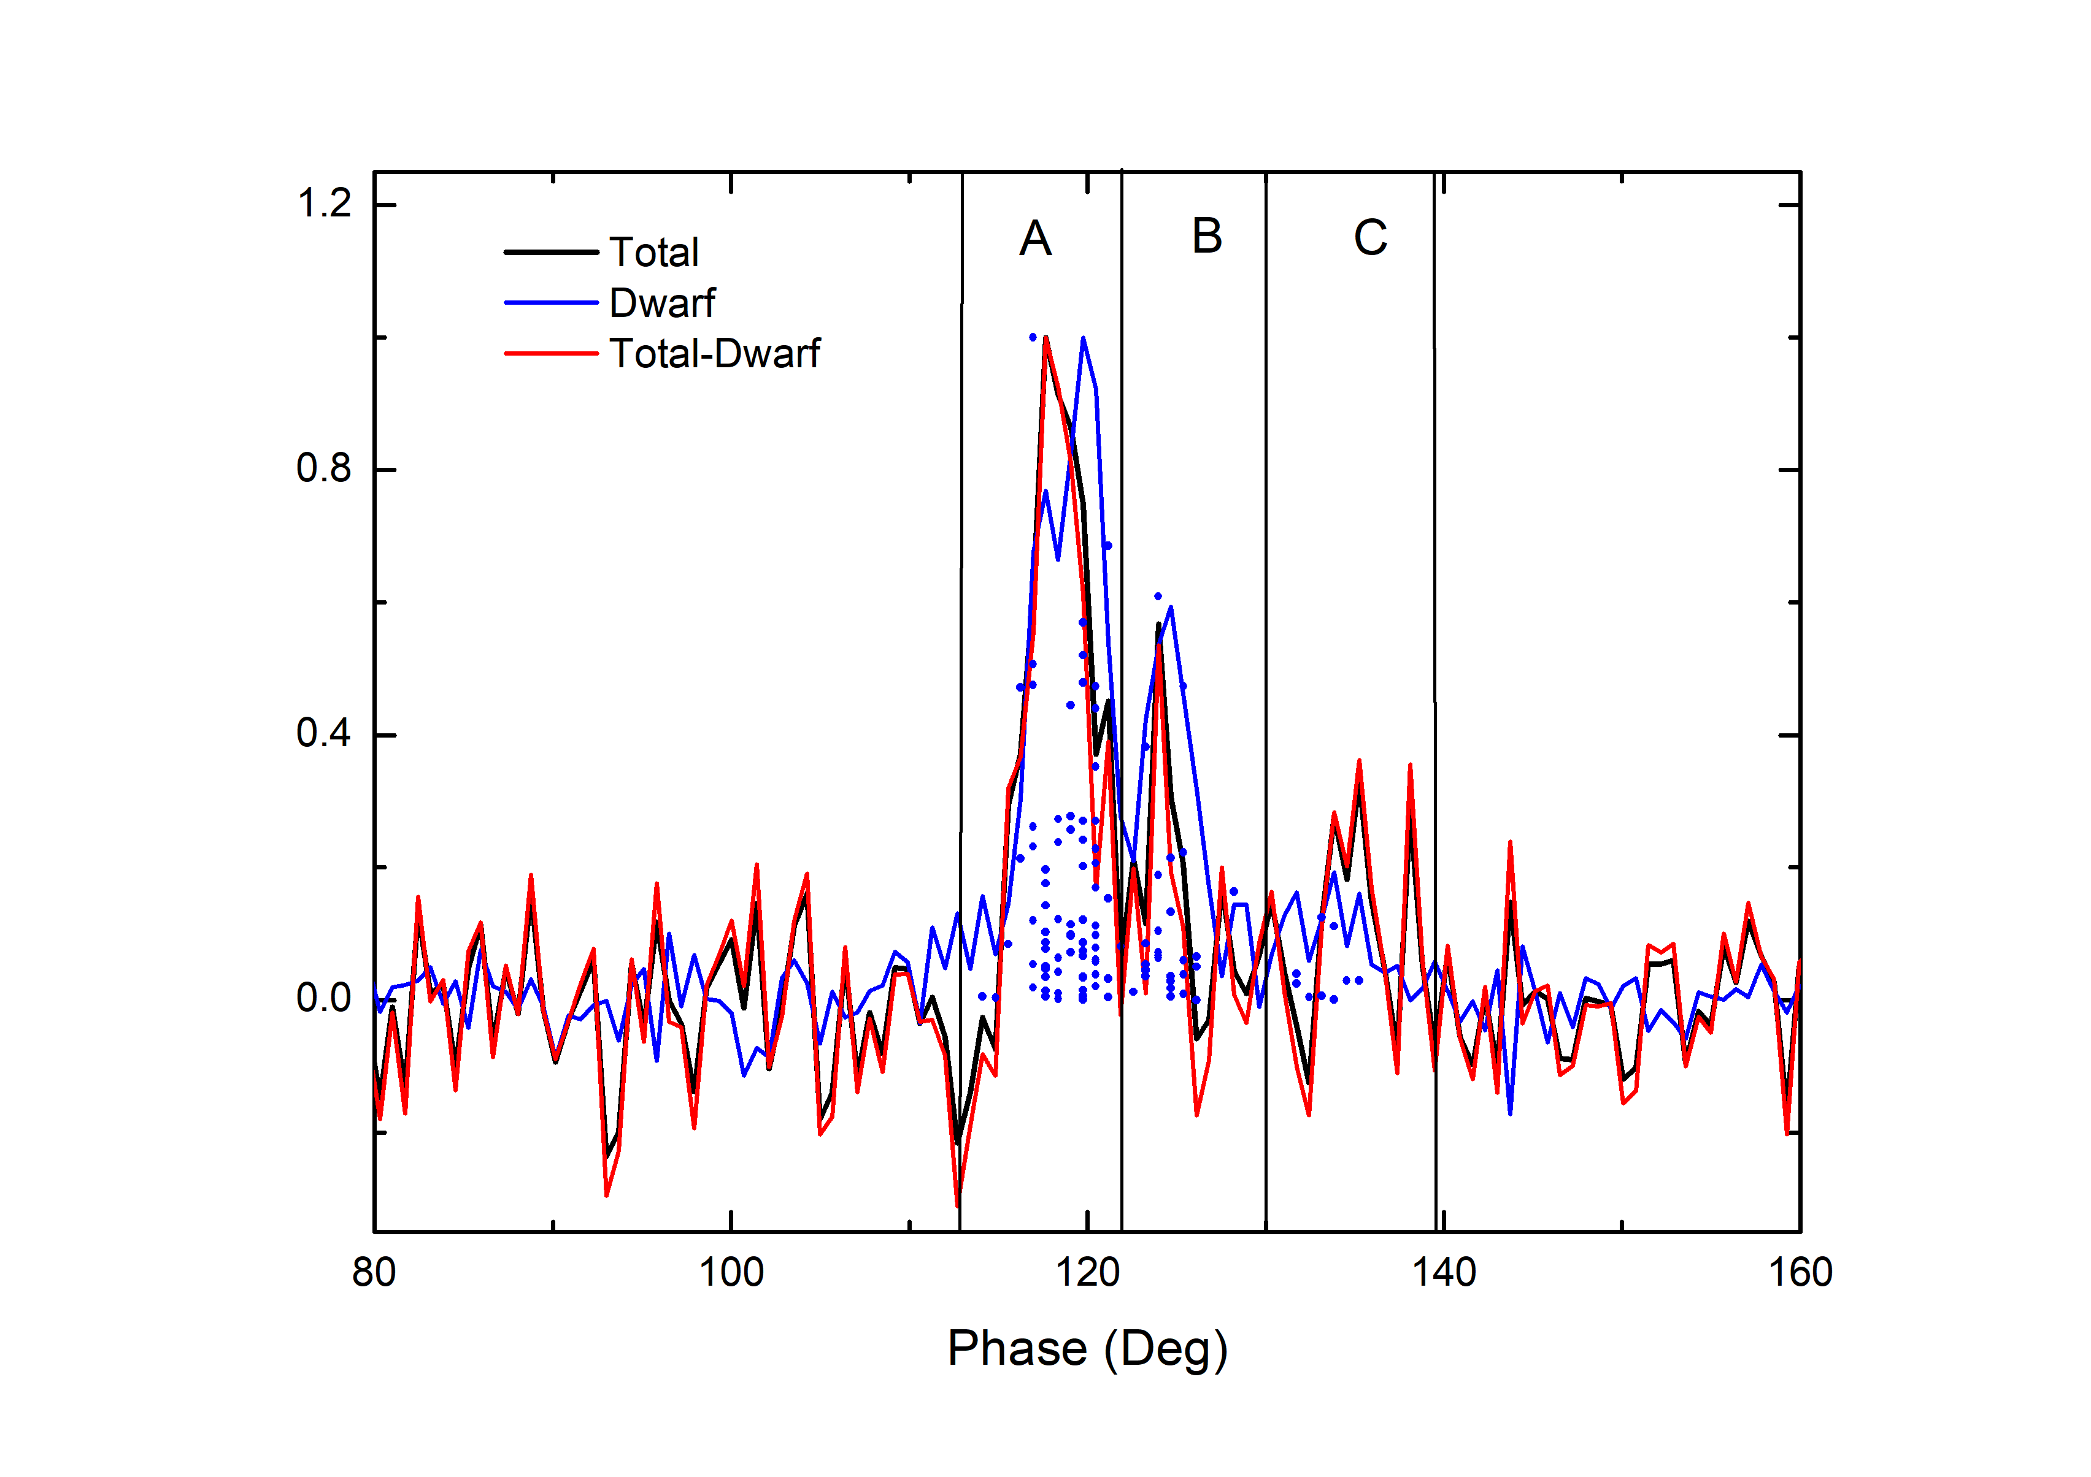


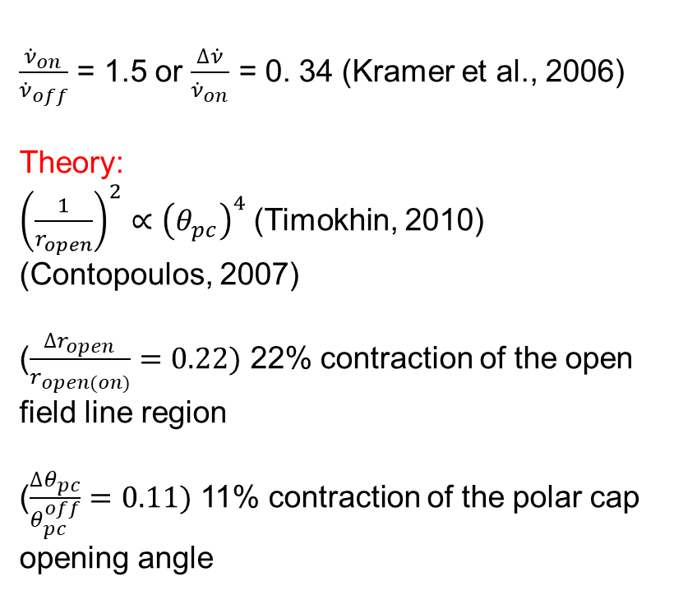
A Long-Awaited Radiation - Changing pulse profile
$\frac{{\dot{ν}}_{on}}{{\dot{ν}}_{off}}$ = 1.5 or $\frac{∆\dot{ν}}{{\dot{ν}}_{on}}$ = 0. 34 (Kramer et al., 2006)
Theory:
${\left(\frac{1}{r_{open}}\right)}^{2}∝{\left(θ_{pc}\right)}^{4}$(Timokhin, 2010) (Contopoulos, 2007)
($\frac{∆r_{open}}{r_{open(on)}}=0.22)$ 22% contraction of the open field line region
($\frac{∆θ_{pc}}{θ_{pc}^{off}}=0.11)$ 11% contraction of the polar cap opening angle
“on” state, $w_{50}={10.11}^{∘}$
“off” state, $w_{50}$=${7.57}^{∘}$
Fig. 2. The integrated pulse profile of PSR B1931+24 in its “on” and “off” state.
The “off” state pulse profile width shrinks by up to 34% at most, 25% at least.

Slide 8
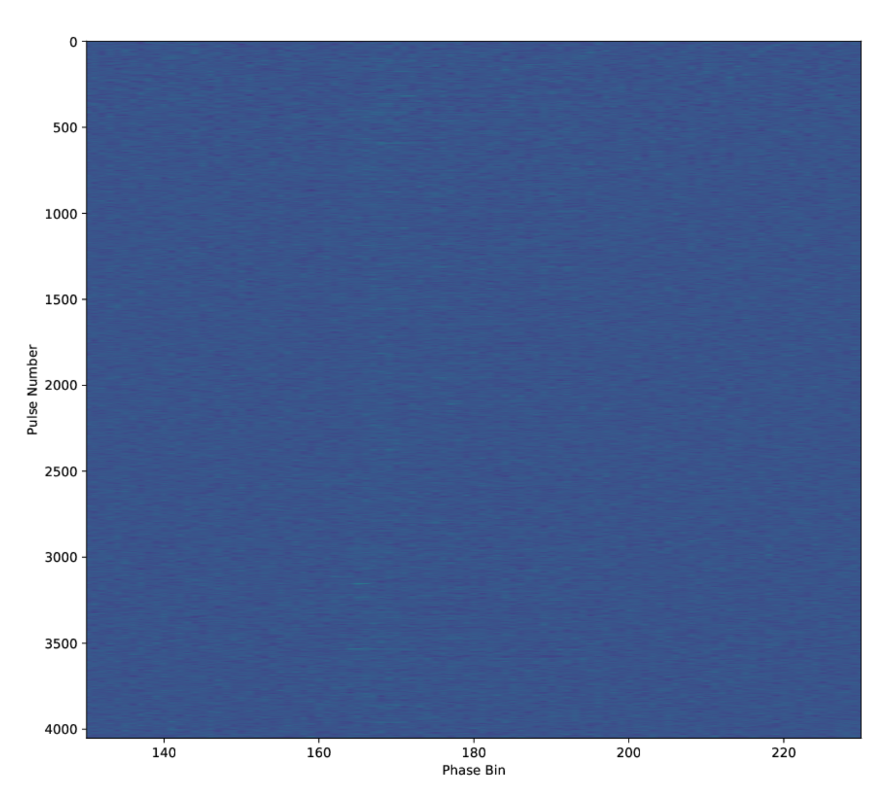
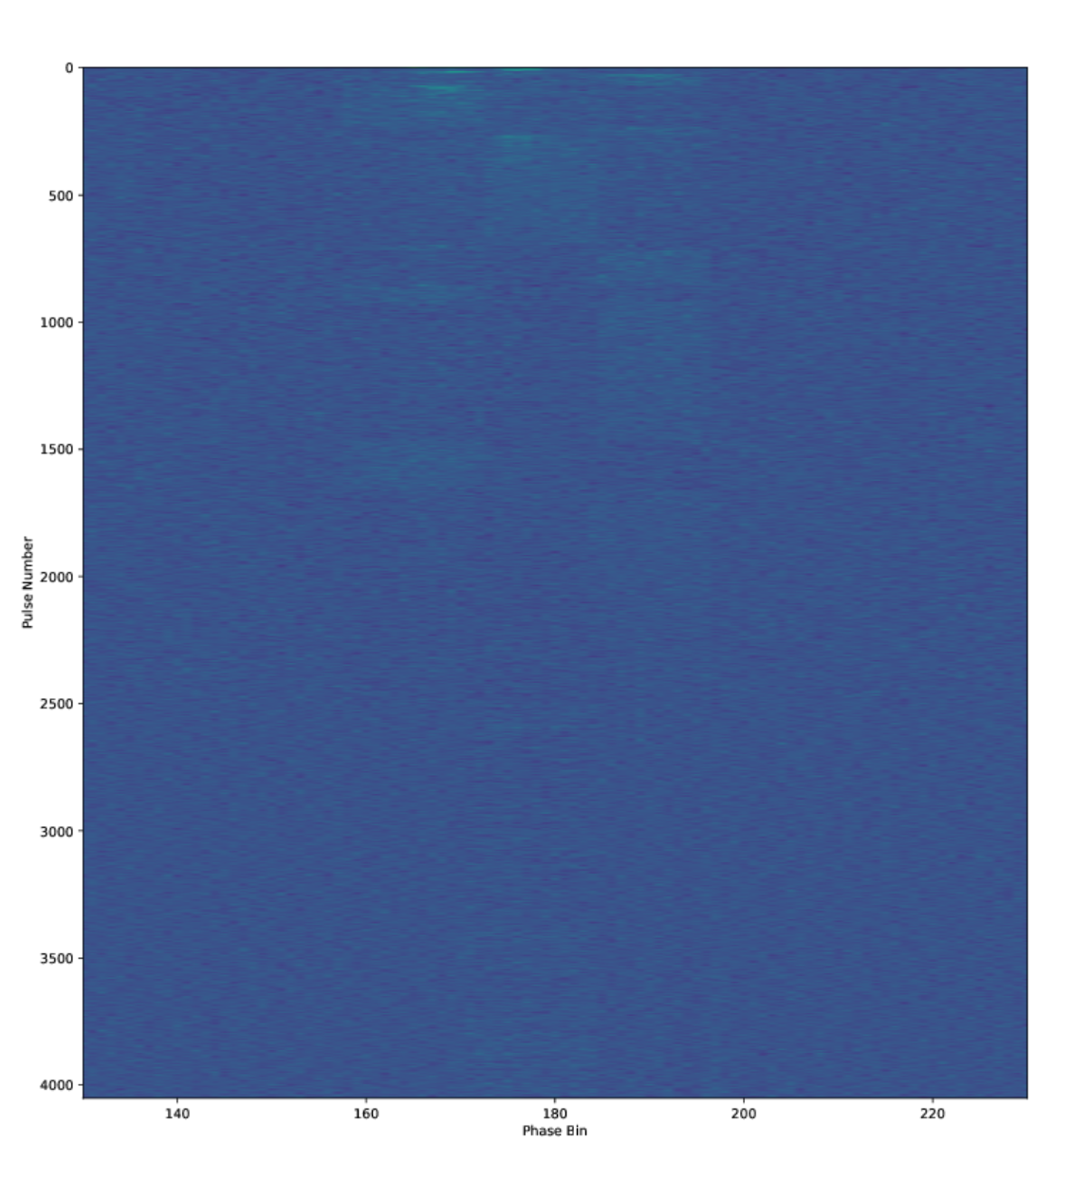
A Long-Awaited Radiation - Dyssynchronous nonuniform emission （off）
Original pulse stack
Pulse stack after rearranging under the energy flux of the total +plus different pulse components
Strong and weak strange striped patchy emission patterns
May represent a desynchronization of discharges on different field lines (Chernoglazov et al., 2024) (Philippov et al., 2020)

Slide 9
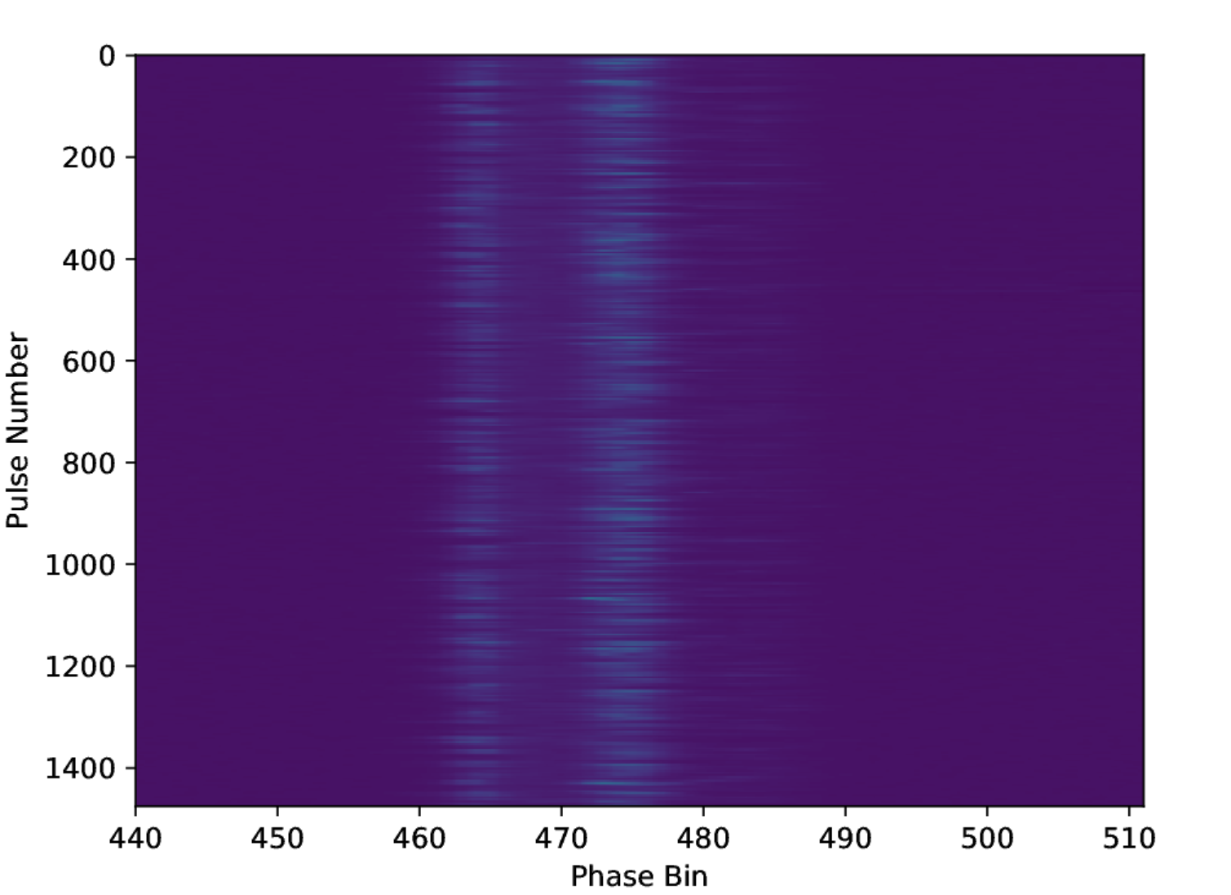
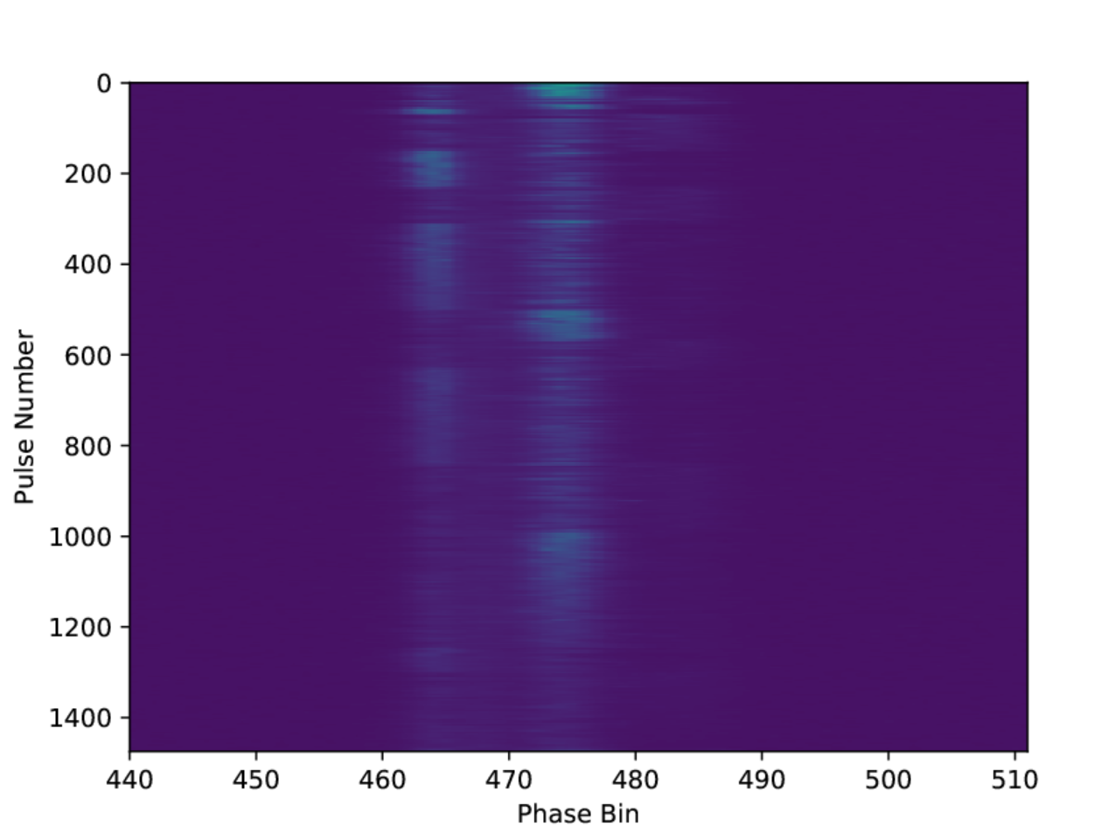
A Long-Awaited Radiation - Dyssynchronous nonuniform emission (on)
Original pulse stack
Pulse stack after rearranging under the energy flux of the total +plus different pulse components
Strong and weak strange striped patchy emission patterns
May represent a desynchronization of discharges on different field lines (Chernoglazov et al., 2024) (Philippov et al., 2020)

Slide 10
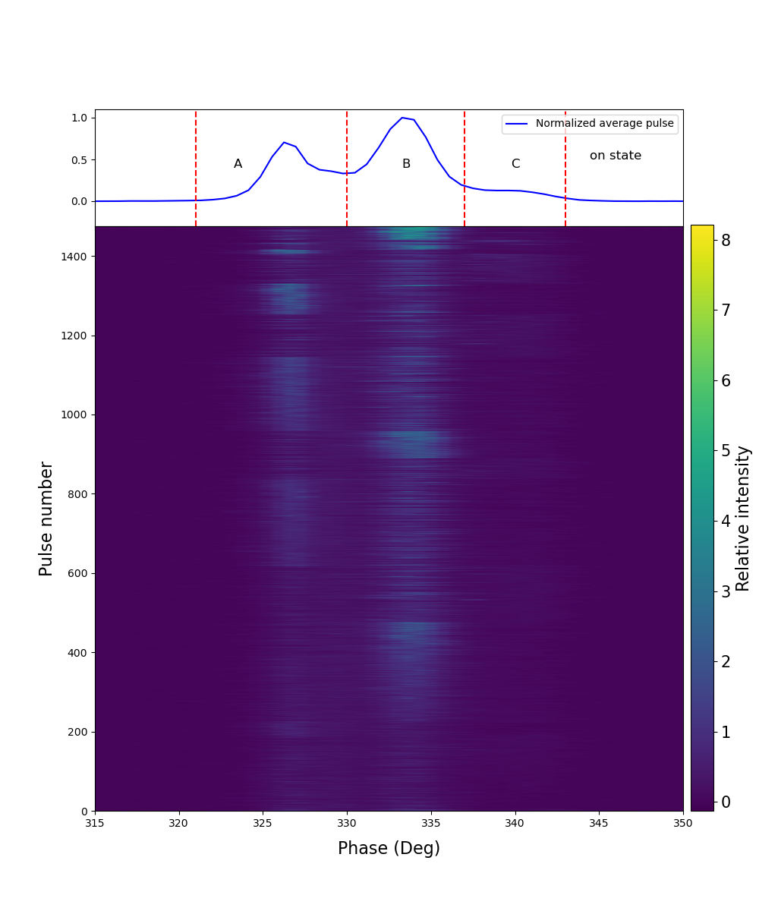
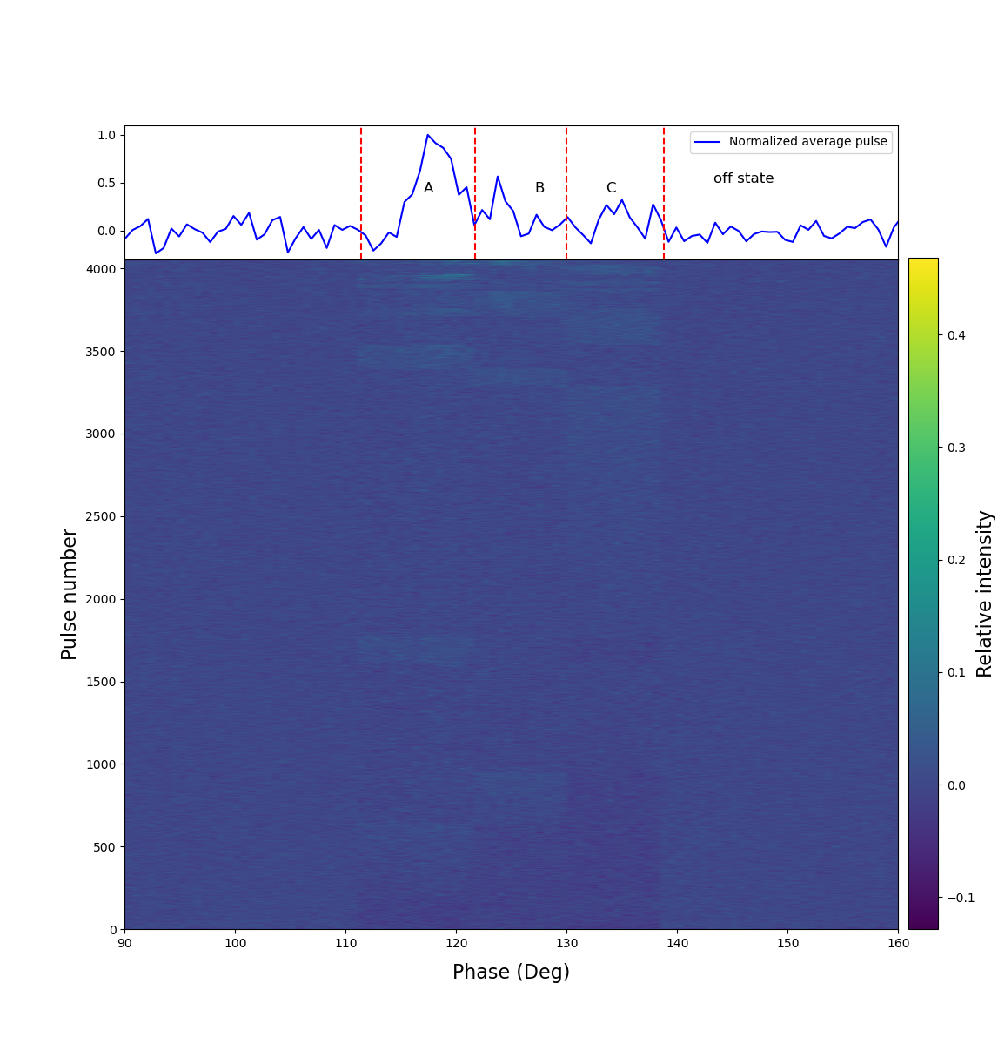
A Long-Awaited Radiation - Dyssynchronous nonuniform emission
Fig. 3. Reorganized pulse stacks for the “on” (left) and “off” (right) state, respectively. A distinct dyssynchronous, striped patchy emission pattern is evident among components A, B, and C of the individual pulses.
May represent a desynchronization of discharges on different field lines (Chernoglazov et al., 2024) (Philippov et al., 2020)

Slide 11
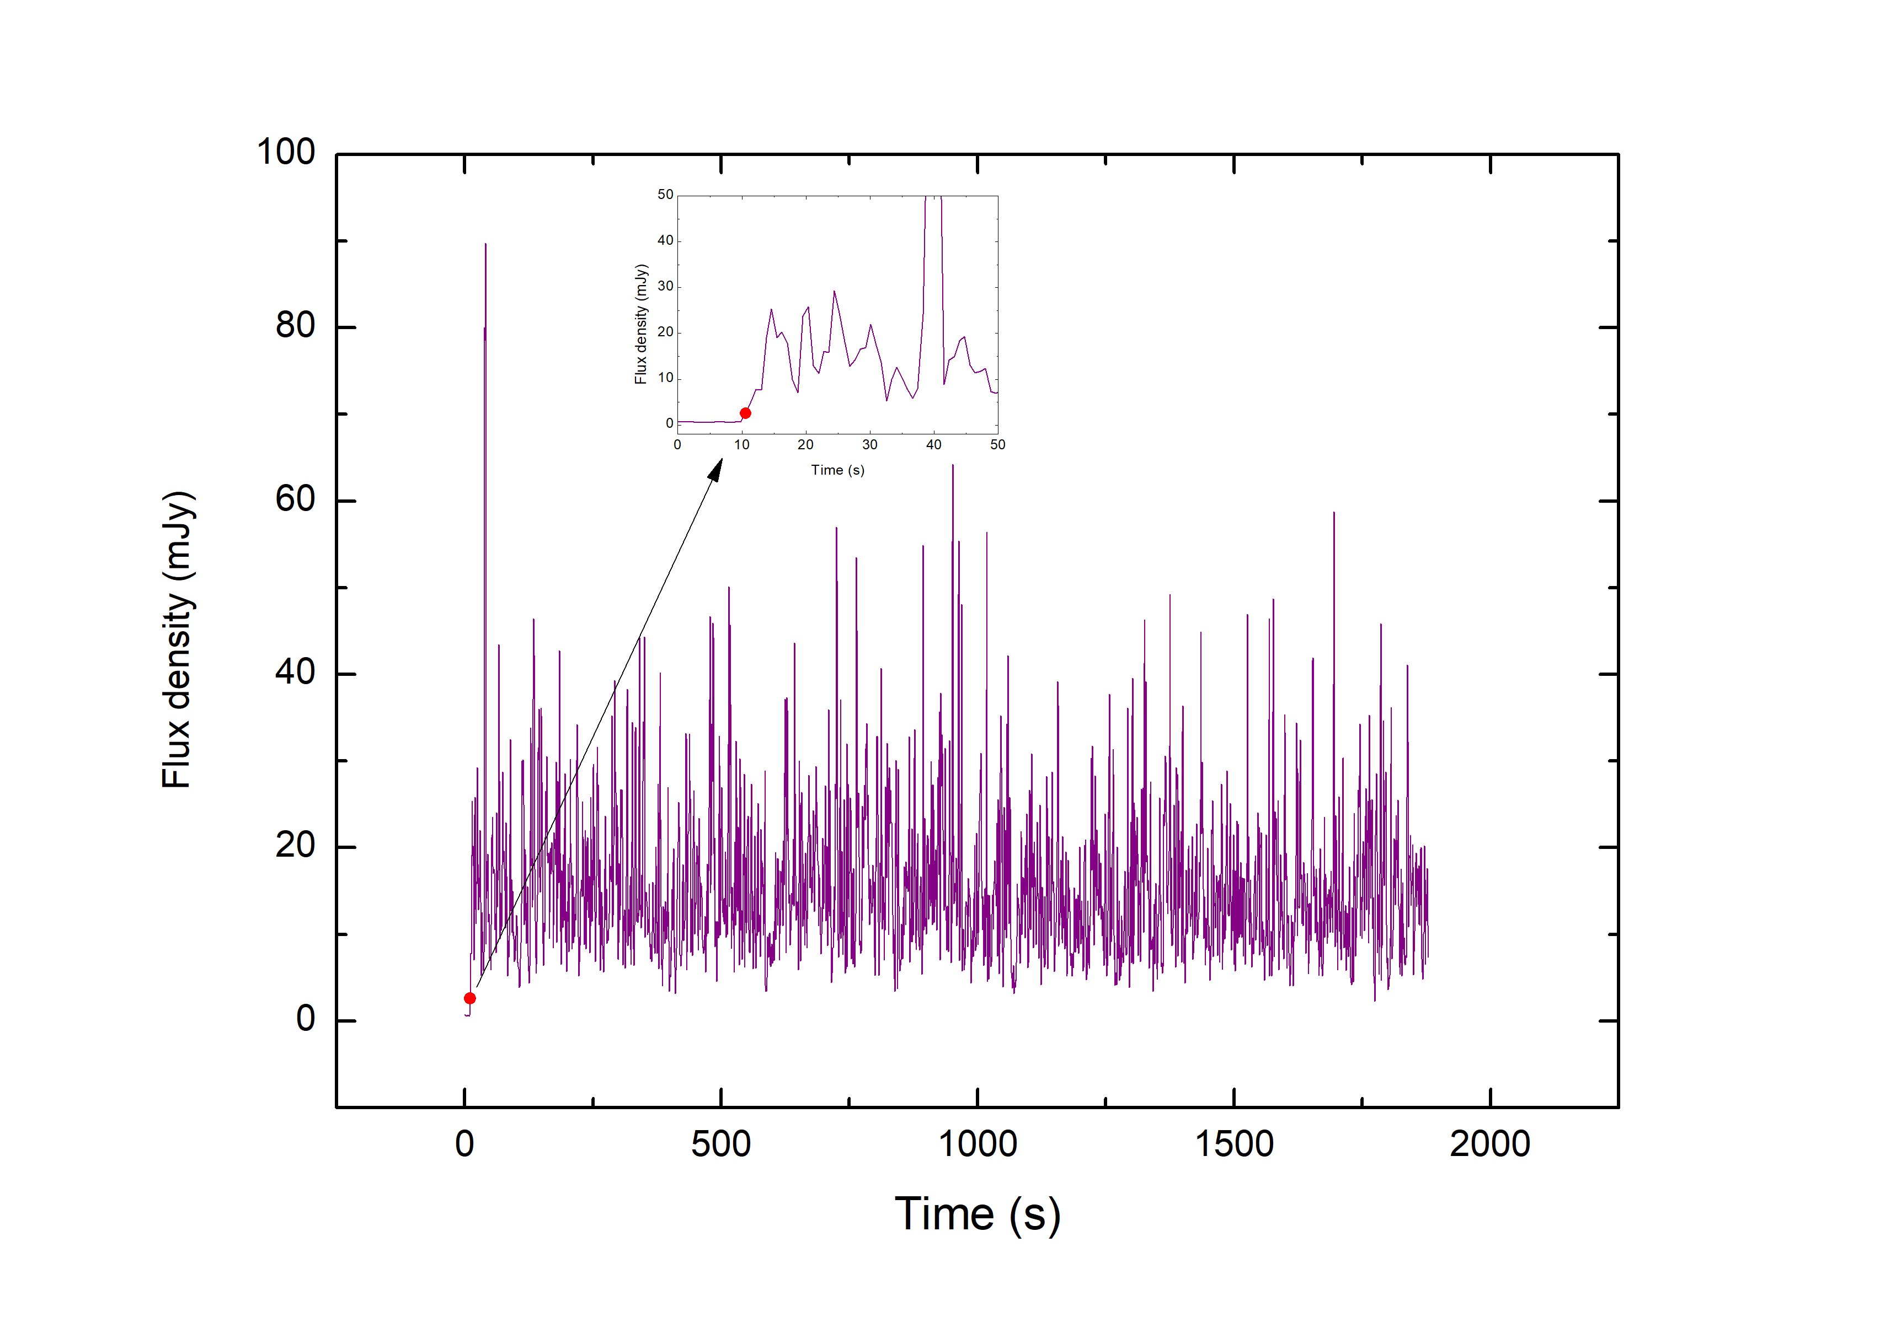
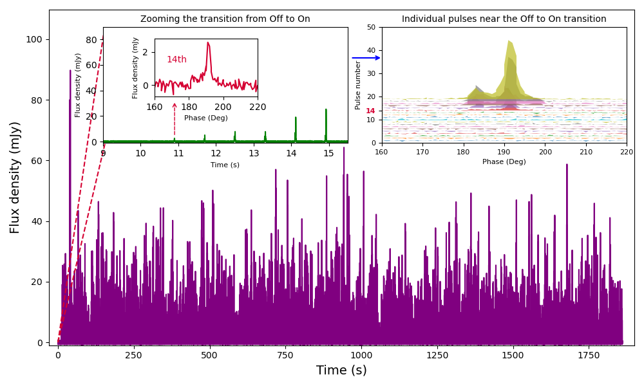
A Long-Awaited Radiation – A state-transition
Fig. 4. The single pulse time series of PSR B1931+24 shows an off-to-on state.
Fig. S7. Flux density evolution of pulse peak of the individual pulse at the state transition
A smooth off-to-on state-transition is captured

Slide 12
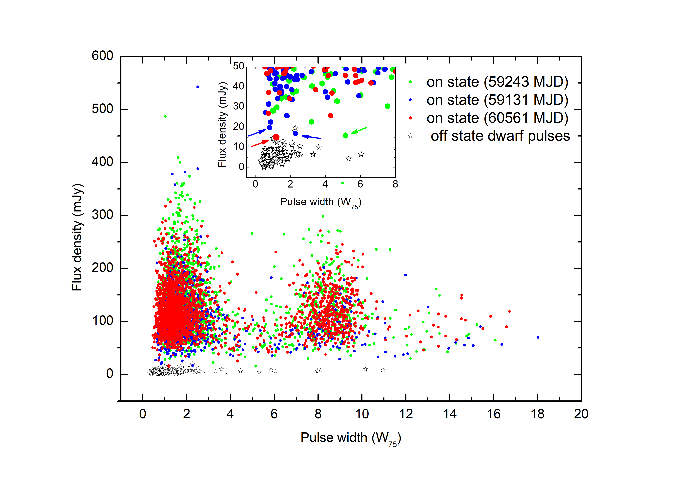
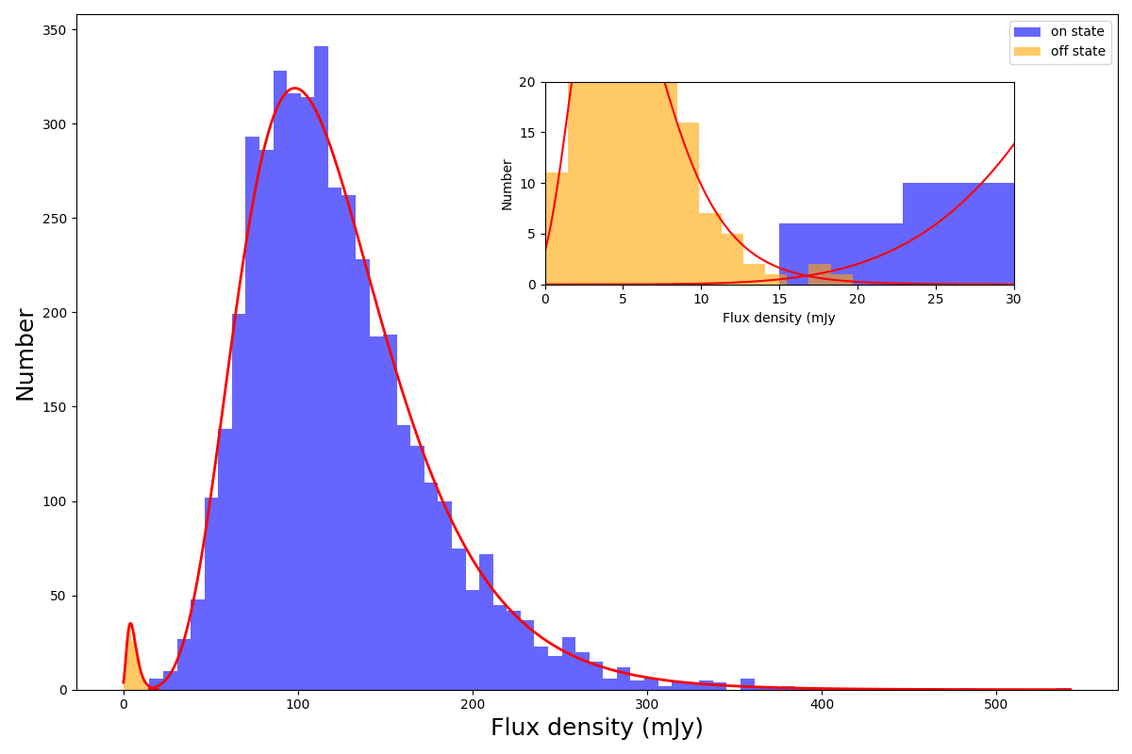
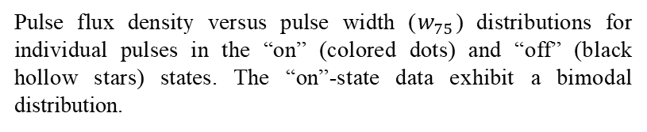
A Long-Awaited Radiation – Pulse flux distribution and dwarf pulses
The flux density distribution of the individual pulses in “on” states and bursting individual dwarf pulses in “off” states. They both follow a lognormal distribution (red line)
Pulse flux density versus pulse width ($w_{75}$) distributions for individual pulses in the “on” (colored dots) and “off” (black hollow stars) states. The “on”-state data exhibit a bimodal distribution.

Slide 13
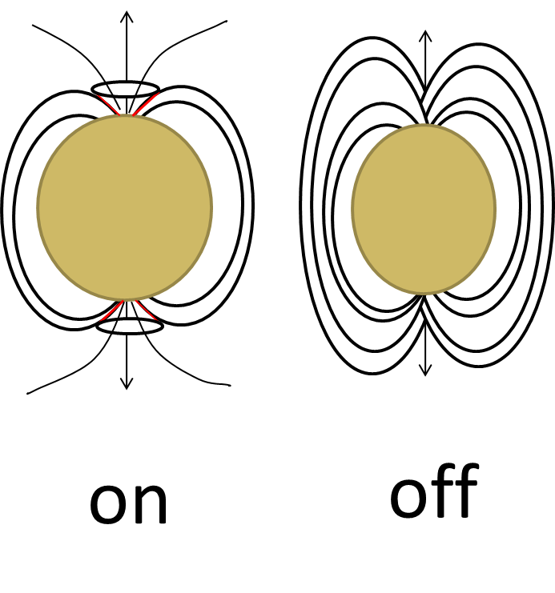
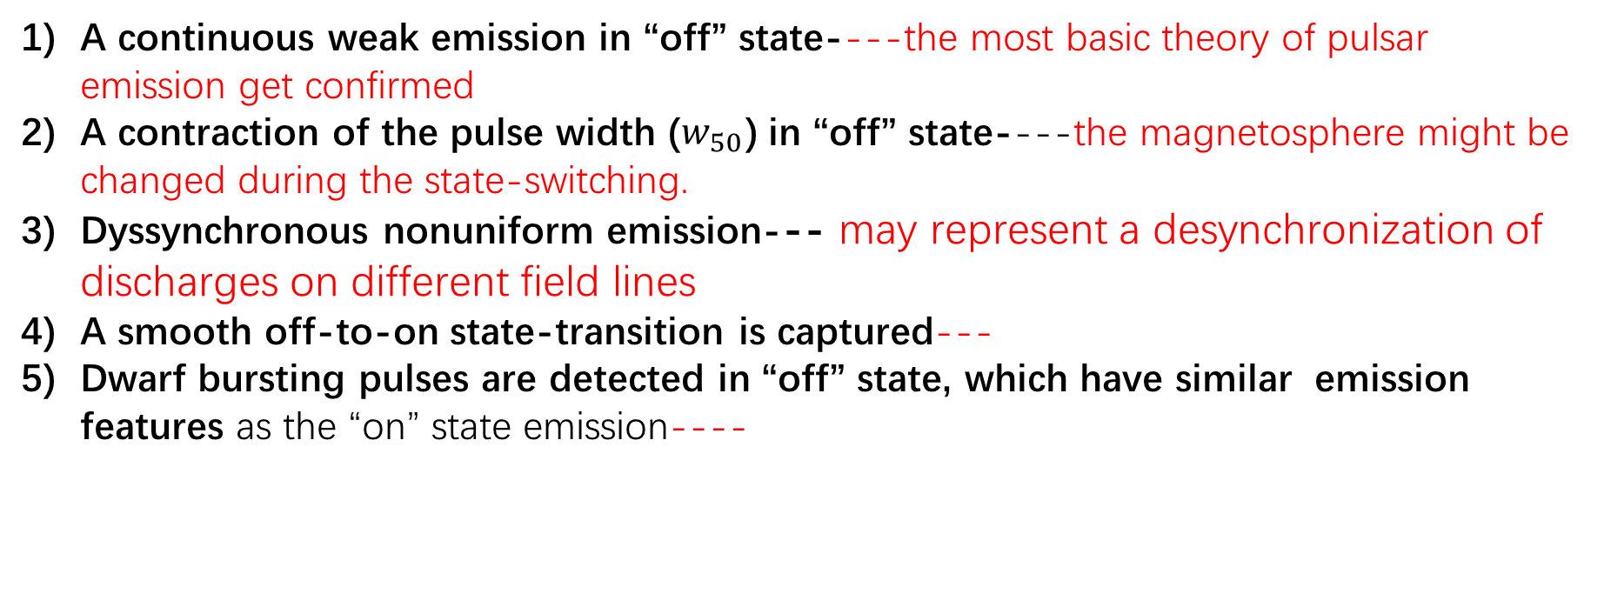
Discussions & Conclusion
A continuous weak emission in “off” state----the most basic theory of pulsar emission get confirmed
A contraction of the pulse width ($w_{50}$) in “off” state----the magnetosphere might be changed during the state-switching.
Dyssynchronous nonuniform emission--- may represent a desynchronization of discharges on different field lines
A smooth off-to-on state-transition is captured---
Dwarf bursting pulses are detected in “off” state, which have similar emission features as the “on” state emission----

Slide 14
Thanks
Thanks to the FAST observing team
Thanks to the encouragement from Prof. Xu Ren Xin and Li Ke Jia at the beginnings of this observational study.
Thanks again for all of you for enjoining this presentation
We Acknowledge the sponsorship of NSFC. NO. 12103021

Slide 15
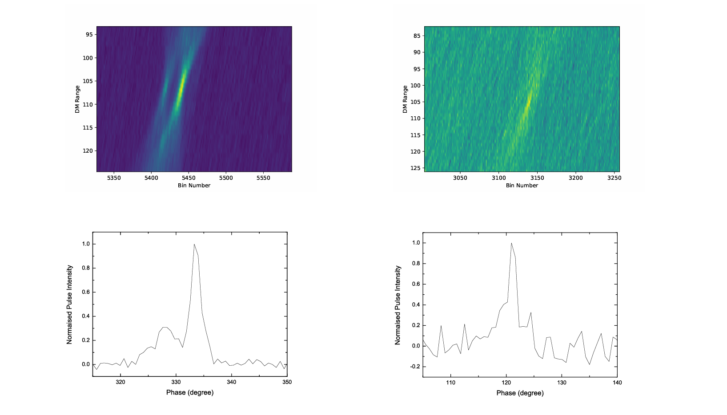
PSR B1931+24 in “off” state
on
off
Checked again with presto
Weak dwarf bursting pulses detected in the off state

Slide 16
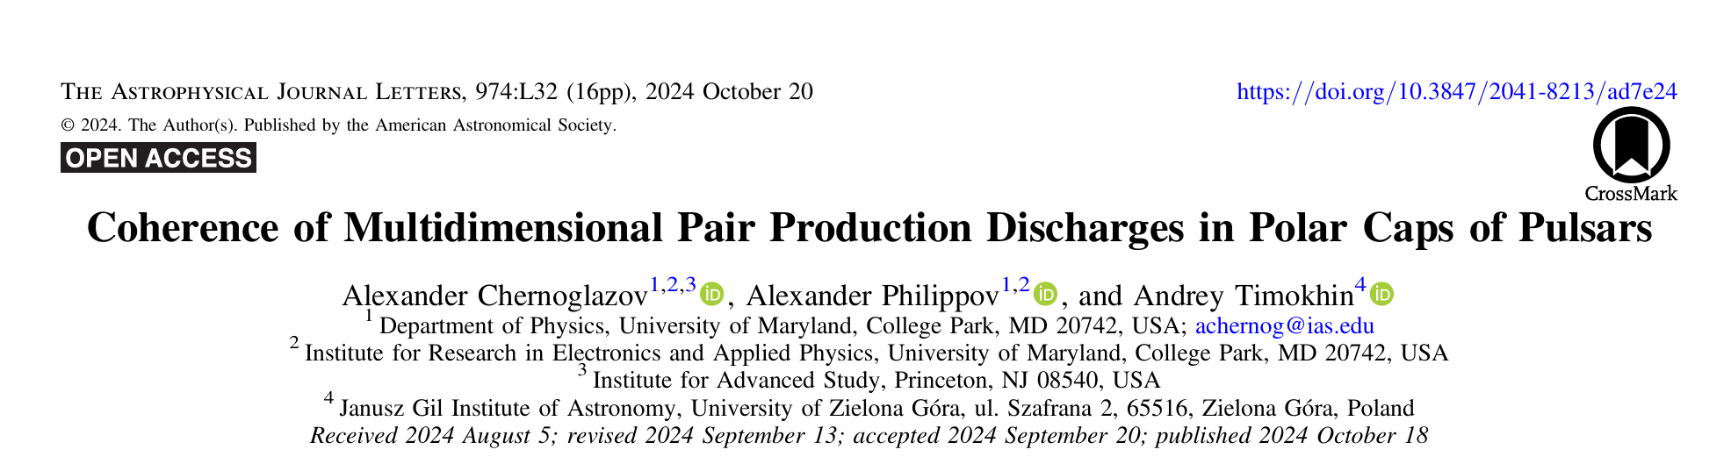
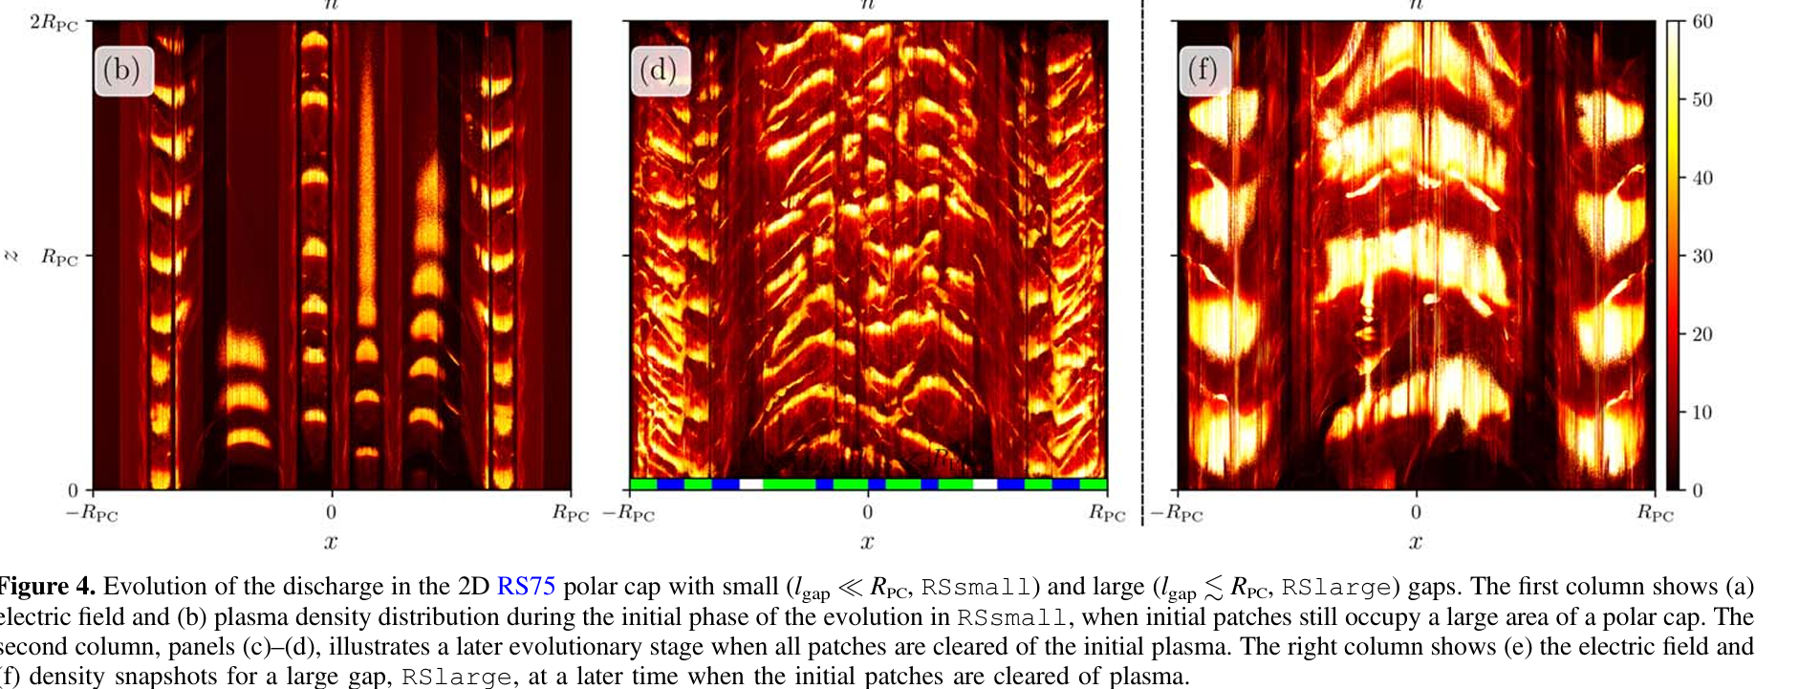

Slide 17
