Slide 1
Search for GW bursts and continuous GW with pulsar timing array
Jingbo Wang
Lishui University
SKA Pulsar Science Symposium 2025
Qingdao 2025.7

Slide 2
Contents
Pulsar Timing Array
Method for search GW with PTA
Results on GW bursts continuous GW

Slide 3
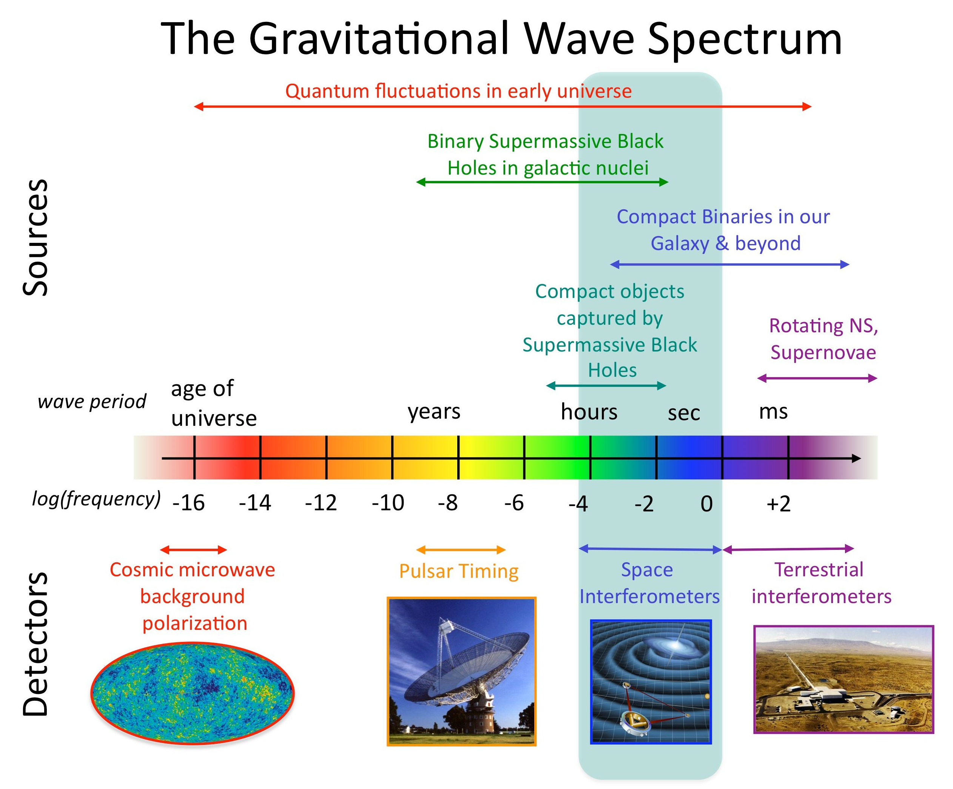
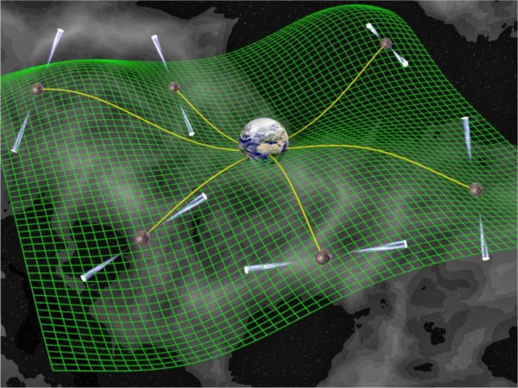
Pulsar timing array
Pulsar timing arrays (PTAs) are a sensitive probe of low-frequency (10⁻⁹ to 10⁻⁷ Hz) gravitational waves (GWs).The PTAs regularly monitor the times of arrival (ToAs) of pulses from a large number of stable millisecond pulsars
PPTA,EPTA,NanoGrav,InPTA,IPTA,MeerKat,CPTA

Slide 4
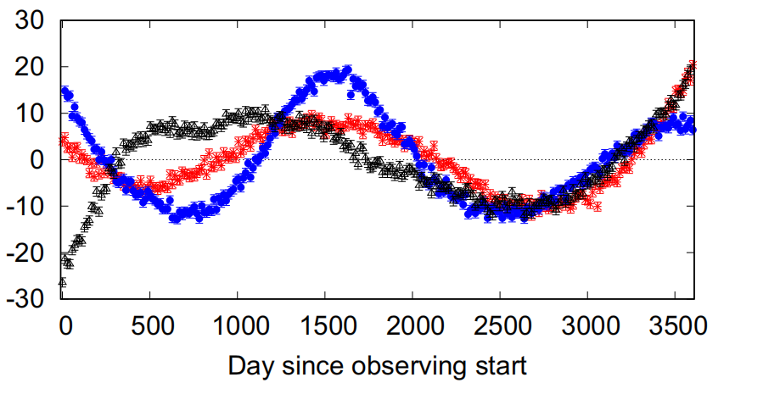
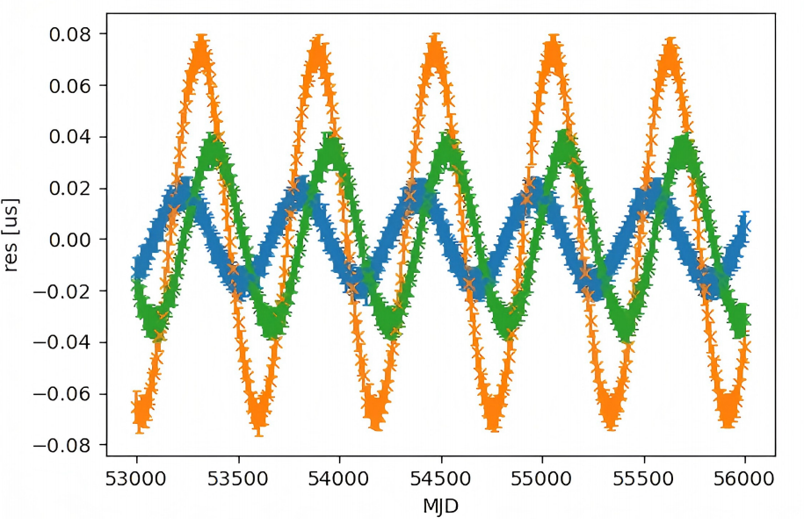
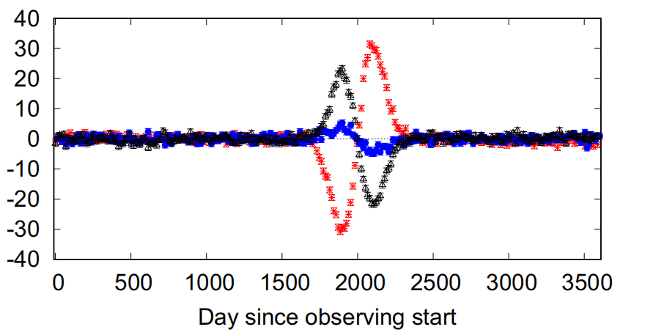
Gravitational wave sources for Pulsar timing array
Currently, there are mainly three types of nanohertz gravitational waves:
Gravitational wave background,the sum of gravitational waves generated by population of supermassive binary black holes is called the stochastic (SGWB), cosmic string,phase transition,etc.
Continuous gravitational waves (CGW or CW)produced by of individual supermassive binary black holes (3C66B, OJ287,etc.).
Gravitational wave bursts generated by close encounters of supermassive black holes (unmodeled), cosmic strings cusps, and mergers of supermassive binary black holes hohoholes(memory effect).

Slide 5
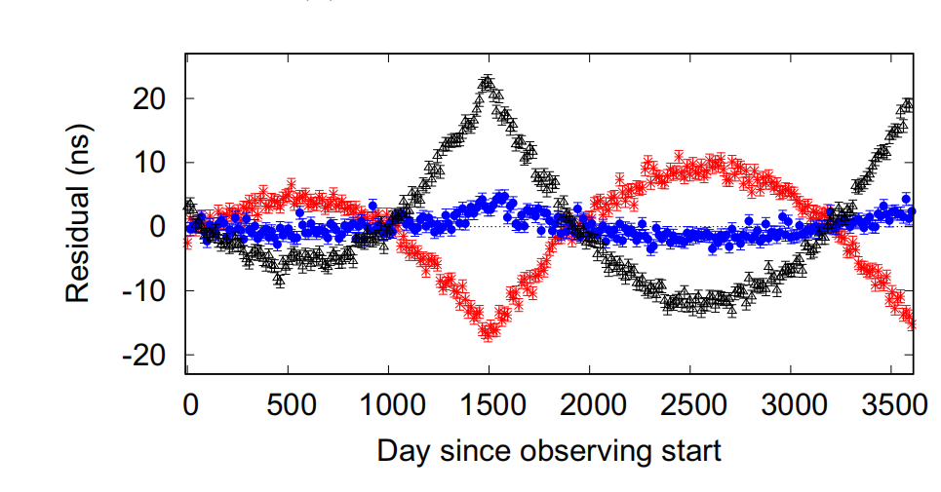

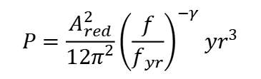
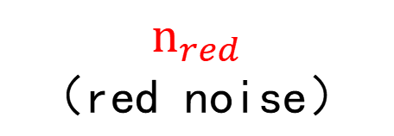
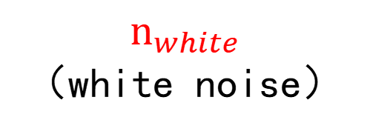

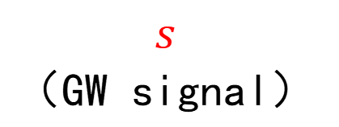
Method for search GW with PTA
Timing residuals
Arzoumanian, et al.
（ISM、solar wind, rotation instability, etc.）
（instrument noise etc.）
$$s$$
（GW signal）
+
+
$$n_{red}$$
（red noise）
+
$$n_{white}$$
（white noise）
$$Tb$$
（timing model）
$$T=\left[M,F\right],b=\left[\begin{matrix}ε \\ a\end{matrix}\right]$$
$$P=\frac{A_{red}^{2}}{12π^{2}}{\left(\frac{f}{f_{yr}}\right)}^{−γ} {yr}^{3}$$
$$N_{{vv}^{′}{tt}^{′}k}=δ_{{tt}^{′}}\left[δ_{{vv}^{′}}\left(ℱ_{k}^{2}σ^{2}+𝒬_{k}^{2}\right)+𝒥_{k}^{2}\right]$$
Notes:
TOA计时残差由连续引力波信号、高斯过程描述的随机过程、红噪声和白噪声组成，对其进行建模。
M is the design matrix, which describes the timing model, and ò is a vector of the linearized timing model parameter offsets from the best-fit solution.
红噪声的功率随频率的降低而增加，白噪声的功率谱平坦，各频率成分强度均匀。

Slide 6
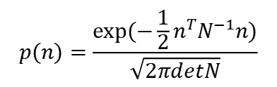
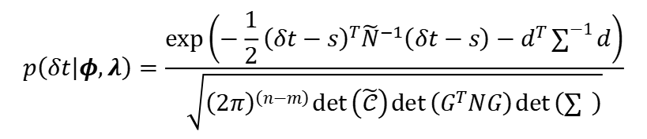


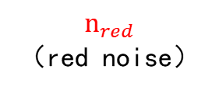
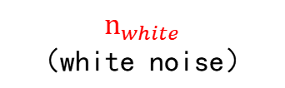
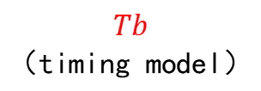

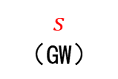
Method for search GW with PTA
Timing residuals
Arzoumanian, et al.
$$n=δt−s−Tb−n_{red}$$
$$Tb$$
（timing model）
+
+
white noise
$$s$$
（GW）
+
$$n_{red}$$
（red noise）
$$n_{white}$$
（white noise）
parameter estimation
$$P=\frac{A_{red}^{2}}{12π^{2}}{\left(\frac{f}{f_{yr}}\right)}^{−γ} {yr}^{3}$$
$$N_{{vv}^{′}{tt}^{′}k}=$$
$$δ_{{tt}^{′}}\left[δ_{{vv}^{′}}\left(ℱ_{k}^{2}σ^{2}+𝒬_{k}^{2}\right)+𝒥_{k}^{2}\right]$$
$$p(n)=\frac{exp⁡(−\frac{1}{2}n^{T}N^{−1}n)}{\sqrt{2πdetN}}$$
$$\begin{aligned}p\left(δt | φ,λ\right)=\frac{\exp\left(−\frac{1}{2}{\left(δt−s\right)}^{T}{\tilde{N}}^{−1}\left(δt−s\right)−d^{T}\sum_{ }^{−1}{d}\right)}{\sqrt{{\left(2π\right)}^{\left(n−m\right)}\det\left(\tilde{𝒞}\right)\det\left(G^{T}NG\right)\det\left(\sum{ }\right)}}\end{aligned}$$
$$T=\left[M,F\right],b=\left[\begin{matrix}ε \\ a\end{matrix}\right]$$
noise-only
model selection
Bayes factor
(CURN,HD)
noise + GW
Notes:
建模后，构建白噪声近似，对其进行参数估计。通过已有的先验知识，利用贝叶斯方法进行参数估计。然后对两种不同的模型进行对比，计算贝叶斯因子，若贝叶斯因子显示没有强烈的证据支持探测到了连续引力波信号，那就对信号进行上限分析，求得95%置信区间的应变振幅上限或啁啾质量上限。这就是一个完整的分析过程。
Noise 考虑加入CURN、HD进行模型对比

Slide 7
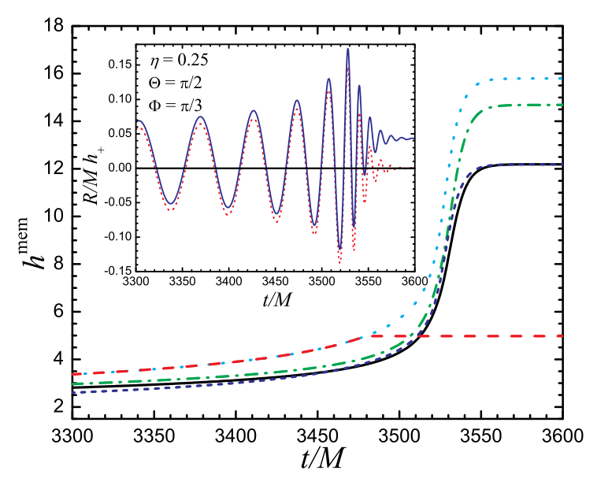


Burst with memory (BWM or GWM)
Gravitational waves with memory will leave a permanent imprint on space-time
Gravitational waves with memory can be produced by merger of binary black holes
It increases rapidly during the
merger phase of binary black holes
We can treat it as a discontinuous jump propagating through space
Fvata 2009, PRD
The pre-fit residuals

Slide 8
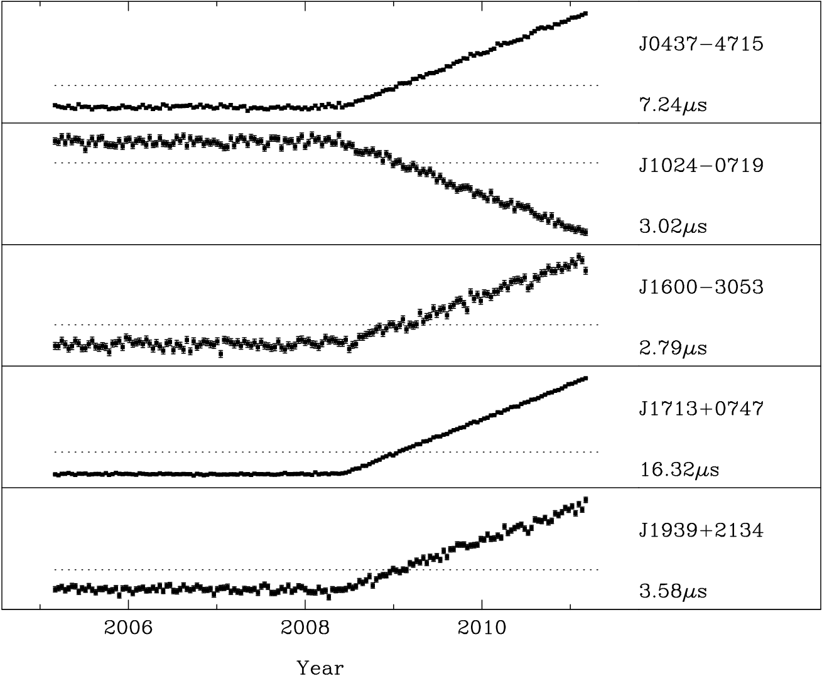
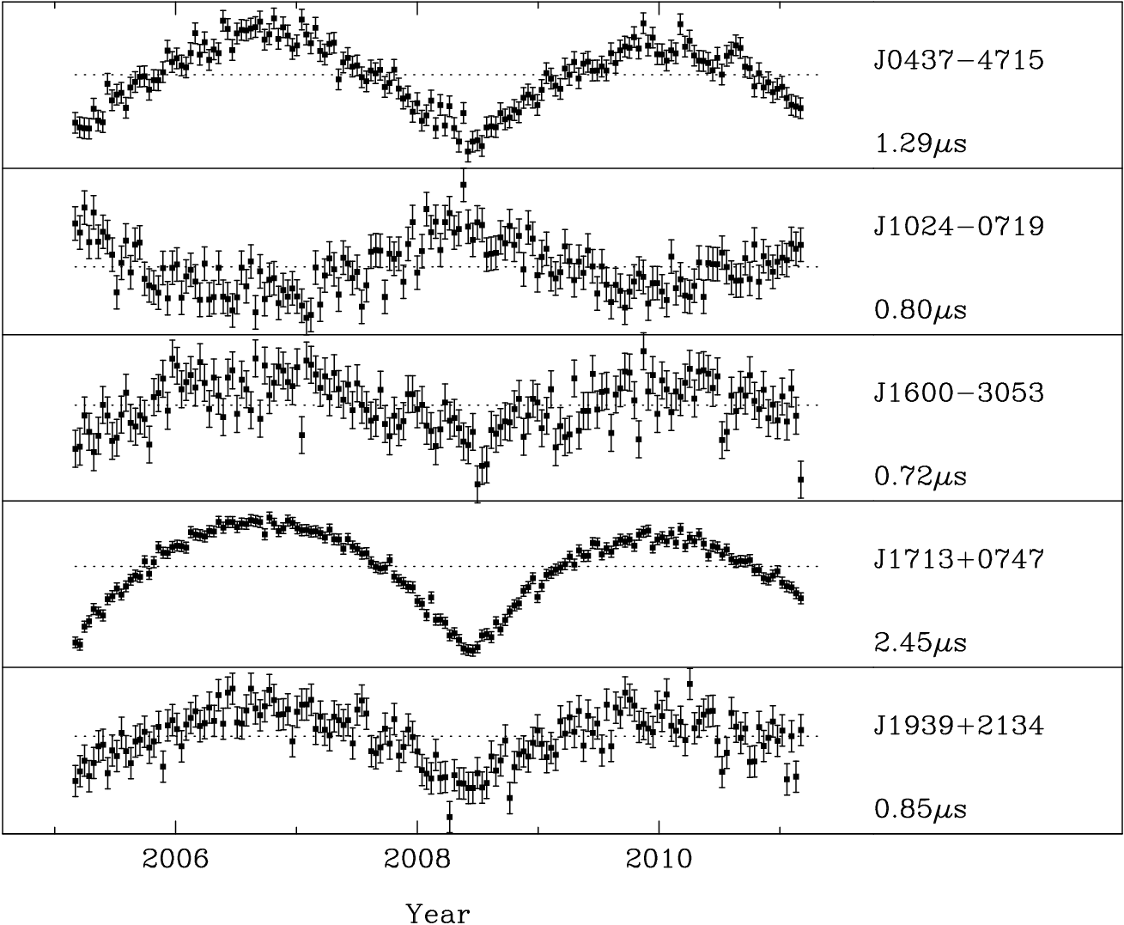
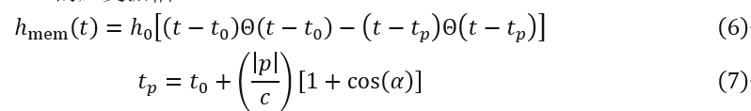
Burst with memory (BWM or GWM)
Fig4 Simulate TOAs witn BWM signals
For burst-like signals, the Earth term can be active while the pulsar term may remain stationary, or vice versa.
Notes:
Conversely, if the burst source is closer to the pulsar, the memory effect will only appear in the pulsar term, and the drift in the Earth term would have either already stabilized or not yet occurred.

Slide 9
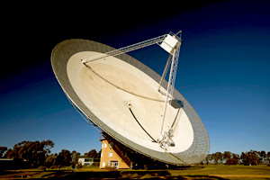
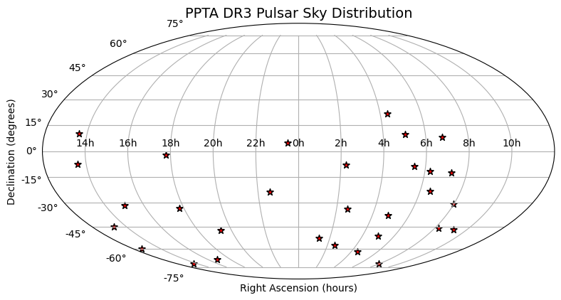
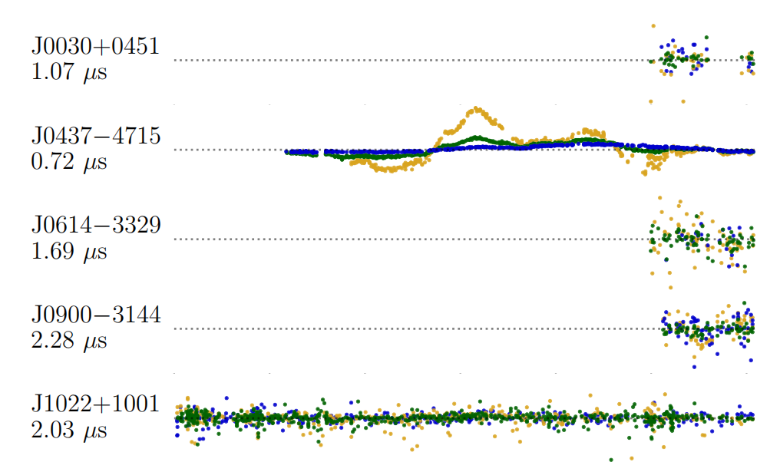
Burst with memory (BWM or GWM)
Parkes radio telescope
Fig6 Image credit : CSIRO/David McClenaghan
Fig6 PPTA DR3
DATA | Pulsar number | Time span(yr)
PPTA DR3 | 30 | 19
Notes:
We used the PPTA third data release dataset and Bayesian methods to search for burst-with-memory (BWM) signals. The PPTA observes 32 millisecond pulsars, mostly in the southern half of the sky. We conducted separate searches for the pulsar and Earth terms.
For the pulsar term, we narrowed the priors on the burst epoch, excluding the first 200 days and last 300 days of each pulsar’s TOAs.

Slide 10
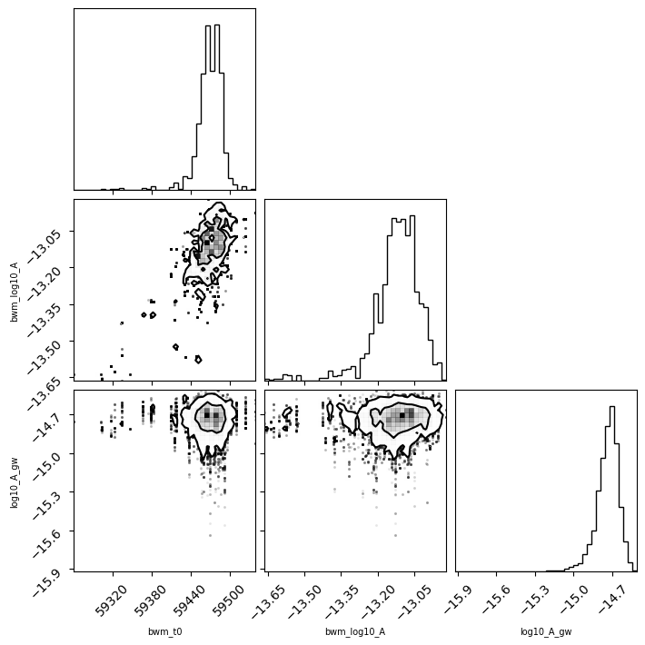
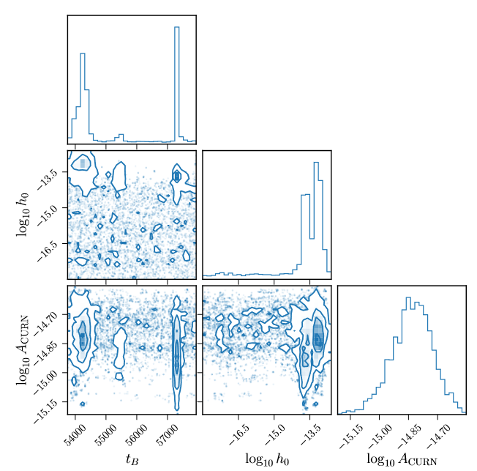

Earth Term searching results
$$ℬ_{gw}\sim 2$$
Fig8 Earth term with PPTA DR3
Fig9 Earth term with NANOGrav 12.5yr
Image credit :Agazie, G. et al. (2023).
Notes:
In the Earth term search, compared to NANOGrav’s 12.5-year BWM search, our sampling is more concentrated at the tail end of the burst time distribution. This is likely because PPTA data is observed earlier and more densely, but, like NANOGrav, the later data points are sparse. Toward the end of the dataset, there’s almost no evidence for BWM since there aren't enough observed TOAs after the trial phase to accurately detect BWM. As a result, late burst times have a much larger posterior probability.

Slide 11
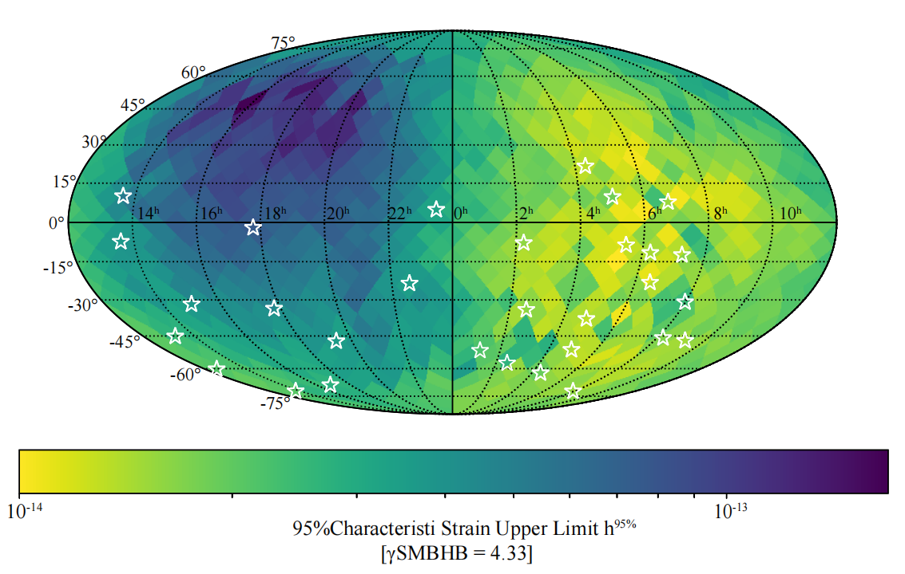
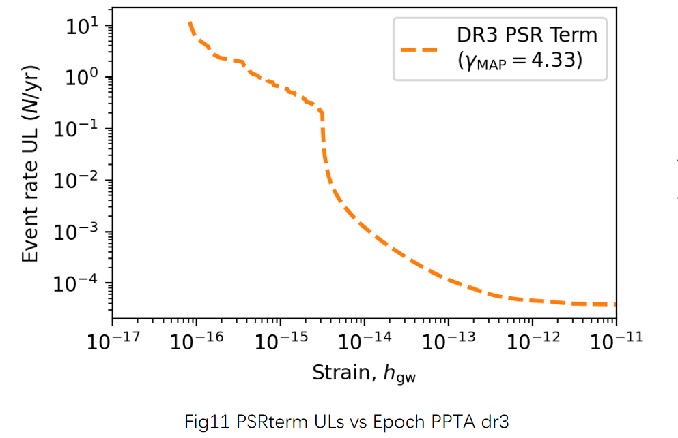
Skymap of Upper limit for earth term
Fig10 skymap PPTA dr3

Slide 12
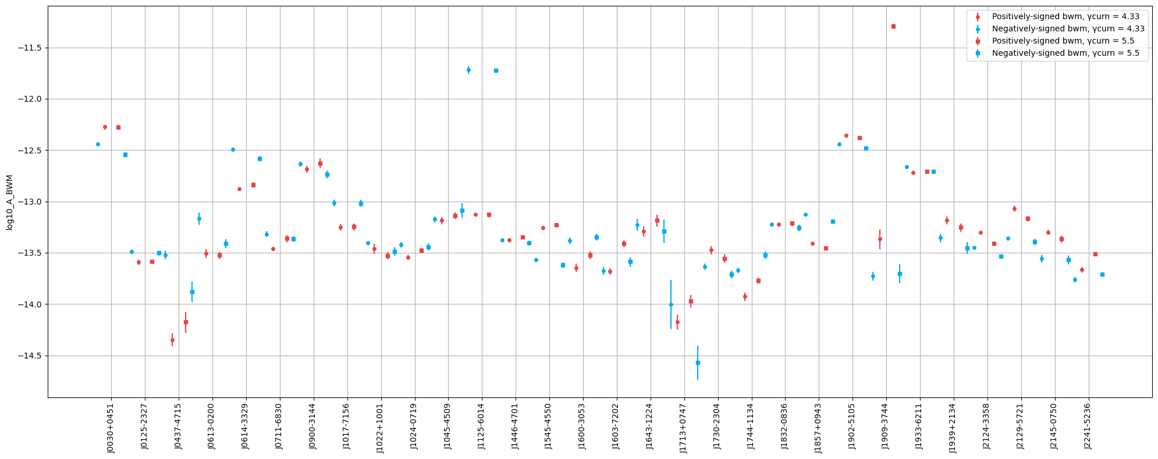
Pulsar term upper limits
Fig7 Pulsar term Strain 95% Uper Limits
Notes:
From the individual pulsar searches, we derived the 95% upper limits on the pulsar term strain. We tested different CURN spectral indices and amplitude signs. Most results were consistent, but a few pulsars showed noticeable differences, even with small variations. Some pulsars also showed intriguing signs of weak BWM evidence.

Slide 13
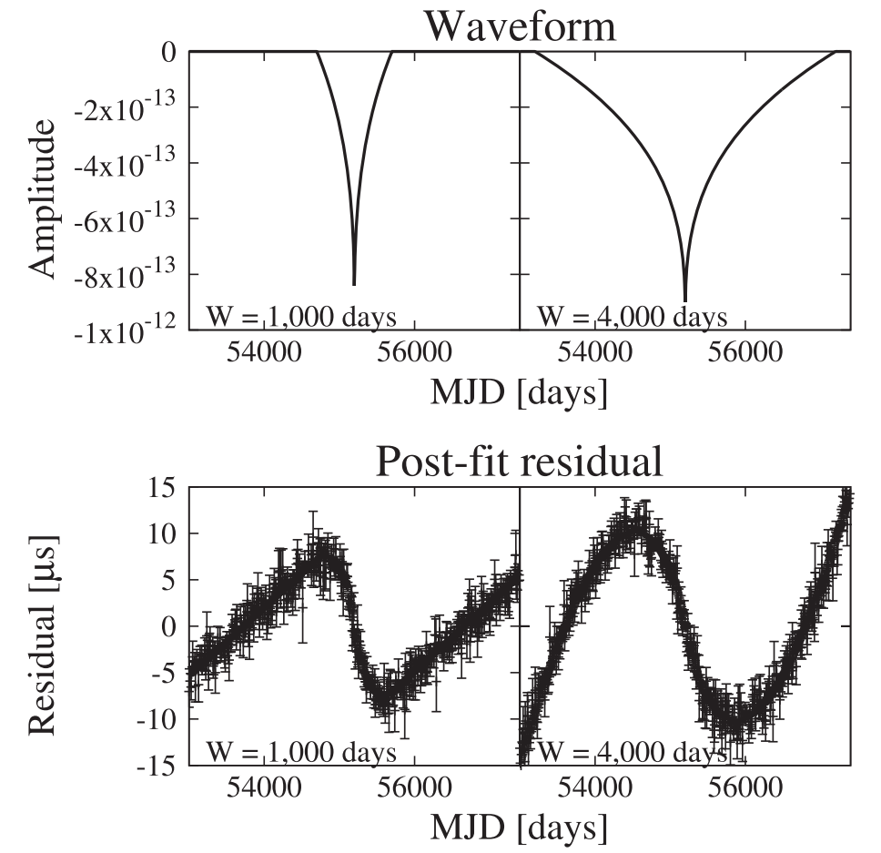
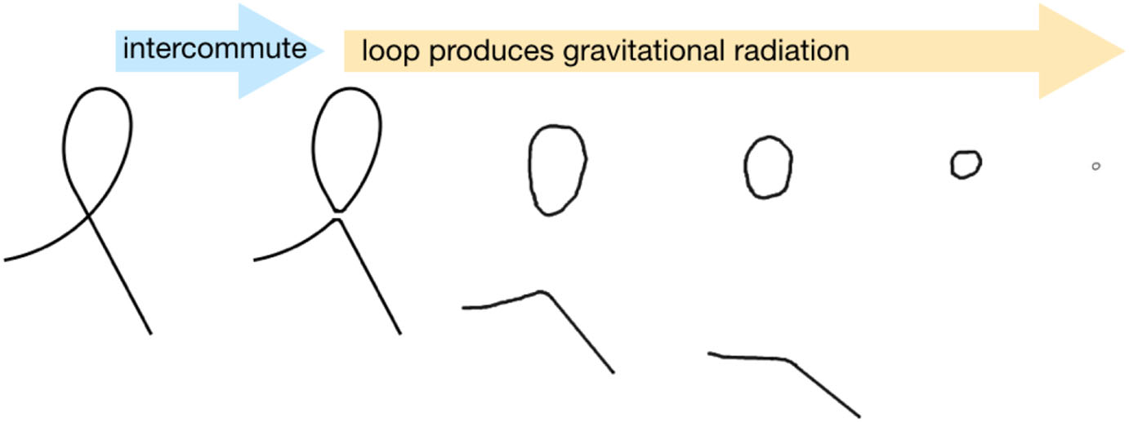
GW burst from cosmic string cusps
Cosmic strings are predicted to emit GW bursts, experiments
such as the PTAs provide a means to test for their existence. The
strongest GW bursts are produced at singularities on string loops
termed cusps. If the GW amplitude of the event is strong enough, it may be observed as a single burst.
Individual GWs from cosmic strings have been searched in the
direction of fast radio burst sources (Abbott et al. 2016) and with
the Laser Interferometer Gravitational-wave Observatory

Slide 14
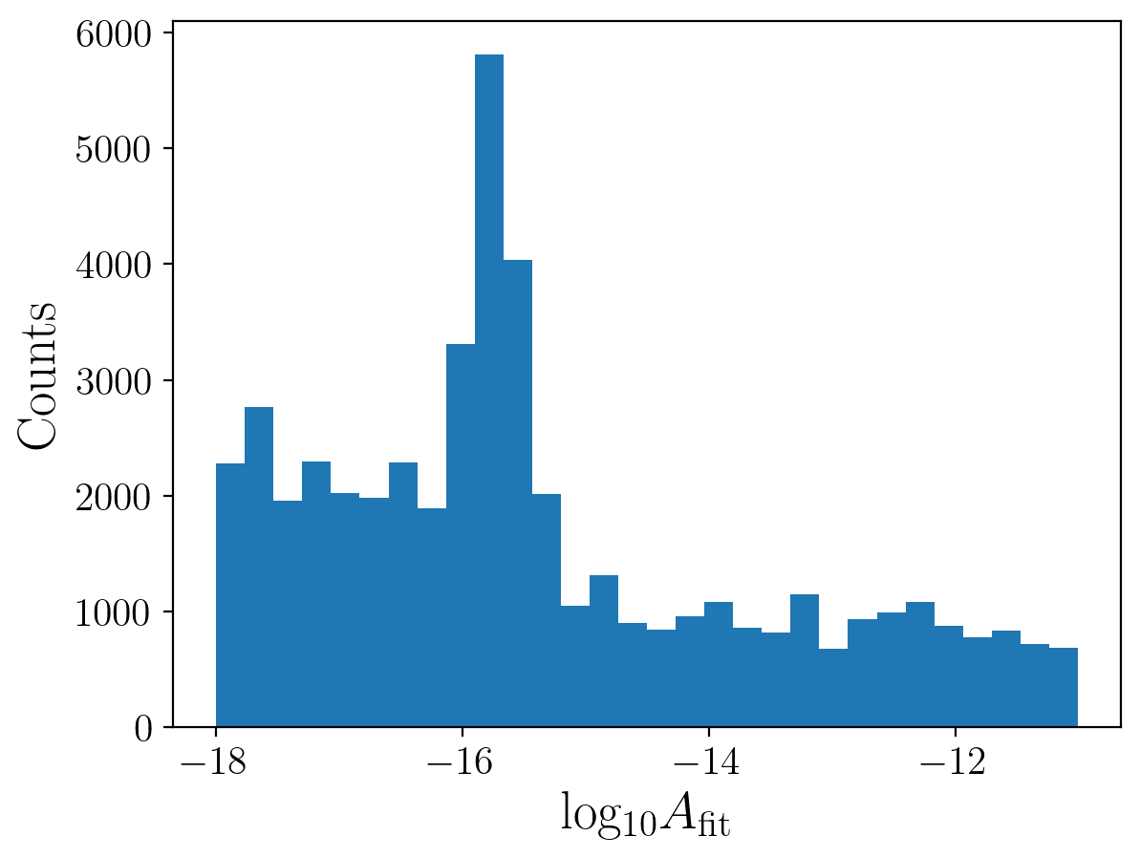
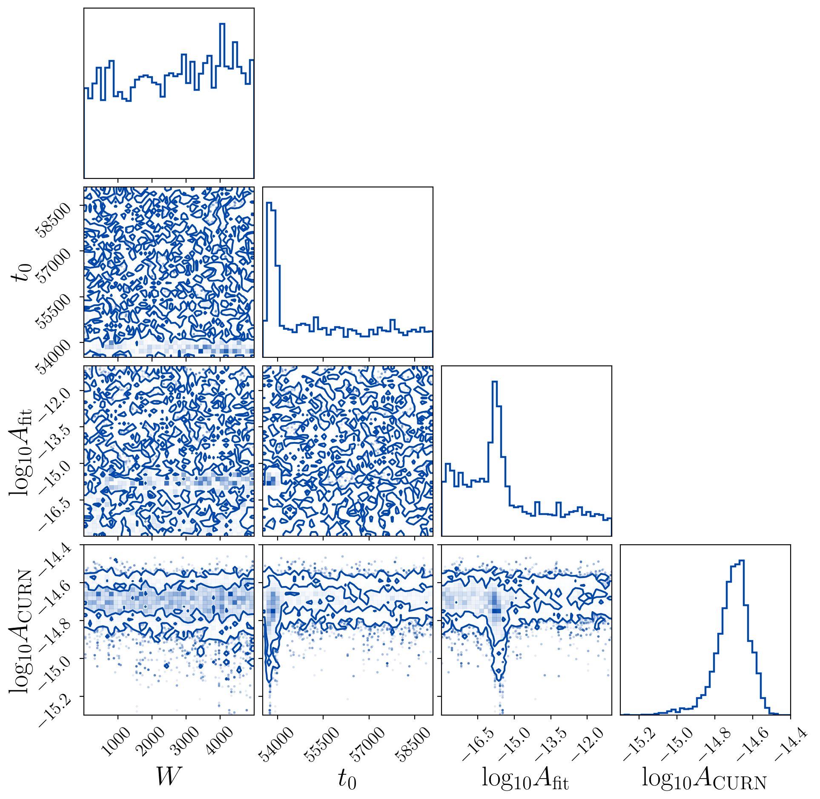
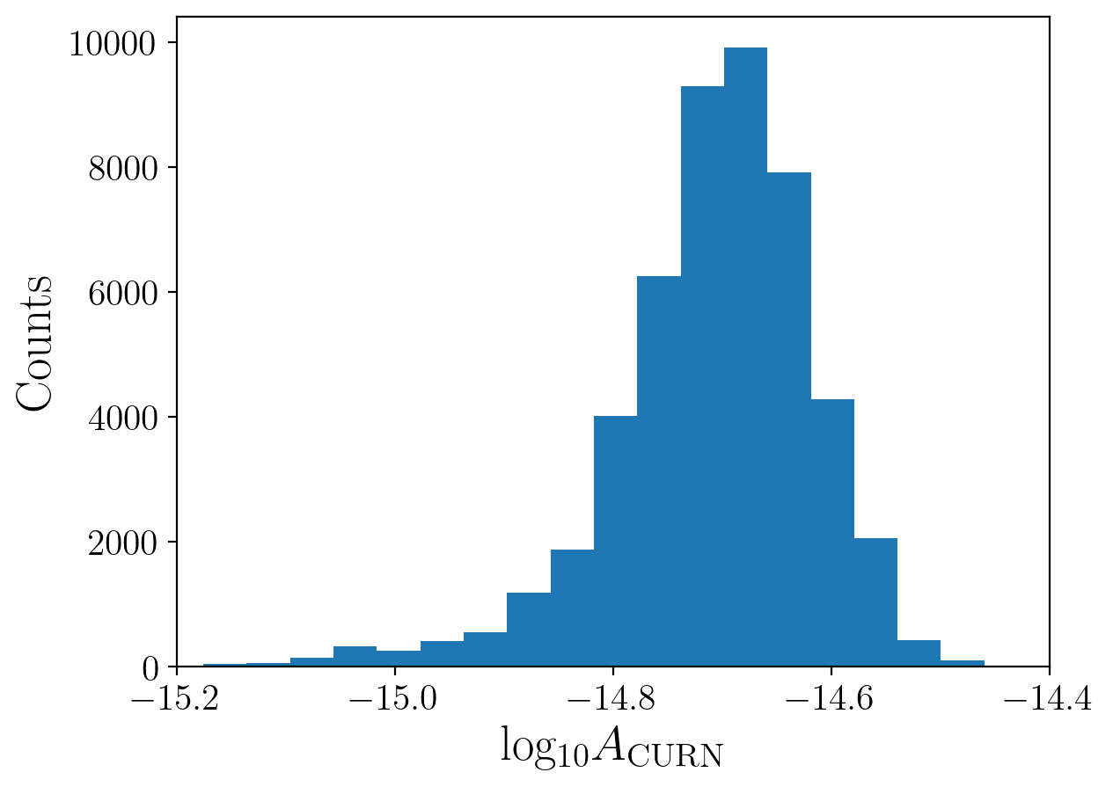
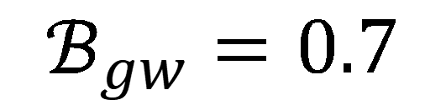
GW burst search from Cosmic string cusps with PPTA DR3
$$ℬ_{gw}=0.7$$

Slide 15
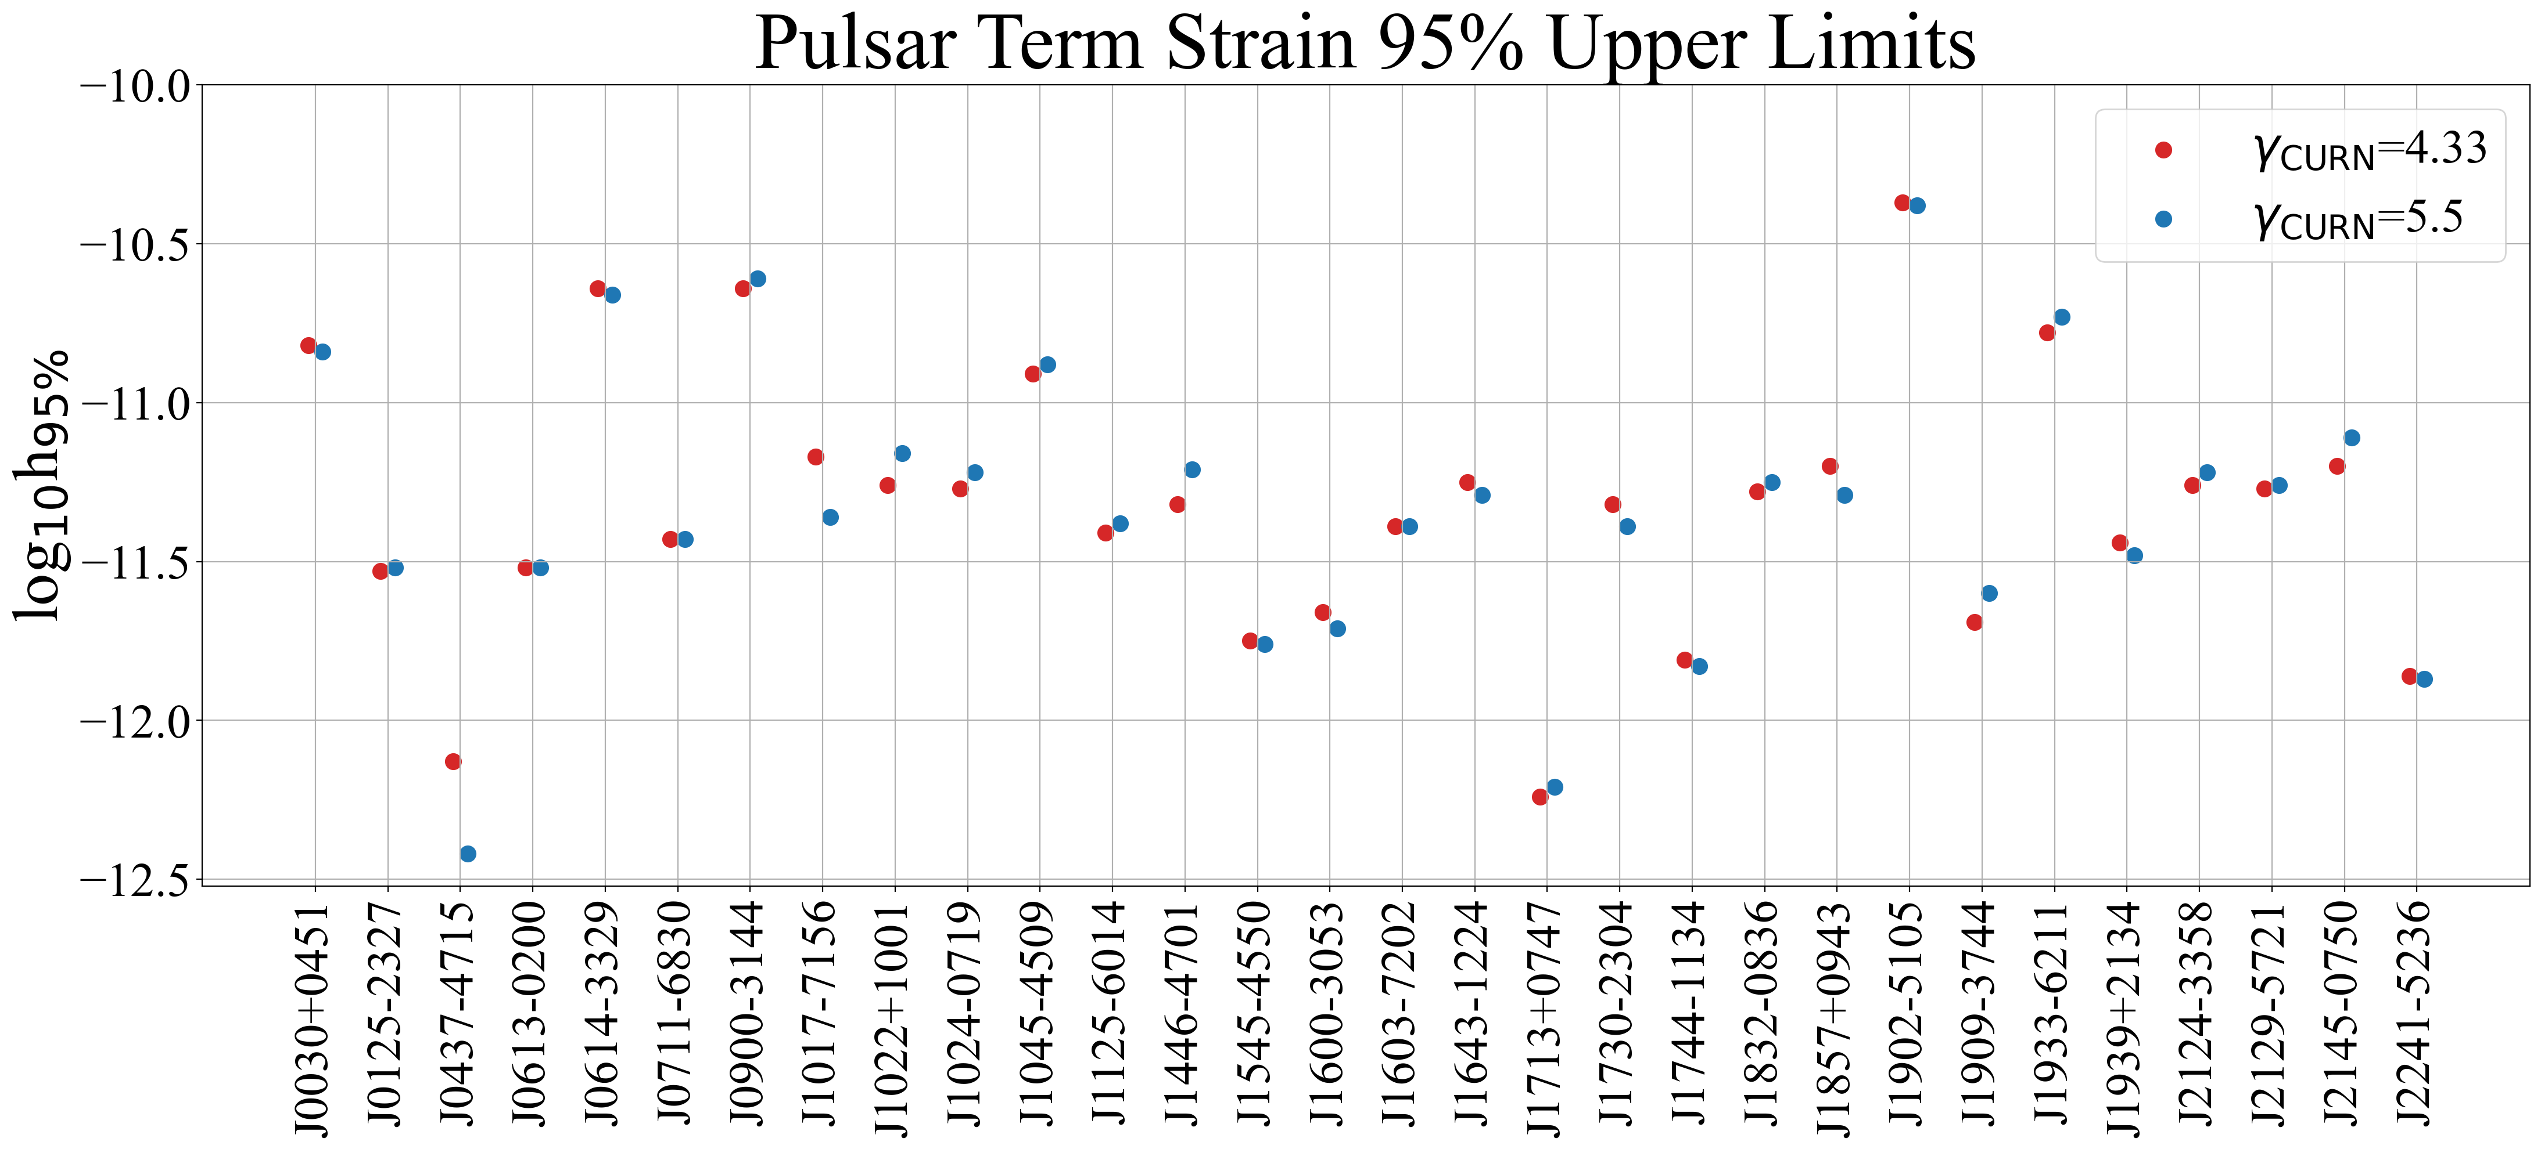
GW burst from cosmic string cusps

Slide 16
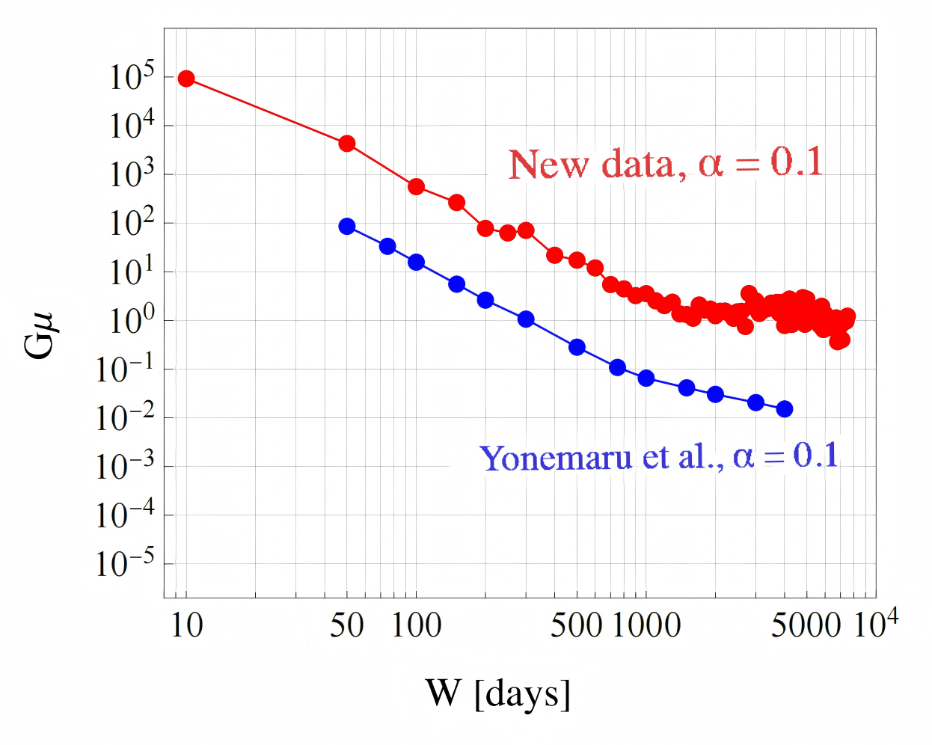
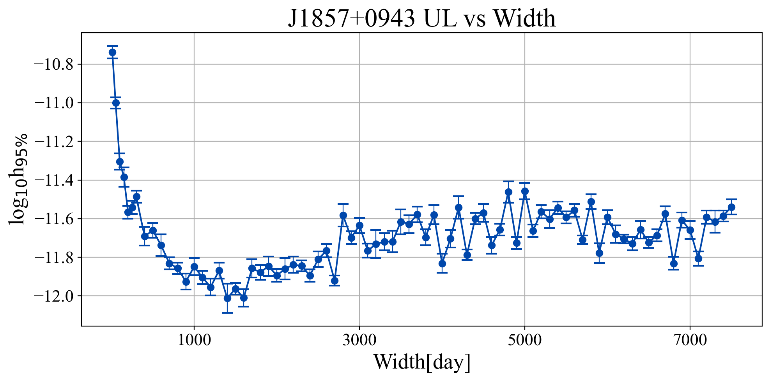
Upper limit on strain and tension

Slide 17
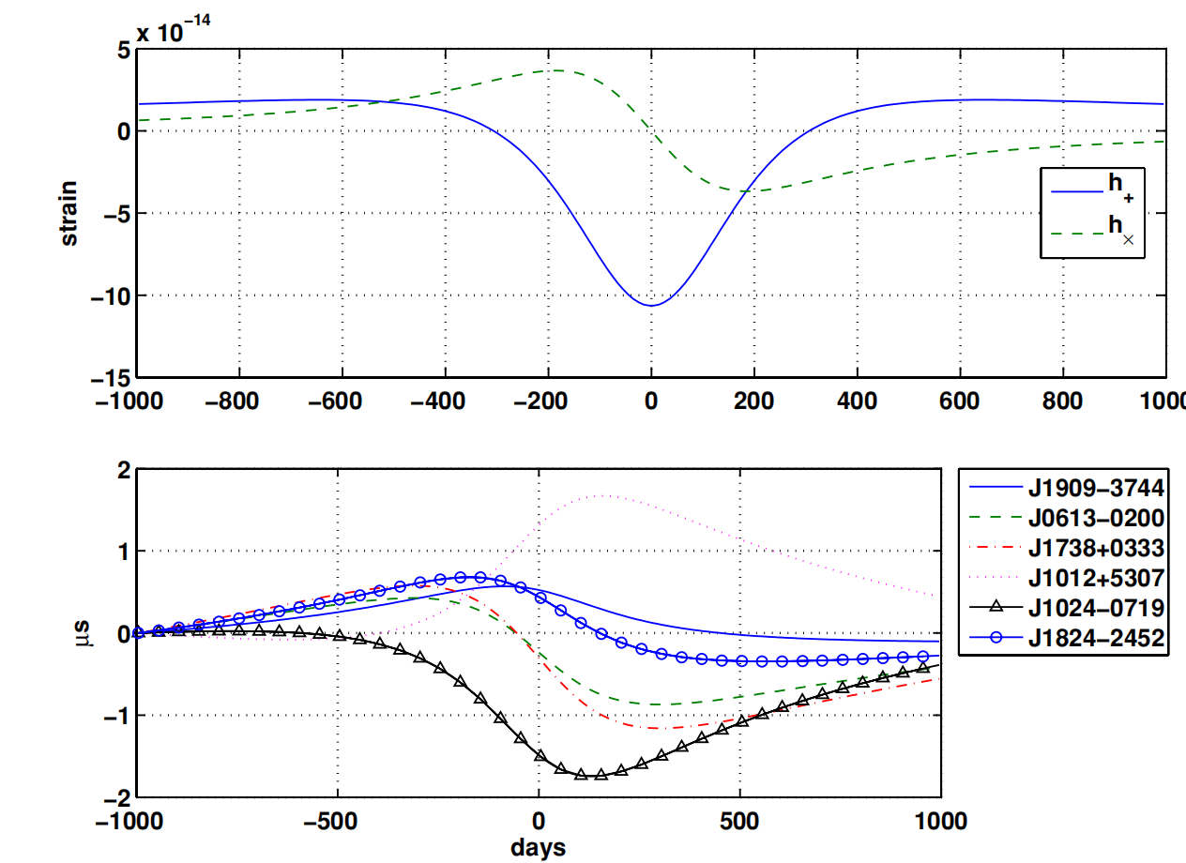
Unmodeled (generic ) GW burst
Waveform of the parabolic encounter of SMBHB at a distance of 15 Mpc in the direction of the Virgo Cluster of galaxies
Simulated timing residuals induced by the waveform in a sample of 6 of the 30 pulsars (Finn 2020)

Slide 18
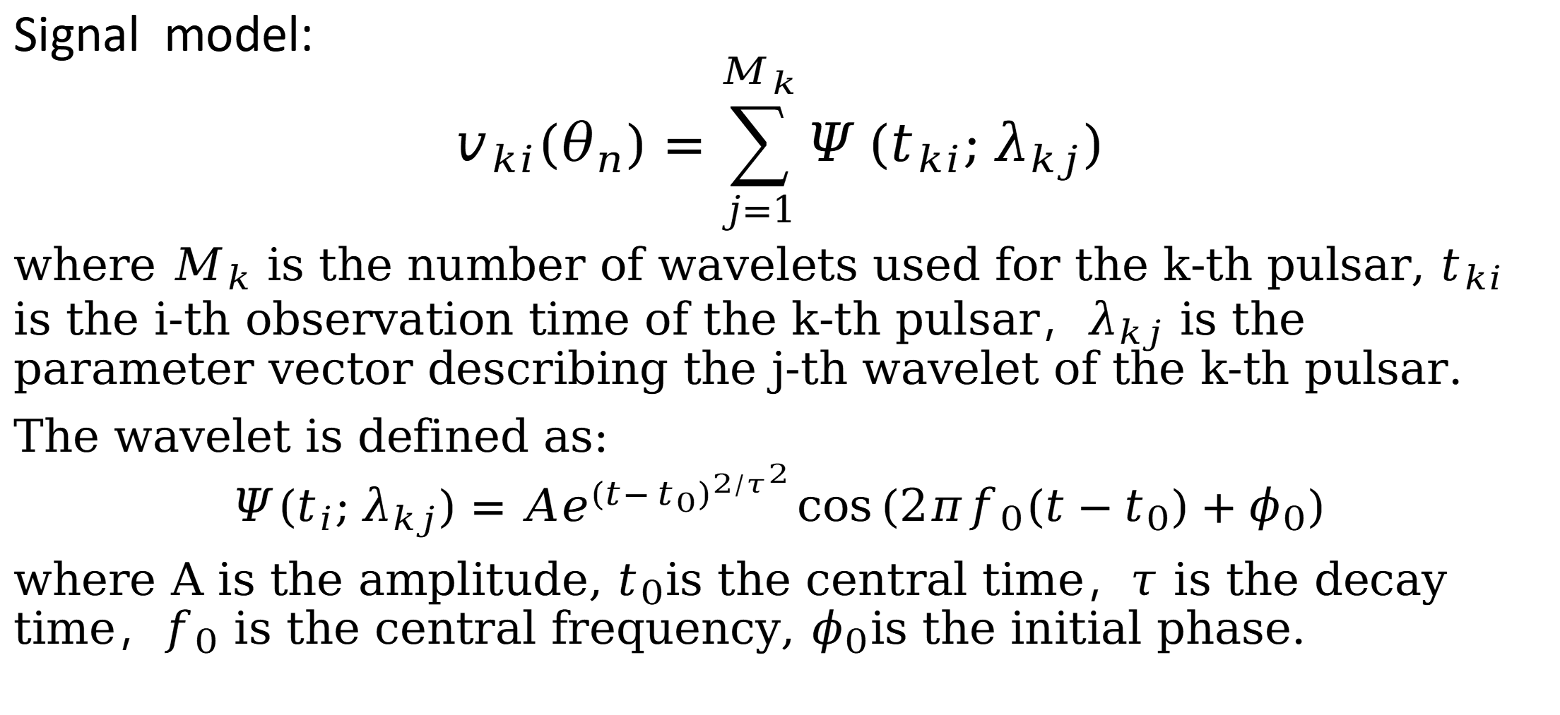
Unmodeled (generic ) GW burst
Signal model:
$$v_{ki}(θ_{n})=\sum_{j=1}^{M_{k}}{Ψ}(t_{ki};λ_{kj})$$
where $M_{k}$ is the number of wavelets used for the k-th pulsar, $t_{ki}$ is the i-th observation time of the k-th pulsar，$λ_{kj}$ is the parameter vector describing the j-th wavelet of the k-th pulsar.
The wavelet is defined as:
$$Ψ(t_{i};λ_{kj})=Ae^{{(t−t_{0})}^{2/τ^{2}}}\cos{(2πf_{0}(t−t_{0})+φ_{0})}$$
where A is the amplitude, $t_{0}$is the central time，$τ$ is the decay time，$f_{0}$ is the central frequency, $φ_{0}$is the initial phase.

Slide 19
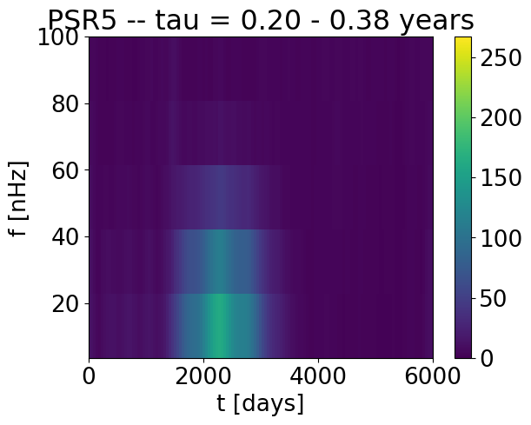
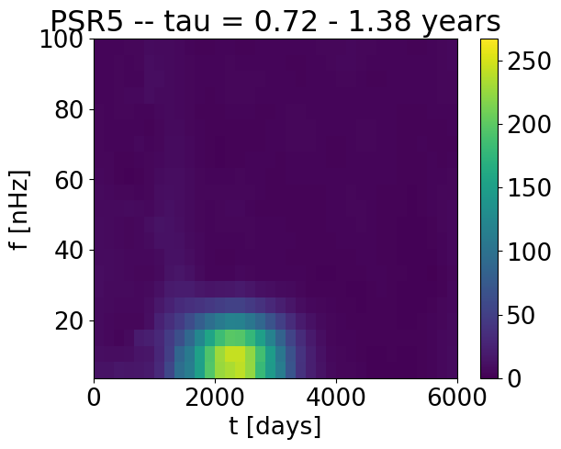
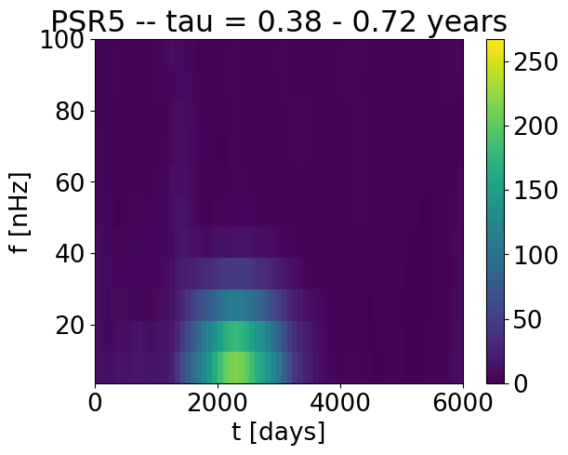
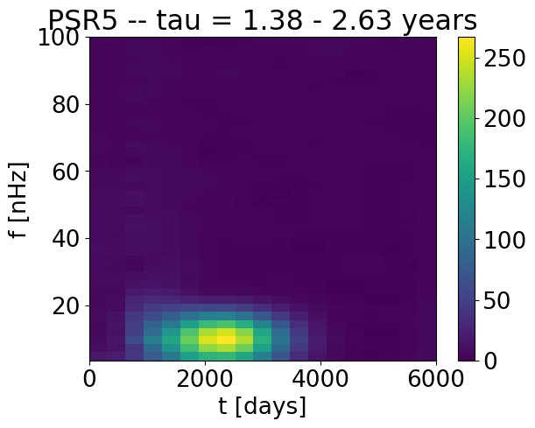
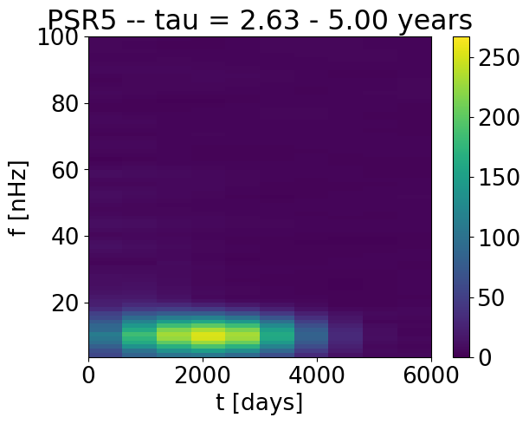
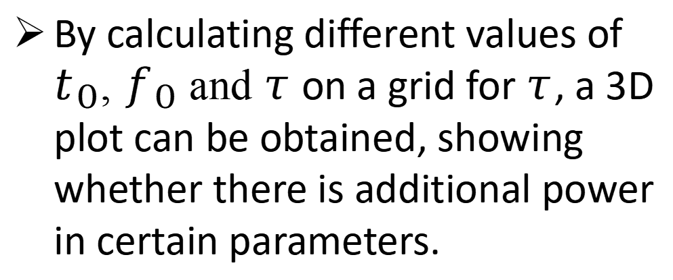
τ Scanning Map
By calculating different values of $t_{0}$, $f_{0}$ and $τ$ on a grid for $τ$, a 3D plot can be obtained, showing whether there is additional power in certain parameters.

Slide 20
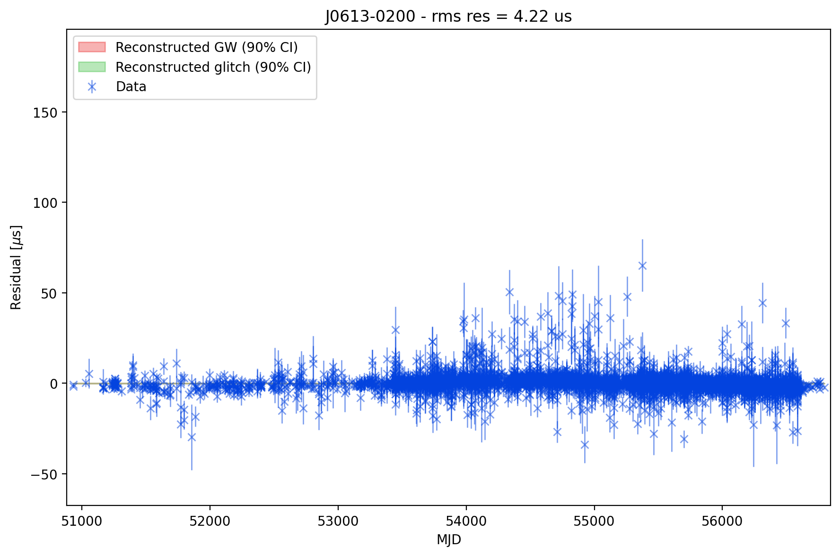
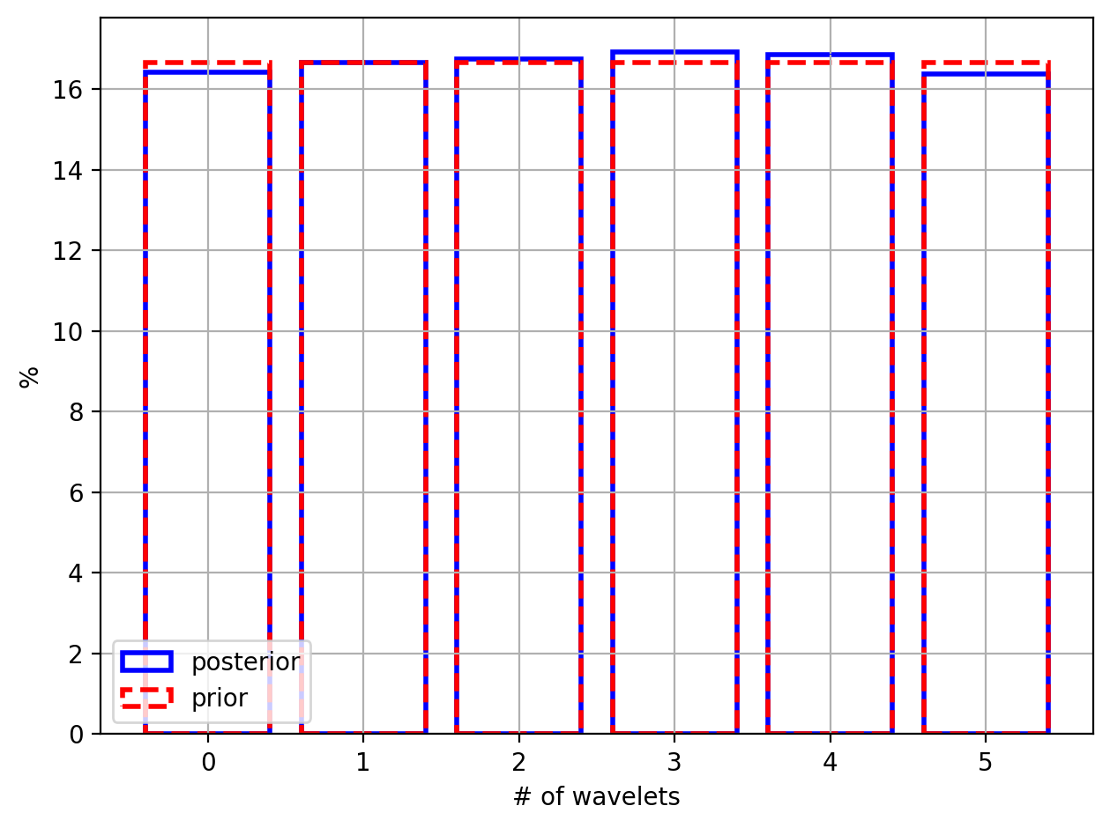
Search unmodel GW burst with IPTA data
7 pulsars have been randomly selected from the IPTA data, and the search over all IPTA data is ongoing

Slide 21
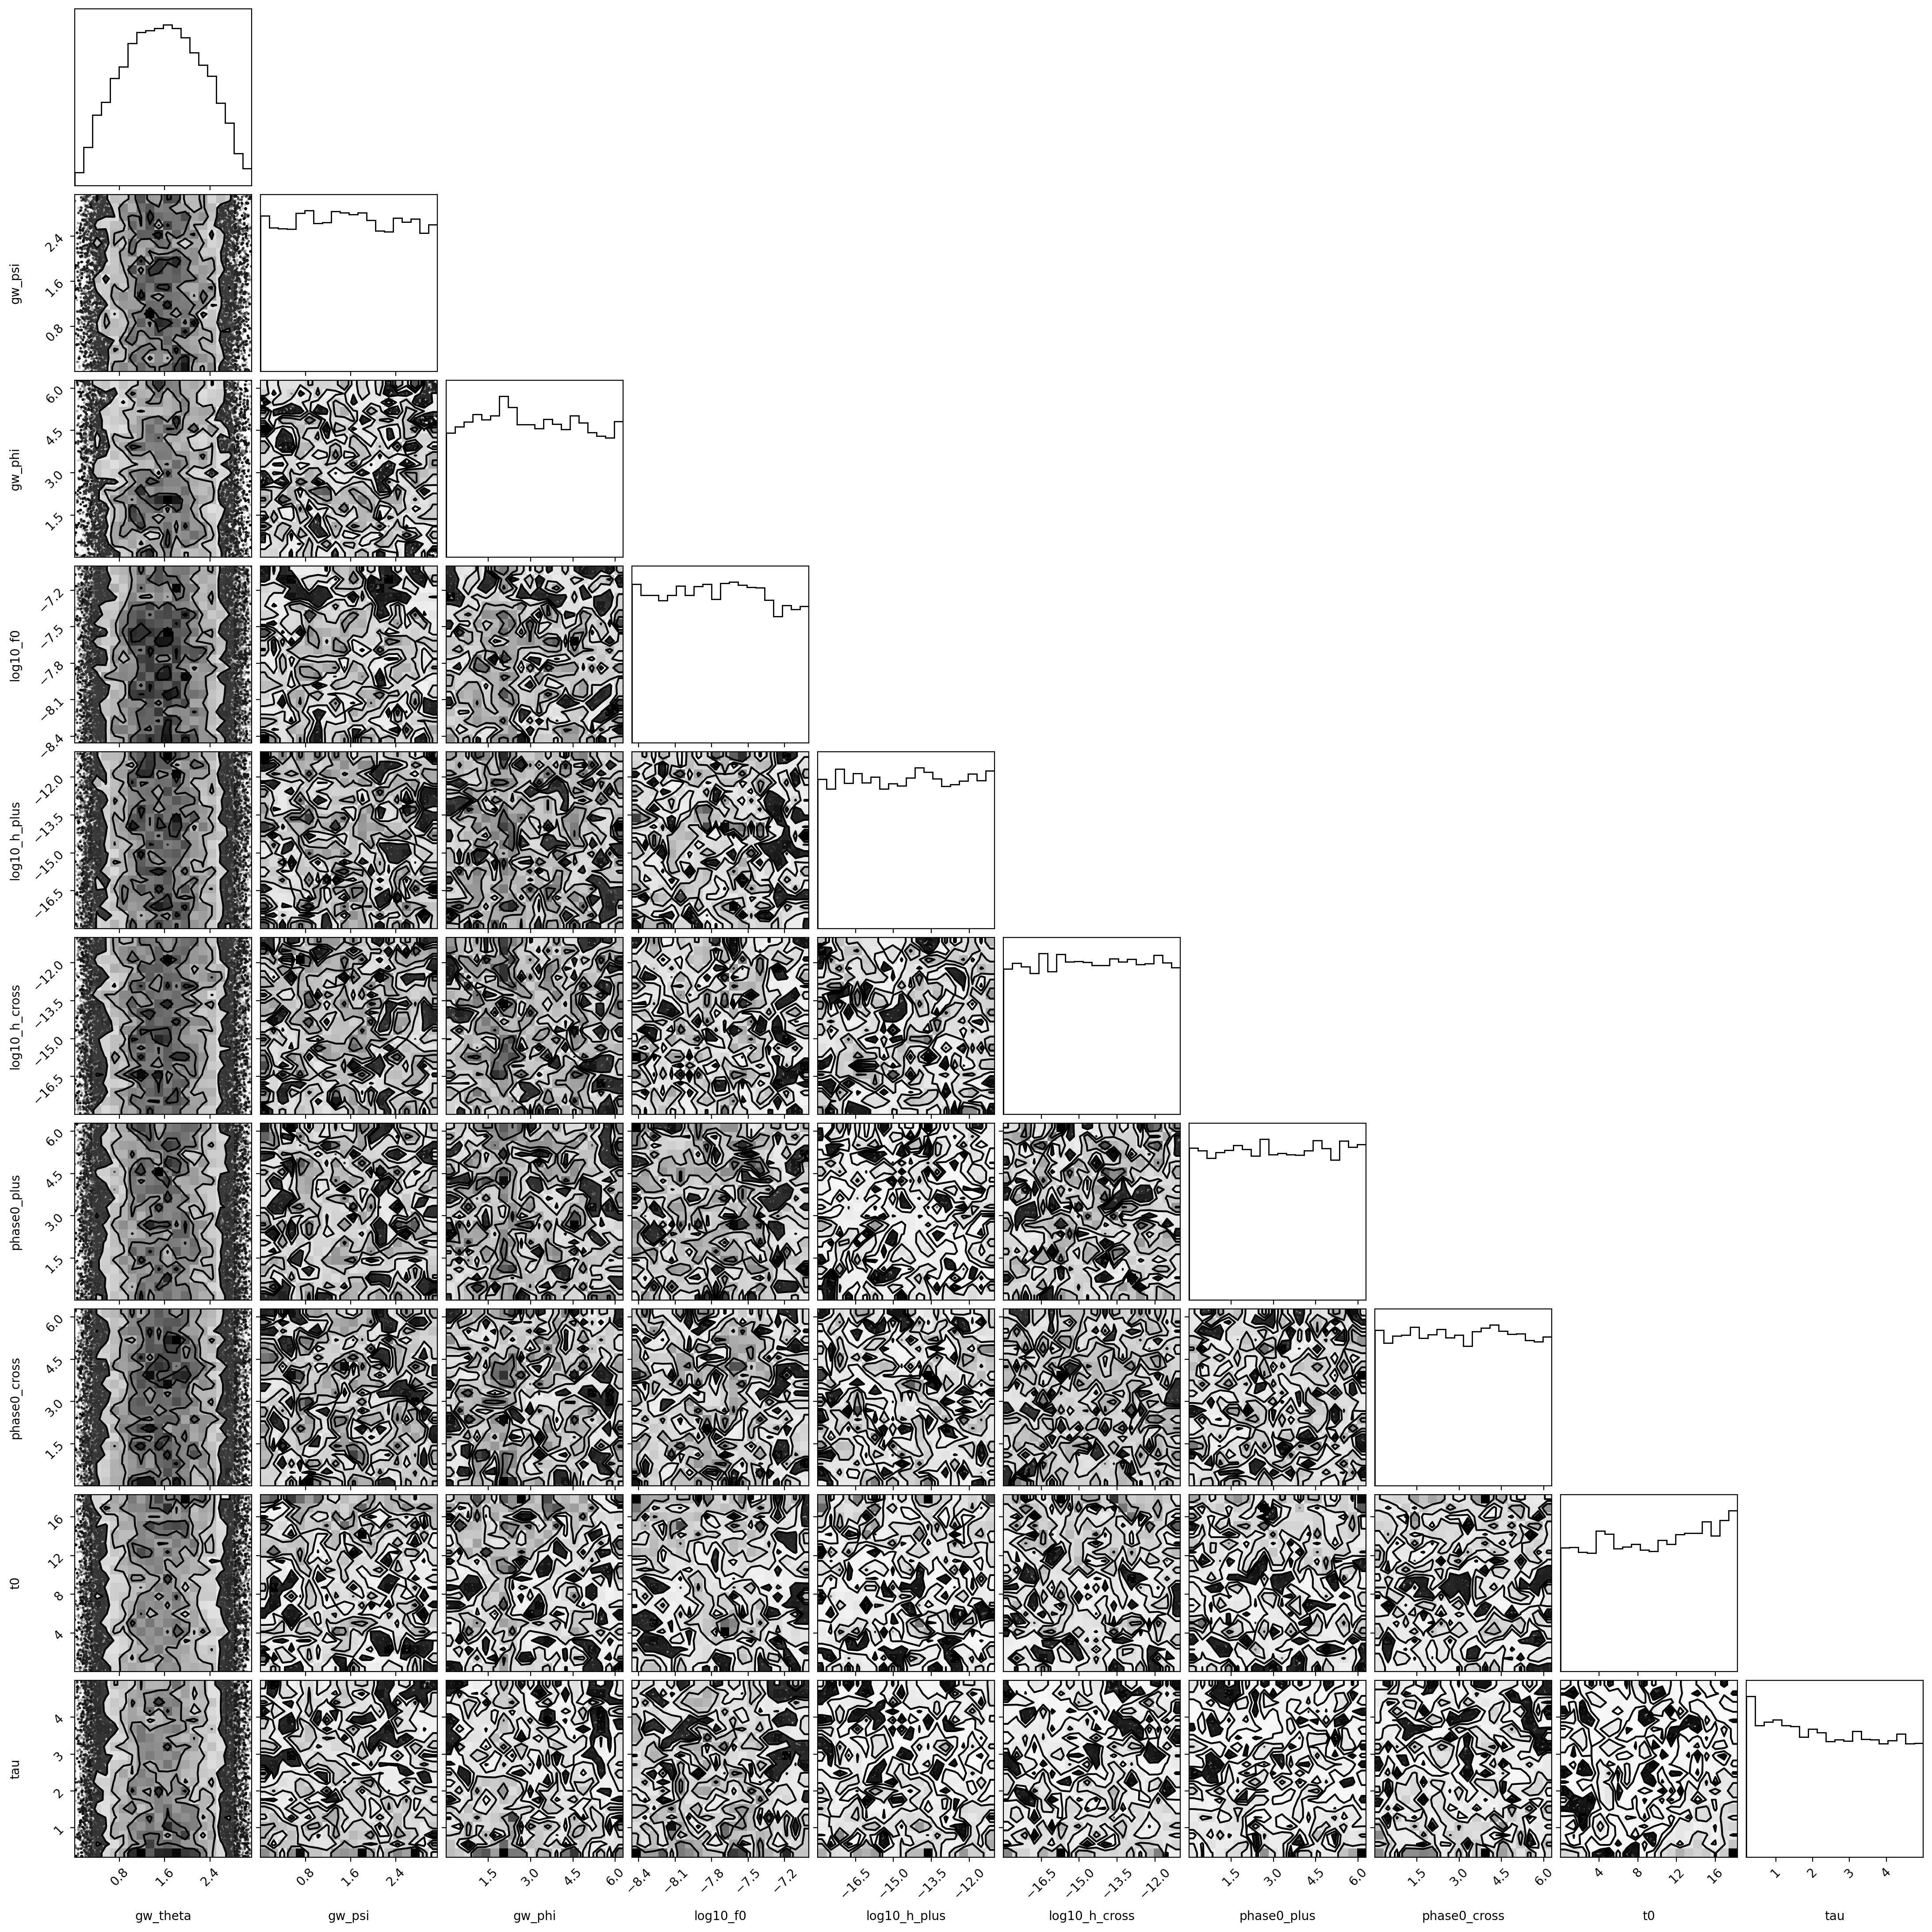
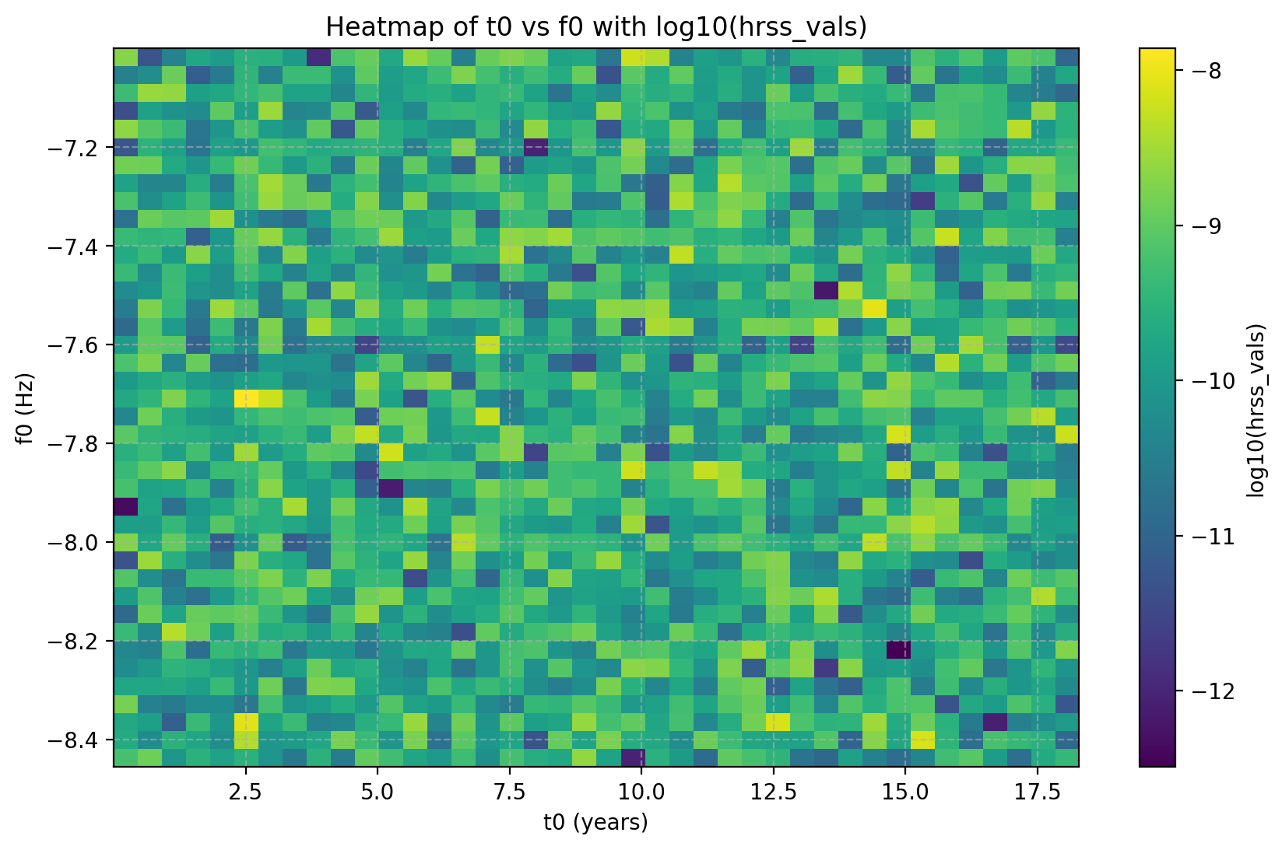
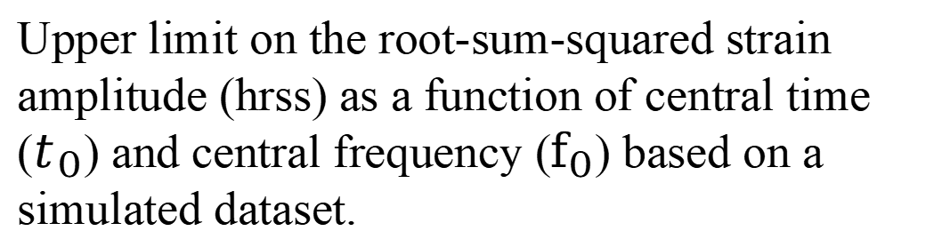
Upper limit on the root-sum-squared strain amplitude
Upper limit on the root-sum-squared strain amplitude (hrss) as a function of central time ($t_{0}$) and central frequency ($f_{0}$) based on a simulated dataset.

Slide 22


Constrain continuous GW with single pulsar
Figure 4 The timing residuals of PSR J1909$−$3744

Slide 23



Constrain continuous GW with single pulsar
Table 4 Optimal statistics of strain amplitude limit
 | $$h_{95}$$ | $$f_{GW}$$
CW | $$1.874×{10}^{−14}$$ | $$7.079×{10}^{−8}$$
 | $$2.295×{10}^{−13}$$ | $$1.0×{10}^{−6}$$
most sensitive skyloc | $$6.211×{10}^{−15}$$ | $$7.079×{10}^{−8}$$
 | $$8.891×{10}^{−14}$$ | $$1.0×{10}^{−6}$$
Figure 6 The sensitivity to single GW source in the observations of PSR J1909$−$3744.

