Slide 1



Propagation-induced Spectro-polarimetric Properties of Fast Radio Burst
Weiyang Wang（王维扬）
arXiv:2502.02857
School of Astronomy and Space Science
2025.7.3

Slide 2

1
Background
OUTLINES
2
Propagation effects
3
Results & Discussion
4
Summary

Slide 3


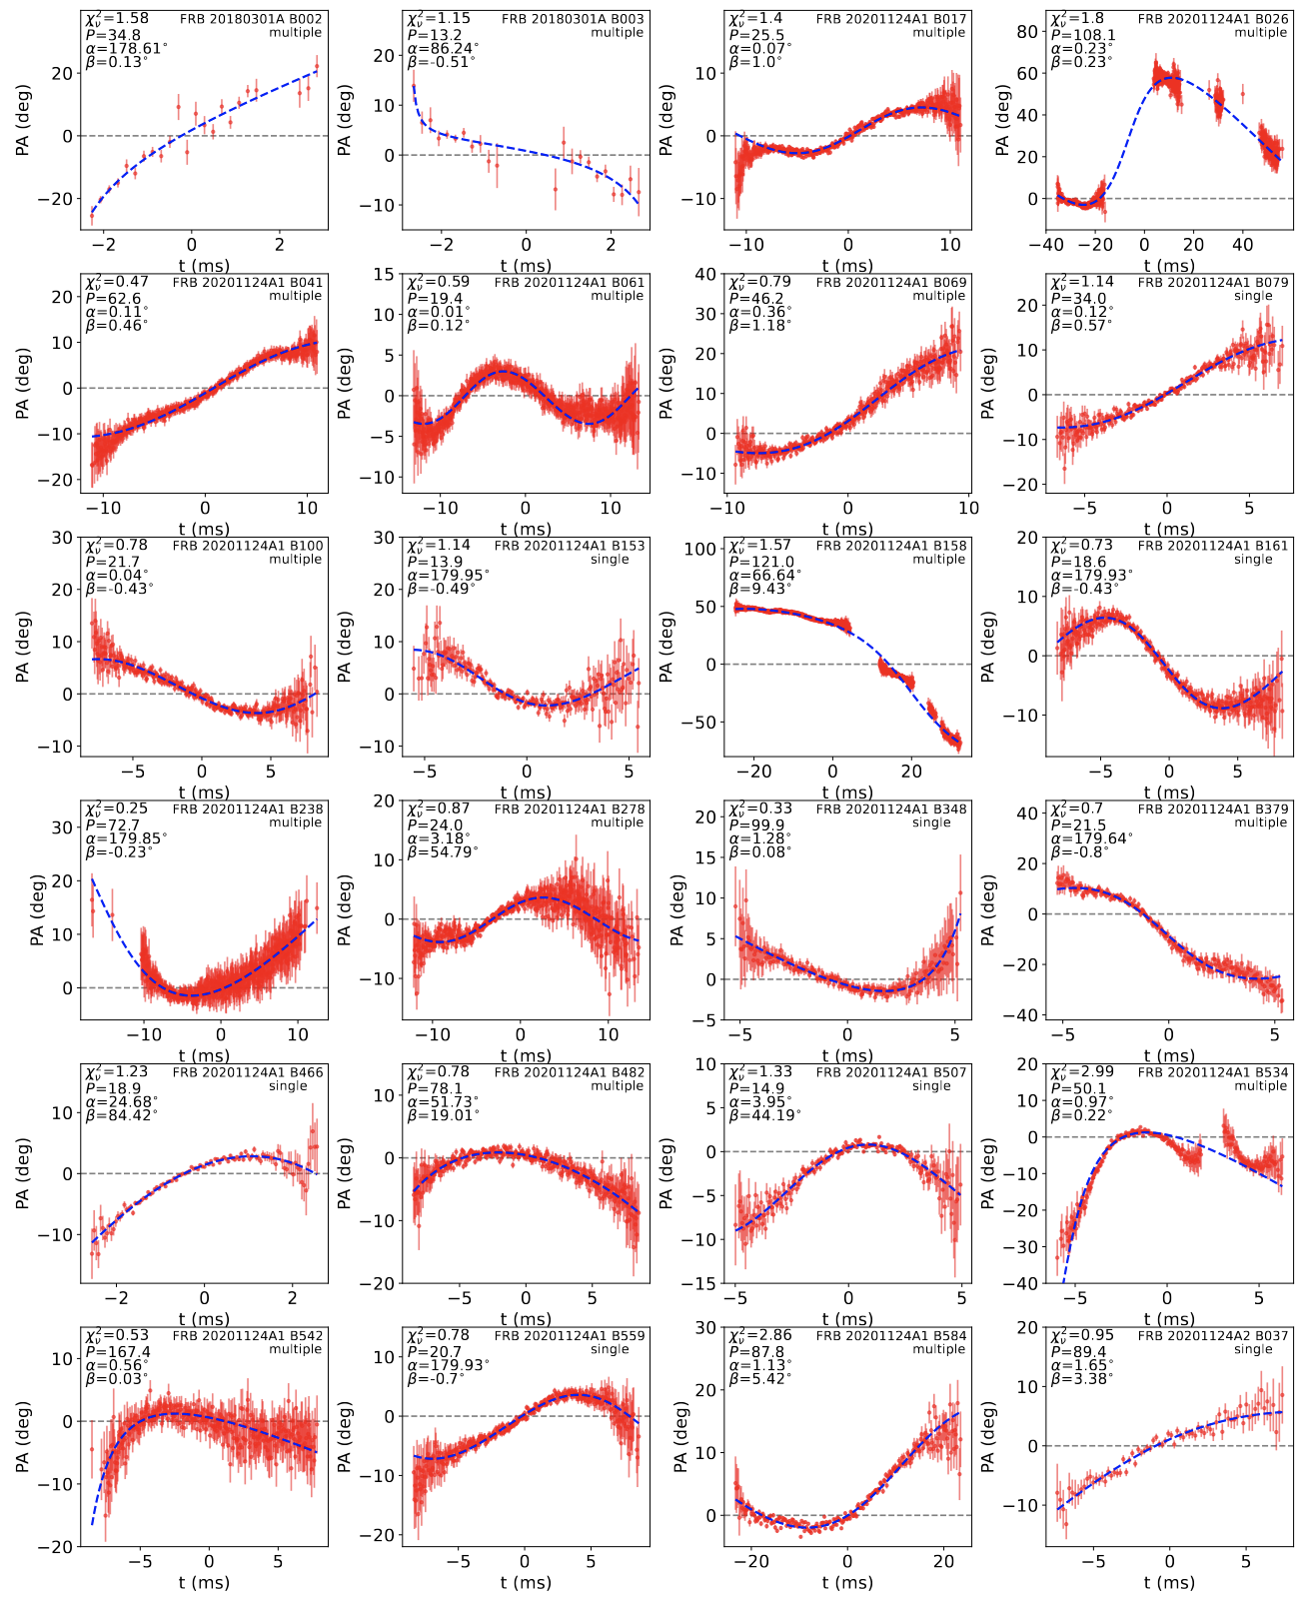
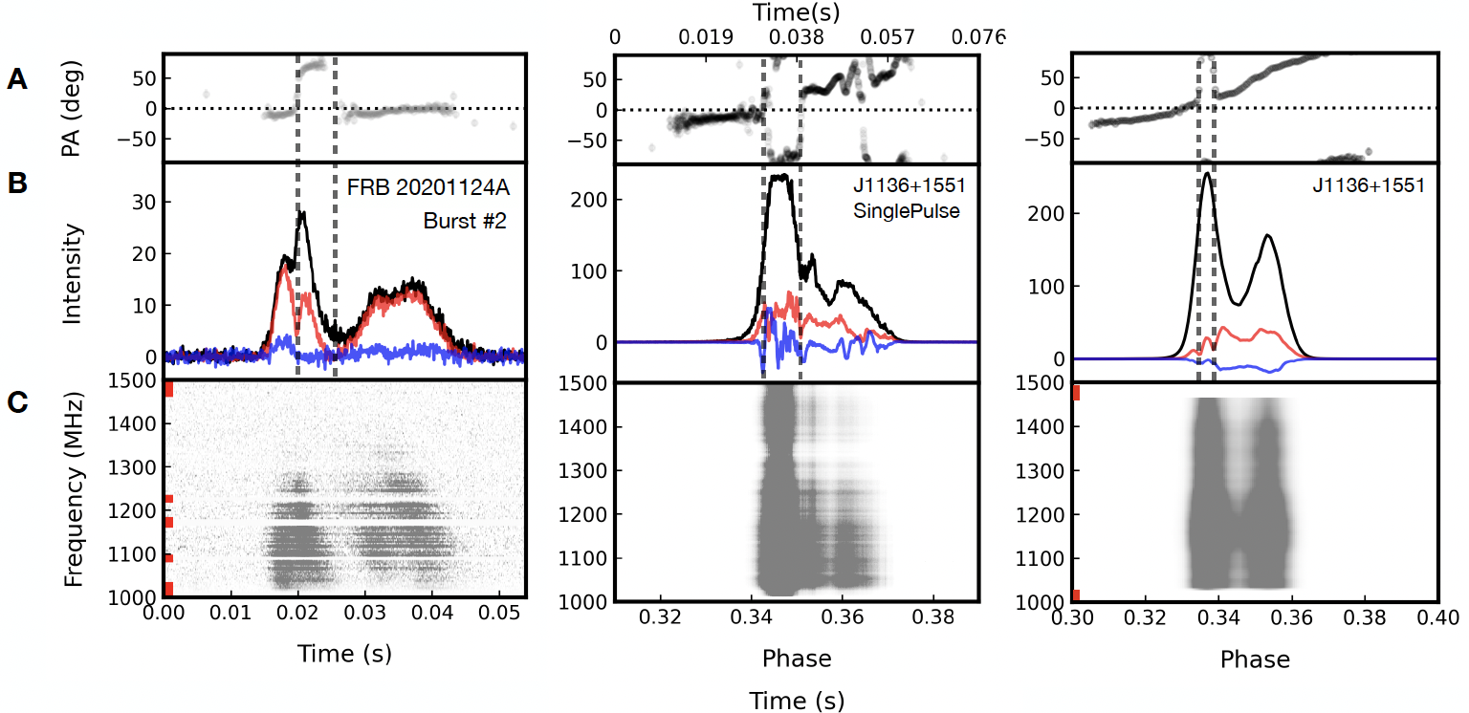
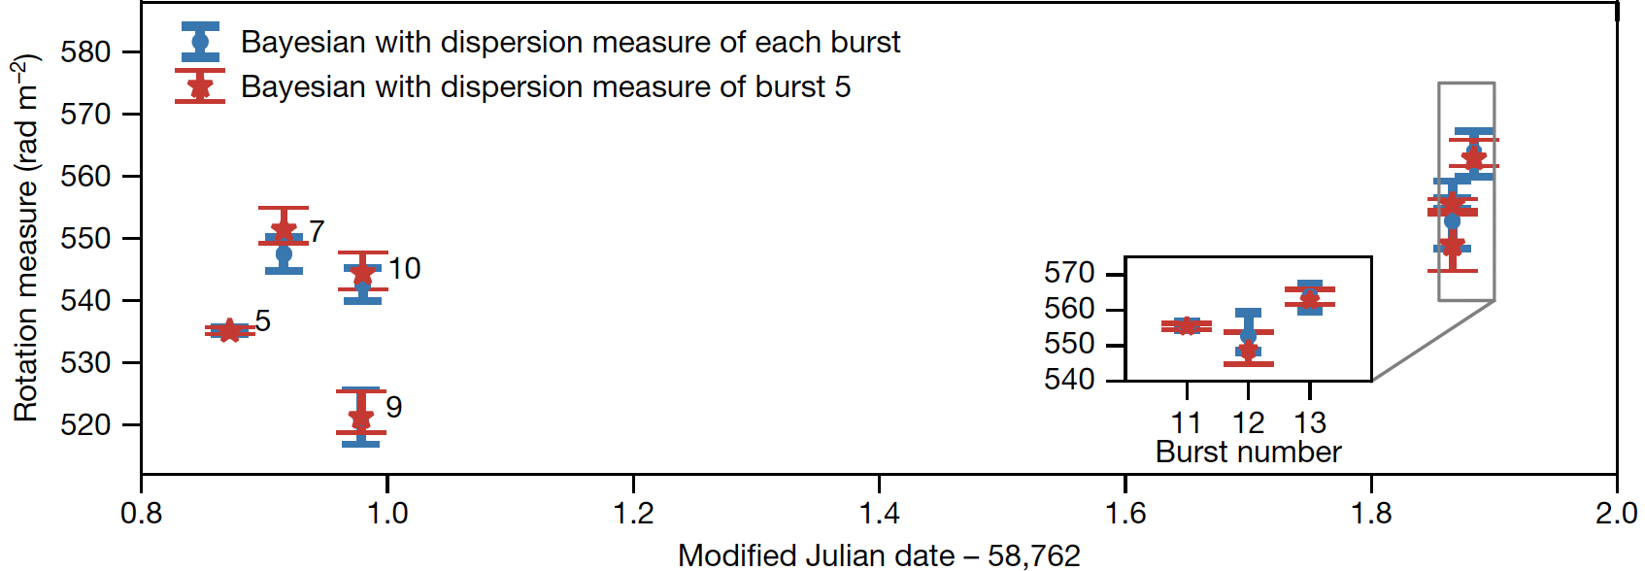
Background
Polarization properties
Background
Rotating Vector Model?
Sudden PA jump!
FRB 20201124A
Niu et al. 2024, ApJL
Varying RM
FRB 20180301A
Complex magnetic environment
01
Liu et al. 2025, ApJ accepted
See Xiaohui’ s Talk
Luo et al. 2020, Nature

Slide 4
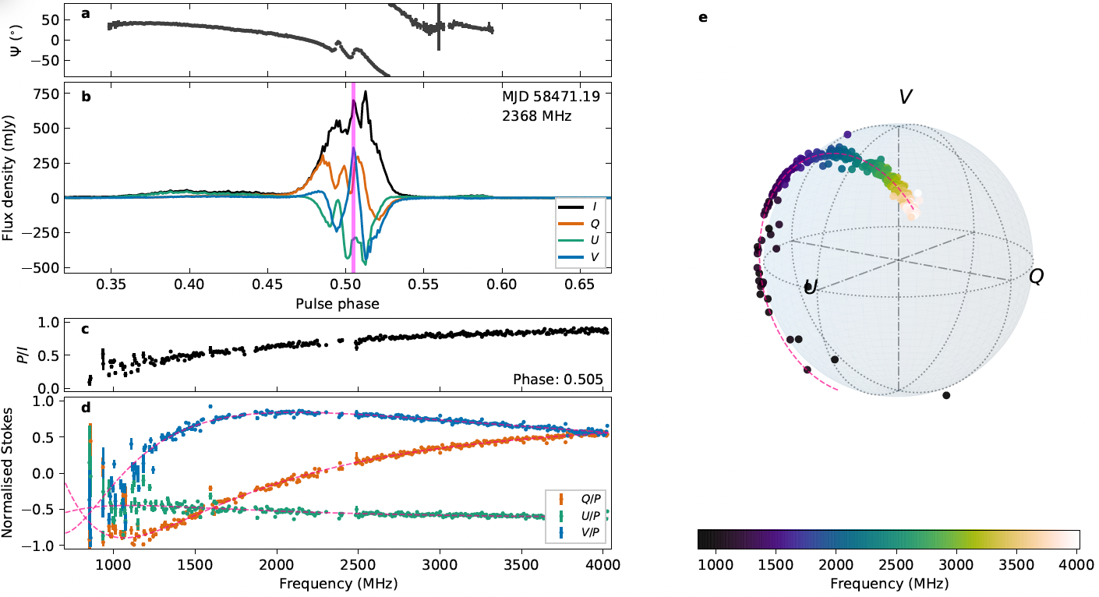
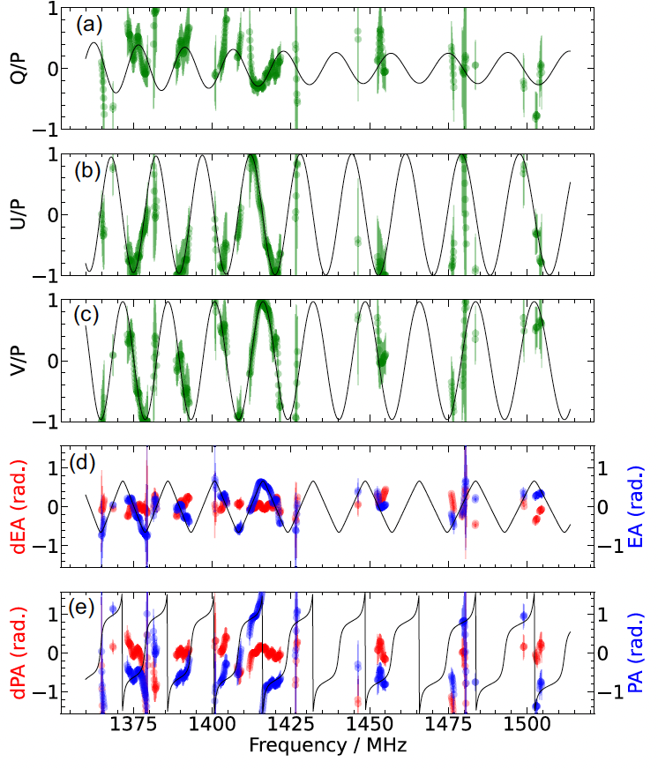
Background
Frequency-dependent polarization
Background
FRB 20180301A
XTE 1810-197
Lower et al. 2024, Nature Astronomy
Frequency-dependent polarizations in pulsars and FRBs!
02
Uttarkar et al. 2024, MNRAS

Slide 5





Background
Faraday rotation and conversion
Background
Faraday rotation:
V
$$\vec{E}$$
$$\vec{E}$$
v
$$\vec{k}$$
U
$$\vec{B}$$
$$ψ=ψ_{0}+RM(λ^{2}−λ_{0}^{2})$$
Incoming
wave
Plasma modes
Outgoing
wave
Q
Faraday Conversion:
V
$$\vec{E}$$
$$\vec{E}$$
FC rate $∝λ^{−3}$
$$\vec{k}$$
v
U
$$\vec{B}$$
Outgoing
wave
Q
Incoming
wave
Plasma modes
03

Slide 6
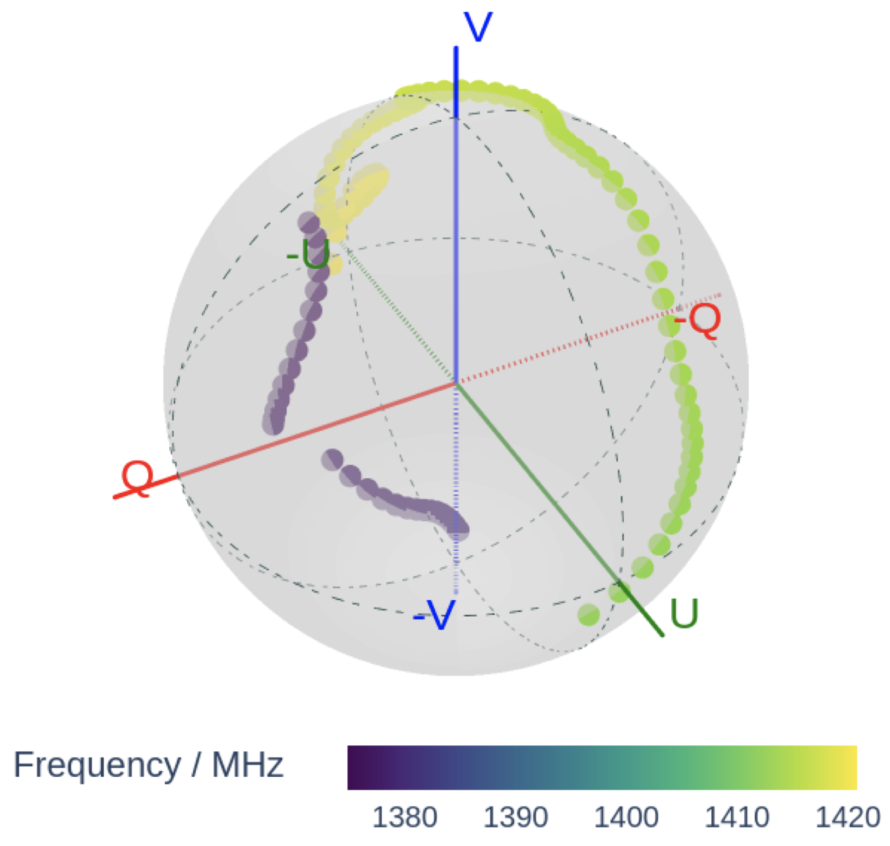

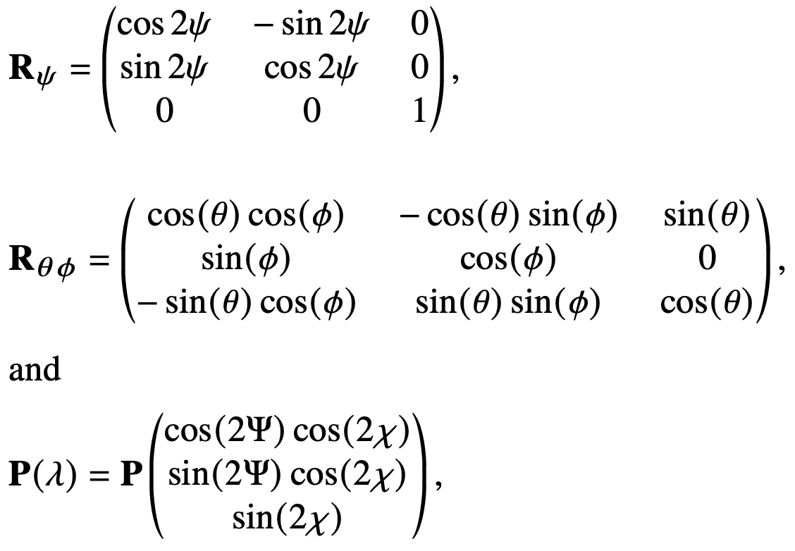
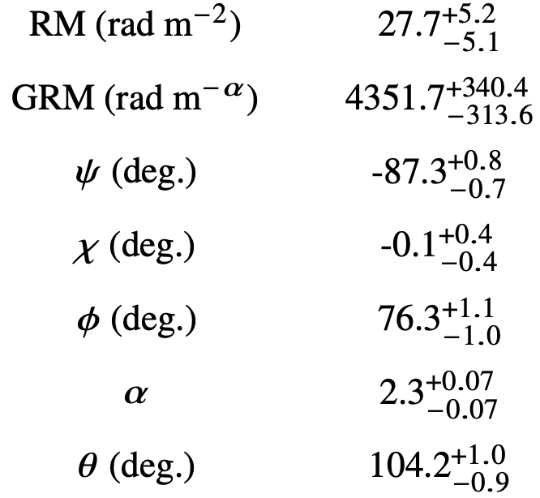

Propagation effects
Generalized Faraday rotation
Background
$$ψ=ψ_{0}+GRM(λ^{α}−λ_{0}^{α})$$
04
Uttarkar et al. 2024, MNRAS

Slide 7
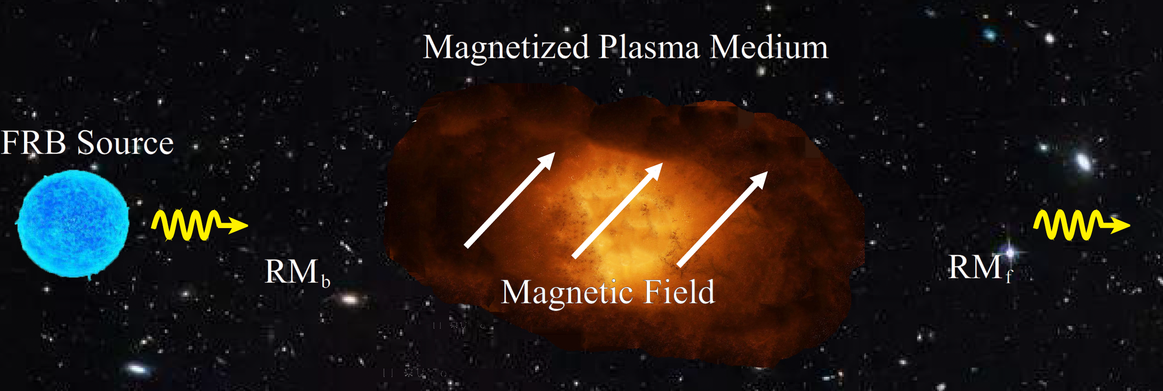
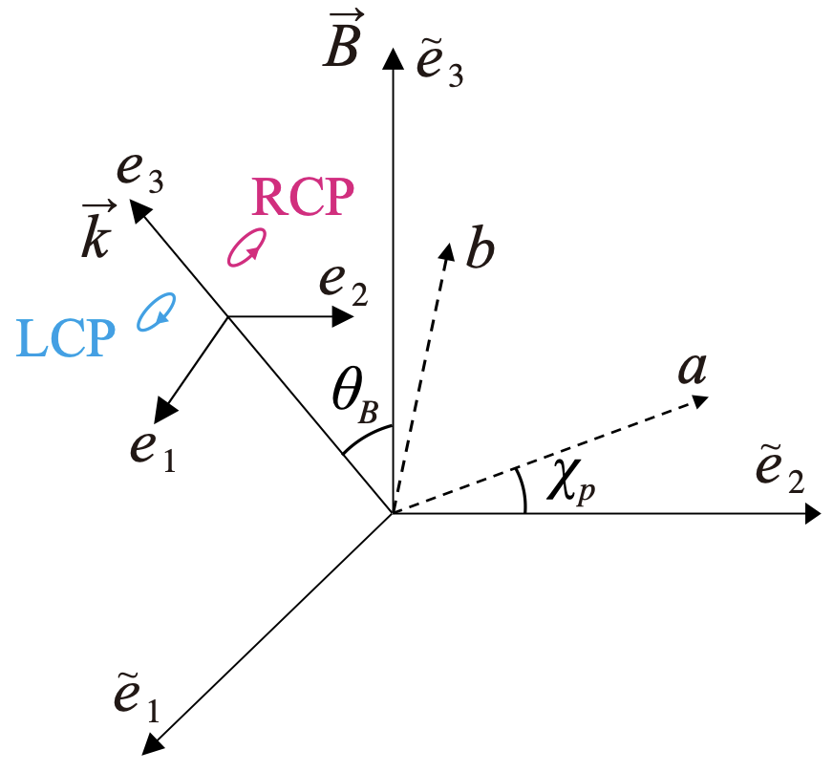
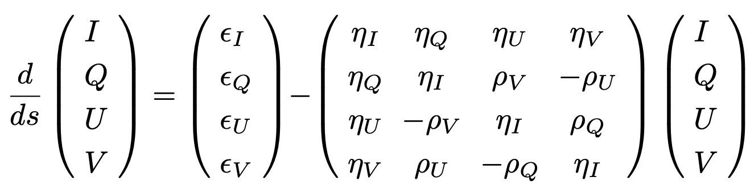
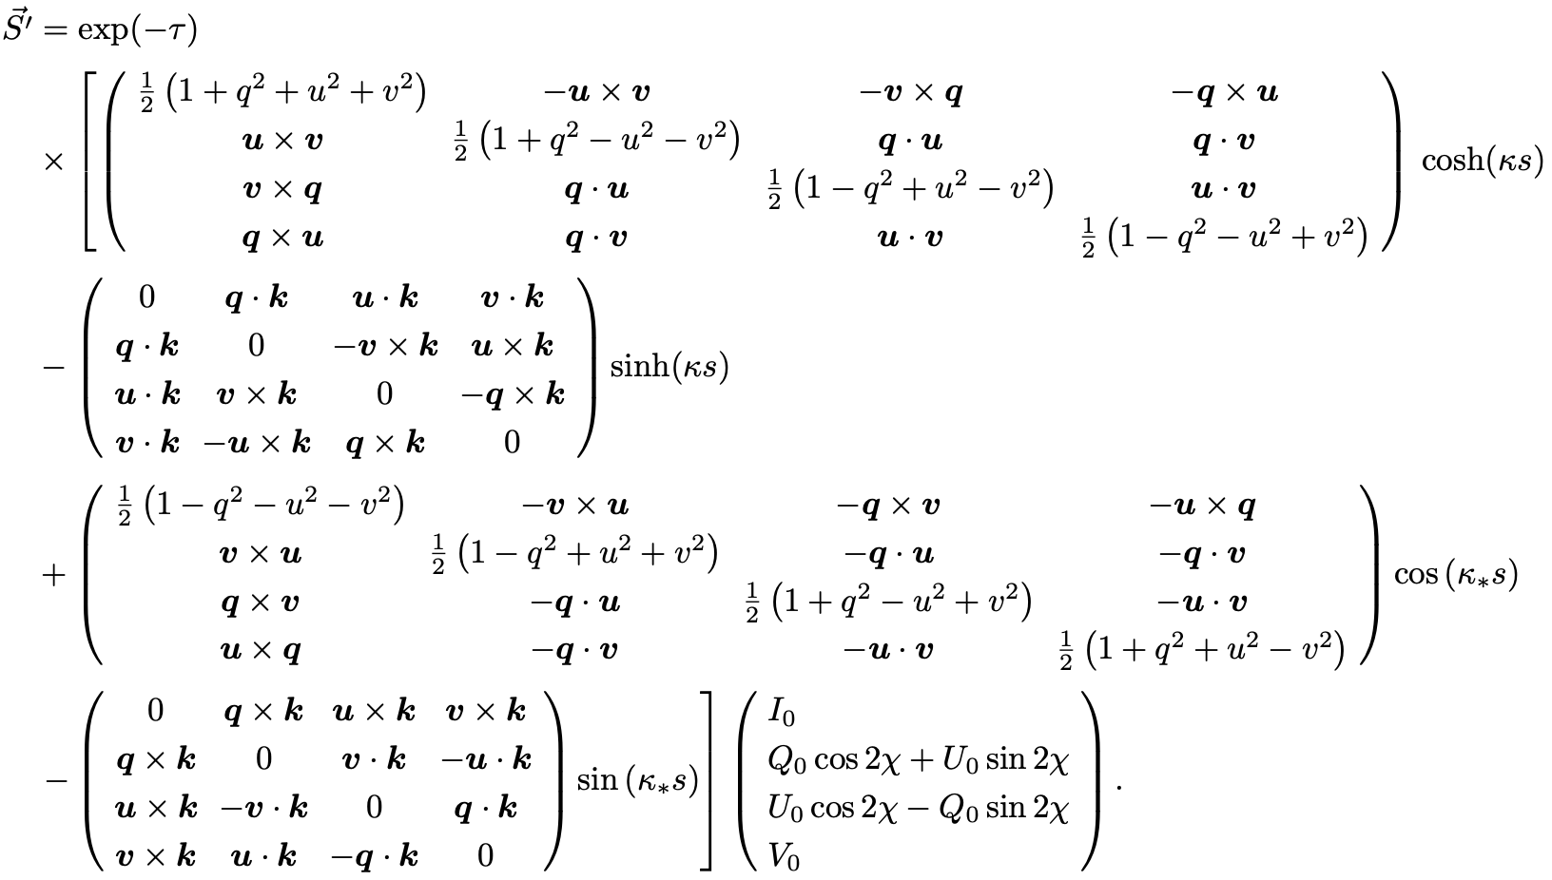

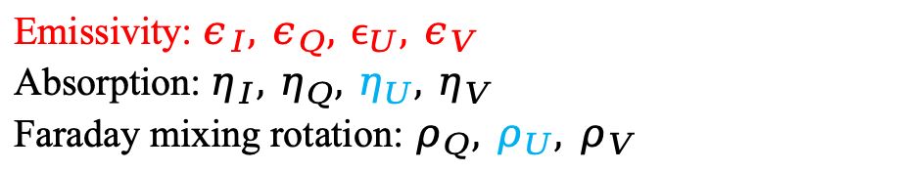
Propagation effects
Wave transformation
Background
Transformation Equation:
An analytical solution:
Emissivity: $ε_{I}, ε_{Q}, ϵ_{U}, ε_{V}$
Absorption: $η_{I}, η_{Q}, η_{U}, η_{V}$
Faraday mixing rotation: $ρ_{Q}, ρ_{U}, ρ_{V}$
Intrinsic plasma coordinate:
$${ϵ_{U}=η}_{U}=ρ_{U}=0$$
Rotates to the observer’s coordinate
05

Slide 8
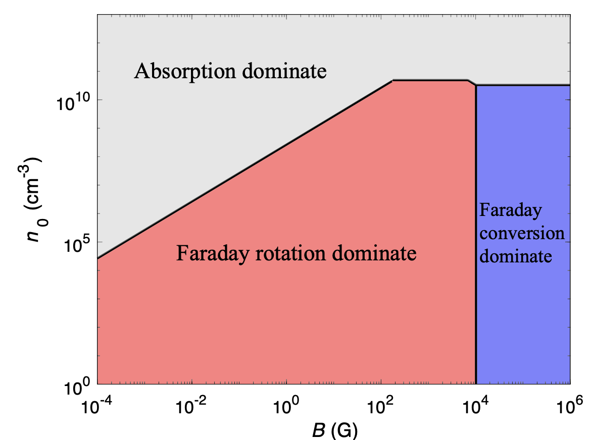
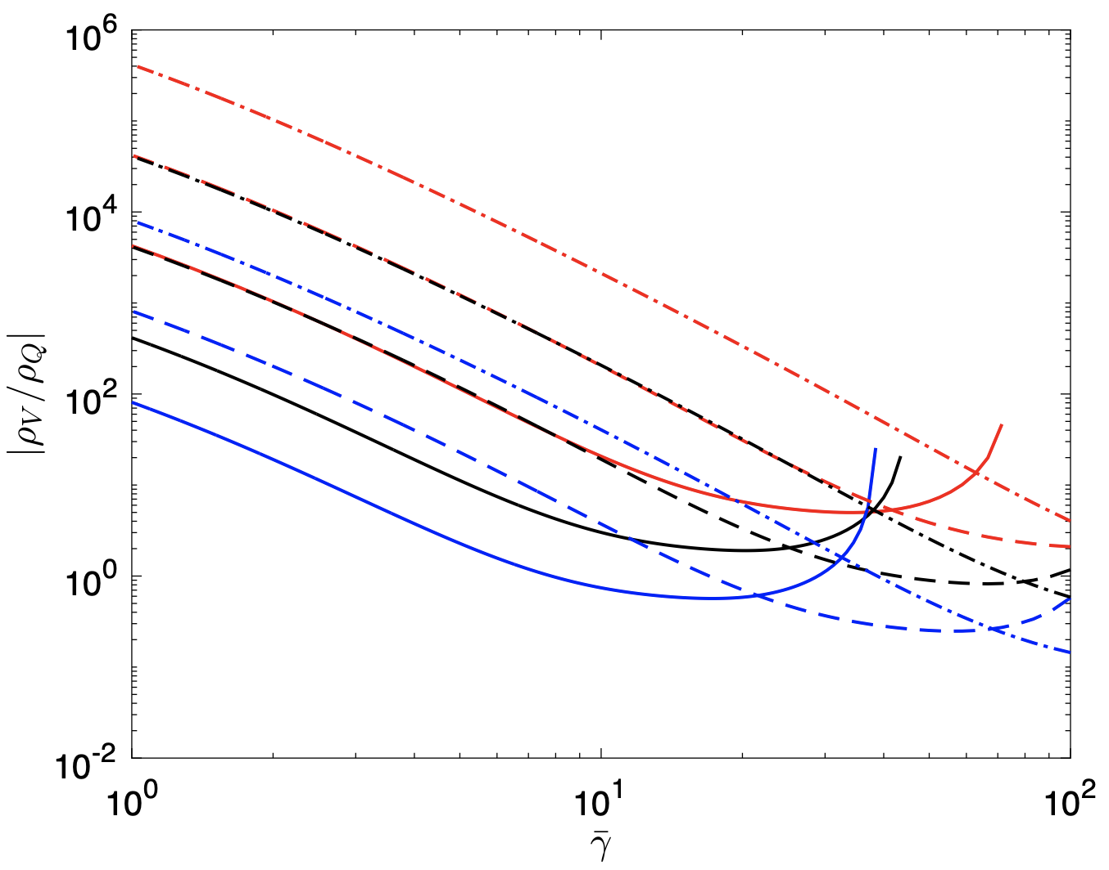
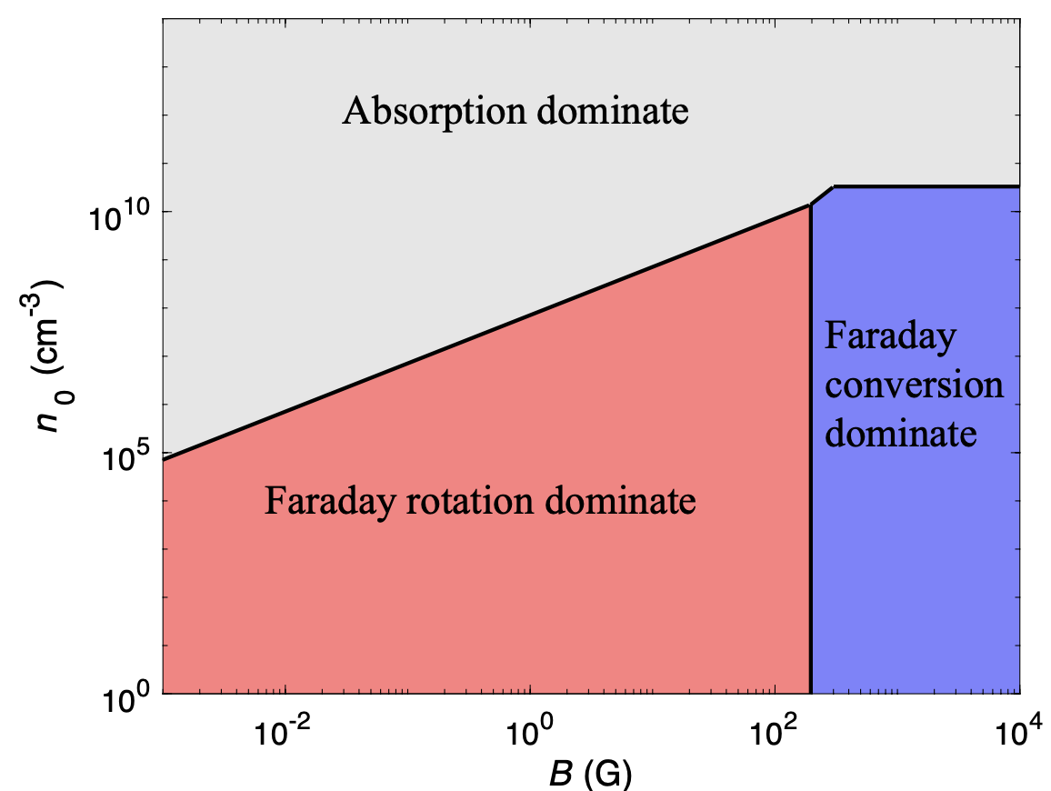

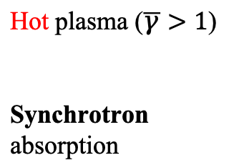


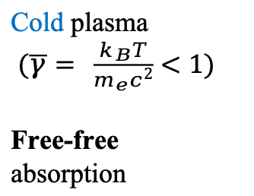
Propagation effects
Plasma medium
Background
Cold plasma
$(\overline{γ}= \frac{k_{B}T}{m_{e}c^{2}}<1)$
Free-free
absorption
Hot plasma ($\overline{γ}>1$)
Synchrotron absorption
$$θ_{B}={15}^{∘}$$
A hot plasma is easier to generate Faraday conversion than a cold plasma.
For a power-law distributed plasma, if $ν≪ν_{B}$
$$η≪ρ_{Q}≪ρ_{V}$$
$$θ_{B}={75}^{∘}$$
06

Slide 9
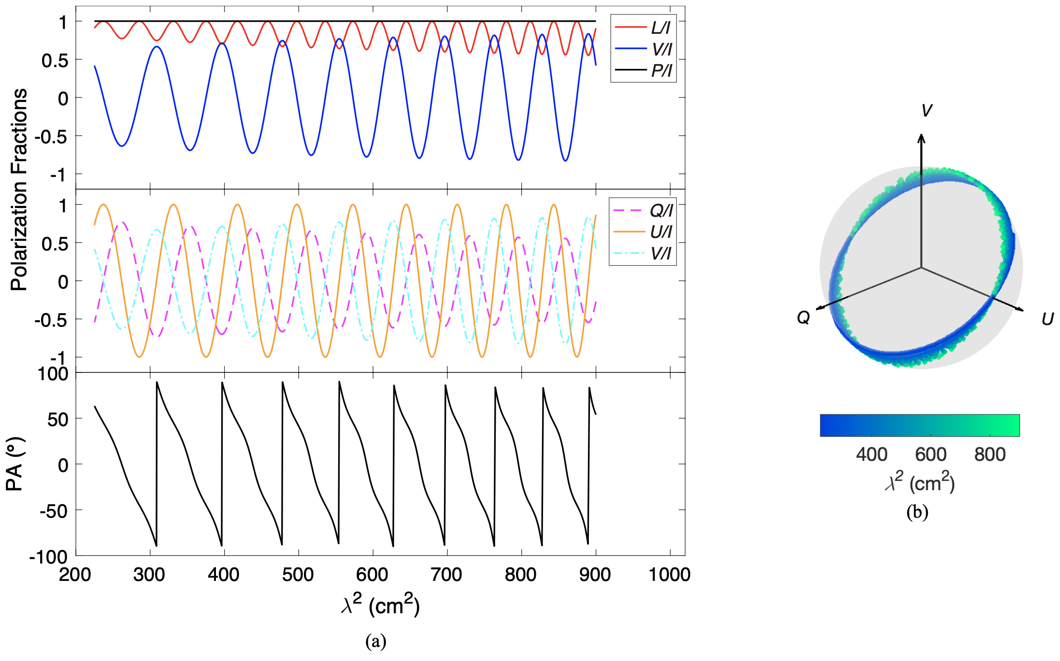
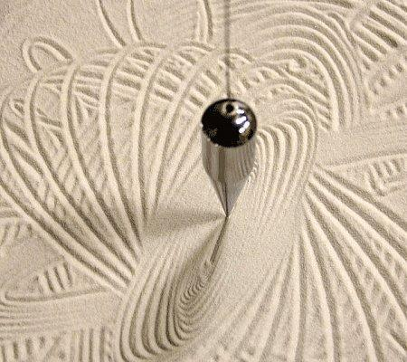
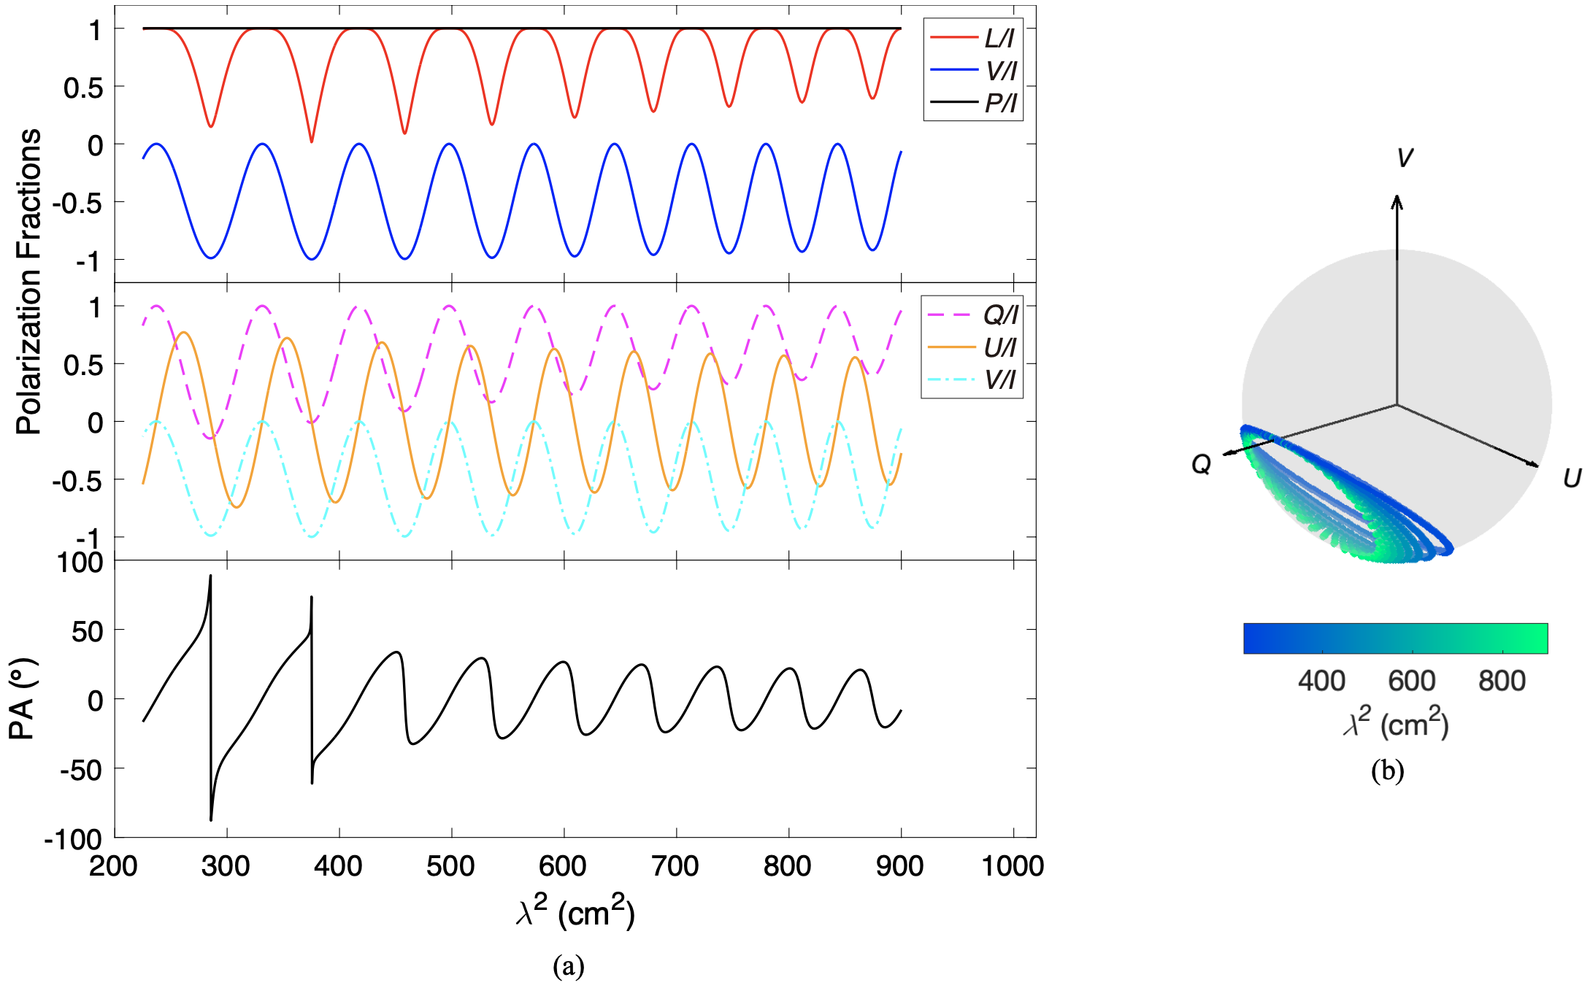
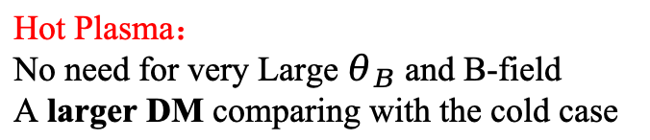
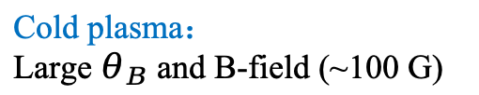
Results
Mixing Faraday spectra
Background
Mixing Faraday:
Comparable Faraday rotation and conversion
Absorption ignored
Procession in Poincaré sphere
Q, U, V oscillate with frequency with different phases
S-shape-like PA curves
Foucault's pendulum
Cold plasma：
Large $θ_{B}$ and B-field (~100 G)
Hot Plasma：
No need for very Large $θ_{B}$ and B-field
A larger DM comparing with the cold case
O and X modes are highly LP
07
Wang et al. 2025, arXiv:2502.02857

Slide 10
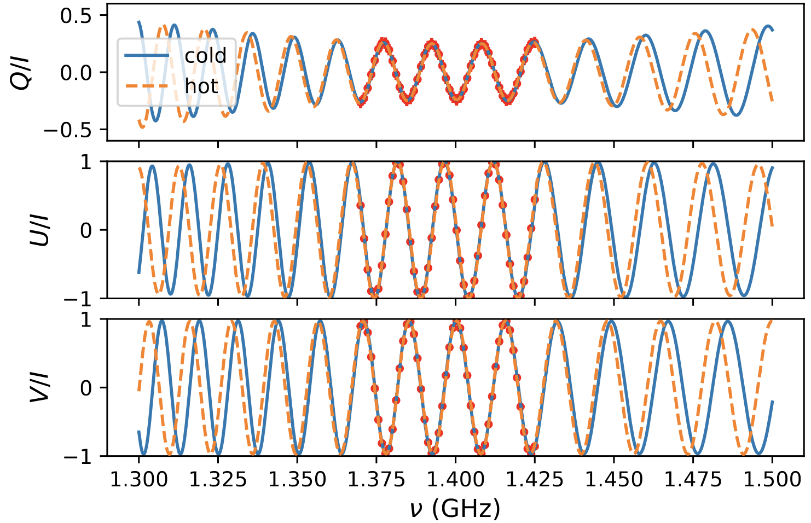

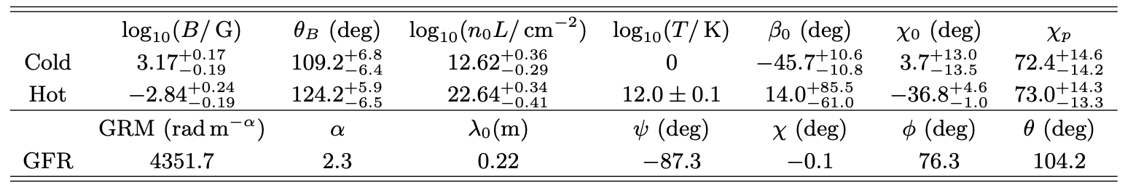




Results:
FRB 20180301A
Background
Mixing Faraday spectra
FRB 20180301A
Red dots: GFR model mock
Blue: cold plasma
Orange: hot plasma
Faraday rotation
FRB
Faraday conversion
the method in MixF code
Xiaohui Liu
https://github.com/GalaxyL777/MixF
The MixF offers a more physical description of the environment properties than GFR
${RM}_{b}=0.09 rad m^{−2}$
${RM}_{f}=27.5 rad m^{−2}$
${RM}_{b}=−5.0 rad m^{−2}$
${RM}_{f}=−3.1 rad m^{−2}$
08
A ～-90 % CP incoming wave
Wang et al. 2025, arXiv:2502.02857

Slide 11
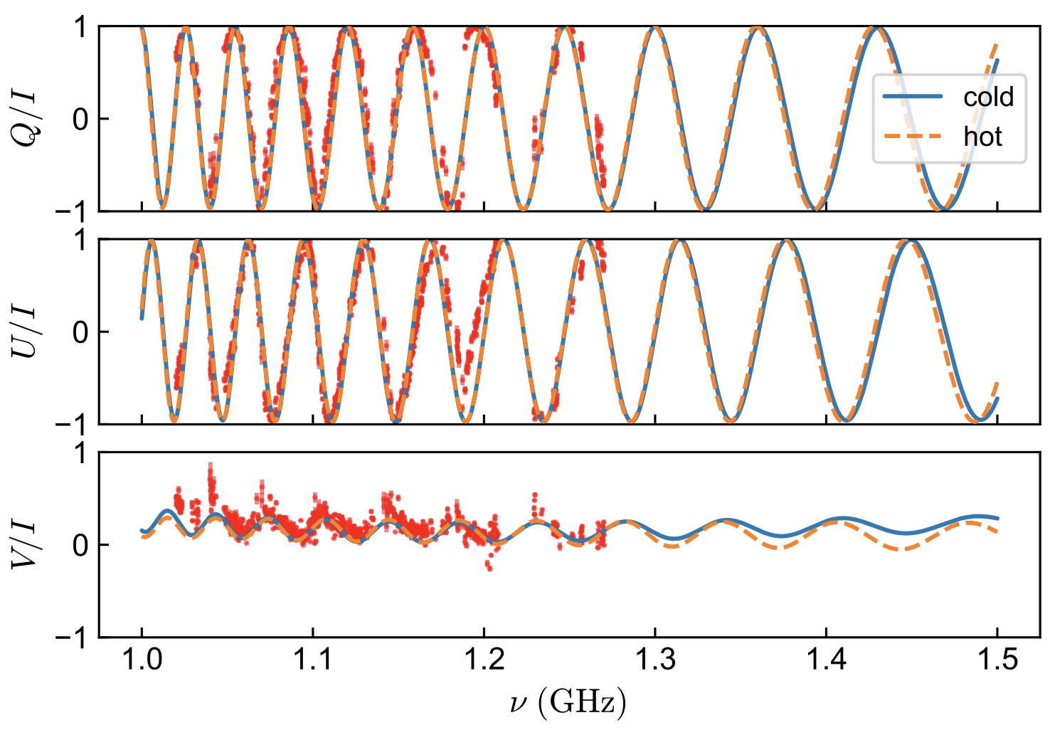
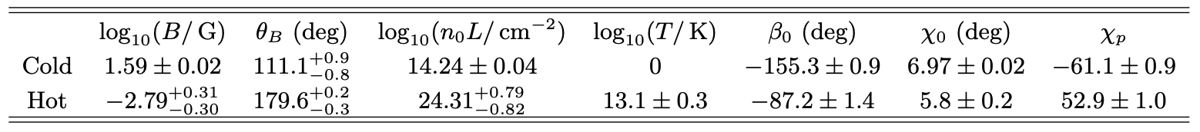






Results:
FRB 20201124A
Background
Mixing Faraday spectra
FRB 20201124A
Red dots: Data from Xu et al. (2022), Nature
Blue: cold plasma
Orange: hot plasma
${DM}_{excess}=183−243 pc cm^{−3}$
${DM}_{hot}=154.3 pc cm^{−3}$
Not exceed the ${DM}_{excess}$
A hot cloud move across the LOS can be ruled out
${RM}_{b}=32.3 rad m^{−2}$
${RM}_{f}=−8.6 rad m^{−2}$
${RM}_{b}=7.7 rad m^{−2}$
${RM}_{f}=−6.7 rad m^{−2}$
09
Wang et al. 2025, arXiv:2502.02857

Slide 12
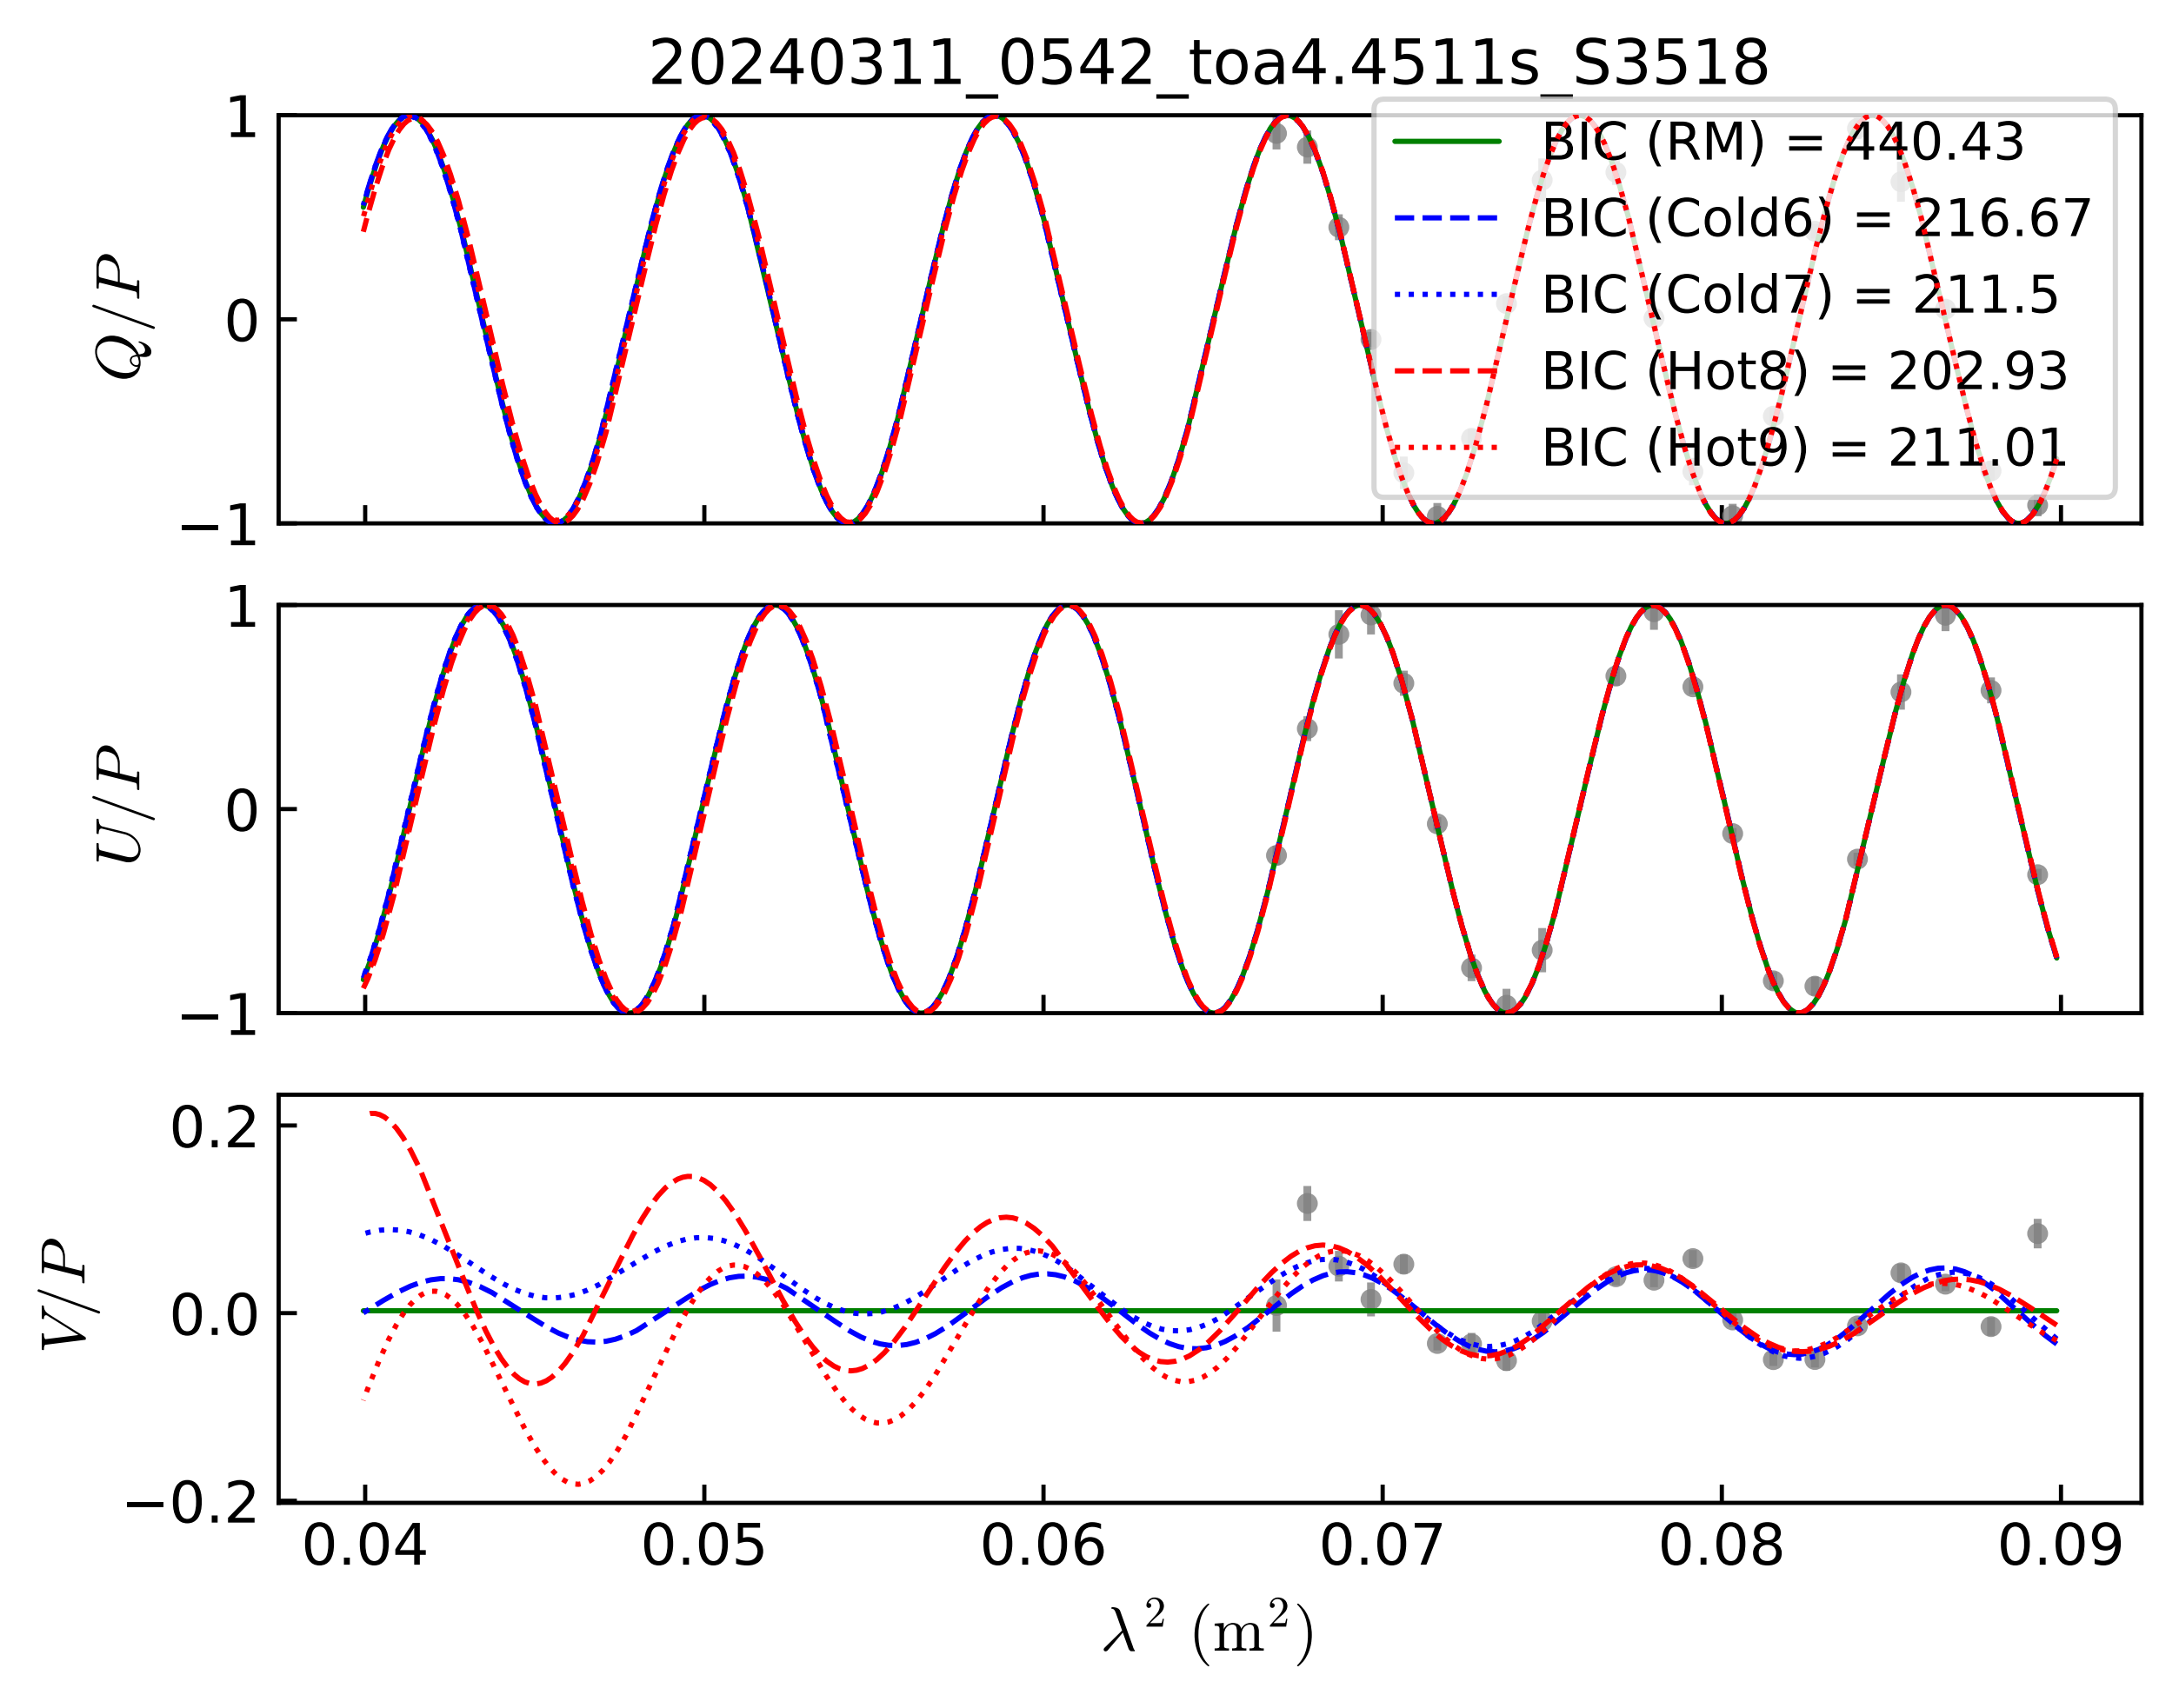

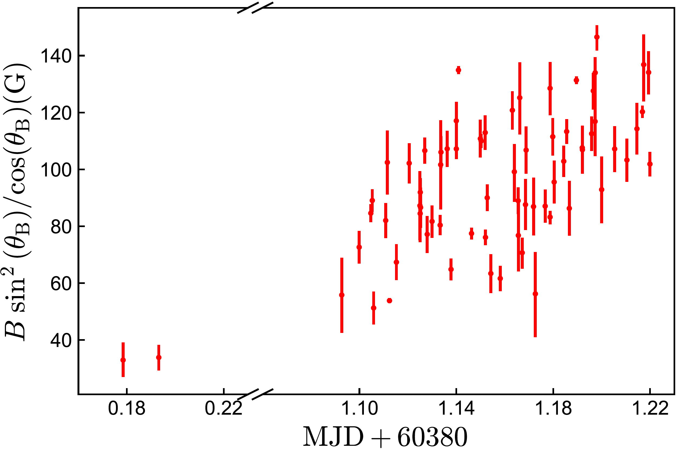
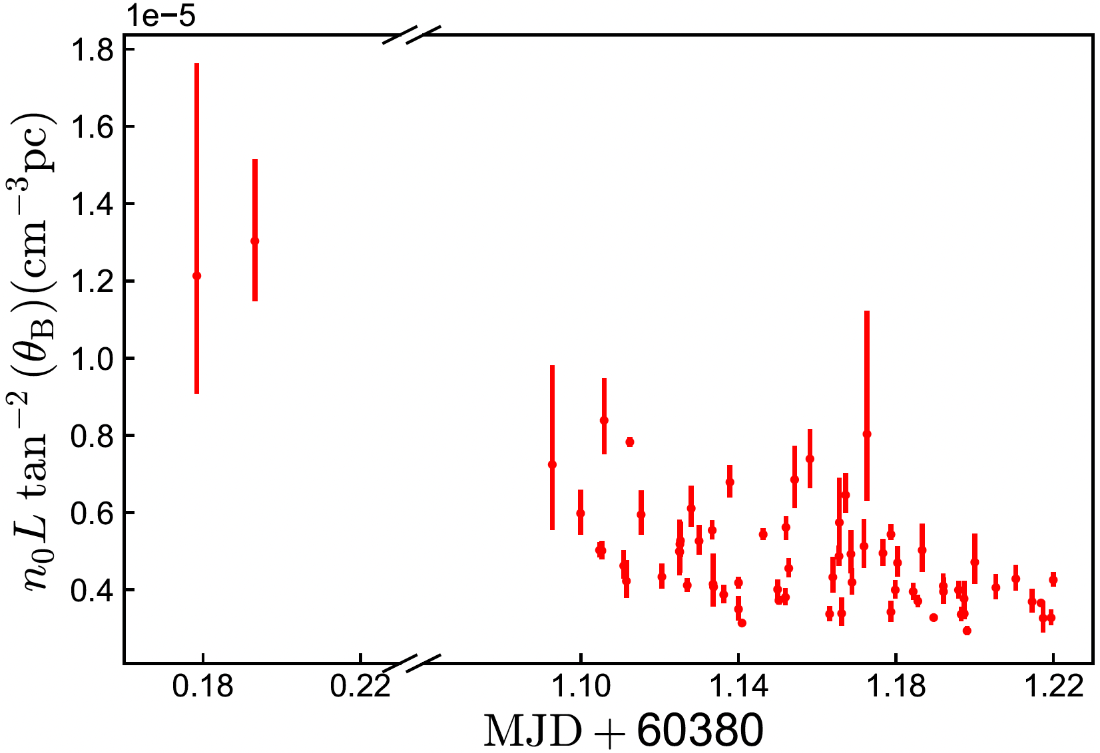
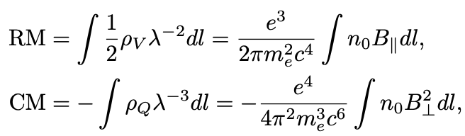
Results:
FRB 20240114A
Background
Mixing Faraday spectra
For some bursts, Q, U, V oscillate with wavelength with 𝛂 ≠ 2
Perpendicular magnetic field evolution?
10
Wang et al. 2025 in press

Slide 13

Summary
Background
1) MixF: A new method to process data.
2) For frequency-dependent V, one must consider Faraday conversion! The RM cannot be derived from Q and U alone via Faraday rotation.
3) Mixing Faraday spectra: The rotational axis of the polarization spectrum undergoes precession as the frequency changes. This can happen in both hot plasma and cold highly magnetized plasma media.
Thank you!
11

Slide 14
Sign Convention
LCP, RCP and RM
Background
PSR IEEE:
IAU IEEE:
High-Energy Radiation from Magnetized Neutron star ——P. M.
Zhang 2023, RvMP (lose a “-” in RM definition)
Sazanov 1969, Soviet Astron.
电动力学——俎栋林
Handbook of Pulsar Astronomy——L.D. & K. M.
It will change in the next version
中子星物理——俞云伟
08

