Slide 1
Strange stars admixed with mirror dark matter:
Confronting observations of XTE J1814-338
杨书华
华中师范大学物理科学与技术学院
SPSS2025 & FPS14，青岛

Slide 2
Outline
1. Introduction
2. EOS of SQM and mirror dark matter
3. Results
4. Discussions

Slide 3
1. Introduction
The EOS of compact stars is still in lively debate.
Besides the conventional NS model, strange stars (SSs) are suggested as a possible nature of compact stars after it was conjectured that strange quark matter (SQM) consisting of up, down and strange quark could be the true ground state of strong interaction (Witten 1984).
SS candidates:
compact stars in X-ray sources SAX J1808.4-3658, 4U 1728-34 , RX J1856.5-3754 ,
4U 1746-37; radio pulsar PSR B0943+10 ; CCO in HESS J1731-347.

Slide 4
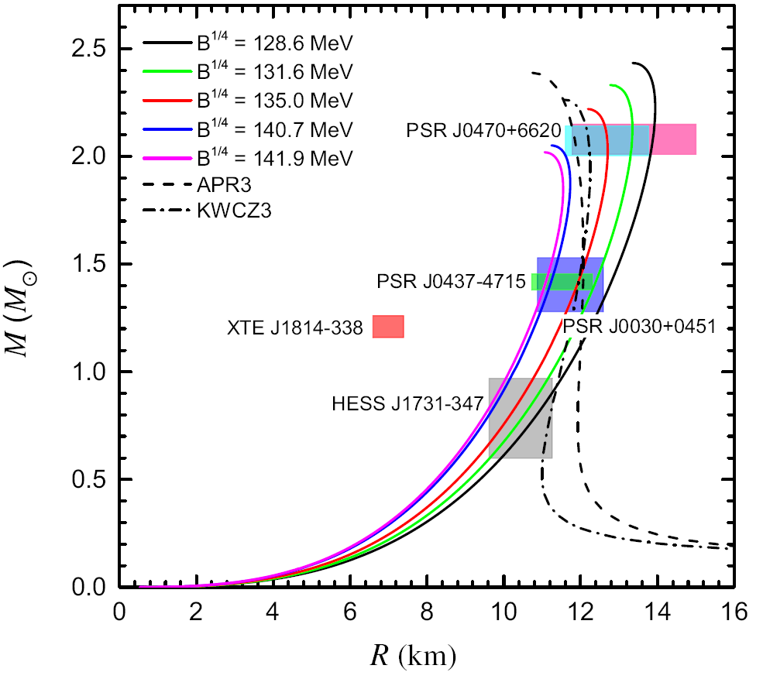


XTE J1814-338
An accretion-powered millisecond pulsar and Type I X-ray burster
By pulse profile modelling (PPM) of its thermonuclear burst oscillations, it is found that:
Kini et al., MNRAS, 535, 1507 (2024)

Slide 5
Explanations to XTE J1814-338
Compact stars admixed with dark matter
Pitz and Schaffner-Bielich, PRD, 111, 043050 (2025); arXiv:2408.13157
Yang et al., PRD, 111, 043037 (2025); arXiv:2409.15969
Lopes and Issifu, Physics of the Dark Universe, 48, 101922 (2025); arXiv:2411.17105
Lopes, arXiv:2501.06379
Hybrid star
Laskos-Patkos and Moustakidis, PRD, 111, 063058 (2025); arXiv:2410.18498
Zhou and Huang, arXiv:2504.08662
Zhang, Pretel and Xu, arXiv:2507.01371

Slide 6
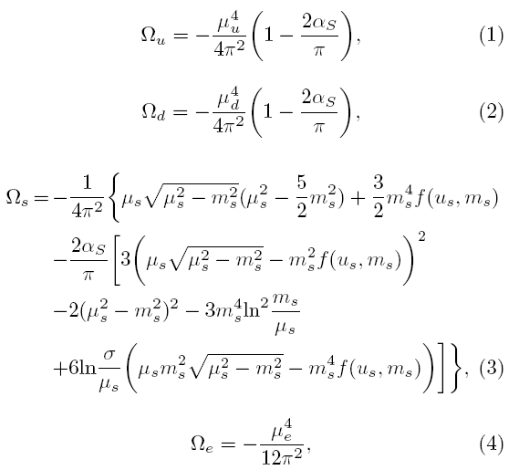


2. EOS of SQM and mirror dark matter
Standard MIT Bag Model
Alcock et al., ApJ 310, 261 (1986)

Slide 7
EOS of mirror dark matter
Mirror dark matter is a stable and self-interacting dark matter candidate that emerges from the parity symmetric extension of the Standard Model of particles.
The idea of the possible existence of MDM can be traced back to 1956. When Lee and Yang proposed that the weak interactions is not parity symmetric, they also pointed out that, even if the interactions of the known particle were to violate parity, the symmetry could be restored if a set of mirror particles existed.

Slide 8
EOS of mirror dark matter
In the minimal parity-symmetric extension of the standard model, the two sectors are described by the same Lagrangians, but ordinary particles have left-handed interactions, mirror particles have right-handed interactions.
Thus, the microphysics of MDM is the same as that of ordinary matter, we could use the same EOS for SQM and MDM.

Slide 9
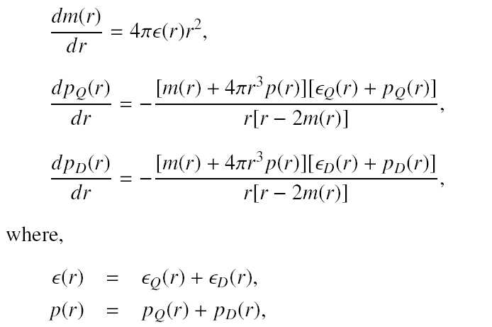
3. Results
To study the properties of SSs with a MDM core, we employ a two-fluid formalism, where SQM and MDM sectors do not interact directly, they only interact through the gravitational interaction.

Slide 10
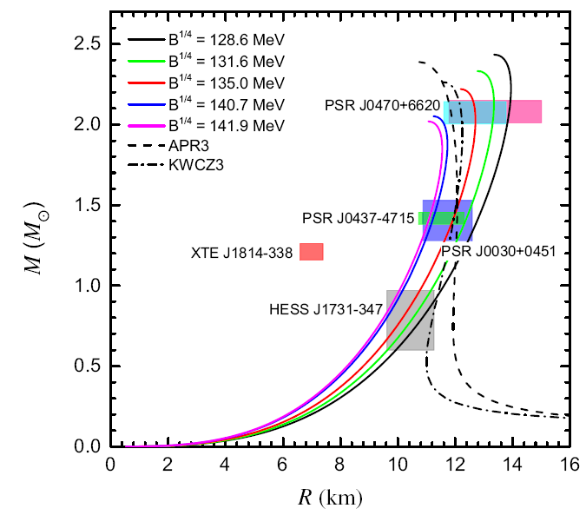
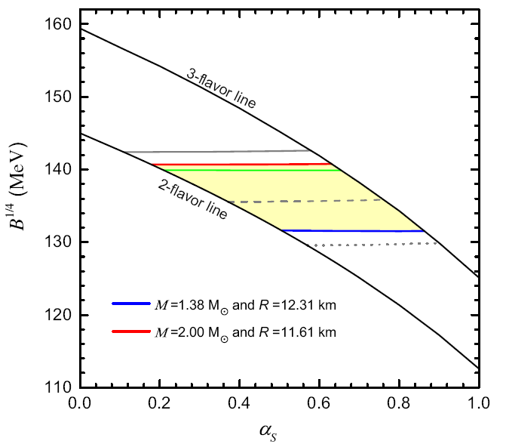
Mass-radius relation of pure strange stars (i.e., without MDM) for
Constraints on and for SQM

Slide 11
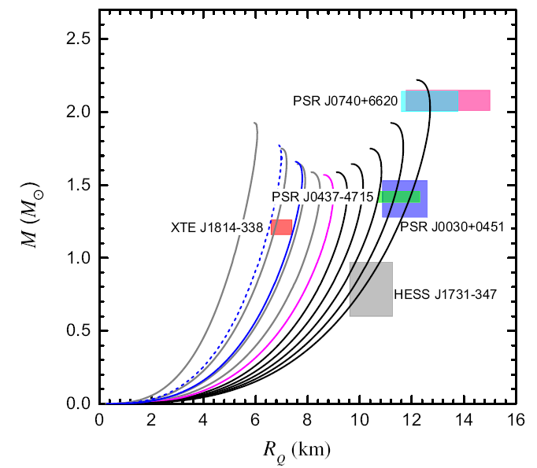
For α_{S}=0.6 and B ^{1/4}=135 MeV，
to explain XTE J1814-338,
the MDM mass fraction falls between 71.8% and 82.2%.

Slide 12
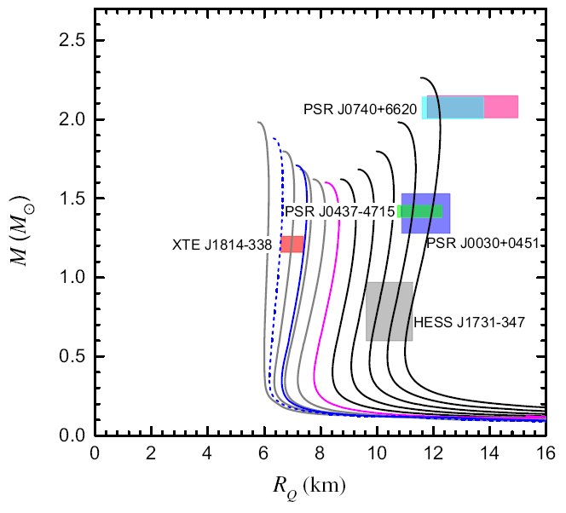
The case of neutron stars:
For KWCZ3 EOS (Kubis et al. PRC 2023), to explain XTE J1814-338, the MDM mass fraction falls between 72.8% and 85.1%.

Slide 13
4. Discussions
For the explanation of the observation of XTE J1814-338, large values of MDM mass fraction (lager than 70%) should be employed, which could not be obtained from normal accretion processes. However, it is reachable through other mechanisms listed in Karkevandi et al. (2022), e.g., it could be realized if a normal SS with a smaller mass mergers with a pure MSS with a larger mass.
In the study of compact stars (NSs, SSs), the degeneracy between the EOS, the gravity theory and dark matter is a great problem. Observations of exotic sources like XTE J1814-338 might help us to break the degeneracy and study the property of dark matter.

Slide 14
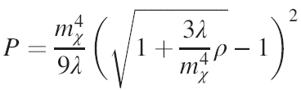

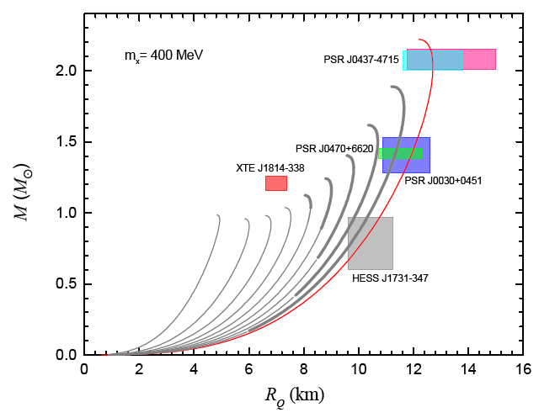
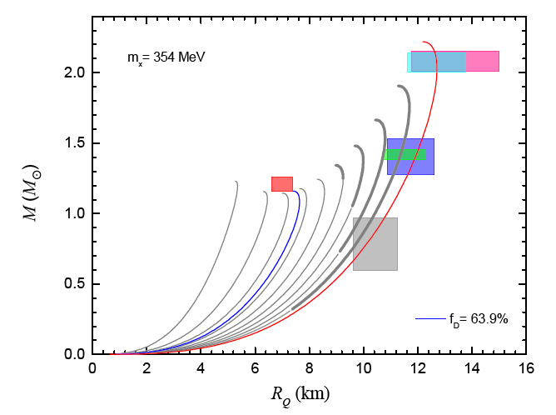
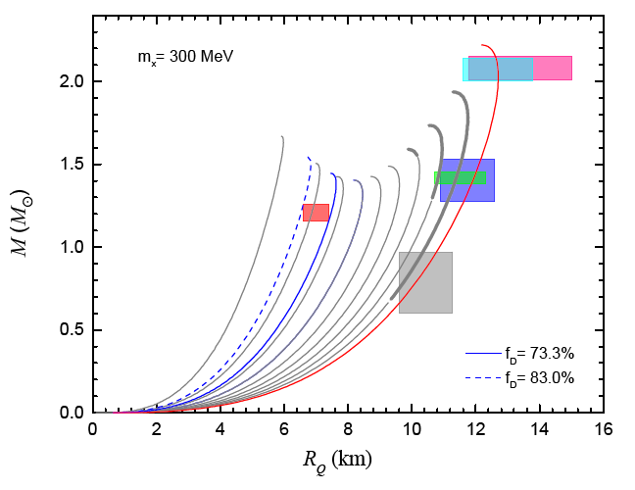
Strange stars admixed with bosonic dark matter
is a dimensionless coupling constant
is the DM particle mass
For λ=π，to explain XTE J1814-338，m_{x} ≤ 354 MeV
Yang et al., in preparation

Slide 15
Thanks！

