Slide 1
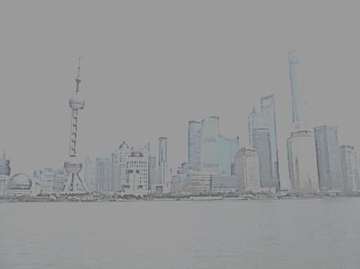
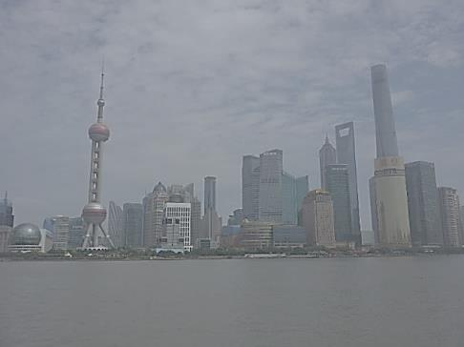
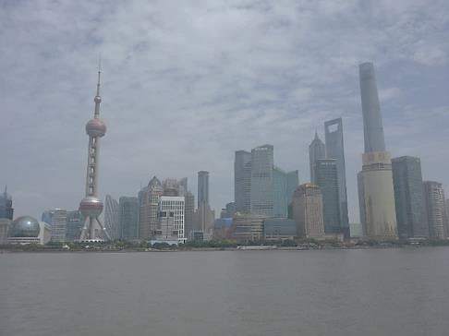
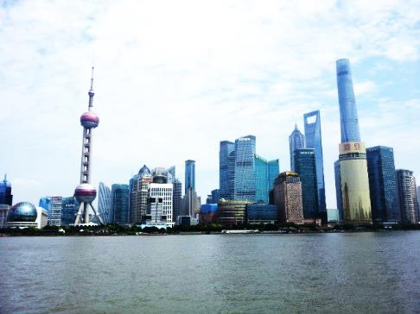
UHECR Astronomy: Disentangling Hot Spots by a new reading key
Abstract:
UHECR events are nearly four hundred.
The Virgo scandal absence and the HOT SPOT bending angle confirm a light nuclei UHECR nature. TA and AUGER composition converged to the same light nuclei result: a Nearby Universe is at hand
D.Fargion, P.Oliva, G.Ucci

Slide 2
UHECR Astronomy: a gamble pocker game
Composition-B_map- GZK-Cosmic Mass_Map
1) Because UHECR are charged particles (and because there are NOT magnetic monopoles)
…the large scale magnetic fields are making a distorted (coherently
or random) bending maps in a smeared sky
2) The bending depends on energy and on the composition and for the latter
3) Different GZK cut off and distances and spectra energy
4a) Fe: too much bending→ No UHECR ASTRONOMY
4b) p: a sharp map, GZK WIDE: Yes Astronomy, 40-80 Mpc
4c) He, Be, B, Light Nuclei; bent+ SMEARED +LOCAL : 4-6 Mpc
4d) Bending by source is usually = Filament chains as multiplets

Slide 3
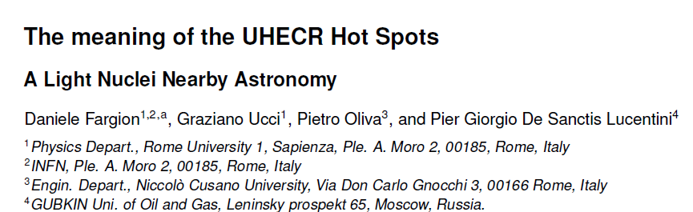
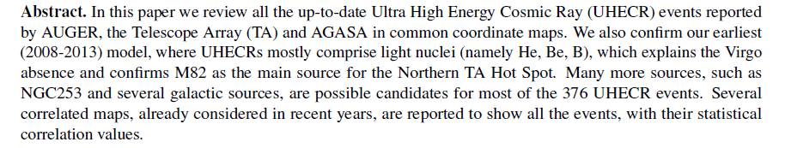
arXiv:1412.1573
EPJ Web Conf. 99 (2015) 08002

Slide 4
UHECR: WHY LIGHT NUCLEI?
Infrared Galaxy maps, GALACTIC coordinate, versus first data
The SCANDAL of VIRGO ABSENCE (AUGER-Science 2007)

Slide 5
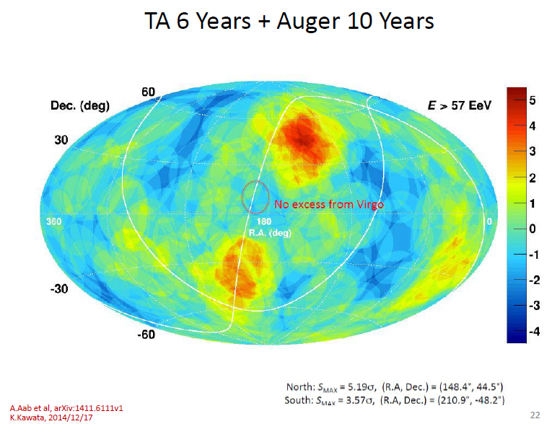
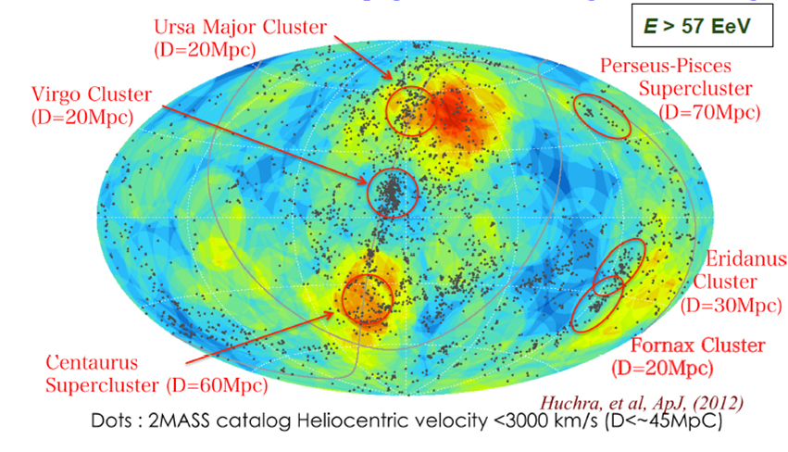
North and South at 50 EeV
The very PERSISTENT SCANDAL (celestial coordinates) of VIRGO ABSENCE
ATTENTION: MOLWEIDE versus HADER—Celestial HADER here-GALACTIC LATER

Slide 6
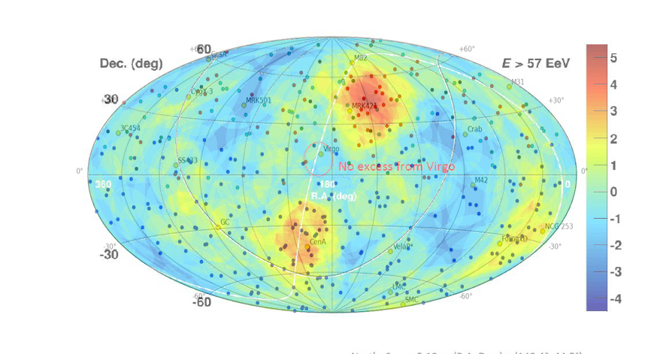
North and South at 50 EeV
The PERSISTENT SCANDAL (celestial coordinates) of VIRGO ABSENCE
ATTENTION: MOLWEIDE versus HADER—Celestial HADER here-GALACTIC LATER

Slide 7
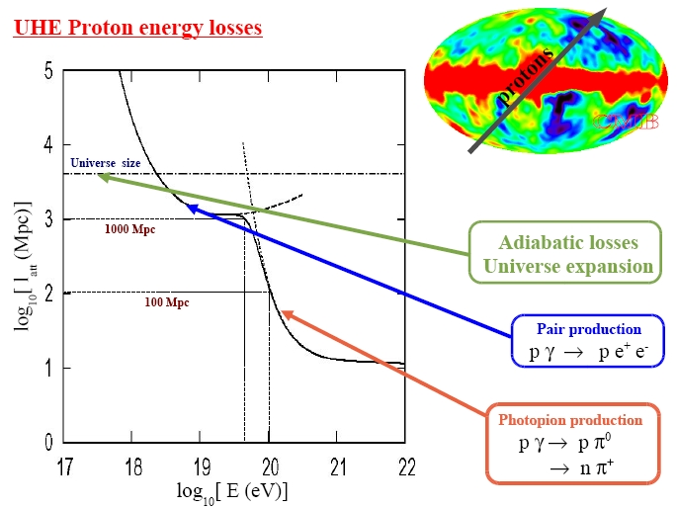
UHECR because of GZK cut off must be in a near (40 Mpc).. Universe..(4 Gpc)

Slide 8
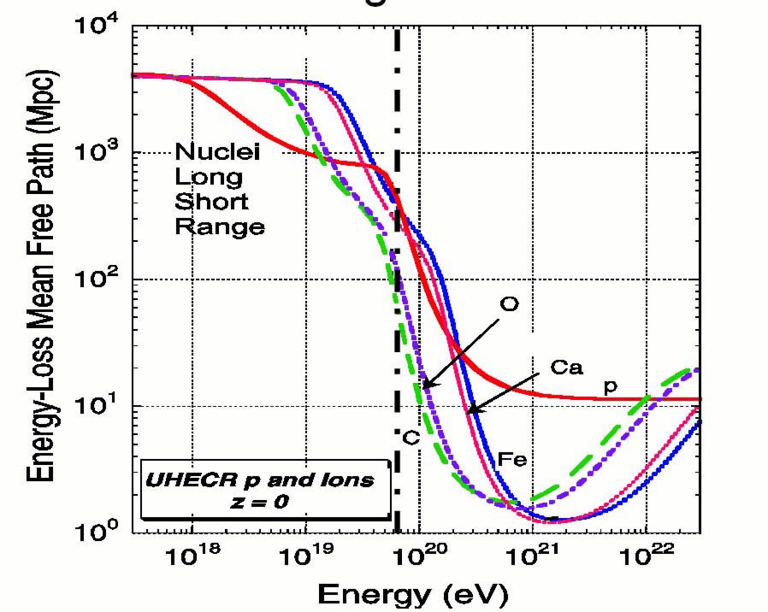
Iron UHECR are much bent (90 degree) hiding any UHECR Astronomy,
Light Nuclei suffer of a more severe GZK cut off (4-10 Mpc) but minor smearing deflections

Slide 9
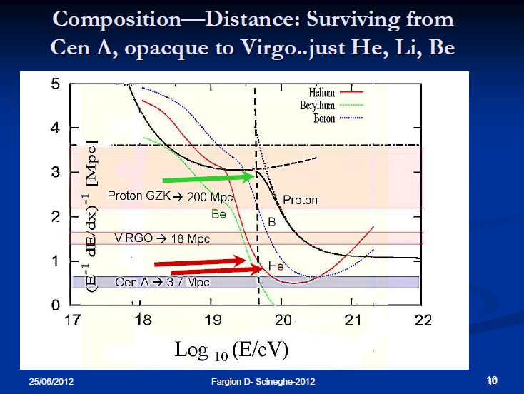
The lightest nuclei: the best filter to mask Virgo

Slide 10
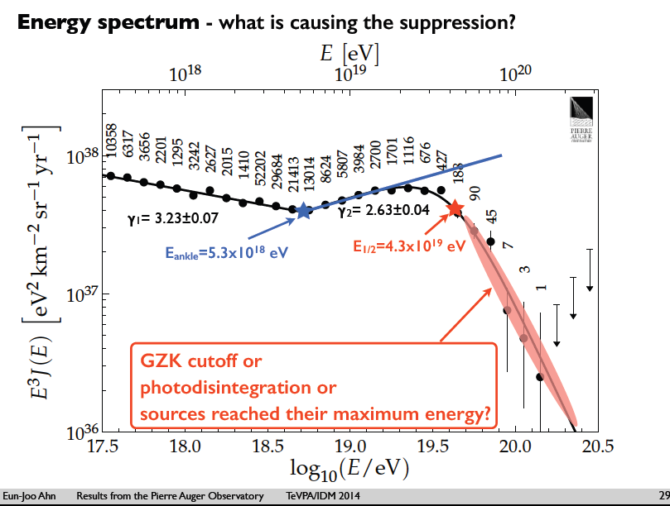

Slide 11
COMPOSITION PUZZLE : the history
For a decade AUGER claimed: Fe+p composition (2004-2014)
TA claimed only proton UHECR (2005-2015)
This year last AUGER declaration: UHECR are
We suggested since 2008:
He (lightest nuclei) and
(light nuclei Be,B,Li..C)

Slide 12
Our old claim: Lightest Nuclei, Virgo, the Cen A smearing
Light Nuclei solving Auger puzzles. The Cen-A imprint (2008) Physica Scripta..up to..
EPJ Web Conf. 99 (2015) 08002
UHECR by lightest nuclei in Nearby Universe and its parasite neutrino trace (2011)
Lightest Nuclei in UHECR versus Tau Neutrino Astronomy (2009)

Slide 13
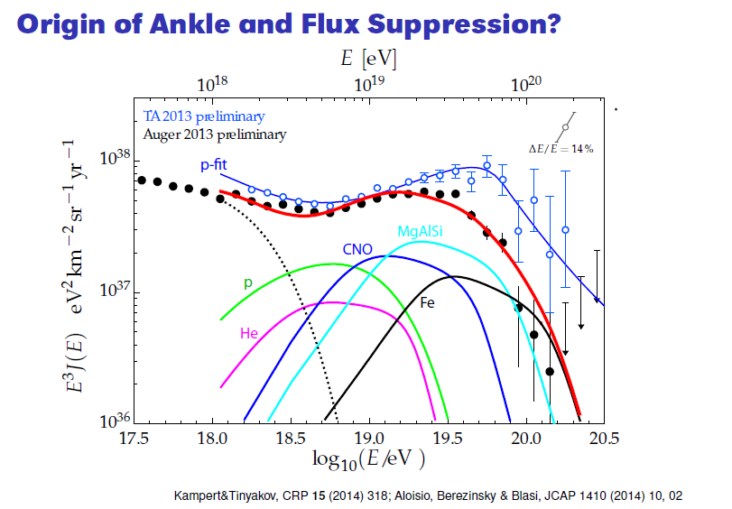

Slide 14
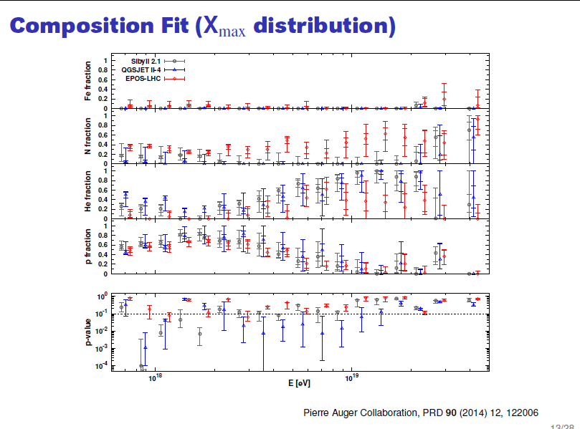
Last AUGER Composition: LIGHT+ LIGHTEST

Slide 15
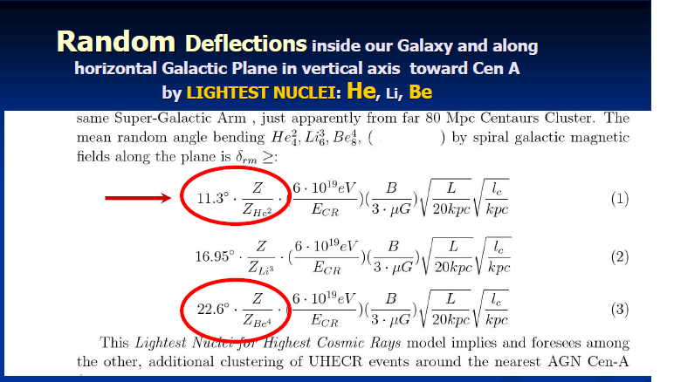
We wanted Light Nuclei also by their consequent UHECR Bending By Random or Coherent B

Slide 16
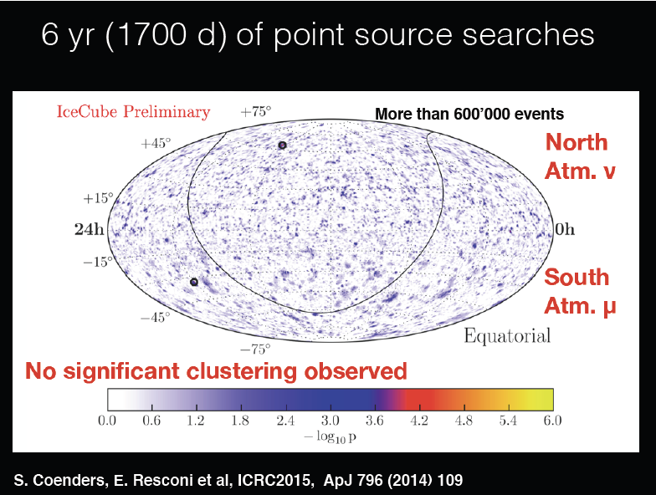
Last icecube

Slide 17
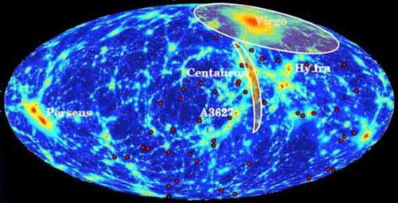
Past 2008-2009 foreseen maps (observed on 2011)
Cen A and Virgo Absence
Coherent and random UHECR Spectroscopy of Lightest Nuclei along CenA: …
- Fargion, D.Nucl.Instrum.Meth. A630 (2011) 111-114 arXiv:0908.2650

Slide 18
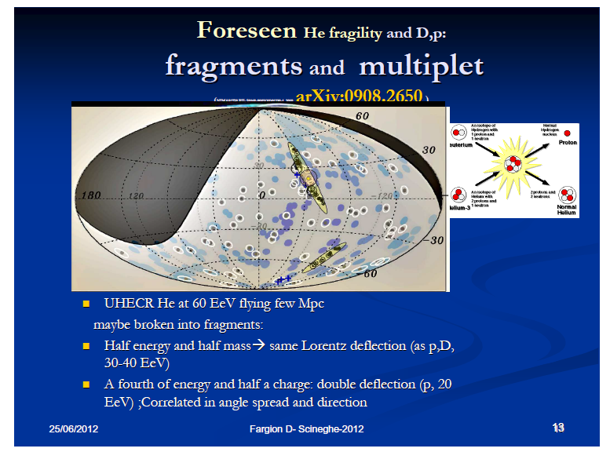

Slide 19
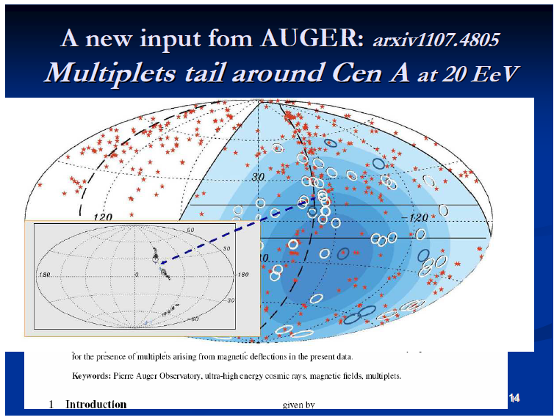

Slide 20
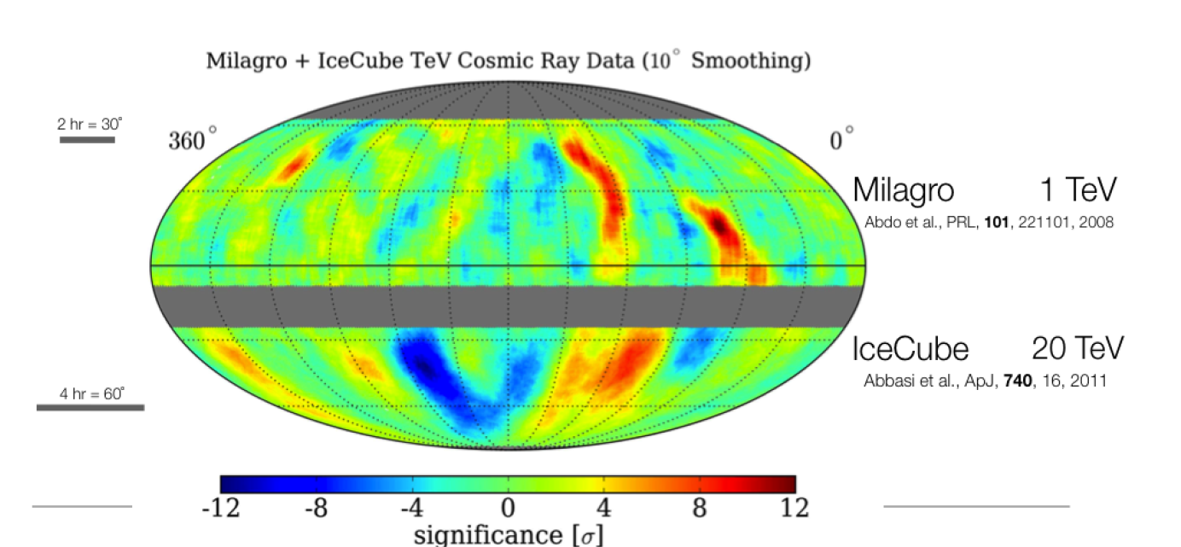
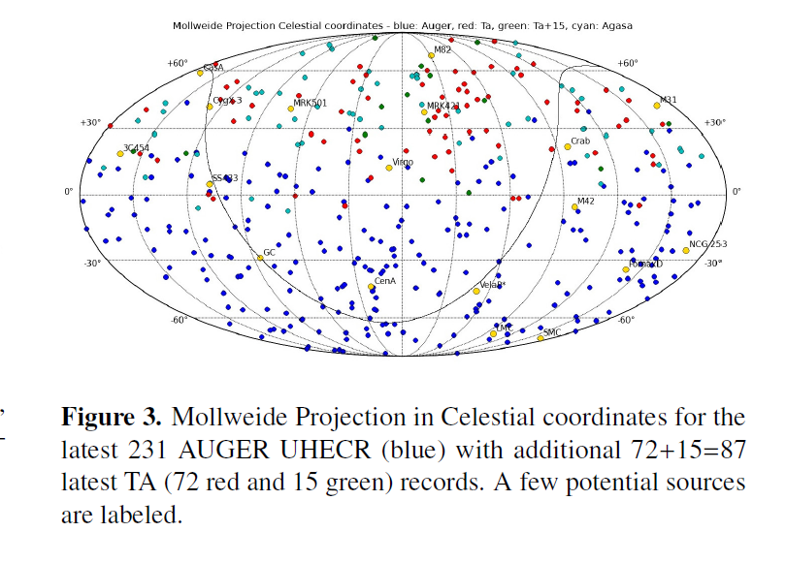
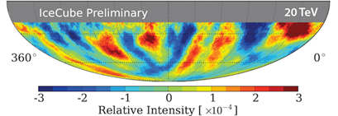
Milagro_ICECUBE

Slide 21
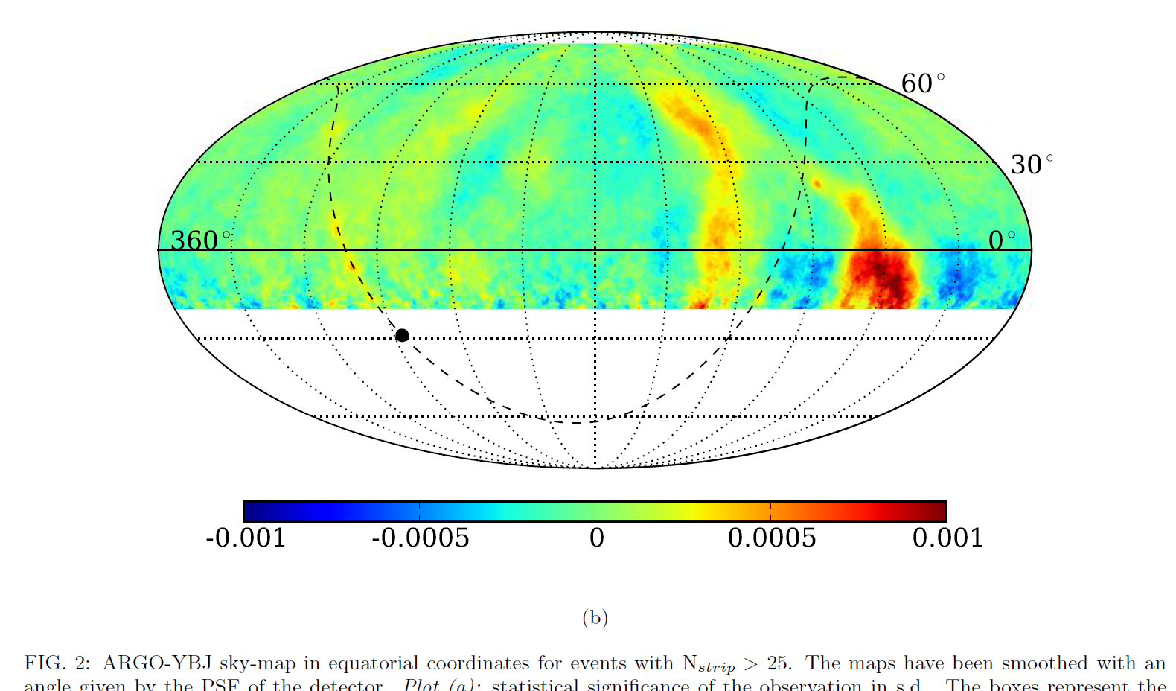
ARGO E ICECUBE over TA and AUGER

Slide 22
Last icecube neutrino

Slide 23
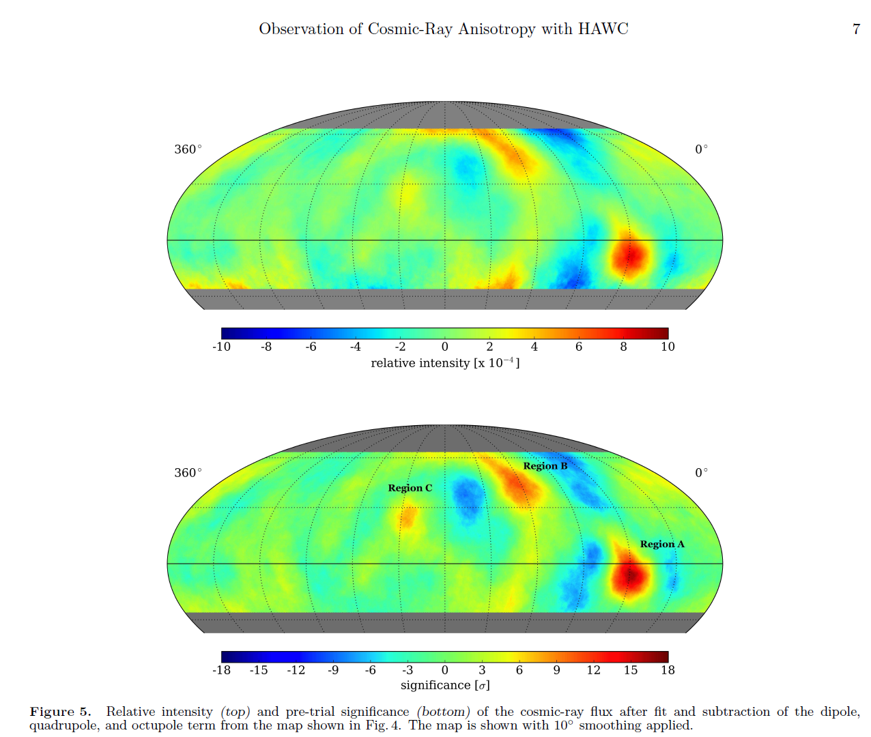
Hawc anisotropy 2 : Virgo A,B, and C?

Slide 24
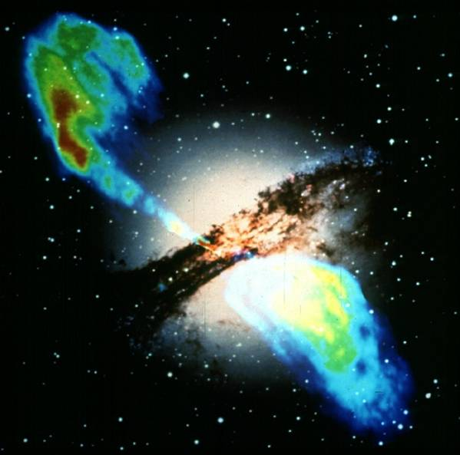
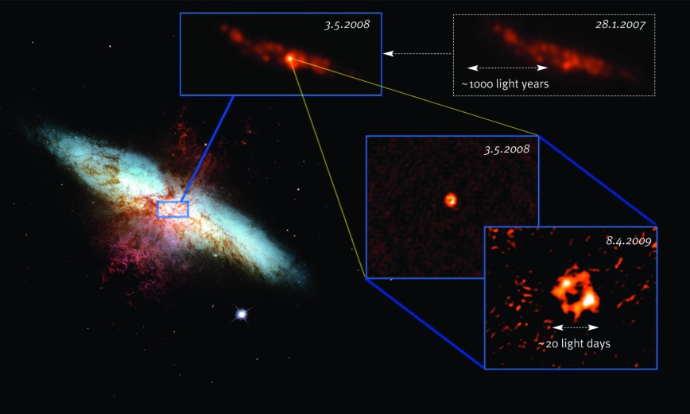

UHECR ASTRONOMY: The Source names: Jets
AGN and NS (BH )
Cen A
M82
Vela?
Crab?
SS433 ?
NGC 253
D.Galaxy Fornax

Slide 25
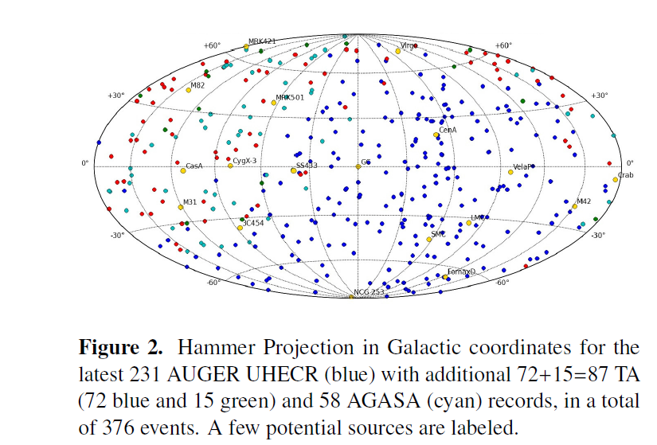
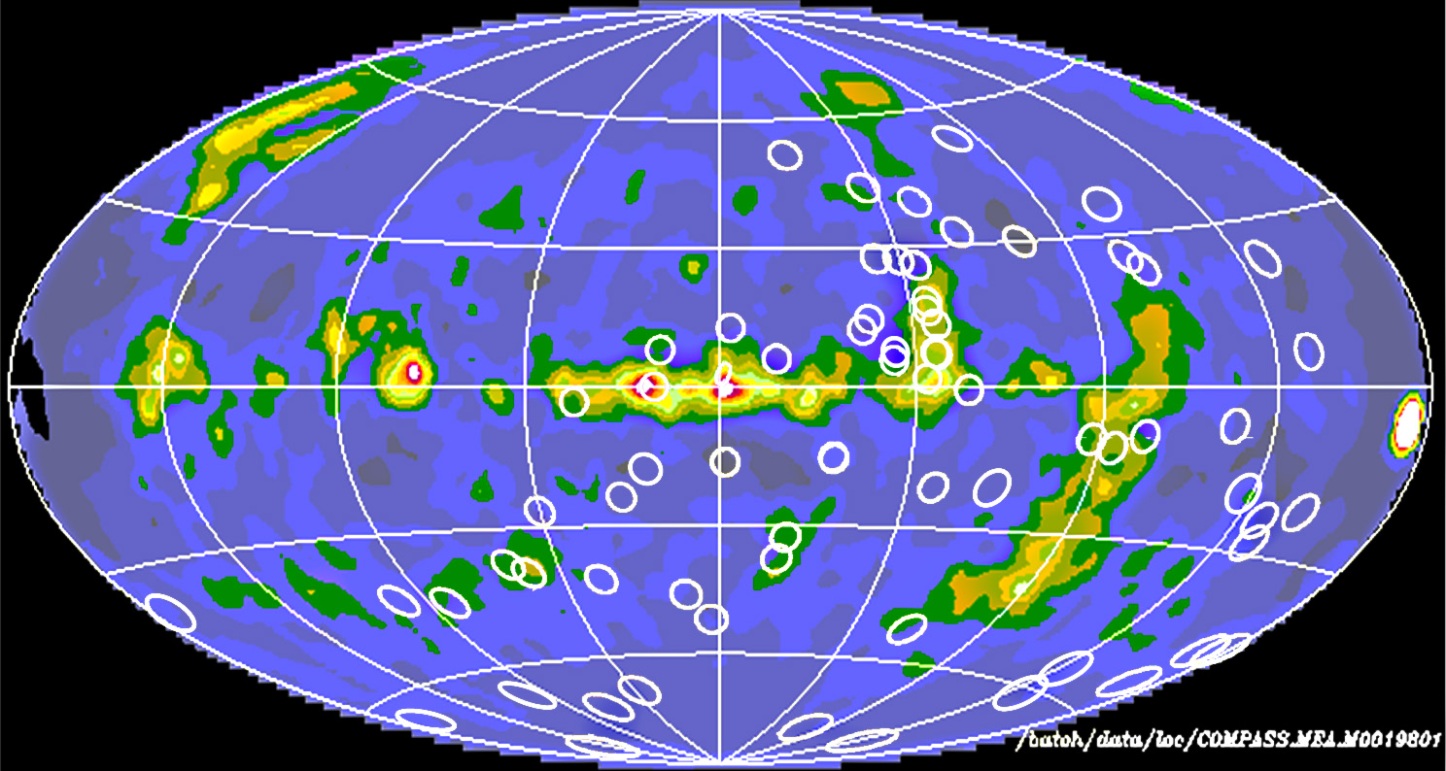
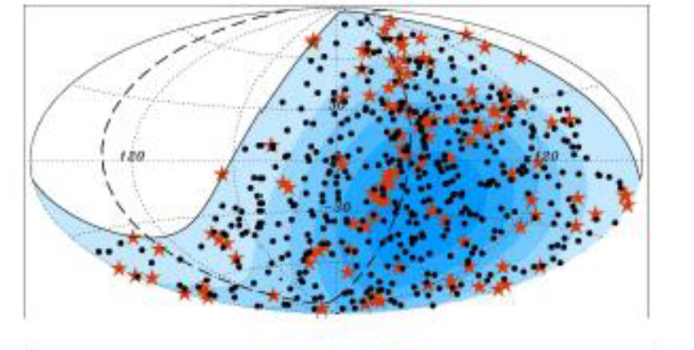
Gamma COMPTON:OSSE halo

Slide 26
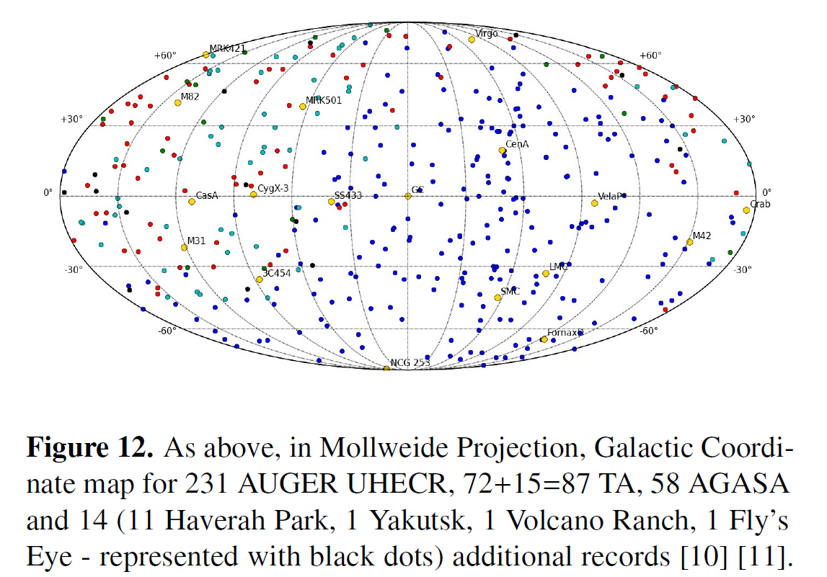
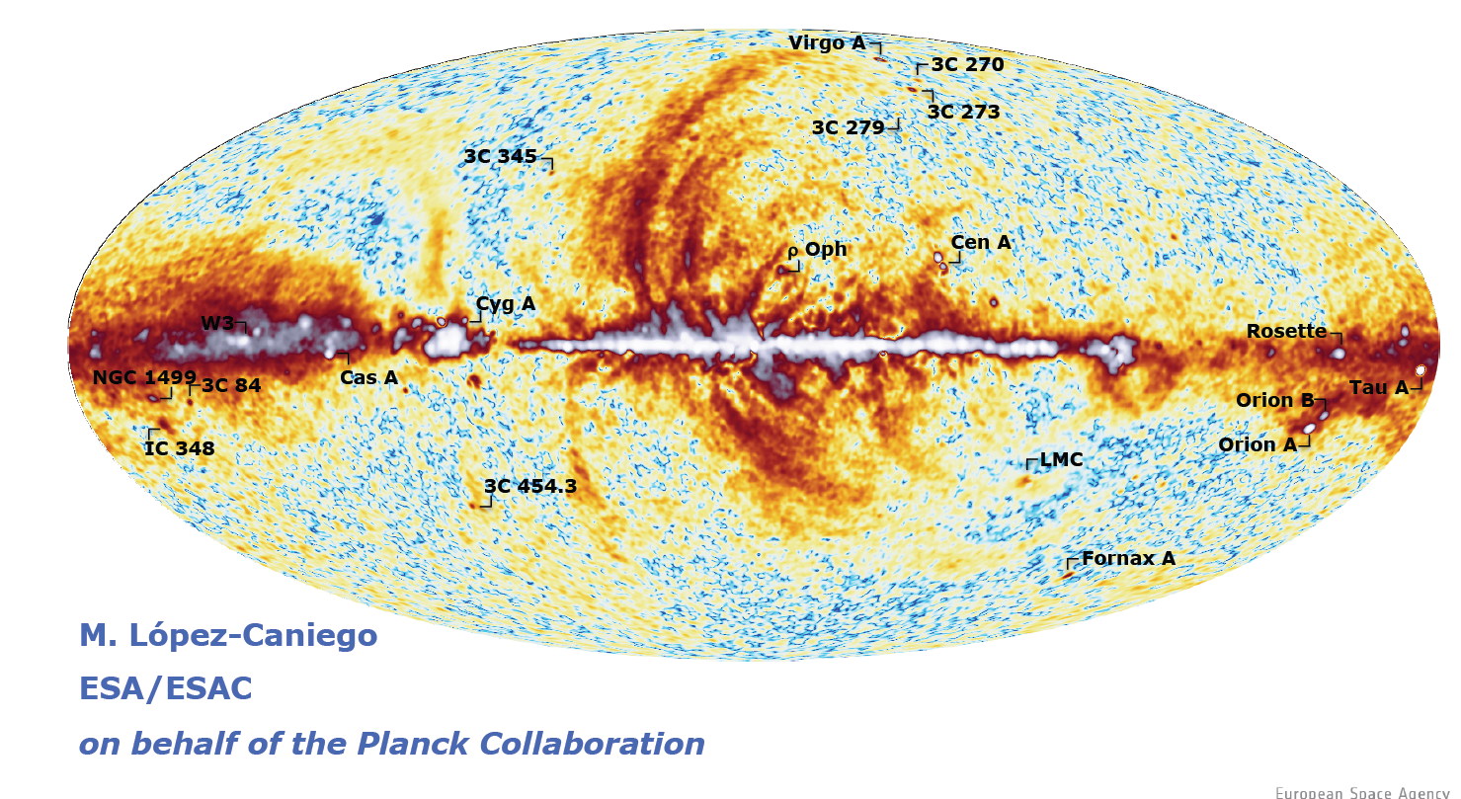
AUGER over Planck IR Galactic Map: The GC role

Slide 27
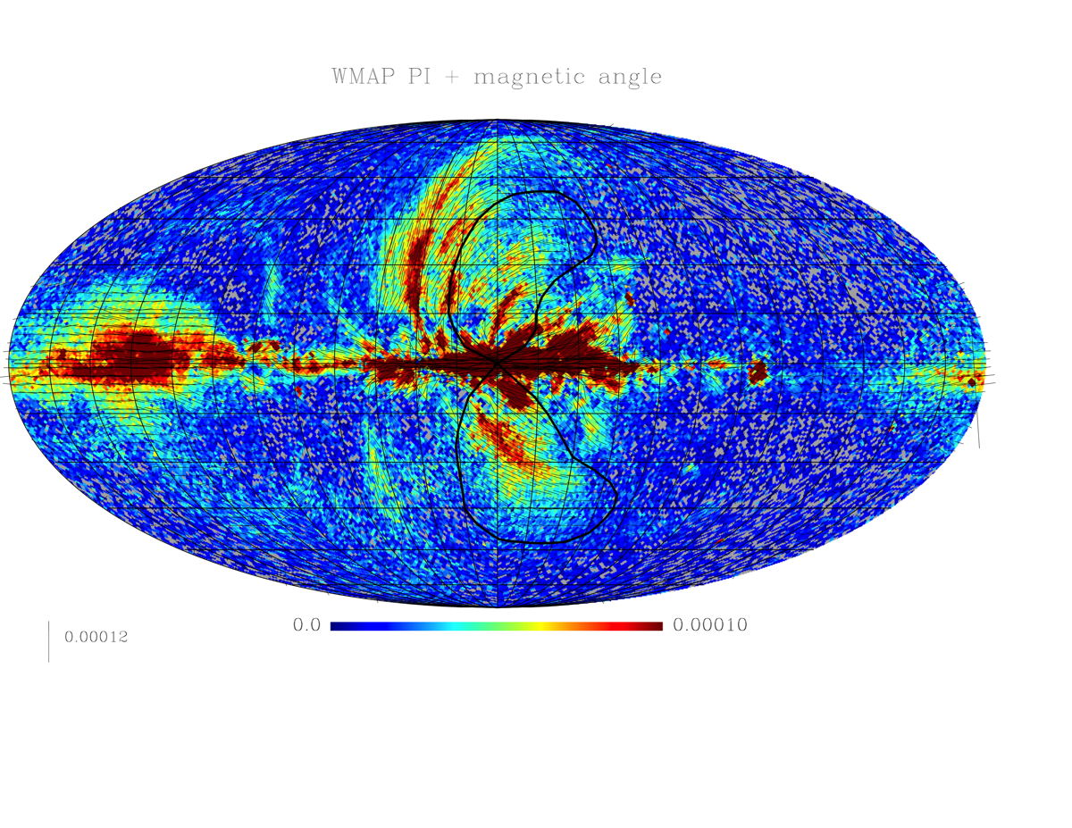
Galactic spur

Slide 28
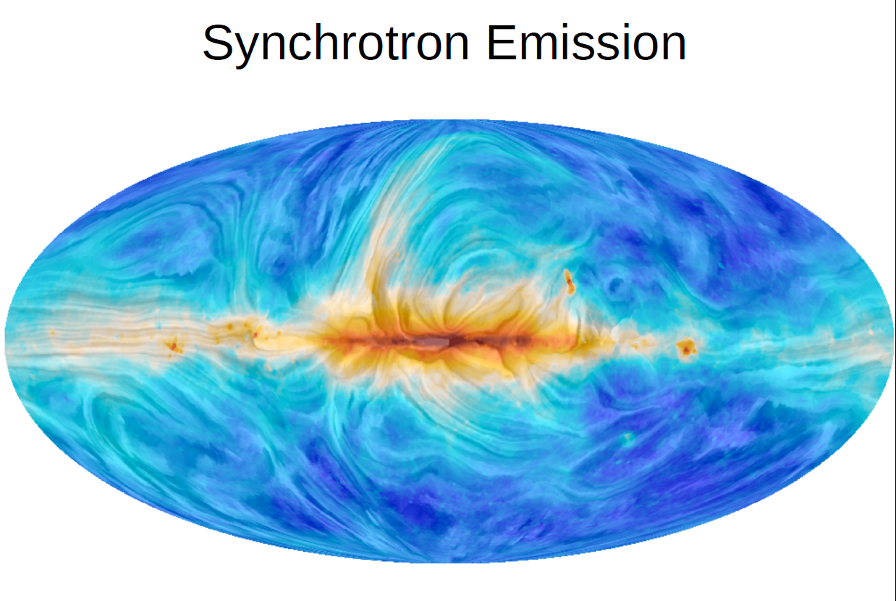
Planck

Slide 29
Light nuclei solving the AUGER puzzles: the Cen-A imprint--2008
D Fargion
Published 30 September 2008 • Physica Scripta,Volume 78, Number 4
Ultra-high-energy cosmic rays' (UHECR) maps at 60 EeV have been found recently by the AUGER group to be spreading anisotropy signatures in the sky. The results have been interpreted as a manifestation of AGN sources ejecting protons at GZK (Greisen–Zatsepin–Kuzmin) edges, around or below 80 Mpc distances, mostly from Supergalactic (SG) plane. The result is surprising due to the lack of correlation with the much nearer Virgo cluster. Moreover, early GZK cutoff in the spectra may be better reconciled with light nuclei (than with protons). In addition, a large group (of nearly a dozen) of events cluster suspiciously along Cen-A. Finally, proton UHECR composition nature is in sharp disagreement with the earlier AUGER claim of a heavy nuclei dominance at 40 EeV, within 13 extreme events (ln A=2.6±0.6). Therefore, we interpret here the signals as mostly UHECR light nuclei (He, Be, B, C and O) ejected from nearest Cen-A, UHECR smeared by galactic magnetic fields, whose random vertical bending is overlapping with SG arm. The (possible) AUGER misunderstanding took place because of a rare coincidence between the SG plane (arm) and the smeared (randomized) signals from Cen-A, bent orthogonally to the galactic fields. Our derivation verifies consistency of the random smearing angles for He, Be, B, C and O range, respectively, 2.7°–11° in reasonable agreement with the AUGER main group event around Cen-A. Only a few other rare events are spread elsewhere. The more collimated from Cen-A, the lighter (lnA_{He}≤2). The more spread, the heavier (lnA≥2). Consequently, Cen-A is probably one of the best candidate UHE neutrinos at ..PeVs. This solution may be tested soon by future (and may even have already been recorded) clustering around the Cen-A barycenter, events smeared by vertical galactic magnetic forces on the lightest nuclei.

Slide 30
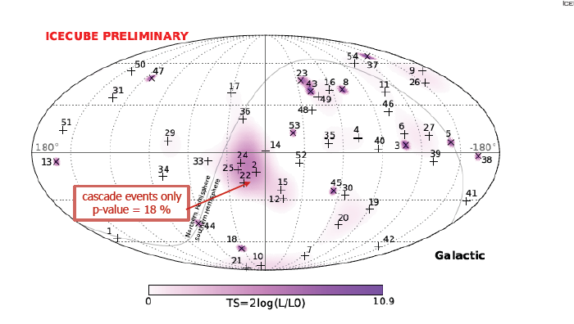
neutrino

Slide 31
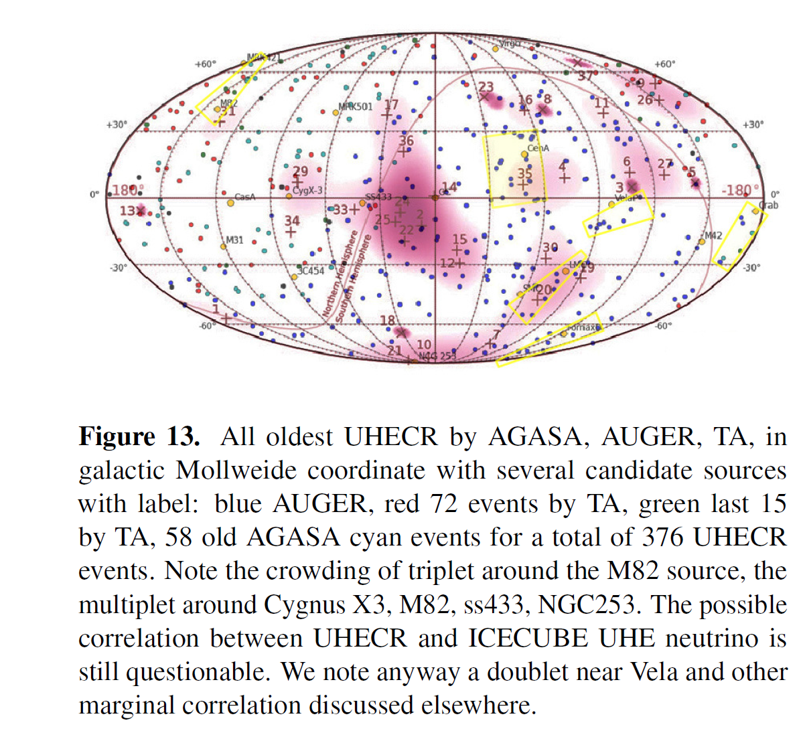
UHECR versus UHE neutrino

Slide 32
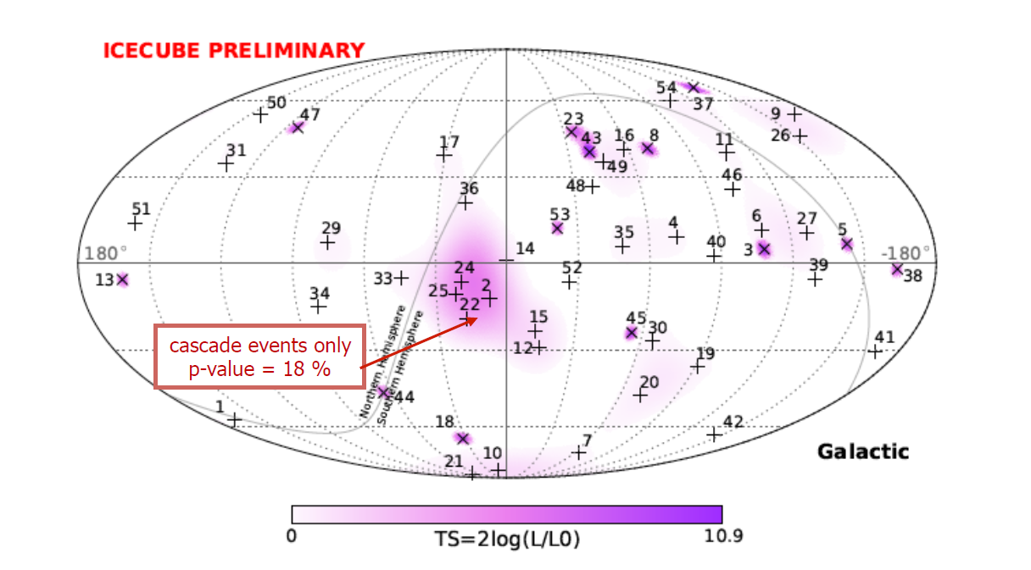
Overlapping Highest and
Lower UHECR in Galactic Coordinate versus newest 54 ICECUBE Highest Energy Neutrino

Slide 33
Summary
We overlap nearly 400 UHECR and their arrival events on different maps as TeVs gamma anisotropies and known sources, finding some first key connections with nearby
AGN Cen A, M82, NGC 253, and Fornax Dwarf galaxy.
Their bending confirm a light nuclei UHECR as most recent AUGER simulations on UHECR compositions.
We report also first hint or evidence by Vela, SS433 , Crab, Cygnus galactic and LMC and SMC UHECR
We also found a possible coherent bending of diluted UHECR events from Virgo.
UHECR are mostly in Local Universe
(4 Mpc) and in our own Galaxy, possibly radioactive and decaying in flight ;
The secondaries or fragments (alfa, gamma , neutrons and neutrinos) might feed TeVs-PeVs anisotropies maps

Slide 34
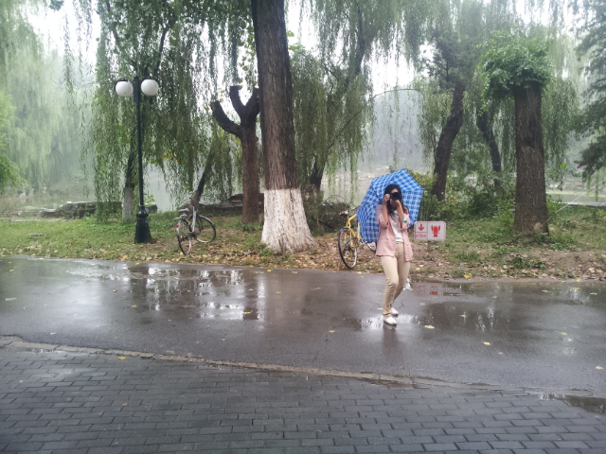

Thank you for your kind, sharp photographic attention

Slide 35
The End

Slide 36
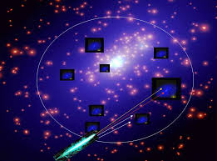
Eventual Homogeneity and isotropy of UHECR and the UHE ZeV neutrino scattering on 0.4 eV relic neutrino showering Z resonance

