Slide 1
High Energy cosmic-Radiation Detection (HERD) Facility onboard
China’s Space Station
Shuang-Nan Zhang (张双南)
zhangsn@ihep.ac.cn
Center for Particle Astrophysics
粒子天体物理中心
Institute of High Energy Physics
Chinese Academy of Sciences

Slide 2
Astroparticle Physics & Particle Astrophysics
Physics
Astronomy
Particle Physics
Astrophysics
Astroparticle Physics
Particle Astrophysics
Tool: Universe
Tool: Particle Physics
Goal: Particle Physics
Goal: Universe
The Physical Universe and Its Laws

Slide 3
Tibet High Altitude
Cosmic-ray Observatory
YBJ－ASγ, ARGO
LHAASO
Sea Level and
Underground Exp.
CMS, Daya-Bay
Dark Matter Search
Space Projects
AMS, CE, HXMT
POLAR, DAMPE, SVOM
SEMS, XTP, HERD
IHEP Center
for Particle
Astrophysics
150 students, postdocs and visiting scholars
180 fulltime staff scientists and engineers
High Energy Cosmic-ray
Charged Particles,
Neutrinos, Gamma-rays
Gravity & Cosmology
Compact Objects
Galaxy, Cluster
CMB
Explosive Phenomena
GRB,SN&SNR
BH&NS accretion
Notes:
3

Slide 4
HERD: High Energy cosmic-Radiation Detector
Science goals | Mission requirements
Dark matter search | R1: Better statistical measurements of e/γ between 100 GeV to 10 TeV
Origin of Galactic Cosmic rays | R2: Better spectral and composition measurements of CRs between 300 GeV to PeV* with a large geometrical factor
Secondary science: γ-ray astronomy → monitoring of GRBs, microquasars, Blazars and other transients → down to 100 MeV for γ -rays → plastic scintillator shields for γ -ray selection
*complementary to high altitude cosmic-ray observations
Notes:
4

Slide 5
HERD Cosmic Ray Capability Requirement
P (<A> ~ 1)
He (<A> ~ 4)
L (<A> ~ 8)
M (<A> ~ 14)
H (<A> ~ 25)
VH (<A> ~ 35)
Fe (<A> ~ 56)
Model 2
Heavy Model
Model 1
Light model
PeV
PeV
Detection limit: N = 10 events
Except for L, up to PeV spectra feasible with GF~2-3 in ~years: discriminate between models.
PeV
PeV
N(E>E0; 2 yr)
HERD
HERD
TeV
TeV

Slide 6
Characteristics of all components
 | type | size | X0,λ | unit | main functions
tracker (top) | Si strips | 70 cm × 70 cm | 2 X0 | 7 x-y (W foils) | Charge Early shower Tracks
tracker 4 sides | Si strips | 65 cm × 50 cm | 2 X0 | 7 x-y (W foils) | Charge Early shower Tracks
CALO | ~10K LYSO cubes | 63 cm × 63 cm × 63 cm | 55 X0 3 λ | 3 cm × 3 cm × 3 cm | e/γ energy nucleon energy e/p separation

Slide 7
Expected performance of HERD
γ/e energy range (CALO) | tens of GeV-10TeV
nucleon energy range (CALO) | up to PeV
γ/e angular resol. | 0.1º
nucleon charge resol. | 0.1-0.15 c.u
γ/e energy resolution (CALO) | <1%@200GeV
proton energy resolution (CALO) | 20%
e/p separation power (CALO) | <10⁻⁵
electron eff. geometrical factor (CALO) | 3.7 m²sr@600 GeV
proton eff. geometrical factor (CALO) | 2.6 m²sr@400 TeV
Acceptance & H-energy > n10X all others

Slide 8
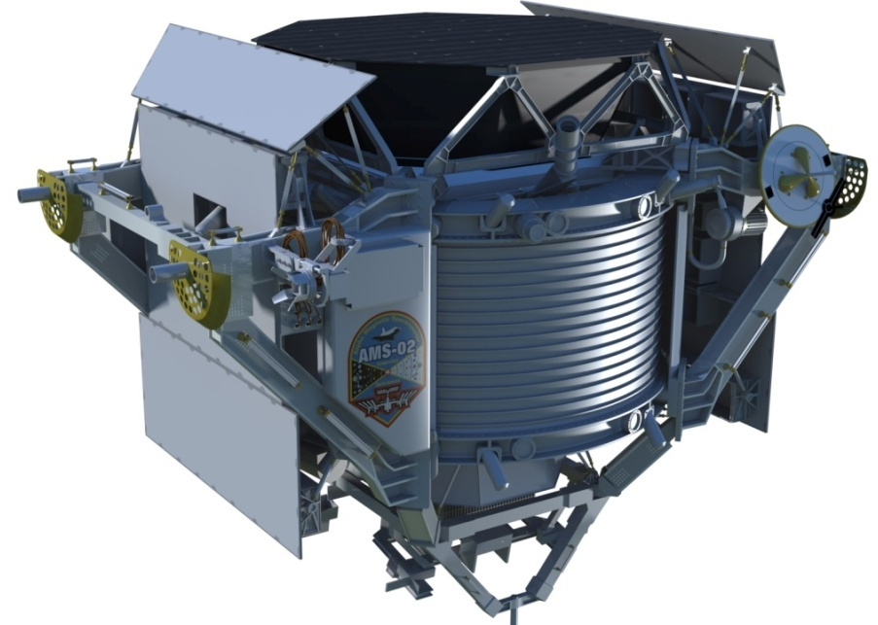
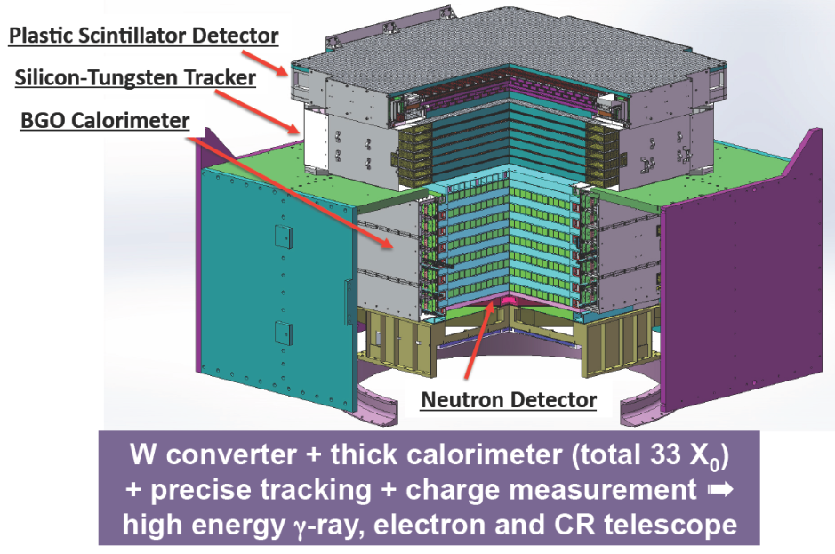
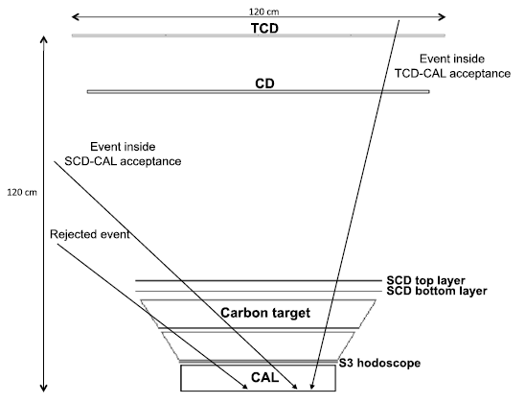
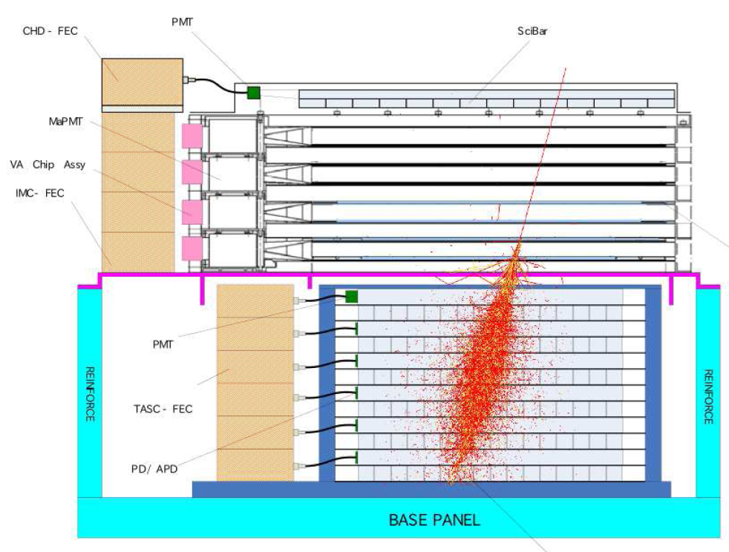
Other detectors: Top down → “small” FoV
DAMPE
2015
ISS-AMS: 2011
ISS-CALET: 2015
ISS-CREAM: 2017?

Slide 9
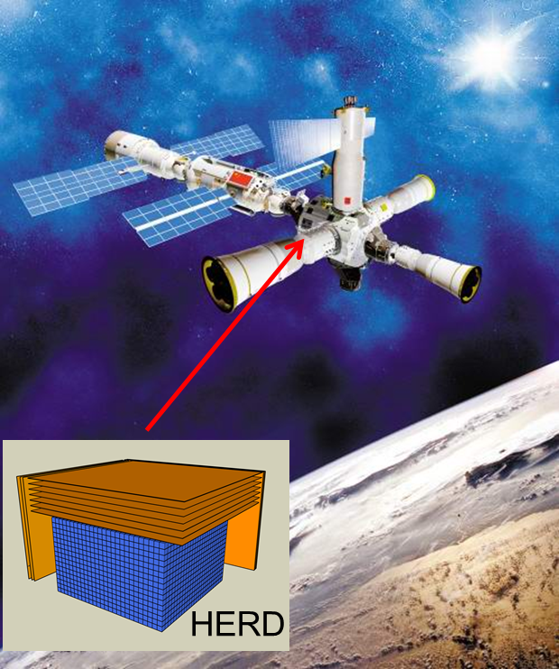
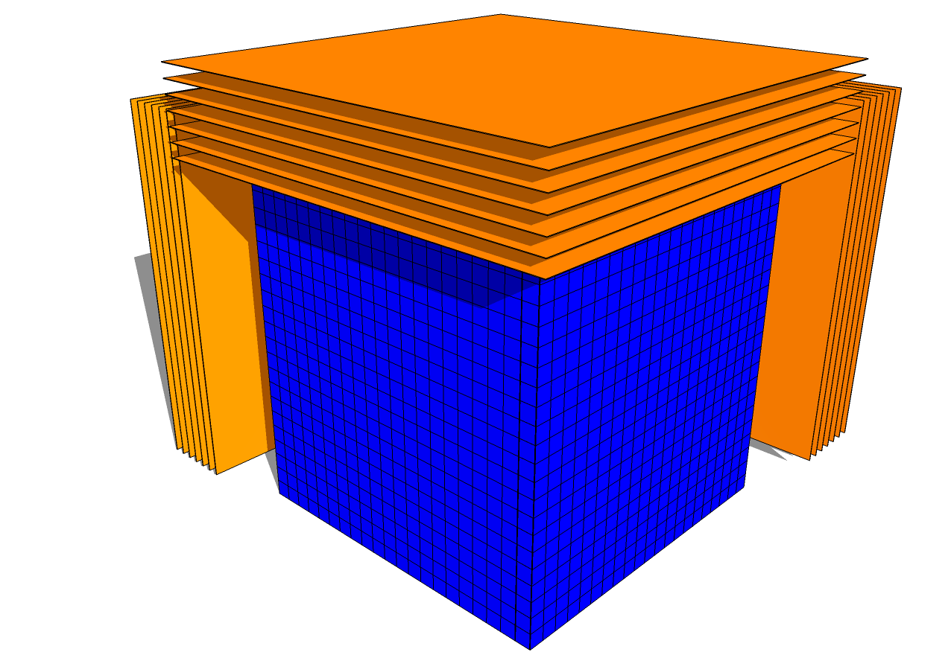
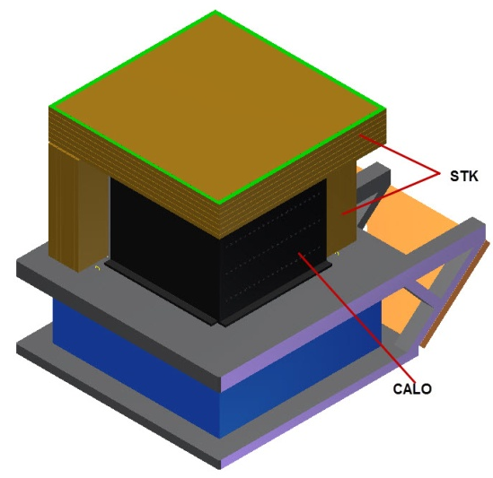
HERD Design：3D Calo & 5-Side Sensitive
n10X acceptance than others, but weight 2.3 T ~1/3 AMS
STK(W+SSD)
Charge
gamma-ray direction
CR back scatter
3D CALO
e/G/CR energy
e/p discrimination
STK(W+SSD)

Slide 10
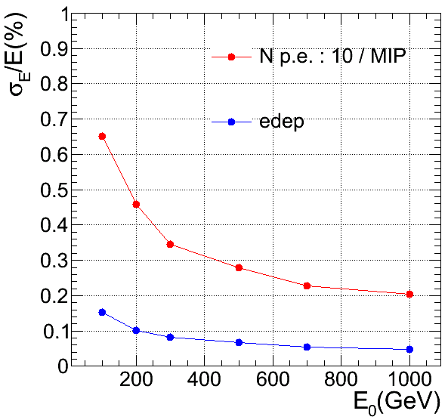
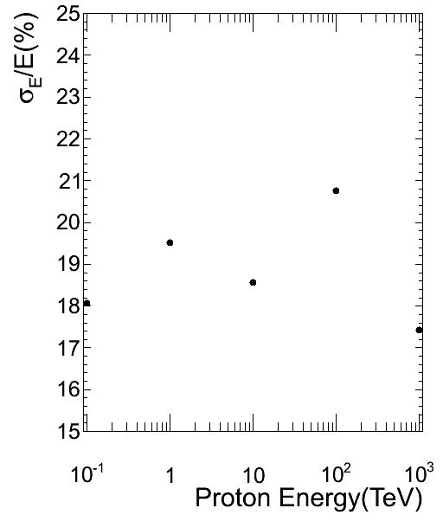
Simulation results: energy resolutions
Protons
Electrons
Electron < 1%; Proton: ~20%
Essential for spectral features!

Slide 11
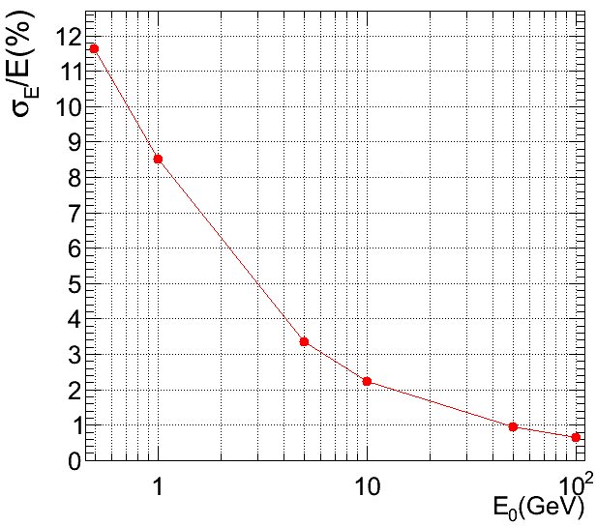
Energy Resolution for gamma-rays
500 MeV-100 GeV result
Notes:
相应的，对能量探测做了低能区的扩展
在1GeV时，光子探测的能量分辨率为8.5%,10GeV时为2%（均考虑了光子数10 p.e/MIP涨落的影响）
右上角的小图为100GeV以上的能量分辨率
如果我们的目标是1GeV以上的伽玛射线，那么2X0的TK可以保证80%的电子对转换效率以及2%@10GeV的能量分辨率
而如果我们侧重于几十MeV-几百MeV的测量，那么需要在TK的设计上和量能器的前几层做一些优化，例如减少TK转换体钨板的厚度，量能器前几层采用PMT/APD等器件提高光电子数，增加能量测量精度

Slide 12
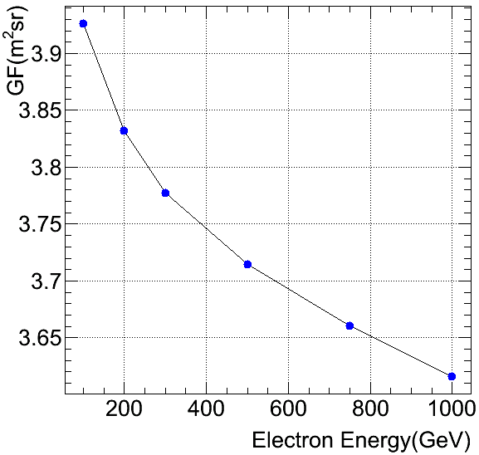
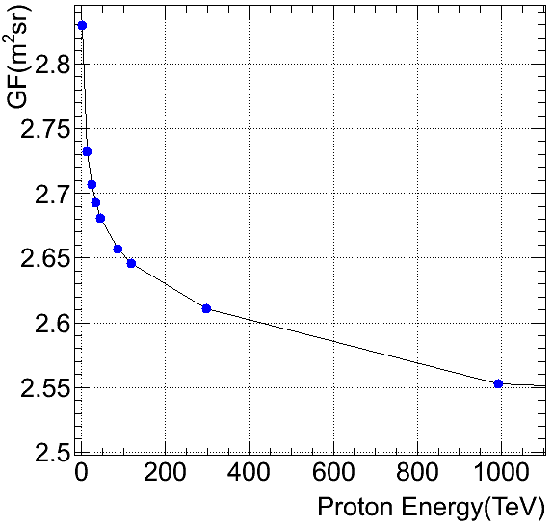
HERD Eff. Geometrical Factor: CALO
All five sides
All five sides

Slide 13
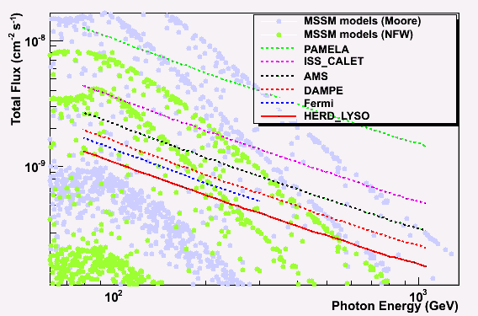
HERD sensitivity to gamma-ray line
HERD 1 yr
PAMELA: 2006-2016 CALET: 2015-2020; AMS: 2011-2021; DAMPE: 2015-2020; Fermi: 2008-2018; HERD: 2020-2021

Slide 14
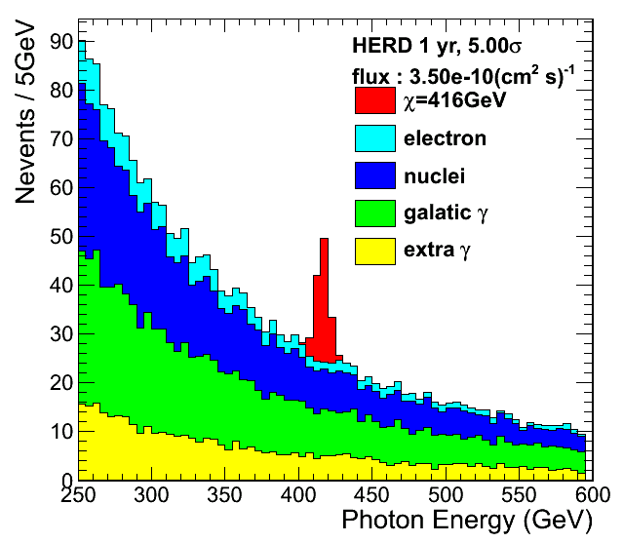
DM annihilation line of HERD

Slide 15
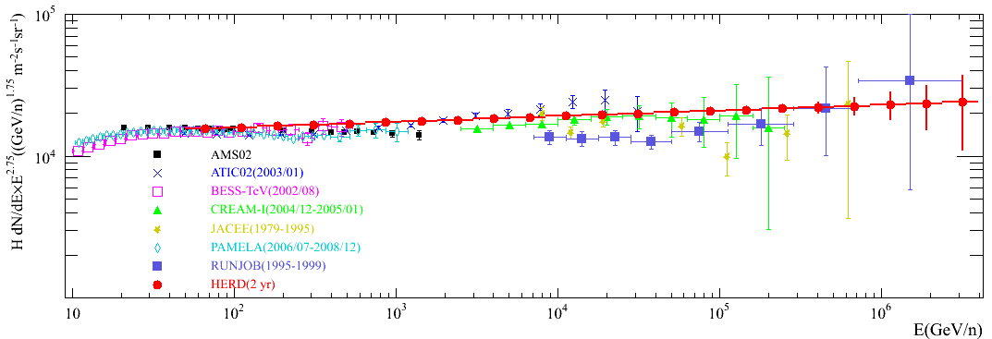
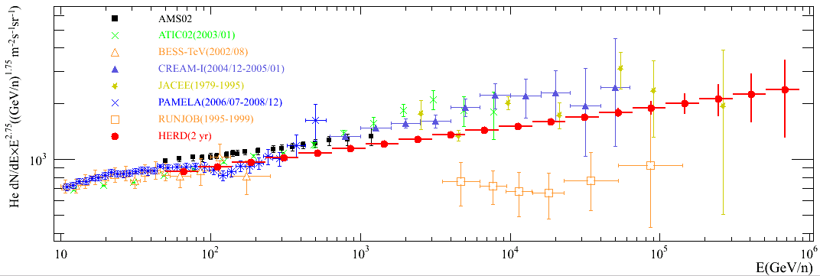
Expected HERD Proton and He Spectra
Horandel model as HERD input
Only statistical error
Protons
He
Notes:
新添加了AMS02的质子和氦核测量数据，AMS02公布的能谱最后一个点都在1TeV附近
对AMS的结果，选取了从几十GeV开始到其公布的上限，每个谱选了均匀挑选了15个数据点，放在图中一并比较

Slide 16
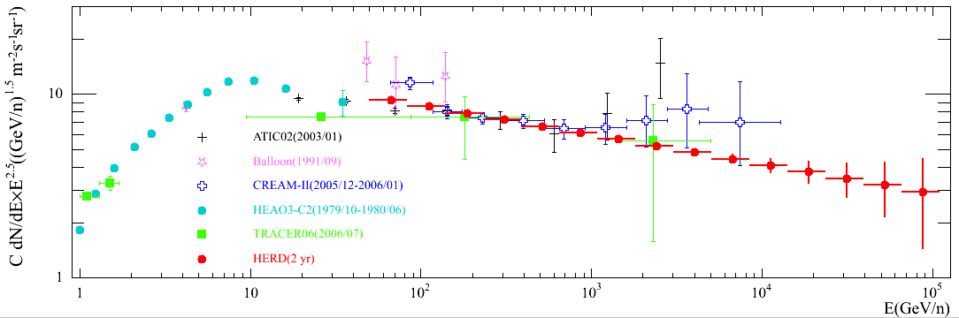
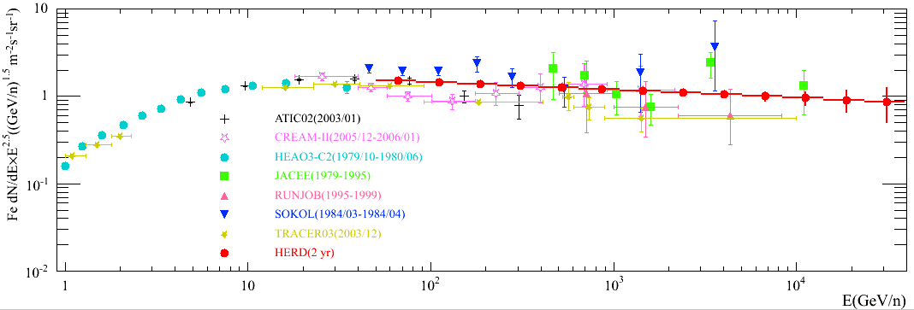
Expected HERD Spectra of C and Fe
C
Fe

Slide 17
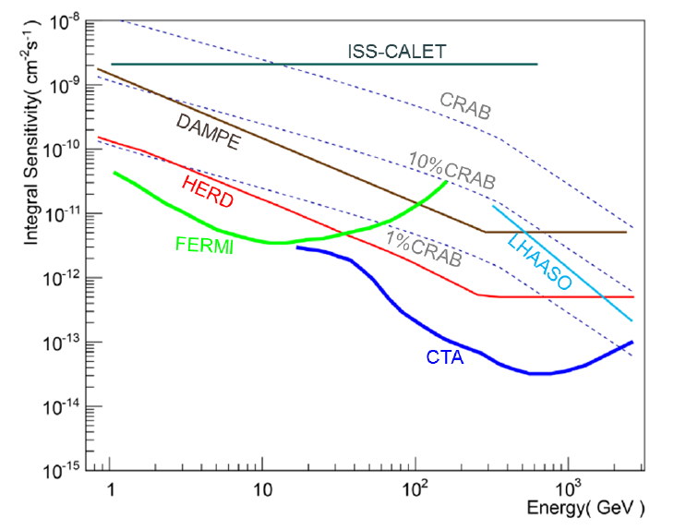
Gamma-ray Sky Survey Sensitivity
Narrow FoV

Slide 18
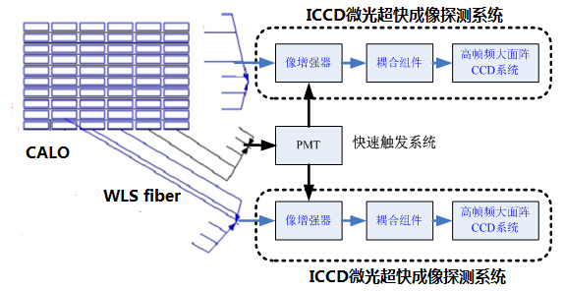
CALO readout
Trigger
Image Intensifier
Optical Coupling
Fast Frame
CCD

Slide 19
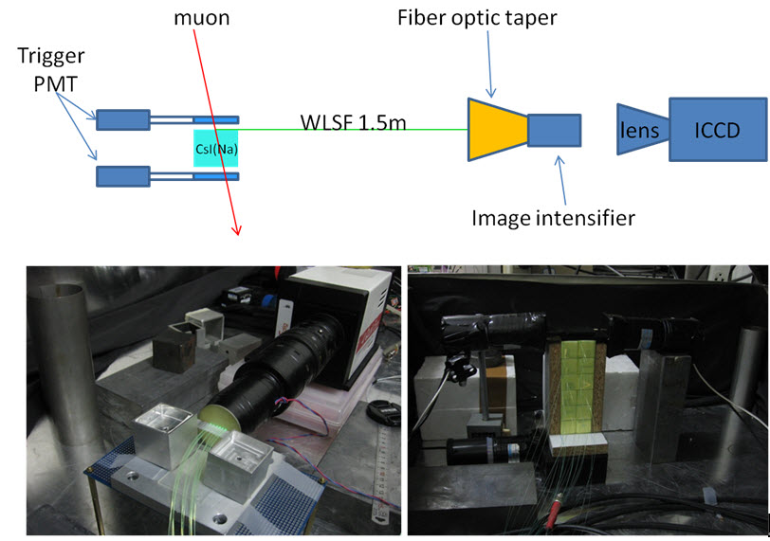
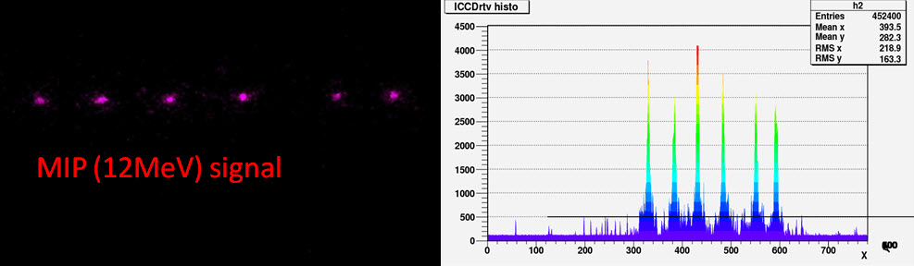
Proof of principle
2×2×6 CsI crystal array
ICCD image of cosmic ray events

Slide 20
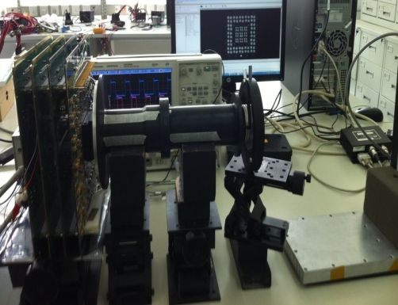
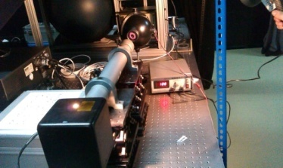
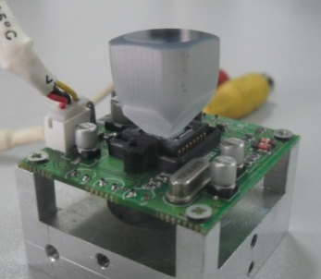
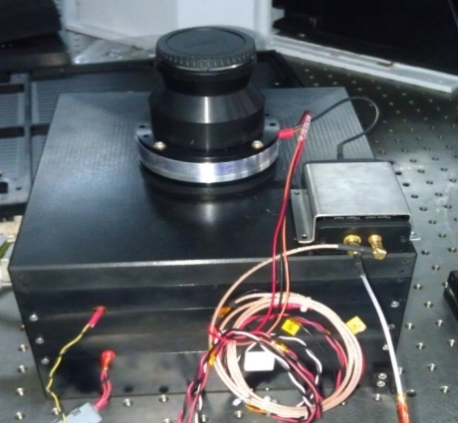
HERD progress – ICCD development

Slide 21
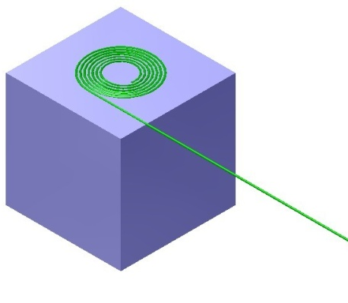
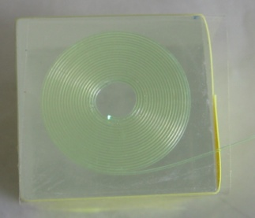
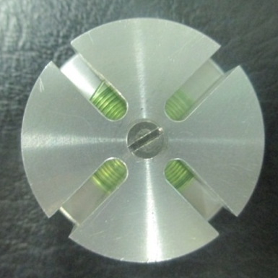
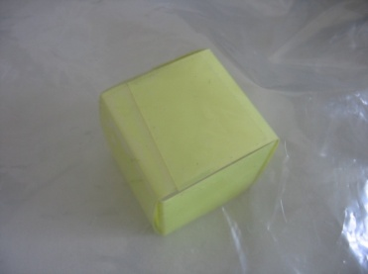
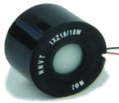
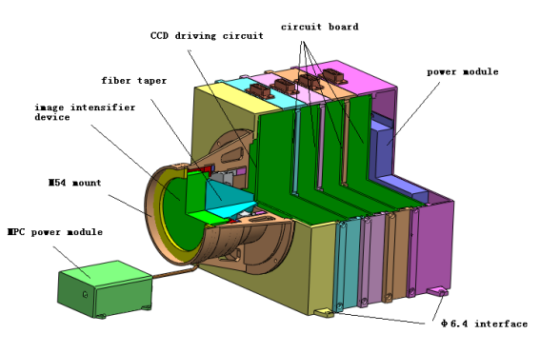
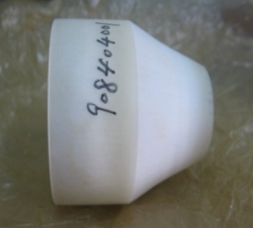
Scintillator signal readouts
LYSO scintillator → WLSF
Fiber to ICCD system
Optical fiber winding
Crystal packing
Image intensifier
ICCD system
Taper

Slide 22
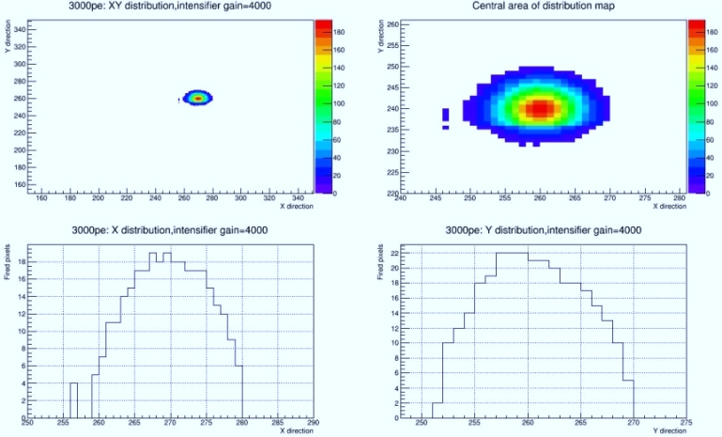
Fiber Image on CCD
Signal: 3000 pe; gain of image intensifier: 4000

Slide 23
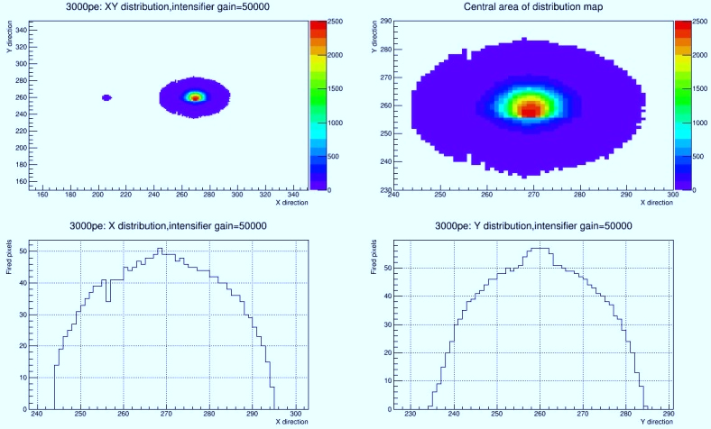
Fiber Image on CCD
Signal: 3000 pe; gain of image intensifier: 50000

Slide 24
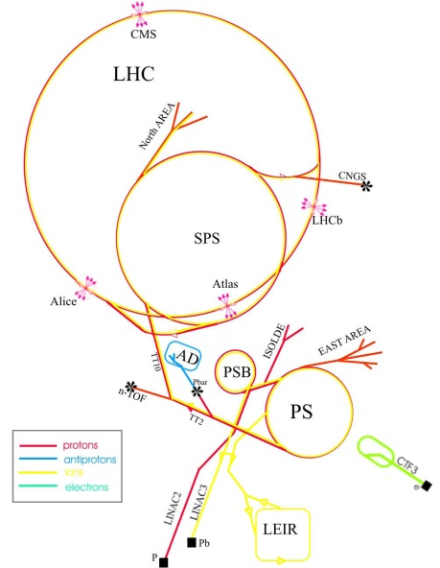
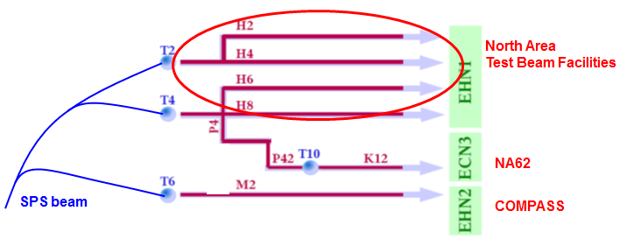
CERN Beam Test in Nov 10-20, 2015
SPS H4: P & Pb

Slide 25
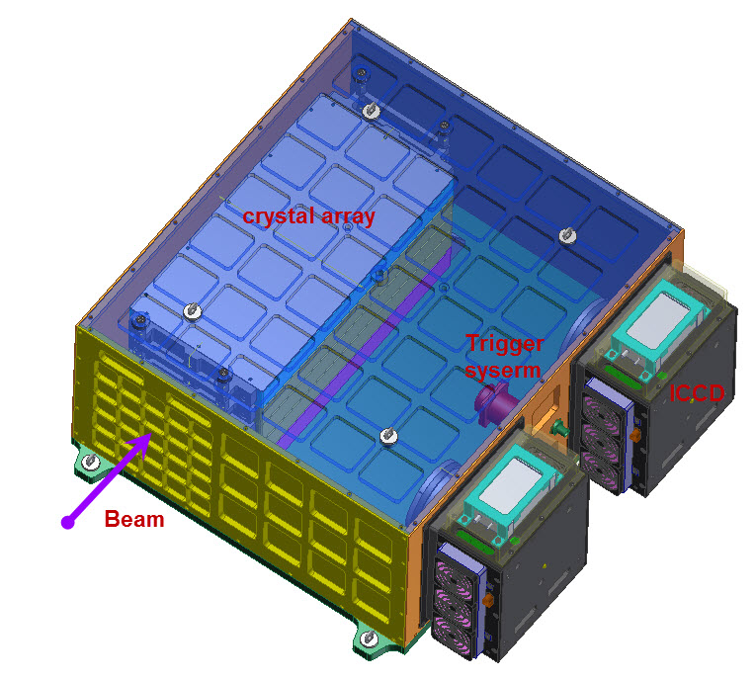
Design of the prototype

Slide 26
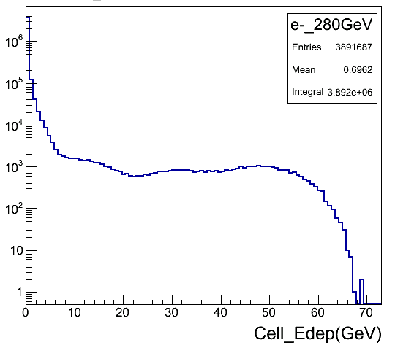
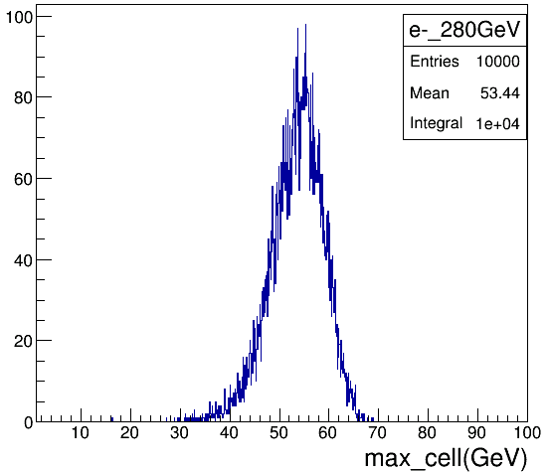
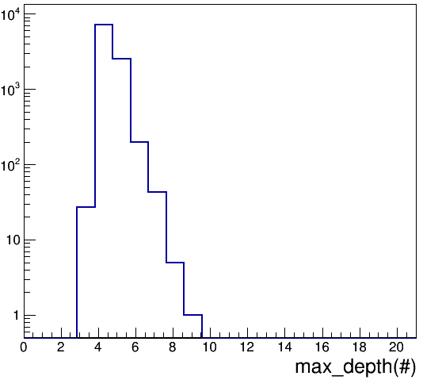
Requirements on the prototype
Requirement on dynamic range: ~6000
  Starting from 1/3 MIPs=10 MeV
  Ending at max. energy deposition: 60 GeV
Requirement on frame rate of ICCD: > 500 fps
  Since the electrons arrive randomly in time
Notes:
据模拟计算结果，LYSO颗粒的MIPs响应约为30MeV，一般取1/3 MIPs响应作为后端读出的起点。单元的最大响应出现在最高能的粒子入射情况下，如280GeV电子入射引发的电磁簇射或者400GeV质子入射引发的强子簇射。
图3.5 280GeV电子入射所有单元沉积能量分布；最大能量沉积单元；最大能量沉积单元的纵向位置（层号）

Slide 27
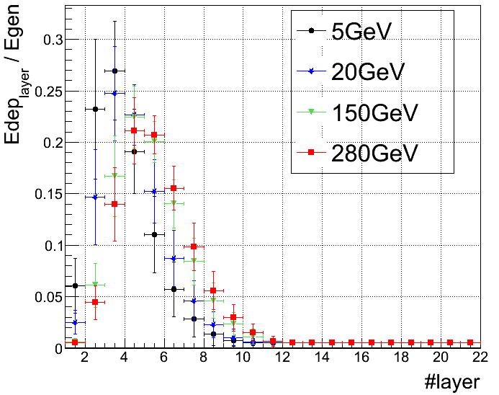
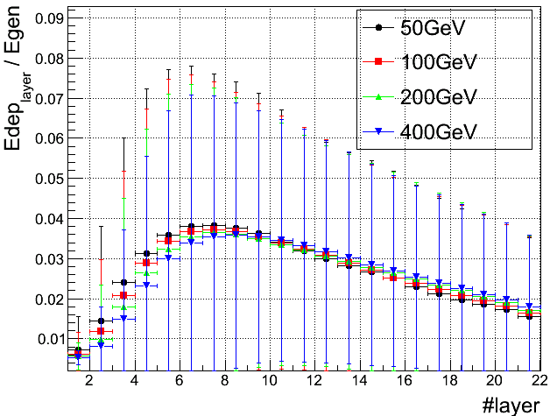
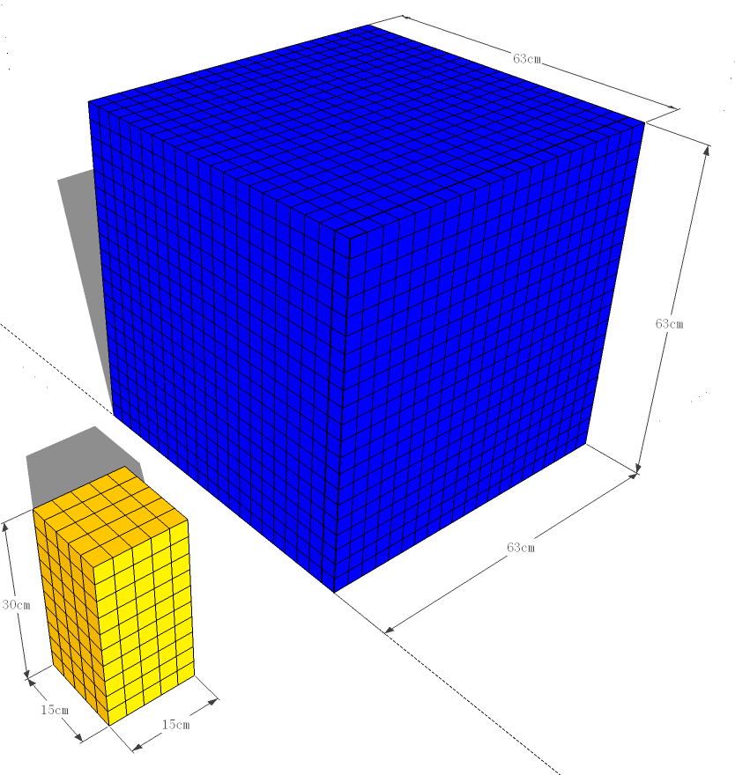
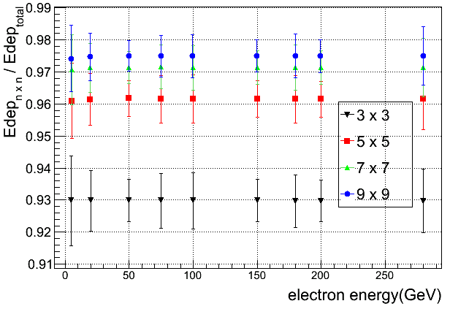
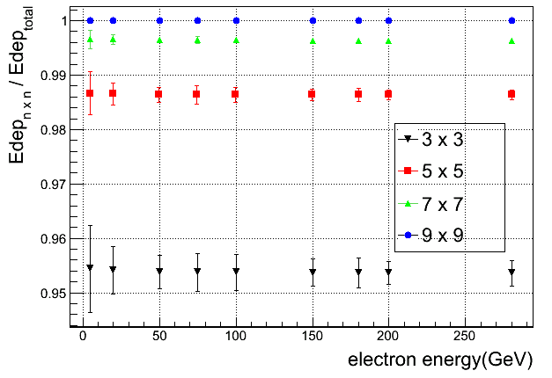
Requirements on the prototype
Scale of the prototype：5×5×10, 3×3×3 cm³
  Larger than envelope of 280 GeV e- shower
  36% of the total energy for protons
Along the beam
1/40 size of HERD
Transverse direction

Slide 28
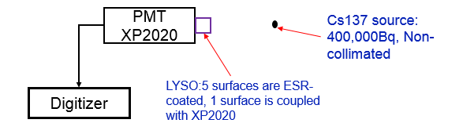
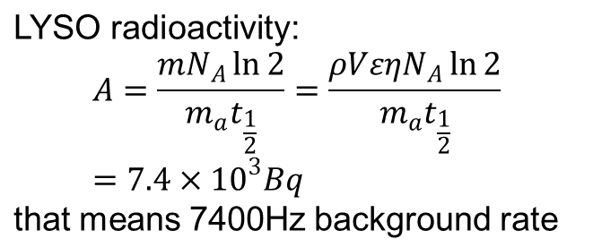
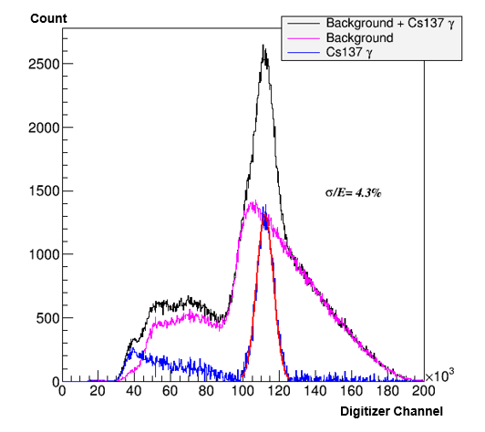
LYSO light output
for 3cm×3cm×3cm cubic LYSO, but signal << 30 MeV MIP

Slide 29
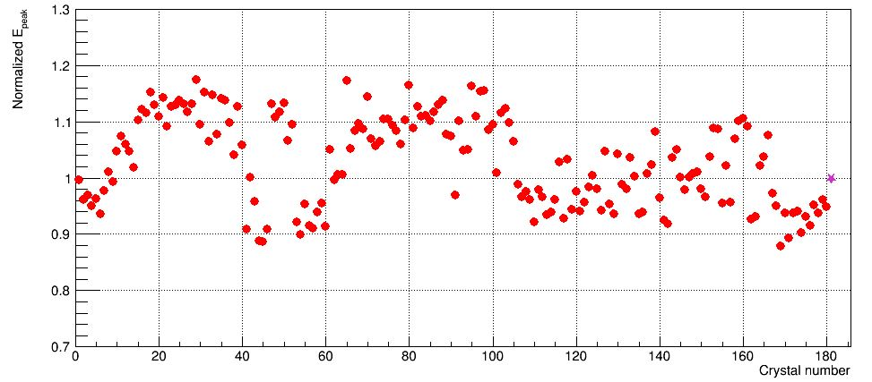

LYSO performance
Variation of LYSO light output:
(Max-Min)/Mean ≈25%
Energy resolution (σ/E) for 662keV γ peak:
< 5%

Slide 30
Realization of two readout ranges
T
H
Low
Low
H
T

Slide 31

Signal ratios ~ 50:1

Slide 32


Fiber winding development
Fiber insert hole
Slot instead of hole

Slide 33

Fiber winding development

Slide 34


Fiber winding development

Slide 35


Fiber winding development

Slide 36


Fiber winding development

Slide 37

Making ESR wrapping

Slide 38




Assembly and lab test of the prototype

Slide 39

1st HERD workshop, Oct.17-18, 2012, IHEP, Beijing

Slide 40

2nd HERD Workshop @IHEP 2013/12/2-3

Slide 41

Beam test preparation meeting 2015/08/31@Rome

Slide 42
The HERD Proto-Collaboration Team
Chinese institutions (more welcome!)
  Institute of High Energy Physics, Purple Mountain Observatory, Xi’an Institute of Optical and Precision Mechanics, University of Science and Technology of China, Nanjing University, Peking University, Yunnan University, China University of Geosciences, Ningbo University, Guangxi University
International institutions (more welcome!)
  Switzerland: University of Geneva
  Italy: Università di Pisa/INFN, IAPS/INAF, University of Florence/INFN, University of Perugia/INFN, University of Trento/INFN, University of Bari/INFN, University of Salento/INFN-Lecce
  Sweden: KTH
  USA: MIT/Harvard

Slide 43

SPIE, 9144, id. 91440X 9 pp. (2014)

