Slide 1
Strange Nuggets in the early and the present Universe
Xiaoyu Lai (来小禹)
Xinjiang University (新疆大学)
2015/9/29

Slide 2
Outline
Formation of Strange Nuggets (SNs)
Cosmological QCD phase transition
Consequences
In the early Universe
In the present Universe
SNs formed in collisions of strange stars
Heavy and ultrahigh energy cosmic rays
Summary

Slide 3
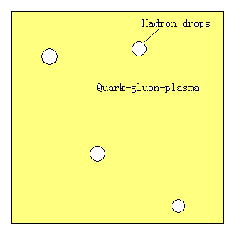
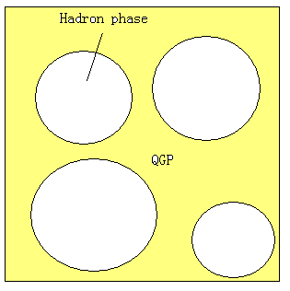
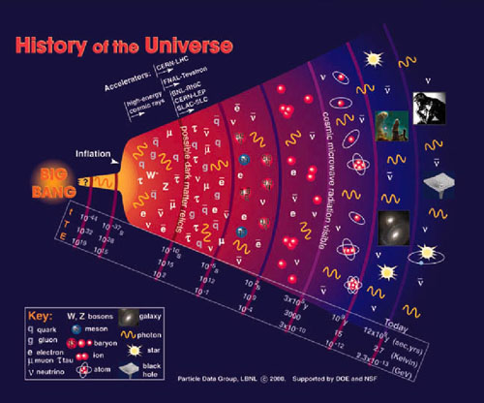
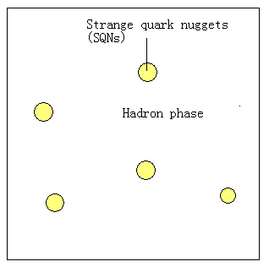
Formation of strange nuggets (SNs)
Cosmological QCD phase transition
Might generate relics: SNs
(Witten, 1984)
t~μs, T~200MeV

Slide 4
SNs: relics from the early Universe
(Witten, 1984)
Very high baryon density: n_{b} >~ n_{nucl}
Composed of u, d and s quarks
Very low charge-to-mass ratio: Z/A ~ 10⁻⁵
Electromagnetic force between them is weak
Evolution of SNs
Evaporation: Disappear or Survive?
Dark matter candidate
SNs constitute the total or a fraction of dark matter?

Slide 5
SNs in the early Universe
Could they lead to different scenario of structure formation from that in standard CDM scenario?
Numerical simulations are needed but difficult
Some astrophysical consequences?
Supermassive black holes at high redshifts
Black holes with M ~ 10⁹ M⊙ at z ~ 6 (Fan et al. 2003)
Black holes with M ~ 10¹⁰ M⊙ at z ~ 6.3 (Wu et al. 2015)

Slide 6
SNs in the early Universe
Formation of supermassive black holes (~ 10⁹⁻¹⁰ M⊙) at high-redshifts (z~6) is still puzzling.
Seed black holes: the role of SQNs? (Lai & Xu, 2010)
Pop III star
(~ 10² M⊙)
Seed black hole
(~ 10² M⊙)
Fast gas accretion
Supermassive
black hole
(~ 10⁹ M⊙)
Strange
Nuggets
Seed black hole
( ≥10³ M⊙)
z~6
Lai & Xu, 2010

Slide 7
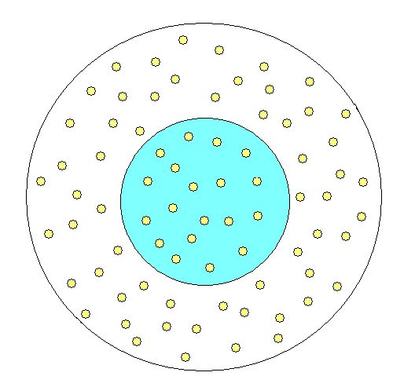
SNs in primordial halo
Primordial halo, total mass ~
Collision between SNs and gas
SNs loose their angular momentum via viscosity
Gas could be heated
SNs could assemble in the center of the halo
SNs: diffuse in the outer part of halo,
assemble in the center of halo
SNs
Lai & Xu, 2010

Slide 8
SNs in the present Universe
If SNs constitute a significant fraction of dark matter
They would collide with stars
Accretion rate: from dark matter accretion rate
Consequences
Interaction between SNs and ordinary matter?
Observational signals?

Slide 9
Accretion of SNs by stars
The expected accretion rate
Choose the NFW profile of dark matter halos
(Kouvaris, 2008)
dark matter → SNs

Slide 10
Accretion of SNs by pulsars
Glitches: timing irregularities
In the framework of star-quake glitch model:
An accreted SN could travel a distance inside the pulsar,
So the SN could break the whole lattice structure of the pulsar
Pulsar has not accumulated enough elastic energy
This could lead to small size glitches (glitch-size = )
Test by observations…

Slide 11
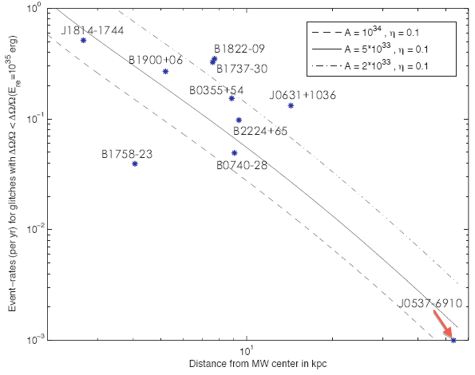
Small glitches: the role of SNs?
Lai & Xu, 2015
Data are from ATNF Pulsar Catalogue and Jodrell Bank glitch-table

Slide 12
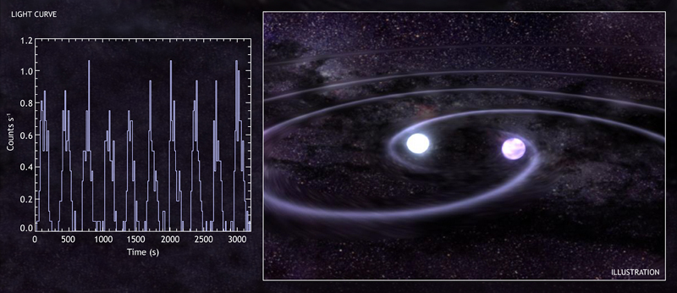
SNs generated in another way
Collisions of two strange stars in binaries.
Tidal disruption could release SNs (Madsen, 2002)
Galactic production rate: 10⁻¹⁰ M⊙ yr ⁻¹ (Madsen, 2005)
Heavy cosmic rays

Slide 13
SNs in heavy cosmic rays
High Z makes SNs to be accelerated more efficiently than protons
SNs as cosmic rays move GZK cutoff to much higher energies (Madsen, 2003)
Could be detected as seismic signals (Rujula and Glashow, 1984)

Slide 14
Summary
SNs, formed in cosmological QCD phase transition or collisions of strange stars, could have interesting astrophysical consequences
Speed up the formation of SMBHs at high-z
Affect the glitch behavior of pulsars
Be the ultrahigh energy cosmic rays
…
More observational tests
Thank you !

