Slide 1
The Knee of the Cosmic P + He Spectrum below 1 P Measured by ARGO-YBJ and a Cherenkov Telescope of LHAASO
Zhen Cao, Shoushan Zhang
ARGO-YBJ Collaboration and LHAASO Collaboration
IHEP (Institute of High Energy Physics), Beijing, China
Workshop on Astroparticle Physics, KIAA, 2015/9/28-29

Slide 2
Outline
Motivation
Hybrid experiment introduction
Data analysis
Result and discussion
Conclusion

Slide 3
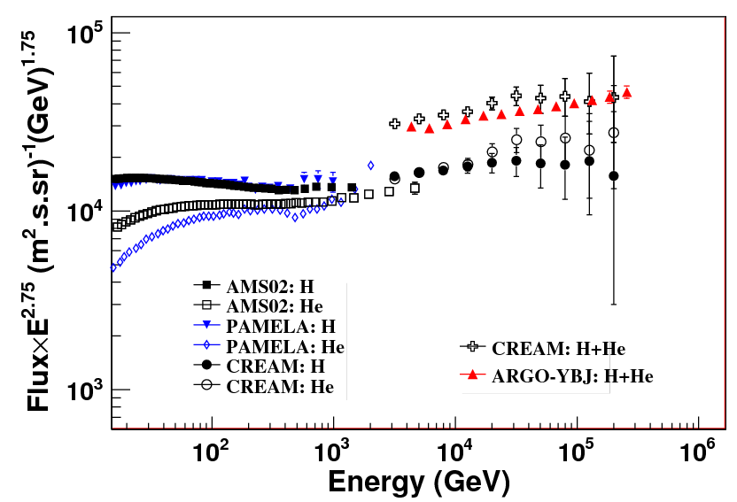
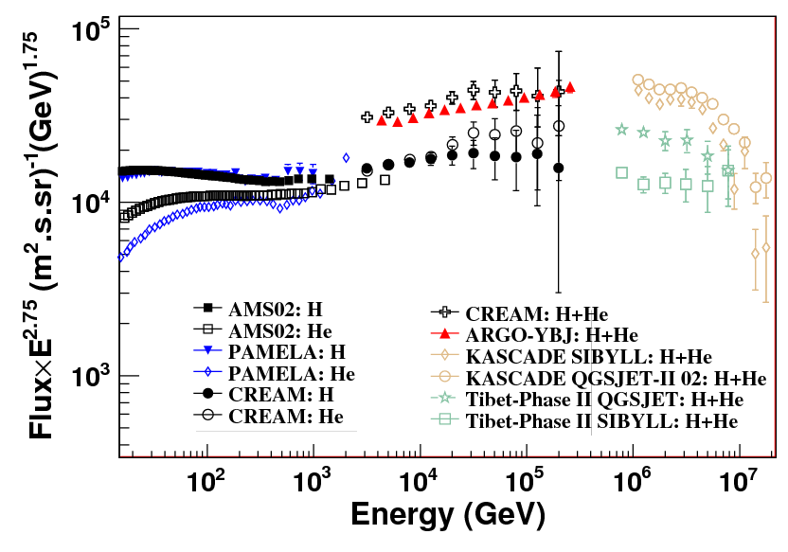
Motivation
CREAM results: energy spectrum of single element up to 100TeV;
ARGO-YBJ（H+He）：3TeV-300TeV;
This work is to extend the ARGO-YBJ results to higher energy;
To fill the gap between the balloon based measurements and ground based experiment for cross-calibration of the experiments.

Slide 4
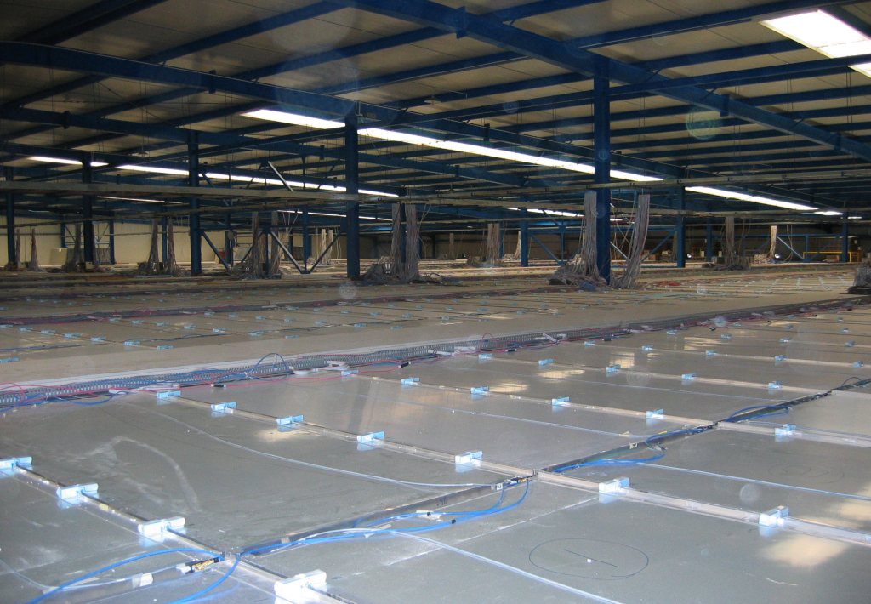
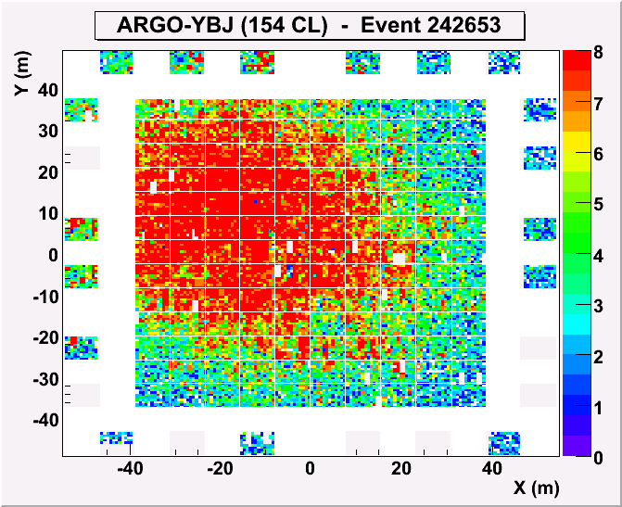
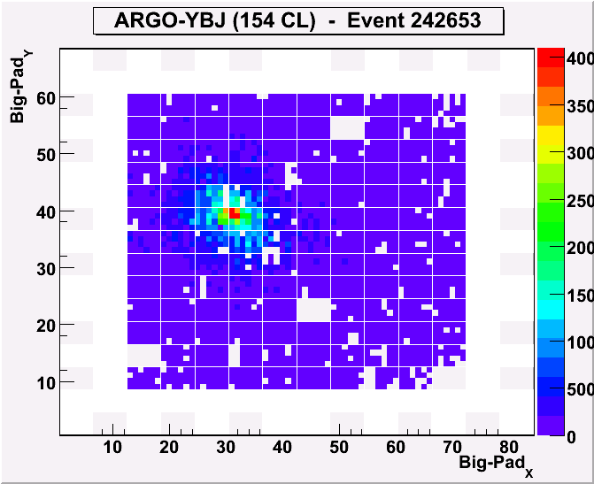
Wide Field of View Cherenkov Telescope (WFCTA)
5m² spherical mirror；
16×16 PMT array
Pixel size 1°；
FOV: 14°× 16°;
Elevation angle: 60°.
One of Cherenkov event
ARGO-YBJ array and Cherenkov telescope
~ 80 m
Strips
Big pad
Full RPC carpet array

Slide 5
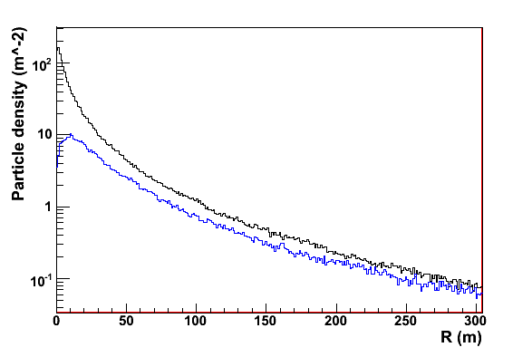
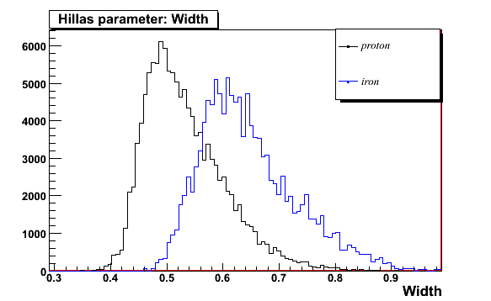
Hybrid experiment
proton
iron
  -- ARGO-YBJ:
  lateral distribution
    Precise geo
    In the core region → mass sensitive
  -- Cherenkov Telescope:
  longitudinal information
    Hillas parameter → mass sensitive
    Good energy resolution
Proton
Iron

Slide 6
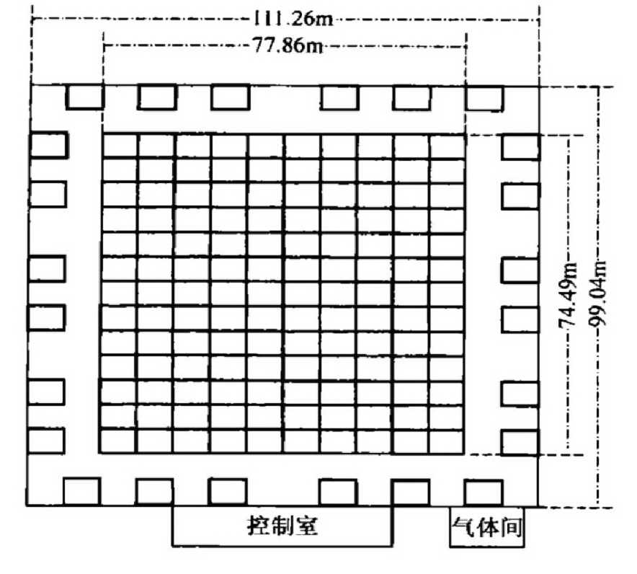
Hybrid Observation and Data Set
Period:
From 2010.12 ~ 2012.02: Coincidence events;
Good weather selection: 7.28×10⁵ sec.
RPC detector array
Criteria for well measured events
Guard ring
Shower core contained in the ARGO central carpet, excluding an outer region by 1 meter;
More than 1000 fired pads on the ARGO-YBJ central carpet;
Cherenkov image must be fully contained in the telescope, i.e. space angle < 6 respect to the axis of the telescope;
The number of fired tubes >= 6.
Central carpet
8218 events are well reconstructed above 100 TeV

Slide 7
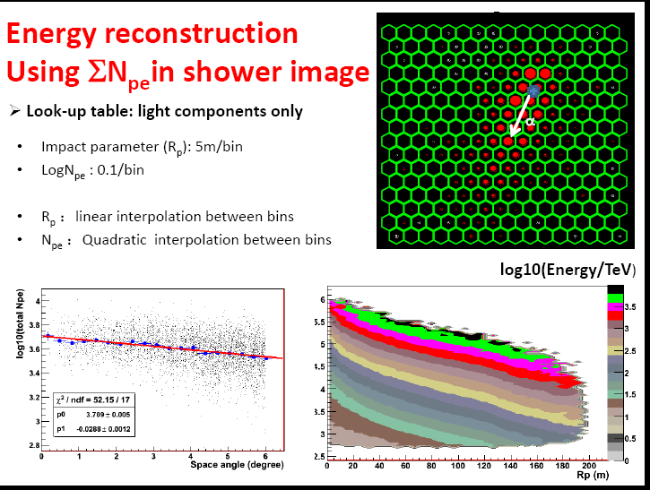
Hybrid Observation and Data Set
Period:
From 2010.12 ~ 2012.02: Coincidence events;
Good weather selection: 7.28×10⁵ sec.
Criteria for well measured events
Shower core contained in the ARGO central carpet, excluding an outer region by 1 meter;
More than 1000 fired pads on the ARGO-YBJ central carpet;
Cherenkov image must be fully contained in the telescope, i.e. space angle < 6 respect to the axis of the telescope;
The number of fired tubes >= 6.
8218 events are well reconstructed above 100 TeV

Slide 8
Simulation information
Extensive air showers simulation
Tool: Corsika6735 + QGSJETII-03 + GHEISHA
Primary particles: proton, helium, CNO, MgAlSi, iron
Energy range: 10 TeV – 50PeV
Geometry: θ: 20° – 42°, Φ: 69°- 111°,
Core: +/- 150 m
Detector simulation
Cherenkov simulation : Ray tracing package
RPC carpet: G4argo (GEANT4 based program)
Geometry reconstruction: From ARGO-YBJ
Core resolution: < 2 m
Angular resolution: < 0.3º

Slide 9



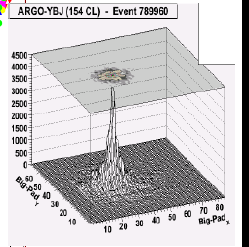
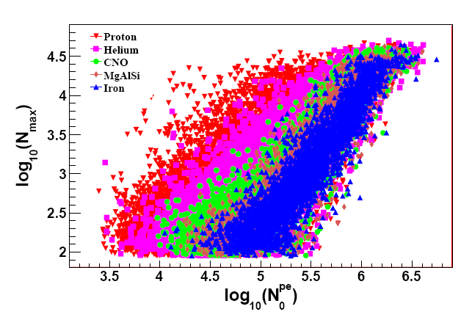
Mass-sensitive Parameter
in the Shower Lateral Distribution
Most-hit-RPC at the core of a shower :
~
is the total number of photo-electrons normalized to R_{p} = 0m and α=0°
R_{p}: the impact parameter;
α: the space angle between shower direction and Cherenkov telescope main axis.

Slide 10
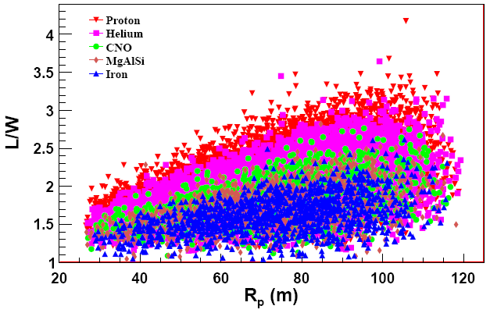
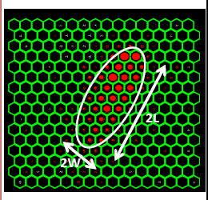
Mass-sensitive Parameter
in the Cherenkov Image
Elongation of the shower image : L/W ~ R_{p}/109.9m
L/W is sensitive to the depth of shower maximum.
Hillas parameters:
Length and Width

Slide 11
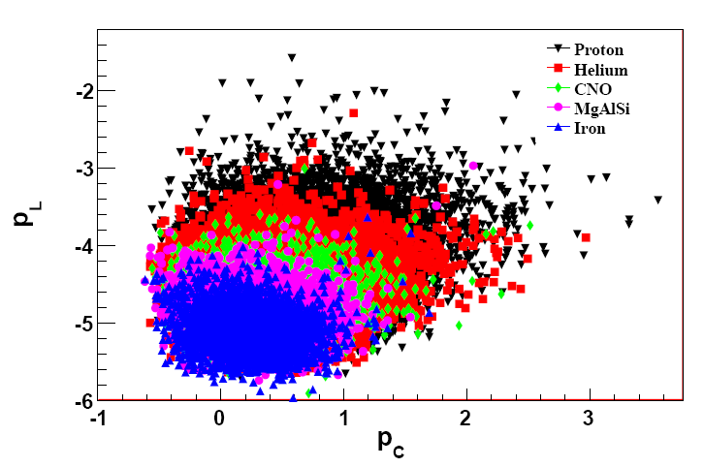
Multi-parameter Analysis

Slide 12
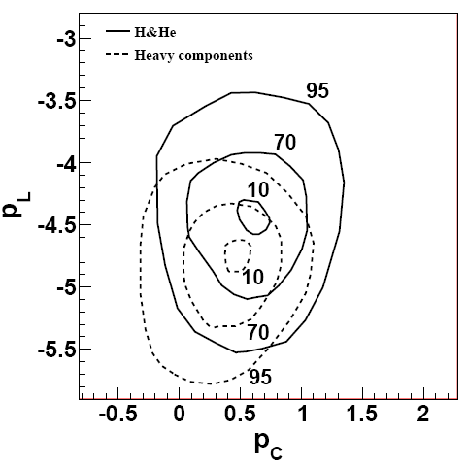
Multi-parameter Analysis

Slide 13
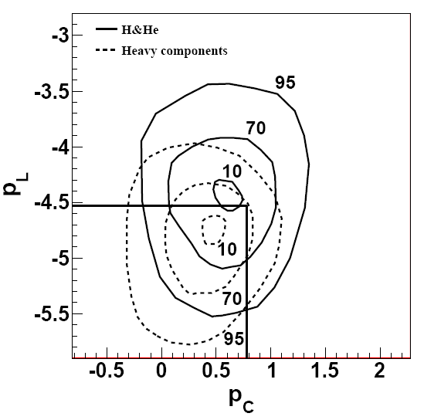
Multi-parameter Analysis
H&He selection critiea : p_{L}>-4.53 or p_{C}>0.78

Slide 14
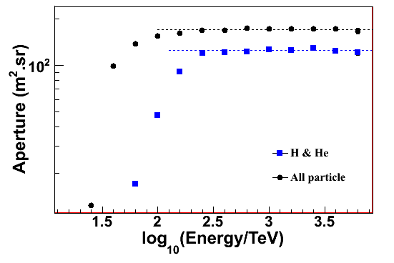
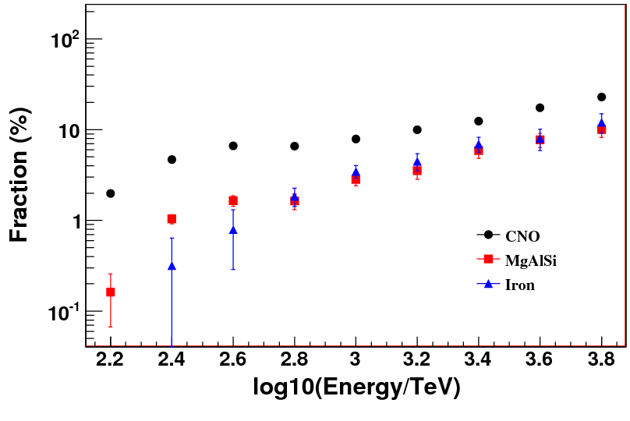
A simple geometrical calculation gives a aperture of 163 m² sr
The aperture of H&He: ~120 m² sr above 300 TeV;
The purity of H&He showers: ~93% below 700 TeV;
The contamination of heavy nuclei increases with energy: 13% @ 1 PeV, gradually increases to 27% @ 3 PeV;
The contamination of heavy nuclei is model dependent

Slide 15
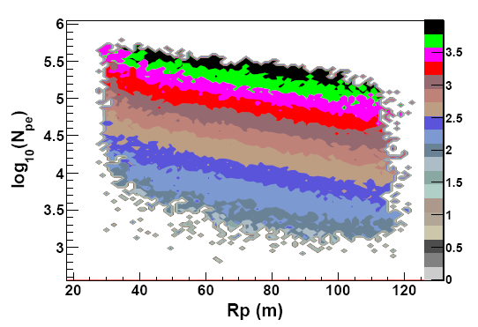
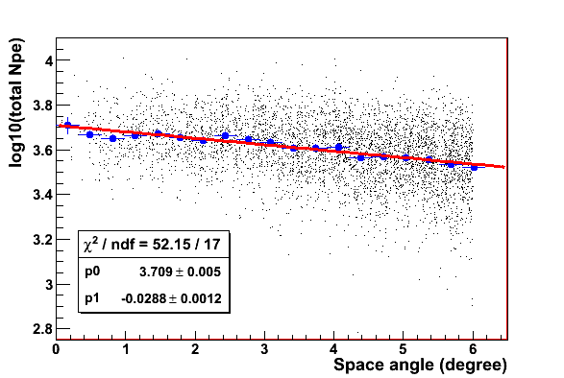
log10(Energy/TeV)
Energy reconstruction
Using ∑N_{pe} in Cherenkov image
Look-up table:
  light component only
Impact parameter (R_{p}): 5m/bin
Log(total N_{pe}) bin: 0.1/bin
R_{p} bin ：linear interpolation
α bin: linear interpolation
Total N_{pe} bin：quadratic curve interpolation
α

Slide 16
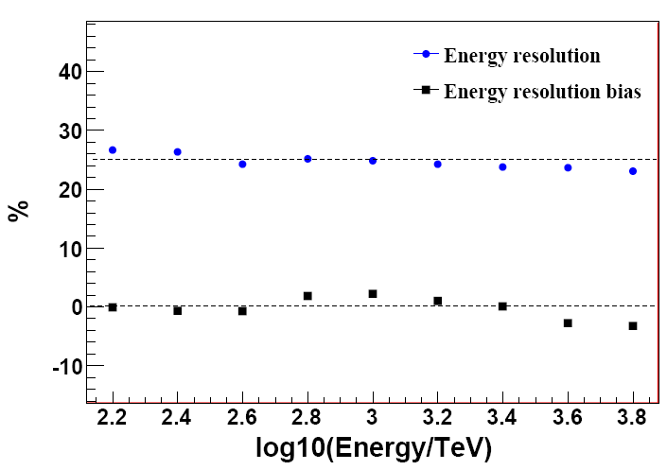
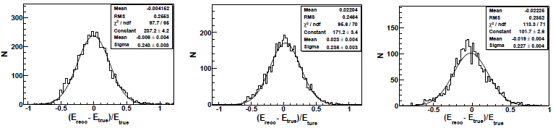
E-reconstruction
Systematic
bias: <3%
Constant resolution: 25%
Gaussian
Energy resolution：~25%
Offset: < 3%
300 TeV 1 PeV 3 PeV

Slide 17
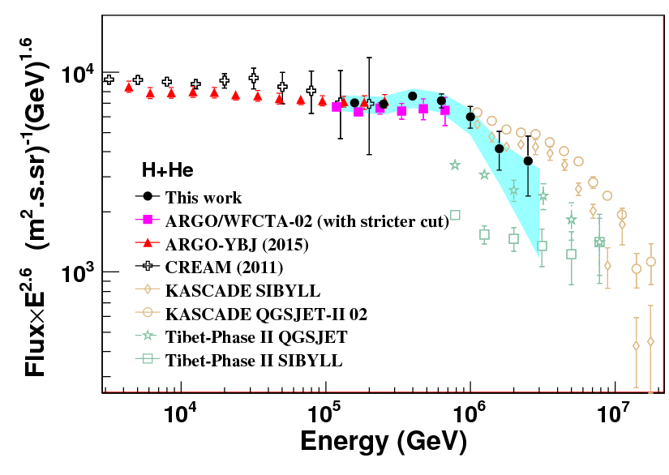
The spectrum of H & He
with its knee below 1PeV
  Light component energy spectrum of 125 TeV - 3 PeV is measured;
  The knee of H&He spectrum at ~700 TeV is clearly measured.

Slide 18
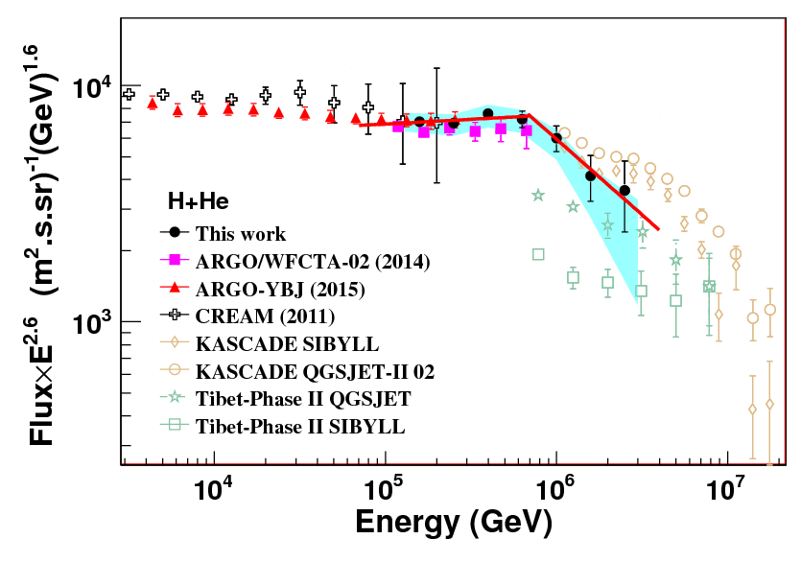
The spectrum of H & He
with its knee below 1PeV
  Spectra index: β1=-2.56 ± 0.05 below knee; β2=-3.24 ± 0.36 above knee; The H&He knee of (700±230) TeV is found. The relatively large error on knee position is due to the limited statistics and the energy resolution.
  Below the knee, consistent with ARGO-YBJ, which is consistent with CREAM

Slide 19
Systematic Uncertainties
Uncertainties in the energy scale: ~9.7 %
  Photometric calibration: 5.6%;
  Weather/atmosphere conditions：7.6%;
  QGSJET II-03 vs. SIBYLL2.1：<1.0%;
  GHEISHA vs. FLUKA：<2.0%;
  Composition model: 1%.
Systematic uncertainties on the H&He flux:
  Contamination of heavy nuclei is not constant with energy and is dependent on composition models:
  -(1.5~2.5)% @ 158 TeV,
  -(29~51)% @ 2.5 PeV;
  ARGO-YBJ RPC calibration: 7%;
  QGSJET II-03 vs. SIBYLL2.1: <1.0%;
  GHEISHA vs. FLUKA：<3.5 %;
  Boundary effects in the hybrid detector aperture calculation: <3%;
  The difference between proton and Helium selection efficiencies: 3%;
  Saturation of RPCs: <0.03%.

Slide 20
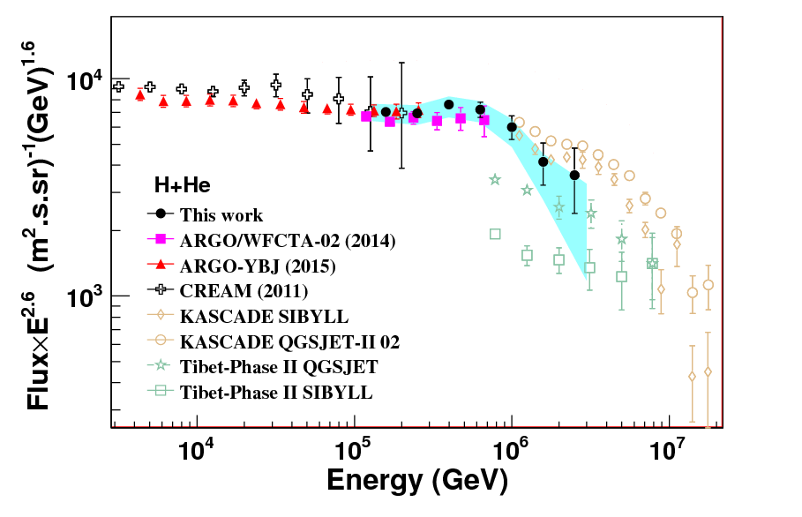
The H & He spectrum :
comparison with other experiments

Slide 21
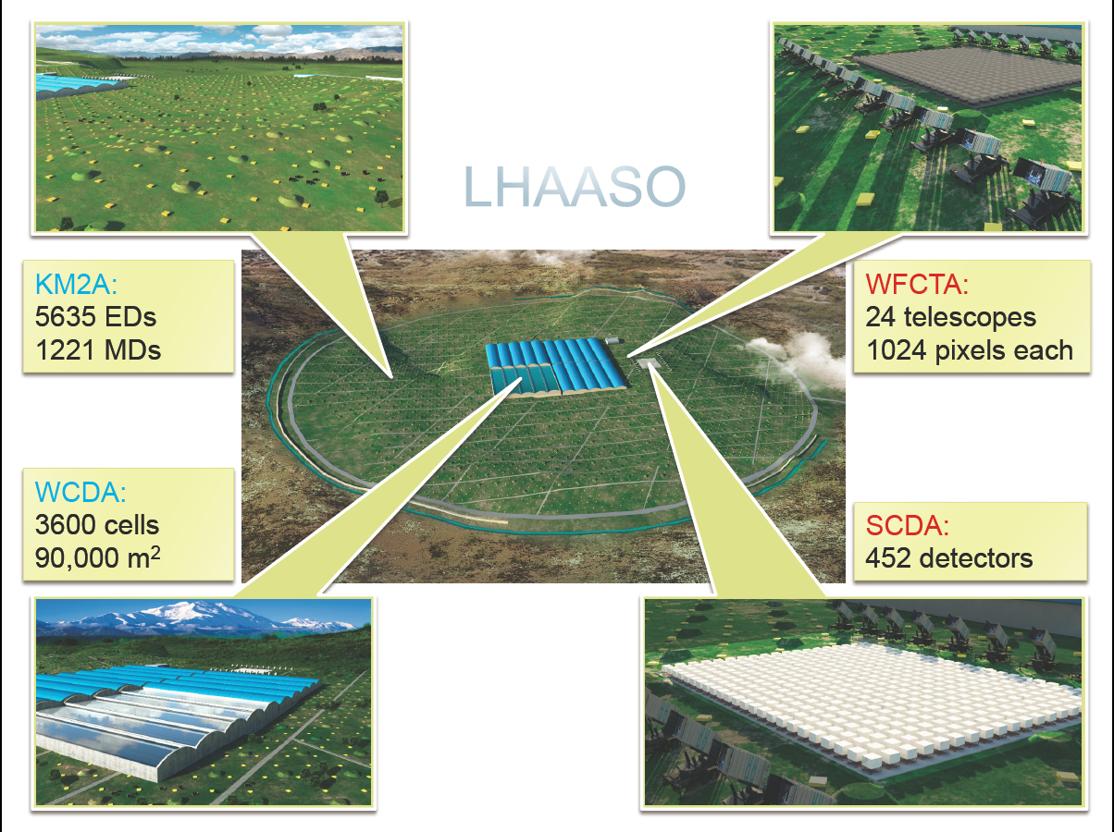
Large High Altitude Air Shower Observatory (LHAASO)
Main physics goals:
-- TeV γ ray observation
-- PeV CR spectra of individual composition
1 km²
5000 m²

Slide 22
Conclusion
Light component (H&He) energy spectrum of 125 TeV - 3 PeV is measured by the ARGO-YBJ detector with a wide field-of-view imaging Cherenkov telescope .
    filling the gap between the direct observations of CREAM and the EAS experiment, such as KASCADE
    The knee of (700±230_{stat.}±70_{sys.}) TeV is found
    Spectra index: β₁=-2.56 ± 0.05 below the knee; β₂=-3.24 ± 0.36 above the knee;
    Energy resolution: ~25% with offset <3%；
    The observation of the knee of the primary light component at such a low energy gives fundamental inputs to galactic cosmic ray acceleration models.
  Single element spectrum will be measured in the LHAASO project: muon detector, Cherenkov telescope, shower core detector, water Cherenkov detector

Slide 23
Thanks！

Slide 24
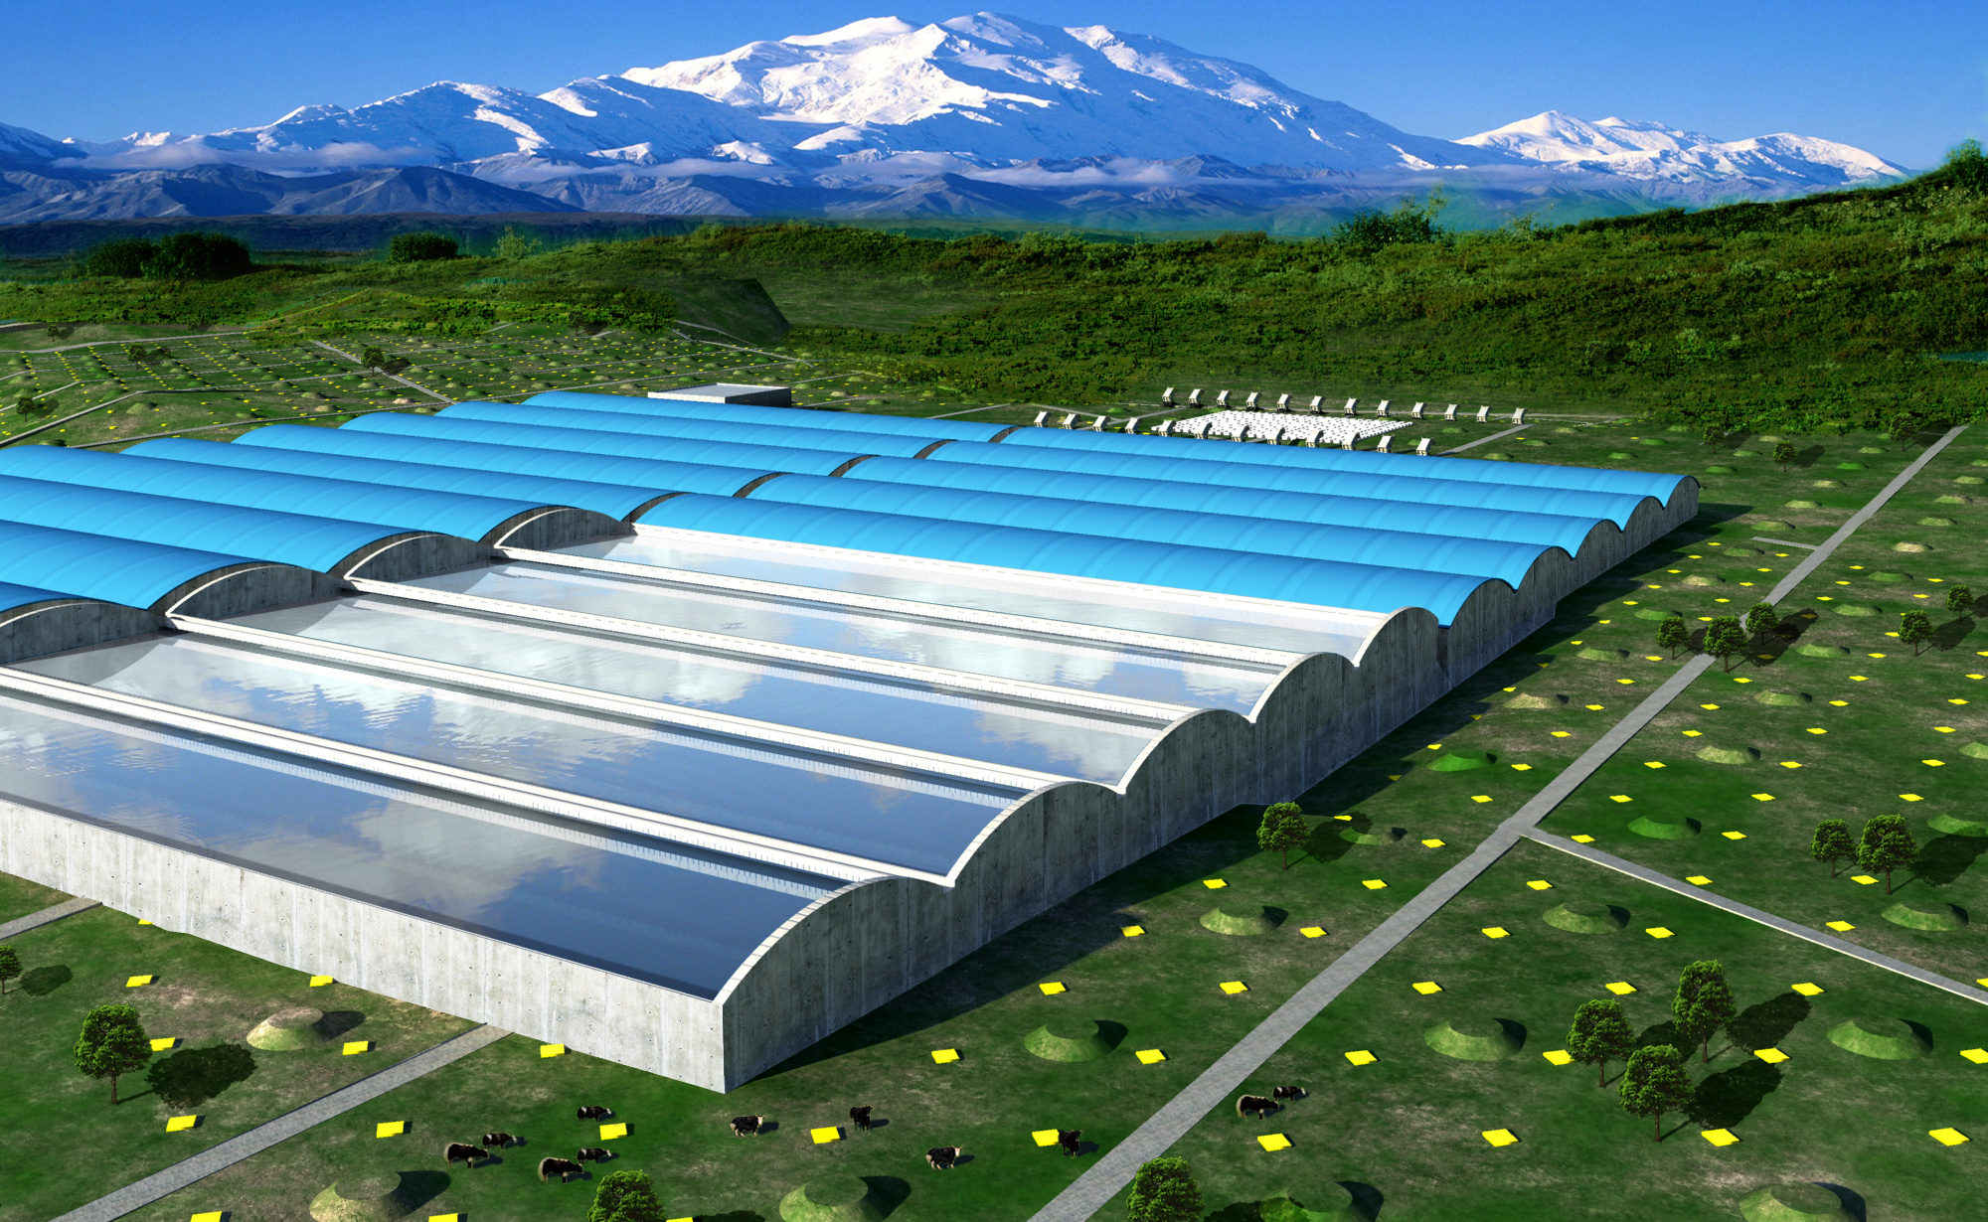
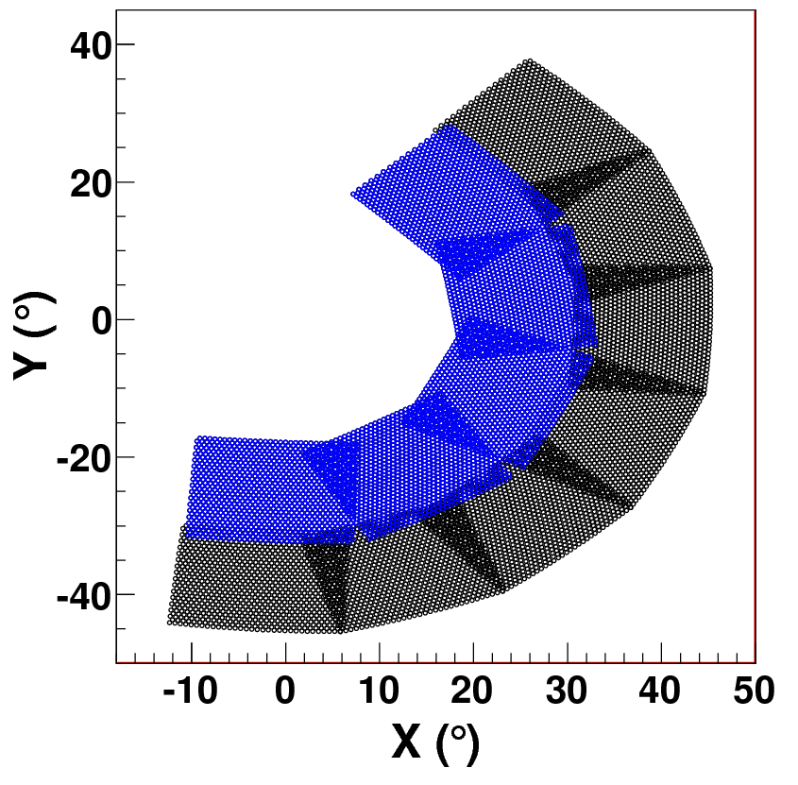
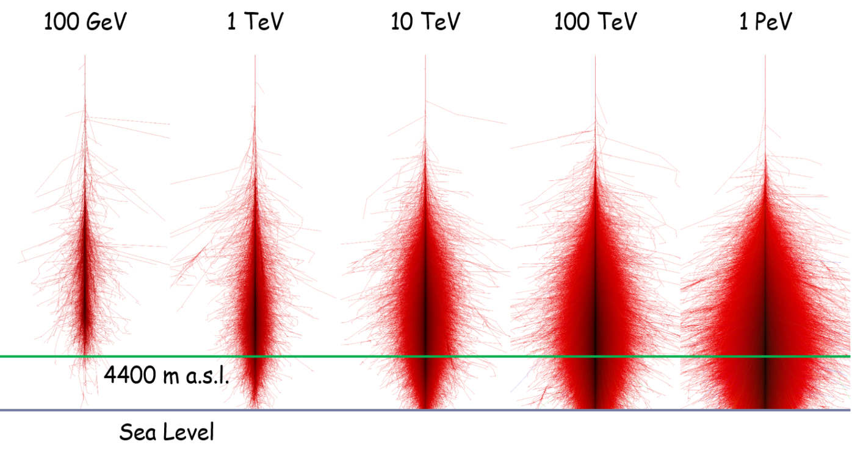
LHAASO project: CR spectrum
WCDA: Water Cherenkov detector array
KM2A: 1 km² muon and electron detector array
WFCTA: 12 Cherenkov telescope

Slide 25
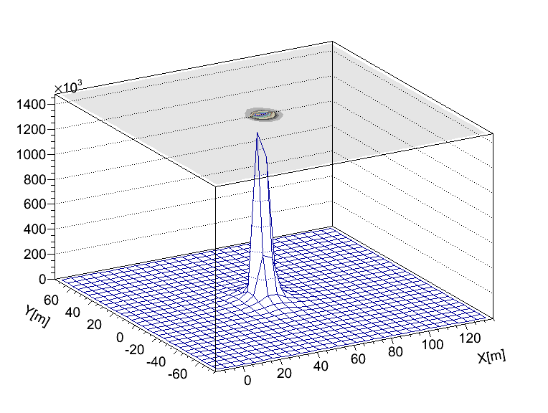
LHAASO project: CR spectrum
An event in WCDA
WCDA: Water Cherenkov detector array
KM2A: 1 km² muon and electron detector array
WFCTA: 12 Cherenkov telescope

Slide 26
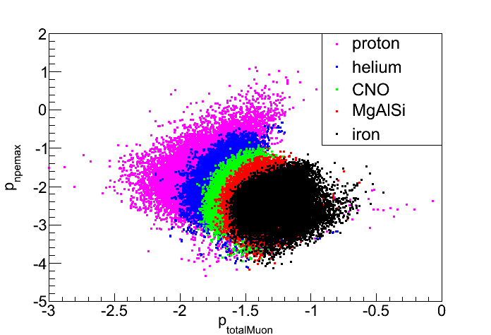
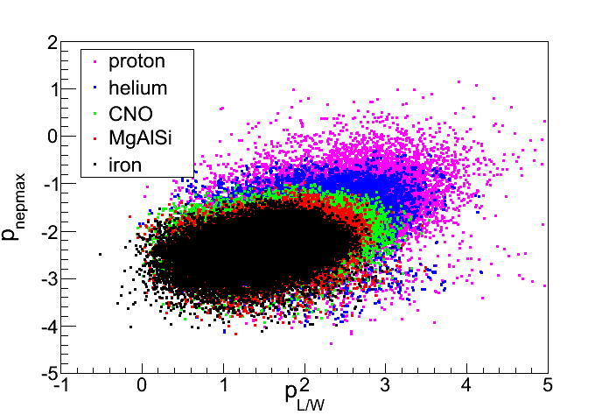
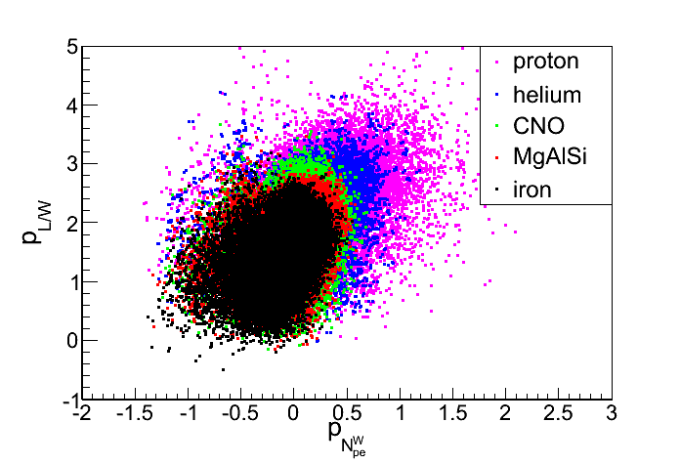
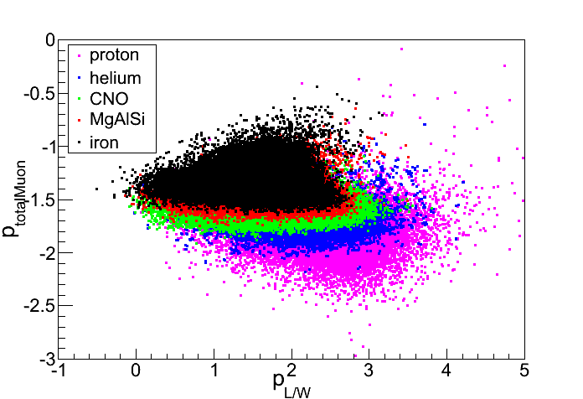
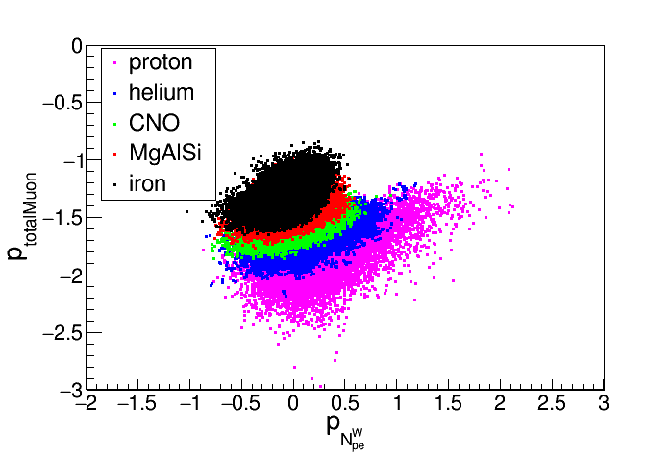
Mass sensitive parameters

Slide 27
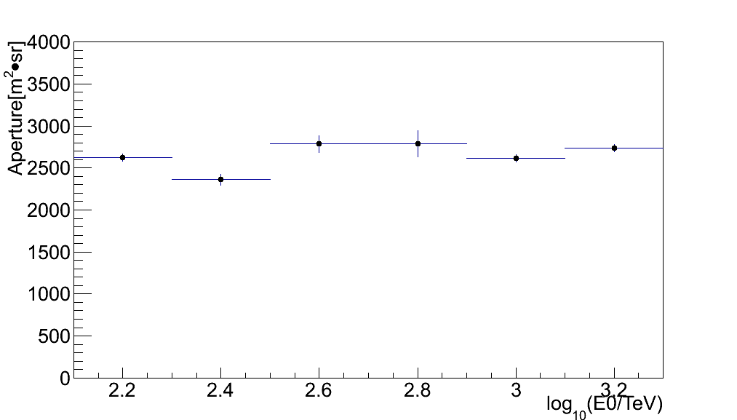
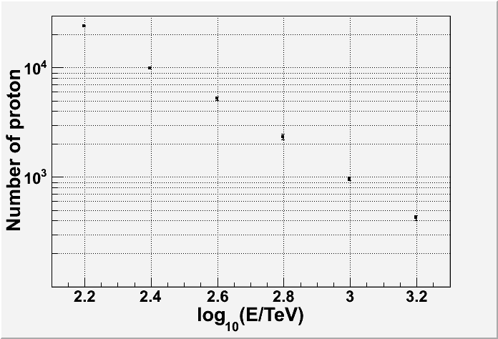
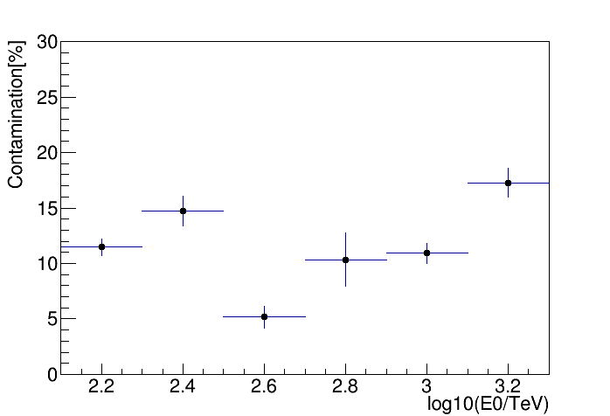
Expected number of events /year

Slide 29
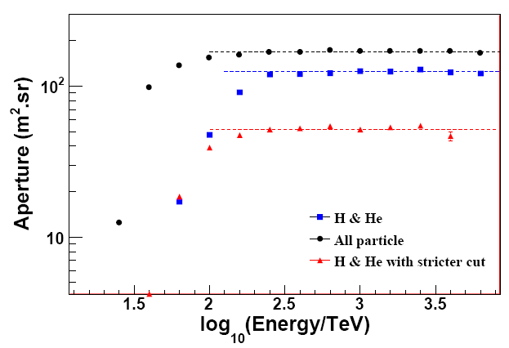
Looser cut:
p_{L}>-4.53 or p_{C}>0.78
Stricter cut:
p_{L}>-4.2 or p_{C}>1.0
With stricter cut criteria
  The purity of H&He showers: ~98% below 700 TeV;
  The aperture of H&He: ~50 m².sr above 300 TeV;

Slide 30
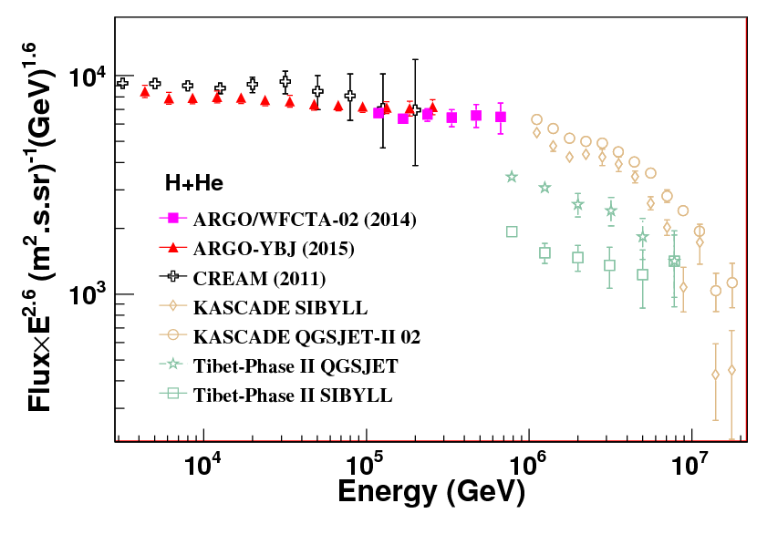
H & He energy spectrum (with stricter cut)
The H&He spectrum (100 TeV- 700TeV) is consistent with a single-index power law, in good agreement with CREAM and ARGO-YBJ results.
-- Spectra index: ARGO-YBJ/WFCTA-02:-2.63 ± 0.06
ARGO：-2.61 ± 0.04
CREAM (H+He): -2.62 ± 0.02
-- The overall difference between three measurements: ±9%;
This makes us confident on the hybrid observation and the analysis techniques

Slide 32
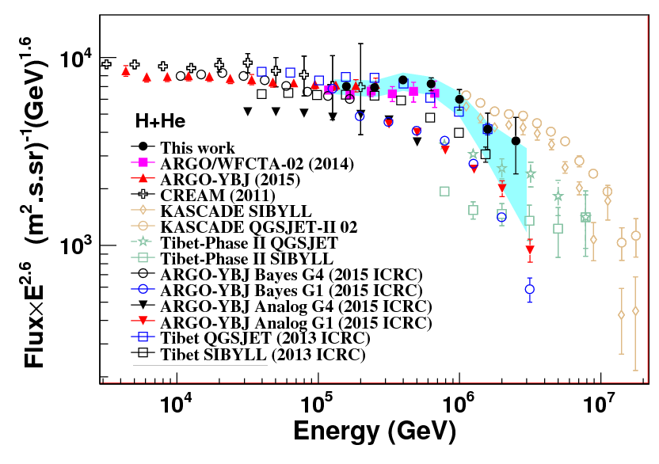
    The knee below 1 PeV is also consistent with two independent analyses of ARGO-YBJ data by using the RPC charge readout only.
-- Event by event reconstruction method.
-- Bayes method.

Slide 33
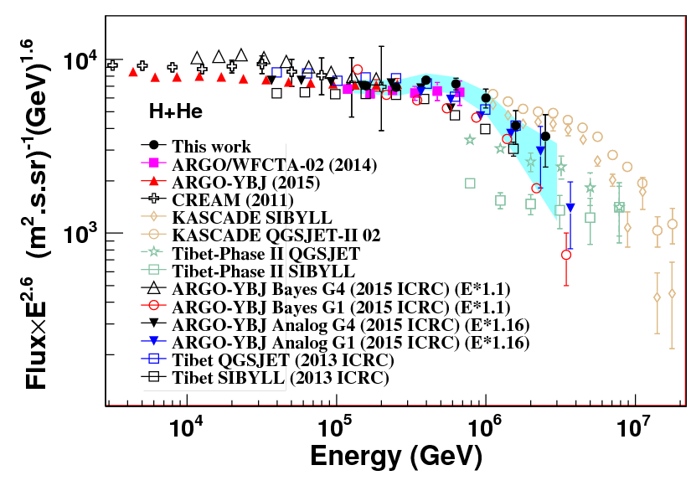
ARGO-YBJ Energy is shifted

Slide 34
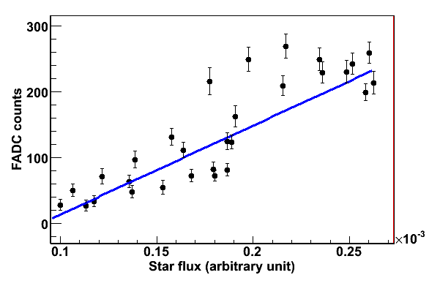
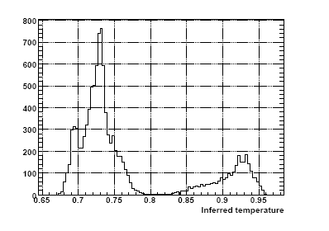
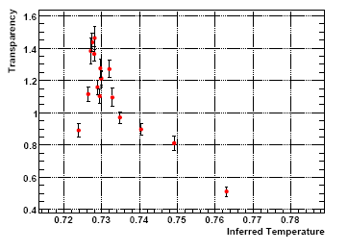
Criteria of good weather selection
The correlation between the star flux in the FOV
of Cherenkov telescope and FADC counts
A star signal
MJD
The correlation coefficient > 0.8 is considered as good weather.
Infrared detector result
Clear
Clear
Cloudy
correlation coefficient
Cloudy
Temperature (℃)
Temperature (℃)

Slide 35
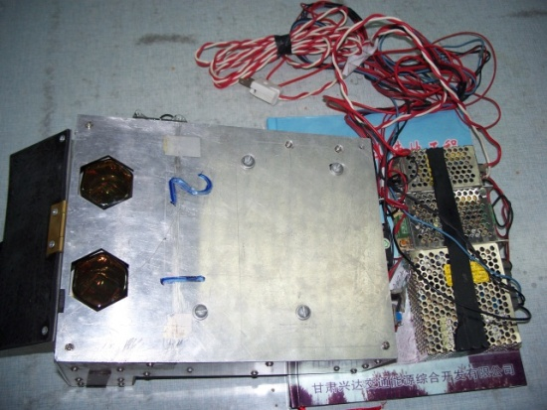
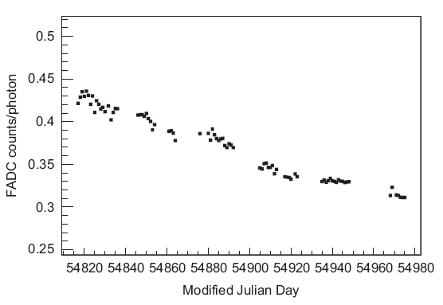
Cherenkov Telescope Calibration
  Probe is calibrated by a HPD (calibrated by NIST) at HiRes lab in America;
  UV LED is calibrated by probe;
  PMT camera is calibrated by UV LED every day.
Probe
The systematic uncertainty of the calibration constant : ~ 7%.
Gain monitor results
Mirror
Probe
UV light 375nm
UV LED
PMT camera

Slide 36
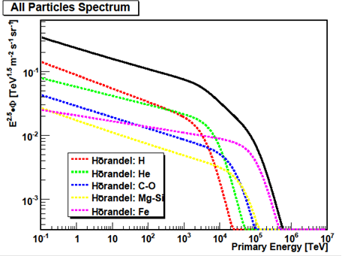
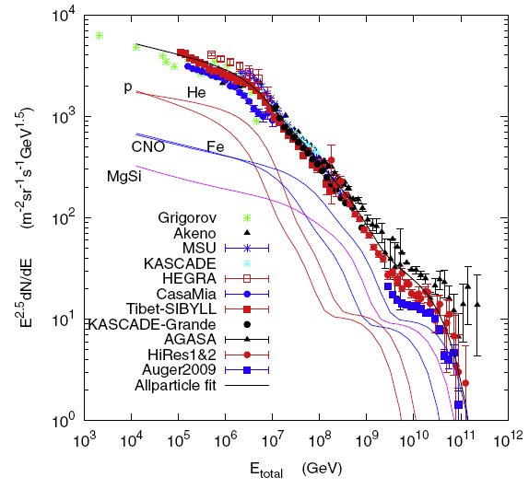
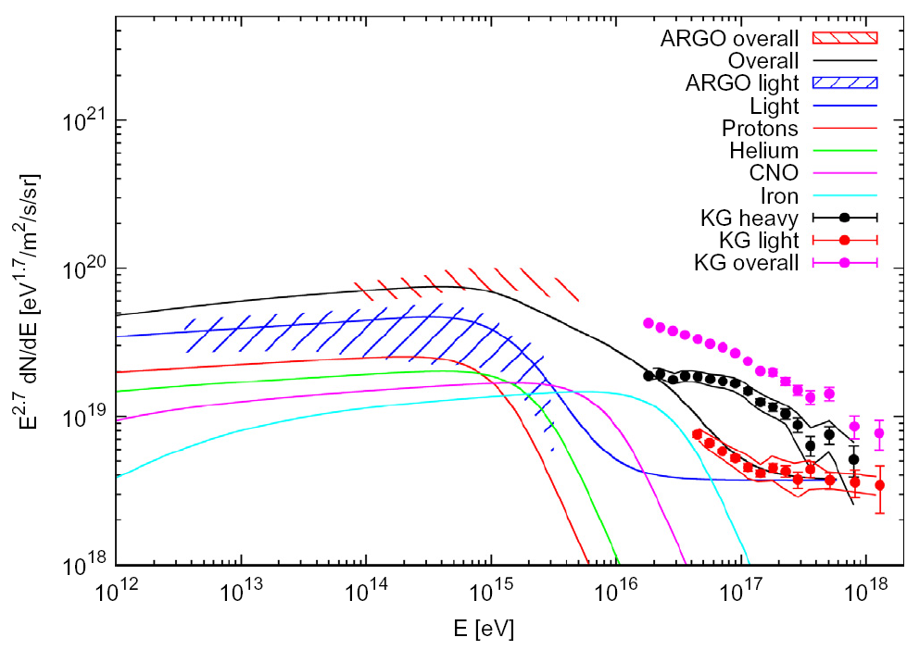
Composition models
J.R. Horandel (2003)
H4a model
Type II supernovae
T.K. Gaisser / Astroparticle Physics 35 (2012) 801
M. Cardillo et al. / Astroparticle Physics 69 (2015) 1–10

Slide 37

Comparison between the input H&He spectrum according to Horandel and the reconstructed one after subtracting the contamination of heavy nuclei. Both spectra agree with each other within 5%, with no new structure found.

Slide 38


Slide 39


Slide 40


Slide 41



Slide 42

All particle energy spectrum

Slide 43

All particle energy spectrum

Slide 44



Energy resolution (H&He)

Slide 45
Hybrid Observation and Data Set
Period:
From 2010.12 ~ 2012.02: Coincidence events;
Good weather selection: 7.28×10⁵ sec.
Criteria for well measured events
Shower core contained in the ARGO central carpet, excluding an outer region by 1 meter;
More than 1000 fired pads on the ARGO-YBJ central carpet;
Cherenkov image must be fully contained in the telescope, i.e. space angle < 6 respect to the axis of the telescope;
The number of fired tubes >= 6.
Cherenkov image cleaning
Single channel threshold: S/N>3.5;
Arrival time information: all triggered pixel should be within a time window Δt=240 ns;
Rejection isolated pixel.
8218 events are well reconstructed above 100 TeV

Slide 46


Weather selection
Infrared detector result
Clear
Cloudy
The correlation coefficient is defined as the transparency of the atmosphere
Temperature (℃)
Mean total Npe
of every day
Star light
Clear
Galactic Plane
Transparency
Cloudy
Temperature (℃)

Slide 47


Slide 48


Slide 49

Fluorescent
Telescopes +
μ -content in KM2A
Re-Configuration
E<2EeV
“2nd knee”
Parameters for CR composition：Xmax，
μ-content
Tower CT: 16
μ : 1200x36m²
Side Trigger CT: 2x4

