Slide 1
Structures and properties of nuclear matter at the first-order phase transitions
Toshiki Maruyama (JAEA)
Nobutoshi Yasutake (Chiba Inst. of Tech.)
Minoru Okamoto (Univ. of Tsukuba & JAEA)
Toshitaka Tatsumi (Kyoto Univ.)
→ private
company

Slide 2
Matter of neutron stars
Density
$≈0⋯≈10ρ0$
Composition
Nucleons + leptons
. . . + mesons, hyperons
quarks + gluons + leptons
Structure & correlation
uniform
crystal
pasta
amorphous
pairing
…..

Slide 3
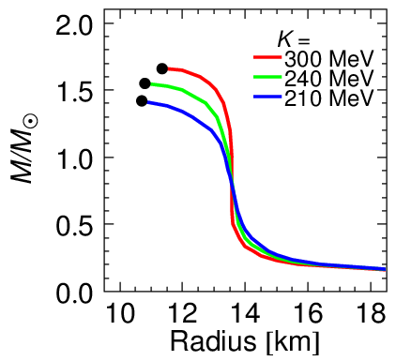
EOS and structure of neutron stars
Tolman-Oppenheimer-Volkoff (TOV) eq. gives density profile of isotropic material in static gravitational equilibrium.
Relativistic
correction
EOS (relation between density $ρ$ and pressure $P$) is essential.

Slide 4
Things to be considered during phase transition
Liquid-gas
Meson condensation
Hadron-quark
…………..
Density
Phase transitions
Chemical composition
Mixed phase
structure
Interaction
Pressure

Slide 5
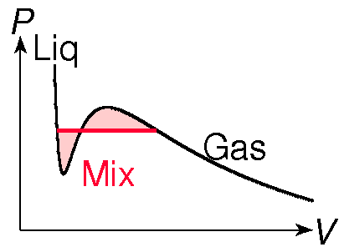
First-order phase transition and EOS
Single component congruent
(e.g. water)
Maxwell construction satisfies the
Gibbs cond. T^{I}=T^{II}, P^{I}=P^{II}, μ^{I}=μ^{II}.
Many components non-congruent
(e.g. water+ethanol)
Gibbs cond.T^{I}=T^{II}, P_{i}^{I}=P_{i}^{II}, μ_{i}^{I}=μ_{i}^{II}.
No Maxwell construction !
Many charged components
(nuclear matter)
Gibbs cond. T^{I}=T^{II}, μ_{i}^{I}=μ_{i}^{II}.
No Maxwell construction !
No constant pressure !
Explicit dependence
on $r$ by Coulomb int.
This is the case for nuclear matter !

Slide 6
Mixed phases in compact stars
Low-density nuclear matter
liquid-gas
neutron drip
High density matter
meson condensation
hadron-quark

Slide 7
(1) Low density nuclear matter
Nucleons interact with each other via coupling with $σ$, $ω$, $ρ$ mesons.
Simple but feasible!

Slide 8
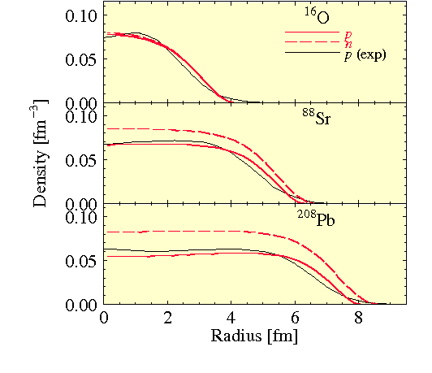
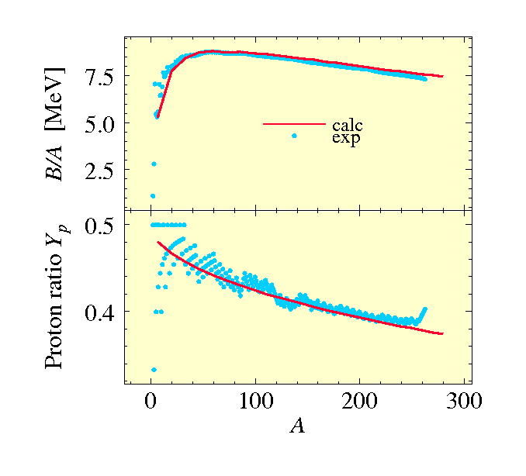
RMF + Thomas-Fermi model
Nucleons interact with each other via coupling with $σ$, $ω$, $ρ$ mesons.
Simple but realistic enough.
Binding energies, proton fractions, and density profiles of nuclei are well reproduced.
Saturation property of symmetric nuclear matter : minimum energy
$E/A≈−16$ MeV at $ρ_{B}≈0.16 {\text{fm}}^{−3}$.

Slide 9
Numerical procedure
Wigner-Seitz approx is often used. But we have performed 3D calc.
To equilibrate ${\text{μ}}_{i}(r)$ in $r$ and among species $i$
$\left.\begin{matrix}\text{remove} r\text{−}\text{dependence} {\text{μ}}_{i}\left(r\right)={\text{μ}}_{i} \\ \text{satisfy} \text{chemical} \text{balances} {\text{μ}}_{n}={\text{μ}}_{p}+{\text{μ}}_{e}\end{matrix}\right\}$ #
Divide whole space into equivalent and neutral cubic cells with periodic boundary conditions
Distribute fermions ($p, n, e$) randomly but $\int{{d_{}^{3}r ρ}_{i}(r)} =given$
Solve field equations for $σ(r), ω_{0}(r), ρ_{0}(r), V_{Coul}(r)$
Calculate local chemical potentials of fermions ${\text{μ}}_{i}(r)$
$$μ_{i}\left(r\right)=V_{i}(r)+\sqrt{{m_{i}}^{2}+{{p_{F}}_{i}(r)}^{2}}$$
Adjust densities $ρ_{i}(r)$ as
${\text{μ}}_{i}\left(r_{1}\right)>{\text{μ}}_{i}(r_{2})$ → $ρ_{i}\left(r_{1}\right)↓$ , $ρ_{i}\left(r_{2}\right)↑$
${\text{μ}}_{n}\left(r\right)>{\text{μ}}_{p}\left(r\right)+{\text{μ}}_{e} \text{→} ρ_{n}\left(r\right)↓ , ρ_{p}(r)↑$ beta equil.
repeat until $⋕$

Slide 10
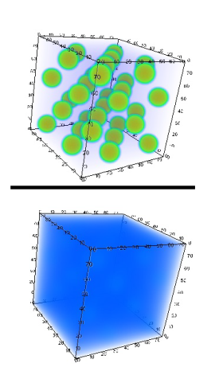
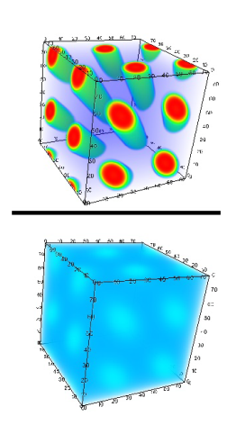
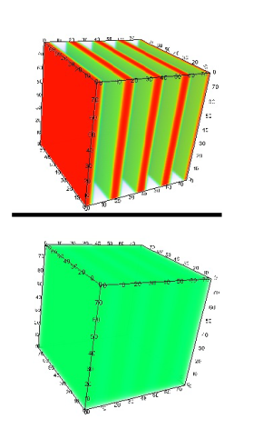
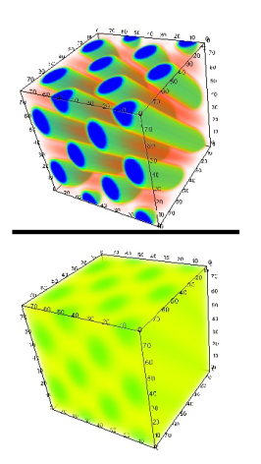
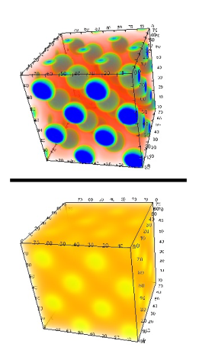
Result of fully 3D calculation
[Phys.Lett. B713 (2012) 284]
Symmetric nuclear matter
Y_{p} = Z/A = 0.5
(supernova matter)
proton
electron
“droplet”
[fcc]
ρ_{B} = 0.012 fm⁻³
“rod”
[honeycomb]
0.024 fm⁻³
“slab”
0.05 fm⁻³
“tube” [honeycomb]
0.08 fm⁻³
“bubble”
[fcc]
0.094 fm⁻³
Confirmed the appearance of pasta structures.

Slide 11
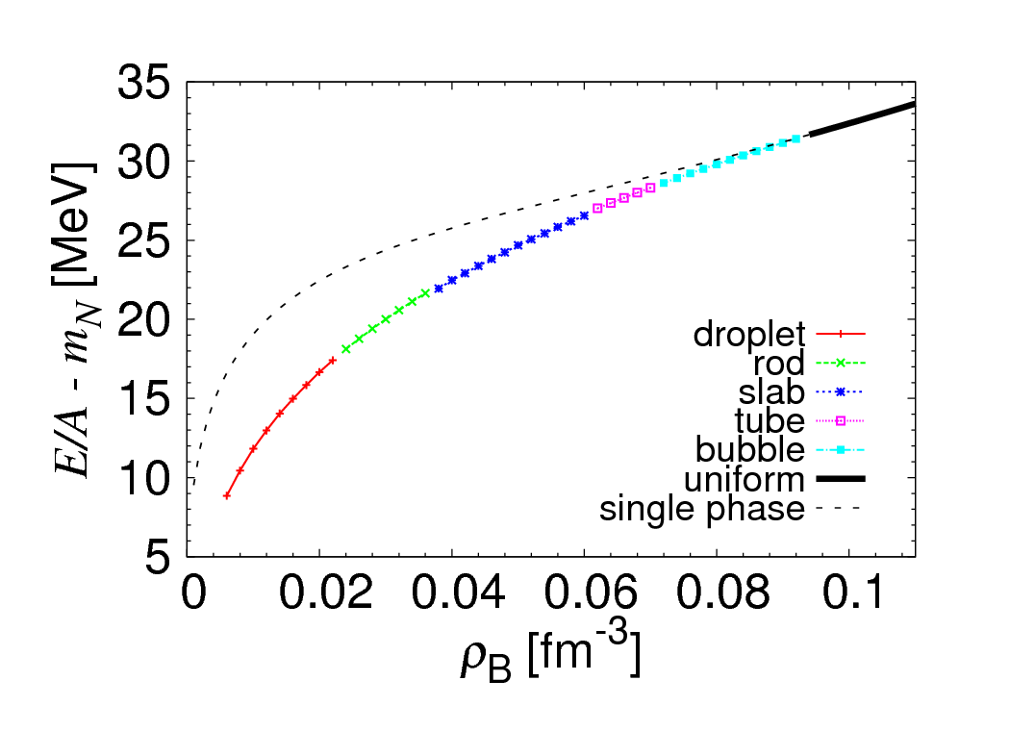
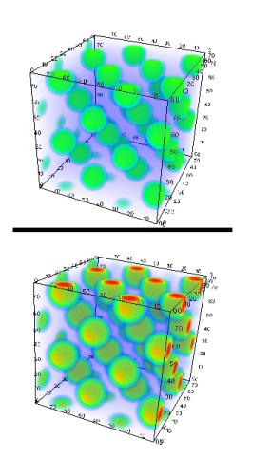
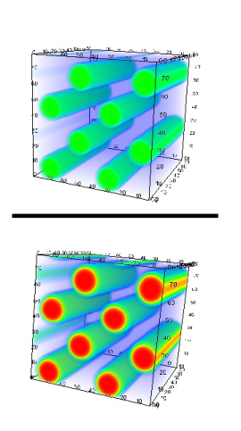
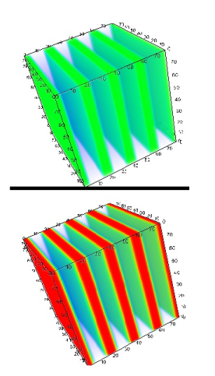
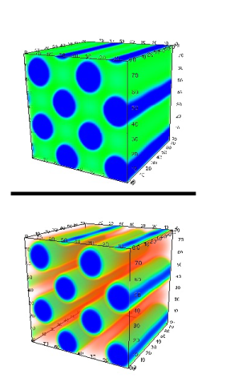
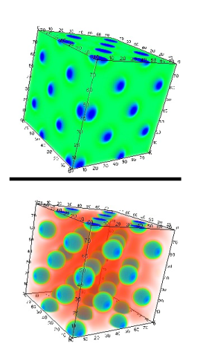
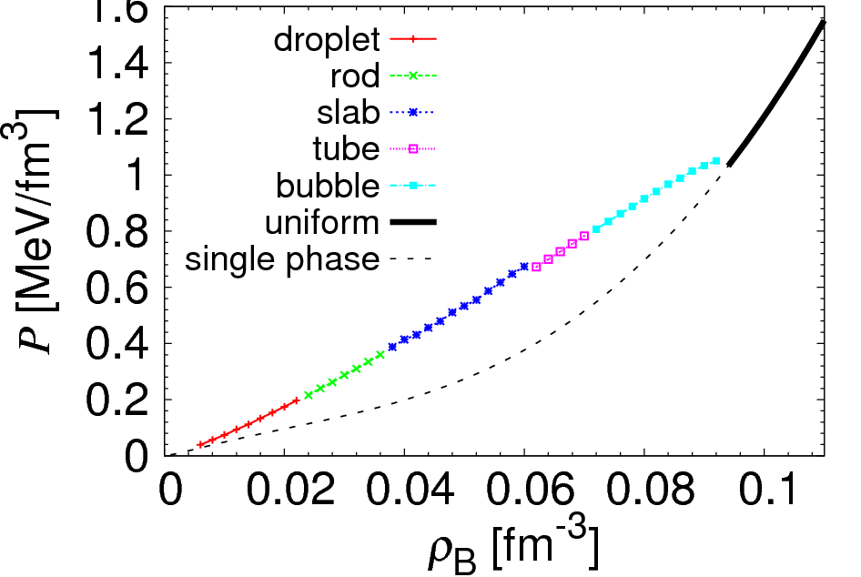
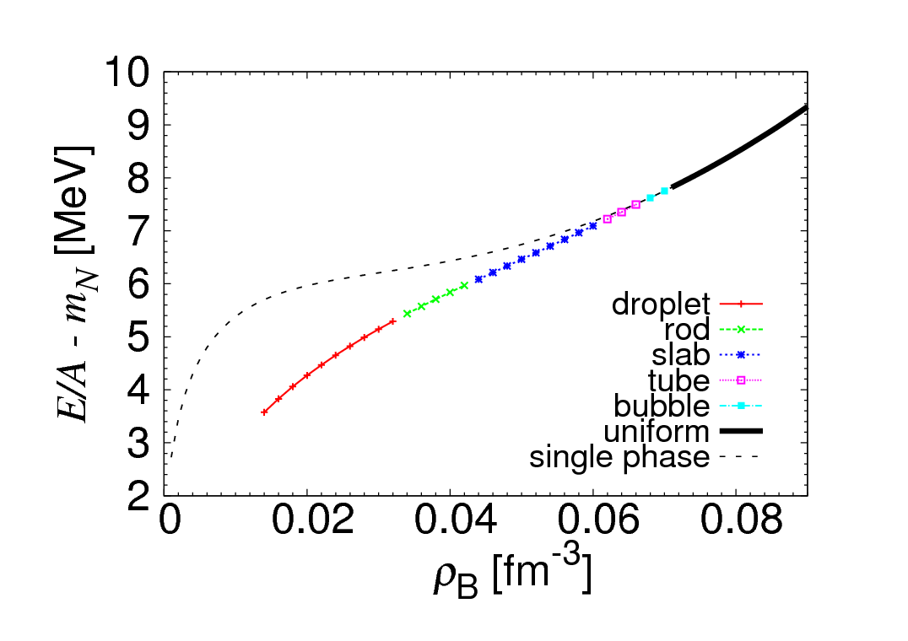
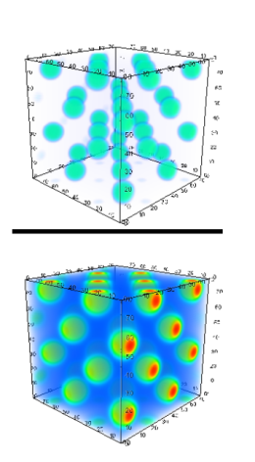
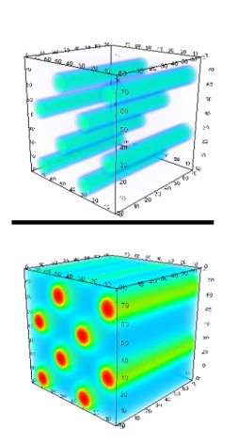
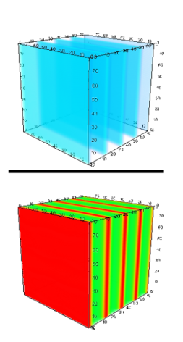
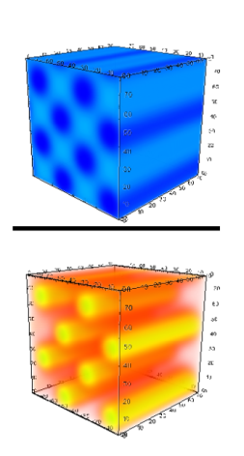
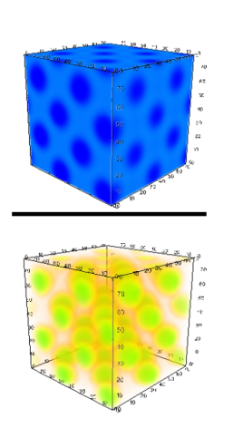
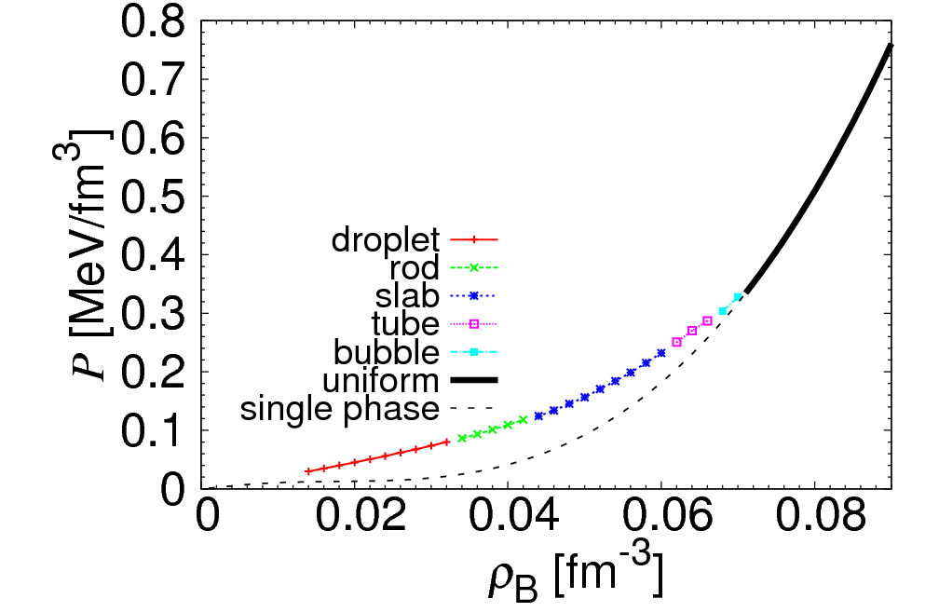
Y_{p} = 0.3
proton
neutron
“droplet”
[fcc]
ρ_{B} = 0.016 fm⁻³
“rod”
[simple]
0.030 fm⁻³
“slab”
0.05 fm⁻³
“tube”
[simple]
0.066 fm⁻³
“bubble”
[fcc]
0.080 fm⁻³
Y_{p} = 0.1
proton
neutron
“droplet”
[fcc]
ρ_{B}=0.020 fm⁻³
“rod”
[simple]
0.040fm⁻³
“slab”
0.05 fm⁻³
“tube”
[simple]
0.066 fm⁻³
“bubble”
[fcc]
0.070 fm⁻³

Slide 12
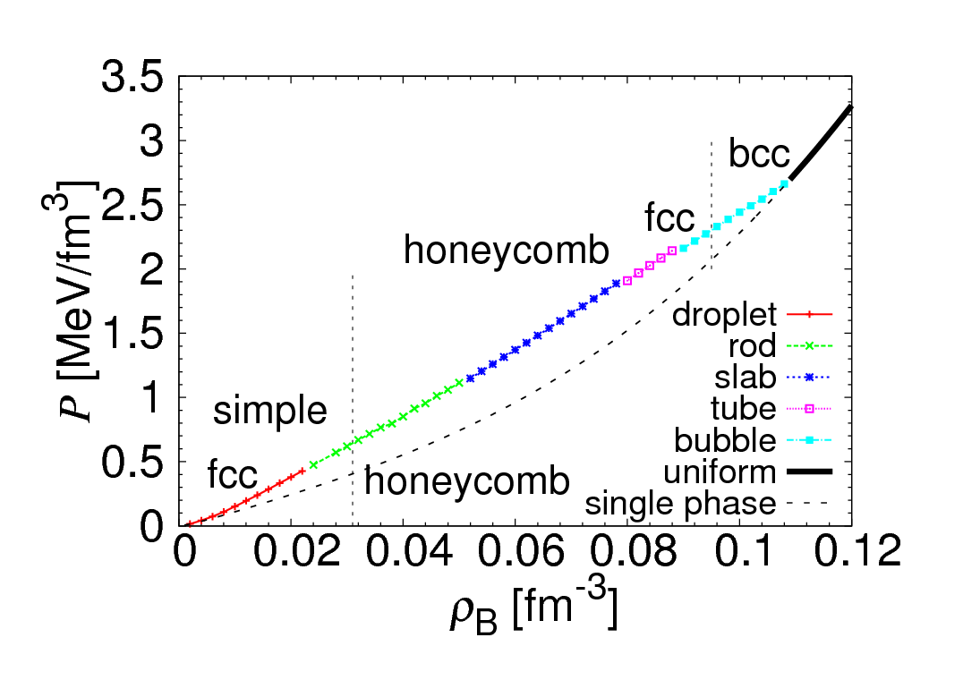
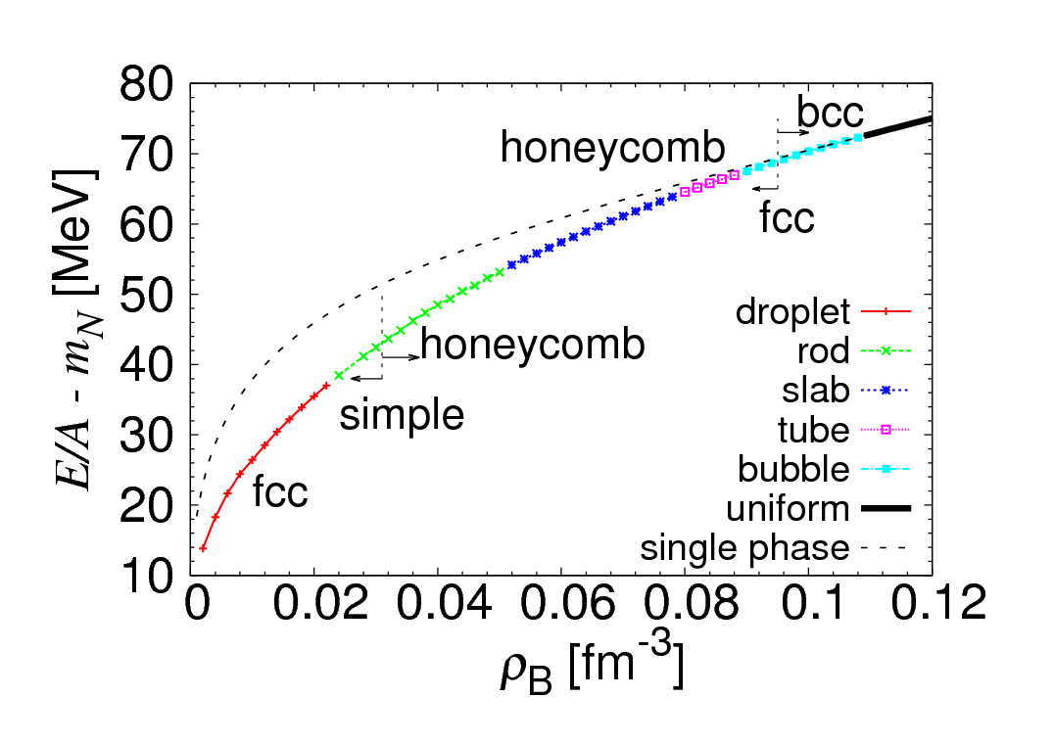
Y_{p} = Z/A = 0.5
EOS (full 3D) is different from that of uniform matter.
The result is similar to that of the conventional studies with Wigner-Seitz approx.
Novelty:
fcc lattice of droplets can be the ground state at some density.
← Not the Coulomb interaction among “point particles” but the change of the droplet size is relevant.
bcc
bcc

Slide 13
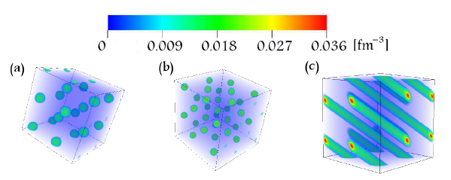
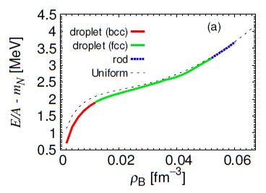
Beta equilibrium case
(neutron star crust)
[Phys. Rev. C 88, 025801]
Slightly different result from
the WS approx.
Crystalline structures bcc & fcc.
Rod phase appears.

Slide 14
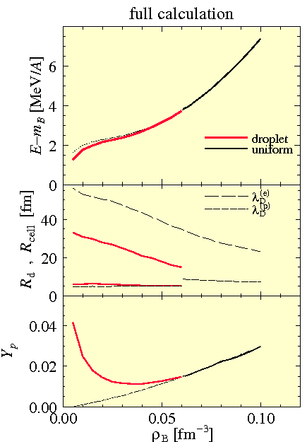
Beta-equilibrium case
_{By Wigner-Seitz approx}
T=0
Beta equil.
Only “droplet” structure appears.
The change of EOS due to the non-uniform structure is small.

Slide 15
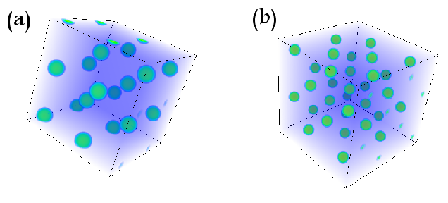
Novelty of 3D calculation
Not only simple structures but any complex ones are taken into consideration in our new calculation.
Above structures are observed as excited states in our RMF calculation for symmetric ($Y_{p}=0.5$) nuclear matter.
Typical pasta structures are found to be the ground states.
Mixture of droplet & rod
Mixture of slab & tube
Dumbbell
Network
Crystalline structures can be discussed. We have found that fcc lattice appears at higher densities of droplet phase.
bcc, $ρ=0.01 {fm}^{−3}$
fcc, $ρ=0.03 {fm}^{−3}$

Slide 16
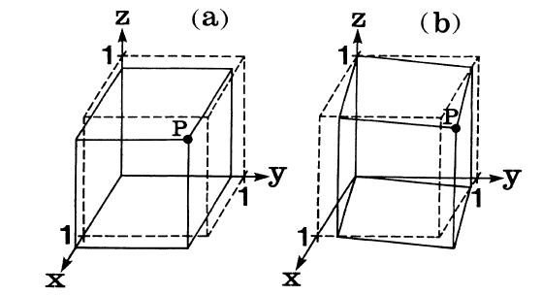
$$r_{i}→r_{k}δ_{ik}u$$
($\overset{⃑}{r}→\vec{r}u$)
Shear
[Ogata etal,
PRA42(1990)4867]
Deformation $=$ $\begin{matrix}\text{translation} \\ or rotation\end{matrix}$ + $\begin{matrix}\text{isotropic} \\ \text{compression}\end{matrix}$ + $shear$
Nothing essential
Conserves the volume.
There are 6 kinds
6 kinds of $shear deformations$
D1: $u_{xx}=\frac{2ε−ε^{2}}{{\left(1−ε\right)}^{2}}, u_{yy}=u_{zz}=−ε$
D2: D1 with $x→y,y→z,z→x$
D3: D1 with $x→z,y→x,z→y$
D4: $u_{xx}=\frac{ε^{2}}{{(1−ε)}^{2}},{ u}_{yz}=u_{zy}=ε$
D5: D4 with $x→y,y→z,z→x$
D6: D4 with $x→z,y→x,z→y$
(D1)
(D4)
$ε$ : infinitesimal
$r_{i}→(δ_{ik}+u_{ik}$) $r_{k}$
$P=(1+\frac{2ε−ε^{2}}{{\left(1−ε\right)}^{2}},1−ε,1−ε$)
$P=(1+\frac{ε^{2}}{1−ε^{2}},1+ε,1+ε$)

Slide 17
Calculation of shear modulus
How rigid against shear deformation
increment of free energy
$$δF=\frac{1}{2}λu_{ii}^{2}+μ{ u}_{ik}u_{ik}$$
$λ$:volume elasticity
$μ$: shear modulus
How to calculate the shear modulus in our framework
Prepare a ground state
Give a small shear deformation without compression
Calculate the curvature of the energy change against a shear deformation.
Average the curvature among different shears

Slide 18
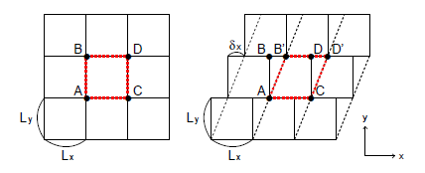
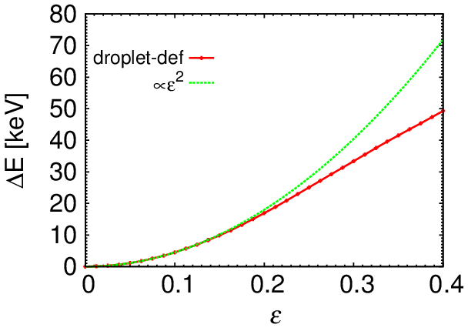
How to give a shear deformation
Deformed periodic boundary condition (DPBC)
$$ε=\frac{δx}{L_{x}}$$
$$\text{F}\text{(}\text{x} ±\text{Lx}\text{, }\text{y}\text{) }\text{ = }\text{F}\text{(}\text{x}\text{, }\text{y}\text{)}\text{, }$$
$$\text{F}\text{(}\text{x}\text{, }\text{y}±\text{Ly}\text{) = }\text{F}\text{(}\text{x}\text{, }\text{y}\text{)}$$
$$\text{F}\text{(}\text{x} ±\text{Lx}\text{, }\text{y}\text{) }\text{ = }\text{F}\text{(}\text{x}\text{, }\text{y}\text{)}\text{,}$$
$$\text{F}\text{(}\text{x}\text{, }\text{y}±\text{Ly}\text{) = }\text{F}\text{(}\text{x}∓\text{δx}\text{, }\text{y}\text{)}$$
Ground state under DPBC
$$ε=0$$
$$ε=0.05$$
$$ε=0.1$$

Slide 19
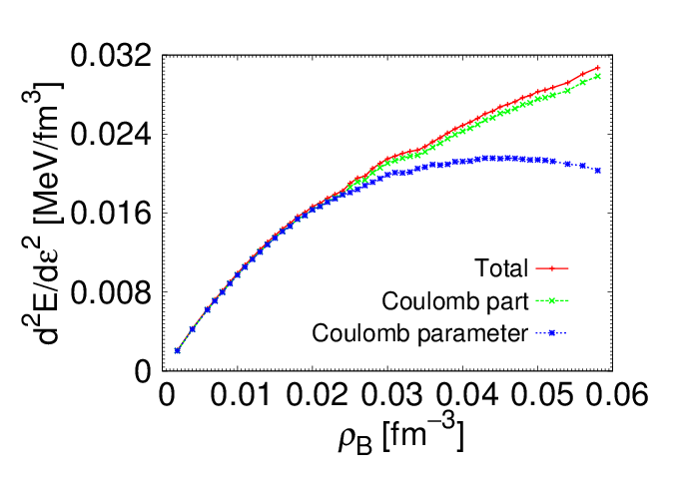
Preliminary result for droplet
Below $0.02 {fm}^{−3}$, we get shear modulus slightly smaller than the conventional study. → screening effects.
→ slightly smooth
Above $0.02 {fm}^{−3}$, our value is larger. →finite size effects. →Rigid.

Slide 20
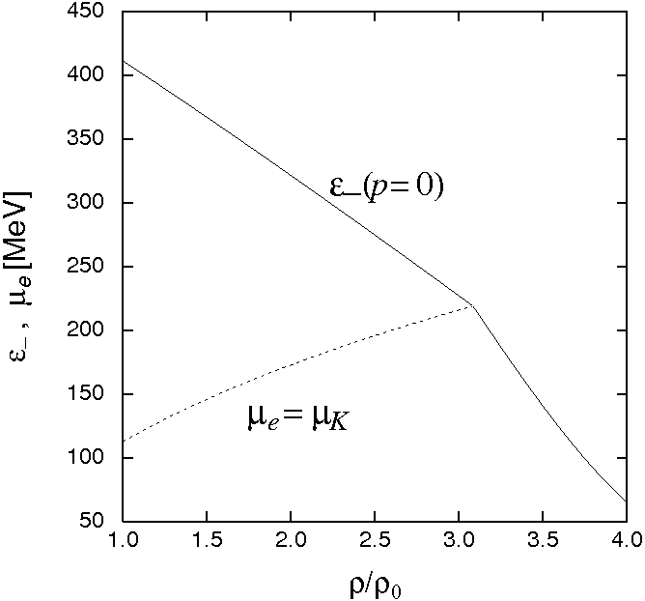
(2) Kaon condensation
[Phys. Rev. C 73, 035802]
K single particle energy (model-independent form)
From a Lagrangian with chiral symmetry
Threshold condition of condensation

Slide 21
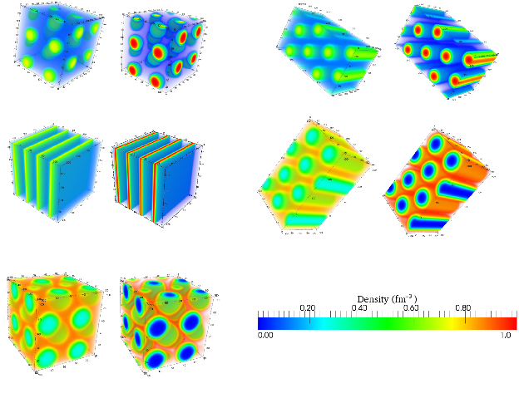
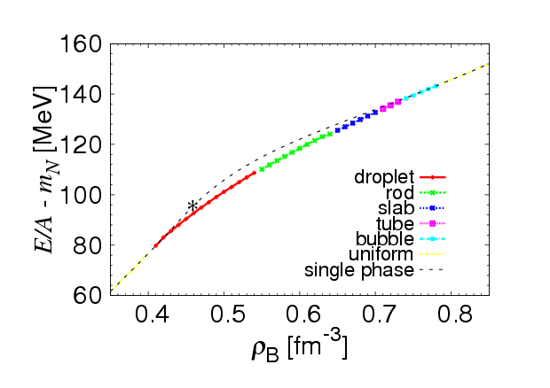
Fully 3D calculation
[unpublished yet]
p
K⁻
p
K⁻
0.45$fm^{−3}$
0.60$fm^{−3}$
0.70$fm^{−3}$
0.72$fm^{−3}$
0.75$fm^{−3}$

Slide 22
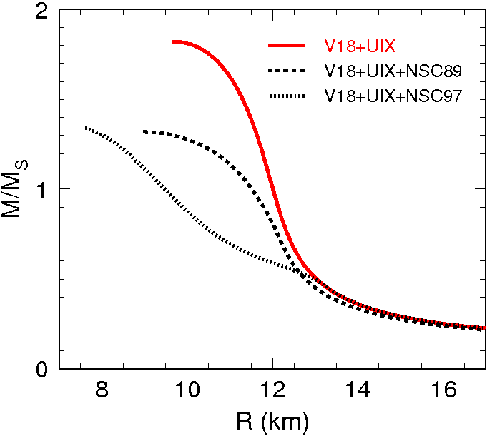
(3) Hadron-quark phase transition
[Phys. Rev. D 76, 123015]
At 2--3$ρ0$, hyperons are expected to appear.
→ Softening of EOS
→ Maximum mass of neutron star
becomes less than 1.4 solar mass
and far from 2 .0 solar mass.
→ Contradicts the obs >1.5 M_{sol}
Schulze et al, PRC73 (2006) 058801

Slide 23
Quark-hadron mixed phase
to get density profile, energy, pressure, etc of the system

Slide 24
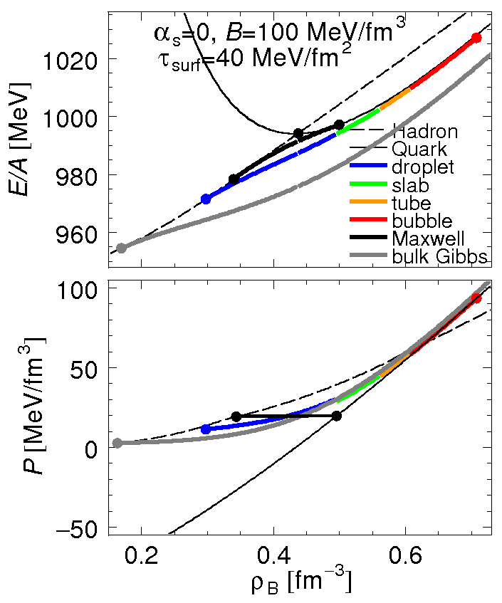
EOS of matter
Full calculation is between the Maxwell construction (local charge neutral) and the bulk Gibbs calculation (neglects the surface and Coulomb).
Closer to the Maxwell.

Slide 25
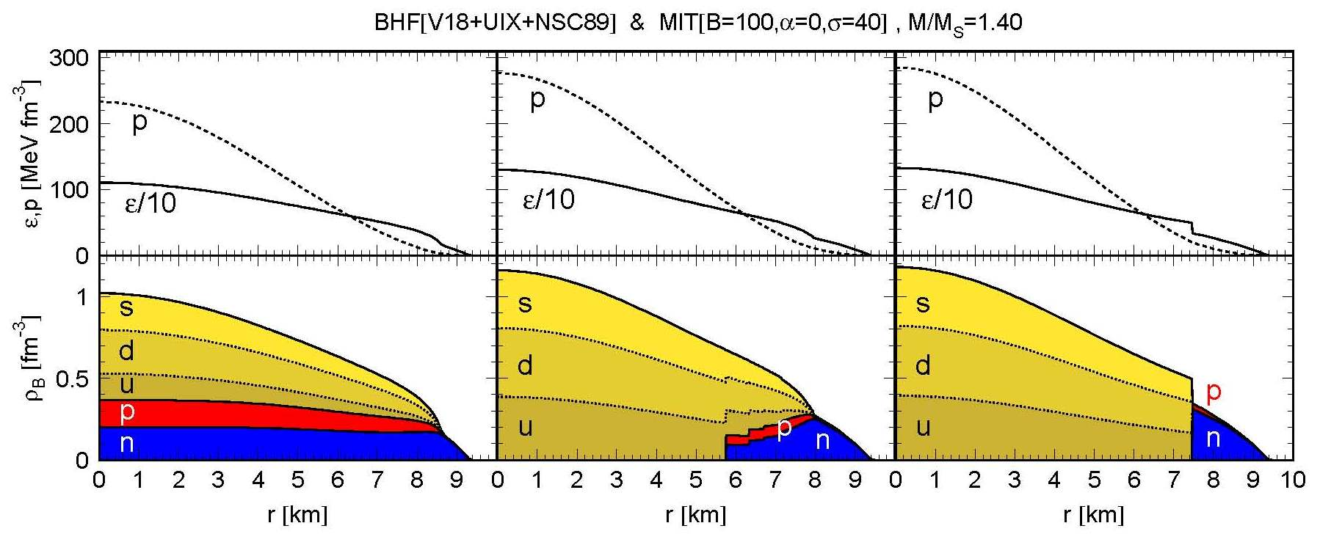
Structure of compact stars
TOV equation
Pressure (input of TOV eq.)‏
Density at position $r$
mass inside the position $r$
total mass and radius.
Density profile of a compact star ($M=1.4 M⨀$)‏
Bulk Gbbs
Full calc τ_{surf}=40 MeV/fm²
Maxwell const.
25
Notes:
25

Slide 26
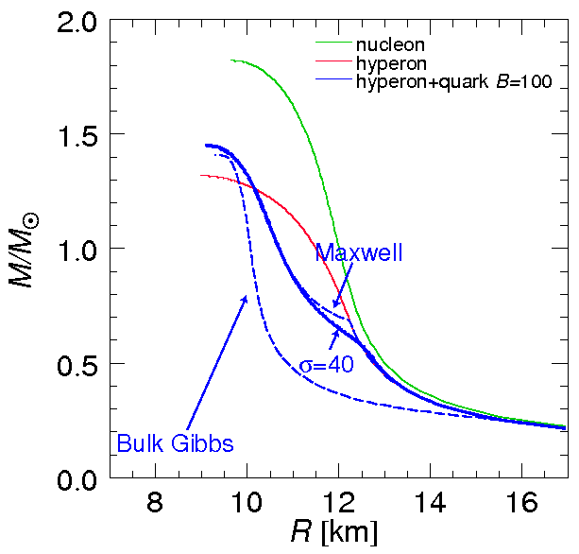
Mass-radius relation of a cold neutron star
Full calculation with pasta structures yields similar result to the Maxwell construction.
Maximum masses are almost the same for 3 cases.
We need to improve largely the quark EOS or hadron EOS to get $\sim 2M⨀$
τ_{surf}=40
26
Notes:
26

Slide 27
Summary
First-order phase transition of nuclear matter
→ mixed phase of multi-components with charge
→ Structured mixed phase (pasta).
important for EOS.
Fully 3D calculation of mixed phase is developing.
Future:
Hadron-quark mixed phase in 3D calc.
Inhomogeneous chiral condensate by 3D calc?

