Slide 1
Oscillation Driven Magnetospheric Activity In Pulsars
Peking University Mengxiang Lin, Renxin Xu, Bing Zhang
Email: linmx97@gmail.com
2014.10.21
Submitted to Astrophysical Journal

Slide 2
Outline
Introduction
Physical model
Results
Explanation of radio AXPs/SGRs
Summary

Slide 3
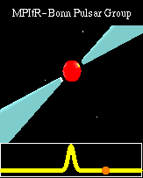
Introduction
Pulsars：
rotational magnetized compact objects

Slide 4
Introduction
Glitches (sudden “spin-up”) are common
Radio AXPs/SGRs (four sources detected)
(mcGill online magnetar catalog)
Quiescent states: radio quiet
After outbursts: radio loud
AXPs/SGRs: anomalous X-ray pulsars /
soft gamma-ray repeaters

Slide 5
Morozova et al. (2010); Zanotti et al. (2012) had studied oscillations’ effect under SCLF model
We study oscillations’ effect under inner gap model

Slide 6
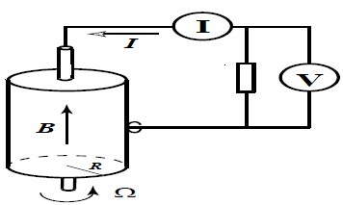
The Physical Model
G-J charge density and toroidal oscillation modification
Unipolar induction:
Goldreich-Julian charge density:
(Goldreich & Julian 1969, only rotation)
Toroidal oscillation:
Oscillation modification to G-J charge density:

Slide 7
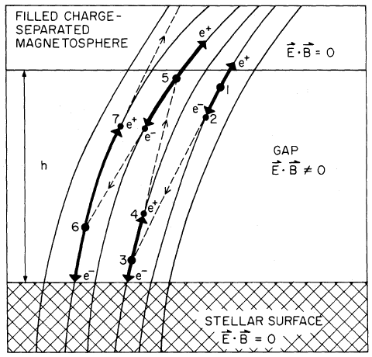
The Physical Model
Inner gap model
Three modes:
CR (curvature radiation)
ICS (inverse Compton
scattering)
2$γ$ (two-photon annihilation)
$$h=min⁡\{h_{CR}, h_{ICS}, h_{2γ}\}$$
Death line criterion :
Ruderman & Satherland (1975)

Slide 8
Results
Typical parameters of normal pulsars:
$P=0.1$s, $B={10}^{12}$G, $T={10}^{6}$K, dipole

Slide 9
Explanation of radio AXPs/SGRs
In magnetar model
Superstrong magnetic field $\sim {10}^{14}G$:
always above the radio death line
Oscillations :
enlarge radio emission beam
enlarge the possibility to be detected

Slide 10
Explanation of radio AXPs/SGRs
In solid quark star model
Normal magnetic field $\sim {10}^{12}G$
Quiescent states
under death line → radio quiet
After outbursts:
Starquakes → oscillations → larger $ΔV$
→ above death line →radio loud
Radio decays with oscillations damping

Slide 11
Explanation of radio AXPs/SGRs
Tong & Wang 2014

Slide 12
Explanation of radio AXPs/SGRs
In solid quark star model
Explanation of
1E 1547.0-5408:
$P=2.07$s,
$B={10}^{12}$G,
$T=5×{10}^{6}$K

Slide 13
Explanation of radio AXPs/SGRs
In solid quark star model
The critical K of the four radio AXPs/SGRs.
Dipole magnetic field with $B={10}^{12}$G is adopted.

Slide 14
Summary
Toroidal oscillations change $ρ_{GJ}$ and then influence the properties of pulsar inner gap
Shorter height, Larger $ΔV$
Larger effective polar cap
Mode change
Explanation of radio AXPs/SGRs
Magnetar model: larger radio beam
Solid quark star model: larger $ΔV$ activate the pulsar inner gap from below the radio death line

Slide 16
The Physical Model
The height of gap in three modes
CR, ICS
$h\sim l_{γ}$,
Case 1: If $l_{γ}\left(γ_{e, max}\right)>l_{e}(γ_{e,max})$: $h=l_{γ}\left(γ_{e,max}\right)$
Case 2: If $l_{γ}\left(γ_{e,max}\right)<l_{e}(γ_{e,max})$:
$h=l_{γ}=l_{e}$ or $h=min⁡\{l_{e}\}$
$γ_{e}$ ↑
$E_{γ}$↑
$l_{γ}$↓
$$γ_{e, max}=eΔV/(m_{e}c^{2})$$

Slide 17
The Physical Model
The height of gap in three modes
Two photon annihilation
(Zhang et al. 1998)
$l_{γ}$ only depends on Temperature

