Slide 1
A strangeness barrier on strange quark-cluster star surface
Renxin Xu
School of Physics, Peking University
( )
1st bilateral meeting on “Quark and Compact stars”
October 22, 2014; KIAA@PKU
Strangeness barrier http://vega.bac.pku.edu.cn/rxxu R. X. Xu

Slide 2
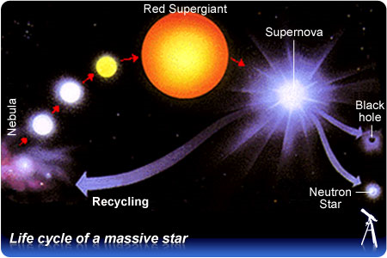
What’s compressed baryonic matter?
CBM is produced inside massive stars after SN
SN occurs due to gravitational energy release when nuclear power cannot stand against gravity.
A strangeness barrier http://vega.bac.pku.edu.cn/rxxu R. X. Xu

Slide 3
Puzzling Pulsar Inside: EoS...
Different models in the market: yours and mine
conventional Neutron Star
light flavour symmetry: Strange Star
A strangeness barrier http://vega.bac.pku.edu.cn/rxxu R. X. Xu

Slide 4
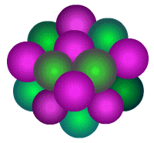
A Quark-cluster matter phase?
Q: The assumption of quark-cluster matter is very loose and not justified from a QCD point of view.
A: Has the properties of nuclei been justified by the QCD first principles? Both CBM and nuclei are of non-perturbative QCD, but with flavor-symmetry changing from 2 (u,d) to 3 (u,d,s).
proton
neutron
Hyperon puzzle?
Quark-confinement?
Not to be problems here!
f = 2
f = 3
A strangeness barrier http://vega.bac.pku.edu.cn/rxxu R. X. Xu

Slide 5
A Quark-cluster matter phase?
Nucleus and Quark-cluster star:
differences and similarities
proton
neutron
Self-bound: by strong int.
Self-bound: by strong int.
l ~ fm: electrons outside
l > λ_{e}: electrons inside
2-flavour symmetry: isospin
3-flavour symmetry: strangeness
light clusters: p(uud), n(udd)
heavy clusters: 6(H), 9, 12, 18
a ~ λ_{c}: quantum effects
a < λ_{c}: classical particle
quantum gas/liquid
solid condensed matter at low-T

Slide 6
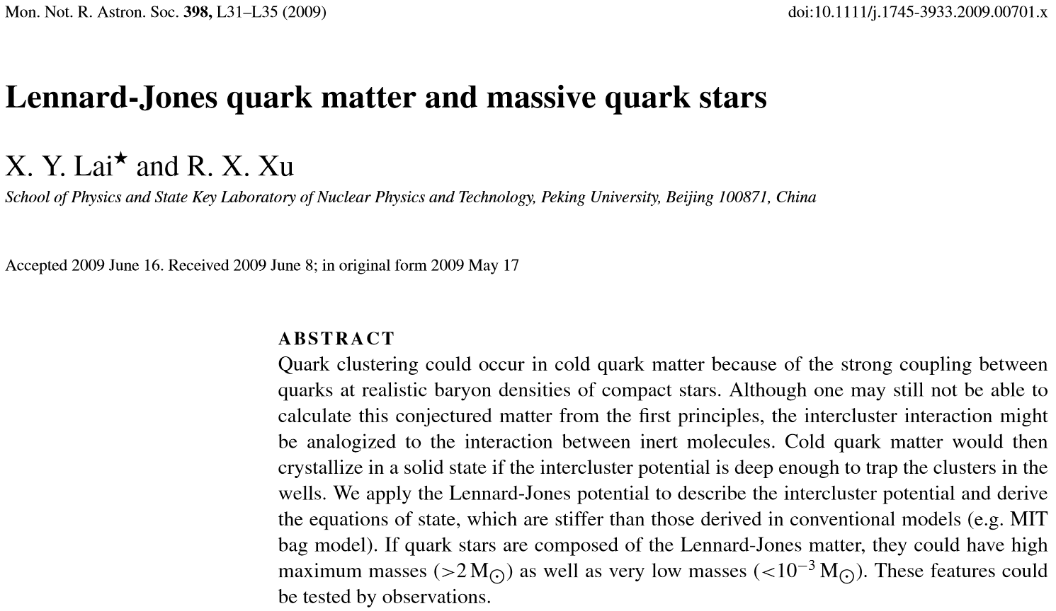
Two features to be tested by observations
Low mass (~10⁻²M⊙) is a direct consequence of self-bound surface!
A strangeness barrier http://vega.bac.pku.edu.cn/rxxu R. X. Xu

Slide 7
Summary
Low-mass strange star: a candidate?
A strangeness barrier necessary
From corona to atmosphere/ocean/crust
Conclusions
A strangeness barrier http://vega.bac.pku.edu.cn/rxxu R. X. Xu

Slide 8
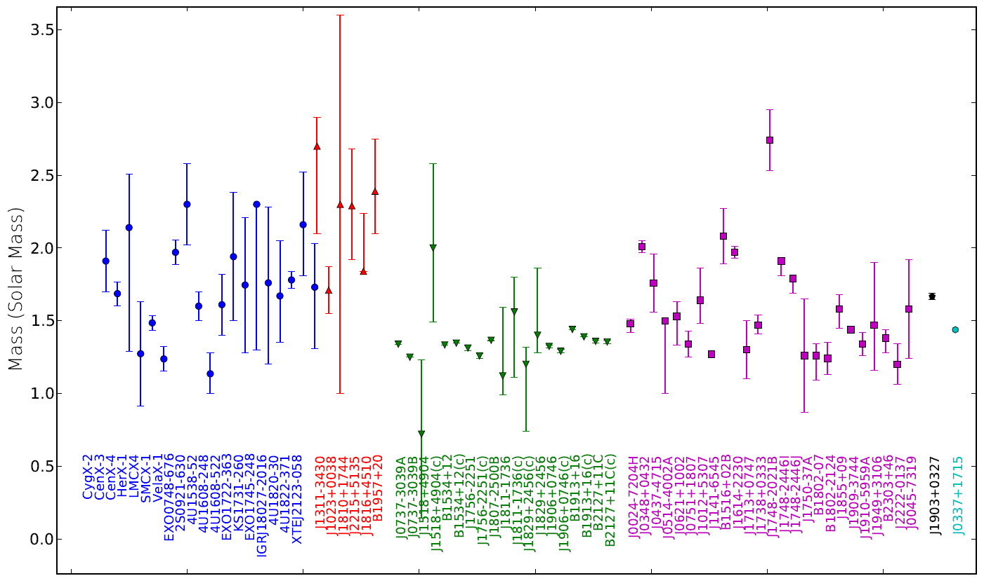
Current mass measurements of “NSs”
Watts et al. (2014)

Slide 9
A low-mass candidate: 4U 1700+24
Red-shift: z ~ 0.009!
X-ray black body radiation area (A^{1/2} ~ 10-10² m) reduce as L_{x} decreases.
The mass function via by observing the G-type red giant company is only f_{o} ~ 10⁻⁵M⊙!
⇒ All 3 could be understood if M_{compact} is only
~ 10⁻²M⊙ unless geometrically fine-turn.
A strangeness barrier http://vega.bac.pku.edu.cn/rxxu R. X. Xu

Slide 10
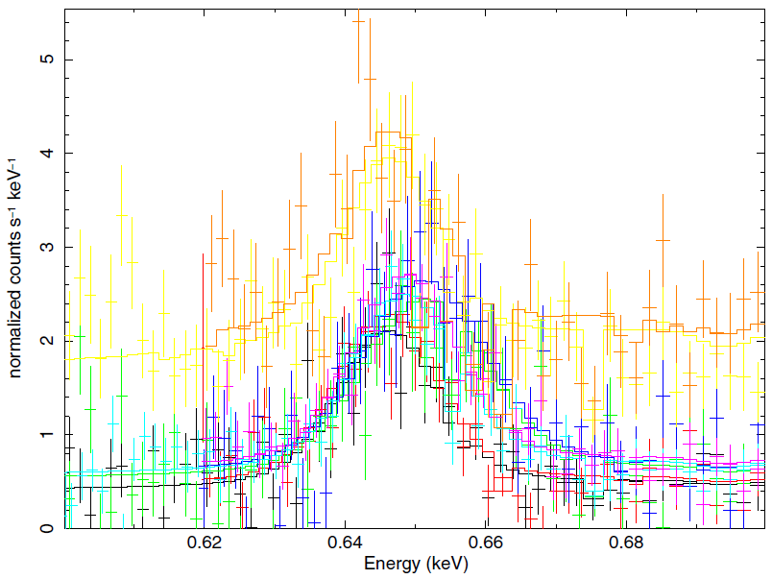
The puzzling symbiotic X-ray system 4U 1700+24
Nucita et al. (2014)
H-like Ly-α Lines at E/eV: {10.2, 40.8, 91.8, 163.2, 255, 367.2, 500, 𝟔𝟓𝟐.𝟖, 826.2, 1020,
1234.2, 1468.8, 1723.8, 1999.2, 2295, 2611.2, 2947.8, 3304.8, 3682.2, 4080, ...}

Slide 11
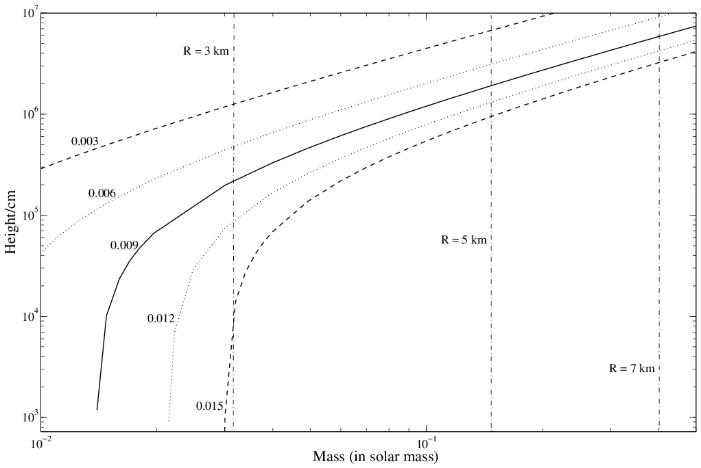
A solution to the puzzling symbiotic X-ray system 4U 1700+24?
Xu (2014)
h = R

Slide 12
X-ray spot, A, reduces as L_{x} decreases
The polar cap radius is r_{p},
The radius is r_{p} ~ 10m if R = 2km and P = 1s.
Polar cap enlarges due to diffusion of matter
Understandable for X-ray spot size ~ 10-10²m!
A strangeness barrier http://vega.bac.pku.edu.cn/rxxu R. X. Xu

Slide 13
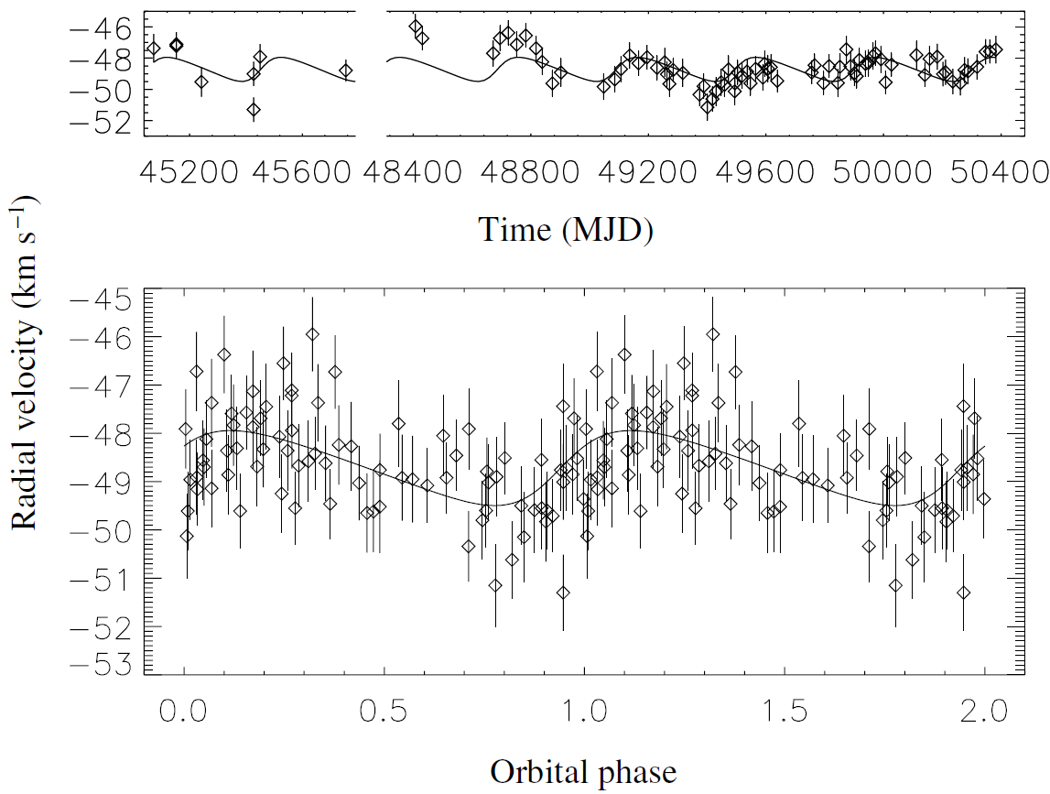
Besides z & A, constraint from red giant, f_{O}
Radial velocity measurements of HD 154791
P_{orb} = 404±3 day
Galloway+ (2002)

Slide 14
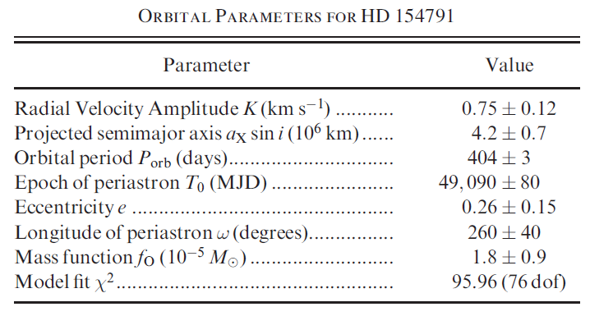
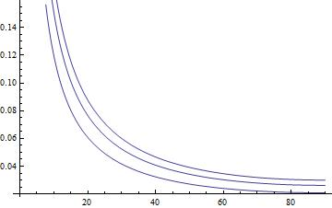
Galloway+ (2002)
M_Compact
f_{O} = 2.7 x 10⁻⁵ M_sun
f_{O} = 1.8 x 10⁻⁵ M_sun
f_{O} = 0.9 x 10⁻⁵ M_sun
i

Slide 15
Summary
Low-mass strange star: a candidate?
A strangeness barrier necessary
From corona to atmosphere/ocean/crust
Conclusions
A strangeness barrier http://vega.bac.pku.edu.cn/rxxu R. X. Xu

Slide 16
A strangeness barrier necessary
Strange (quark) stars
Witten’s (1984) conjecture: for quark matter {u, d, s, (e)}
Analogy of Nuclear Symmetry Energy:
from Baoan’s talk at CUSTIPEN2014
Kinetic
Potential
e
e
e
e
u d s e
e
~10³ fm
e
e
Coulomb barrier on surface: ~10 MeV
Greiner et al. (1998)
Xu & Qiao (1999)
A strangeness barrier http://vega.bac.pku.edu.cn/rxxu R. X. Xu

Slide 17
A strangeness barrier necessary
Accreted matter easily penetrate Coulomb barr.
p
free fall
Accreted ions (with kinetic energy ~ 100 MeV) could easily penetrate the Coulomb barrier: de-confine first into 2-flavour quark matter by fast strong force (~10⁻²⁴s) and then change to 3-flavour quark matter by slow weak force (~10⁻⁷s).
A strange quark star should keep bare even during a phase of accretion!
~10 km
~1 M⊙
A strangeness barrier http://vega.bac.pku.edu.cn/rxxu R. X. Xu

Slide 18
A strangeness barrier necessary
Weak interaction first for quark-cluster star!
pp reaction as an analogy: p + p → d + e⁺ + ν_{e}
Two steps: barrier penetration (~10⁻¹⁰), flavor-changed weak interaction (~10⁻²⁰)
For comparison: ¹²C(p, γ)¹³N, cross-section > 10²⁰ times higher
p
Though ion kinematic energy could be higher than the barrier, V_{coulomb}
But it is difficult to produce strangeness from u and d
A corona composed by ions and electrons forms above a strange quark-cluster star!
p
strangeness barrier
A strangeness barrier http://vega.bac.pku.edu.cn/rxxu R. X. Xu

Slide 19
Summary
Low-mass strange star: a candidate?
A strangeness barrier necessary
From corona to atmosphere/ocean/crust
Conclusions
A strangeness barrier http://vega.bac.pku.edu.cn/rxxu R. X. Xu

Slide 20
From corona to atmosphere/ocean/crust
A very simple corona model: ρ(h)
Because of mass conservation, we have
or the bottom density of the corona above strange star surface
Then we could have a very simple model for the corona:
.
Atmosphere/ocean/crust could exist for high M

Slide 21
Summary
Low-mass strange star: a candidate?
A strangeness barrier necessary
From corona to atmosphere/ocean/crust
Conclusions
A strangeness barrier http://vega.bac.pku.edu.cn/rxxu R. X. Xu

Slide 22
Conclusions
A strangeness barrier is suggested to exist on a strange quark-cluster star surface, that should be necessary to keep normal matter outside a strange quark-cluster star surface.
Beside observations (stiff EoS, two types of glitches and extra free energy for bursts), the quark-cluster model is also good to understand detected z, A, and f_{O} of 4U 1700+24, ~10⁻²M⊙!
THANKS!
A strangeness barrier http://vega.bac.pku.edu.cn/rxxu R. X. Xu

