Slide 1
Asymmetric Neutrino Emissions in
Relativistic Mean-Field Approach and Observables: Pulsar Kick and Rapid Spin-Deceleration of Magnetized Proto-Neutron Stars
Tomoyuki MARUYAMA BRS, Nihon Univ. (Japan)
Collaborators
Toshitaka KAJINO Nao, Univ. of Tokyo (Japan)
Jun HIDAKA Nao (Japan)
Nobutoshi YASUTAKE Chiba Inst Tech, (Japan)
Takami KURODA Nao (Japan)
Myung-ki CHEOUN Soongs Univ. (Korea)
Chung-Yeol RYU Hangyang Univ. (Korea)
G.J. MATHEWS Univ. of Notre Dome (USA)
T. Taklwaki Nao (Japan)
1

Slide 2
§1. Introduction
High Density Matter Study ⇒ Exotic Phases inside Neutron Stars
Strange Matter, Ferromagnetism, Meson Condensation, Quark matter
Observable Information ‥‥Neutrino Emissions
S.Reddy, et al., PRD58 #013009 (1998) Influence from Hyperons Λ，∑
Magnetar 10¹⁵G in surface 10¹⁷⁻¹⁹G inside (?) → Large Asymmetry of ν？
P. Arras and D. Lai, PRD60, #043001 (1999) , S. Ando, P.R.D68 #063002 (2003）
(Non-Rela.)
Our Works ⇒ Neutrino Reactions on High Density Matter wih Strong Mag. Fields
in the Relativistic Mean-Field (RMF) Approach
TM et al., PRD83, 081303(R) (2011)
Application to Phenomena related with ν －Asymmetric Emission
Pulsar Kick in Poloidal Magnetic Field PRD86,123003 (‘12),
Spin Deceleration in Toroidal Magnetic Field PRC89, 035801 (14)

Slide 3

§2. Formulation
Magnetic Field :
Baryon
Lepton
B & L – Mag.
Proto-Nuetron-Star (PNS) Matter without Mag. Field
Baryon Wave Function under Mag. Field in Perturbative Way
Cross-Sections for ν reactions
Weak Interaction
ν_{e} + B → ν_{e} + B : scattering
ν_{e} + B → e⁻ + B’ : absorption
S.Reddy, M.Prakash and J.M. Lattimer, P.R.D58 #013009 (1998)

Slide 4
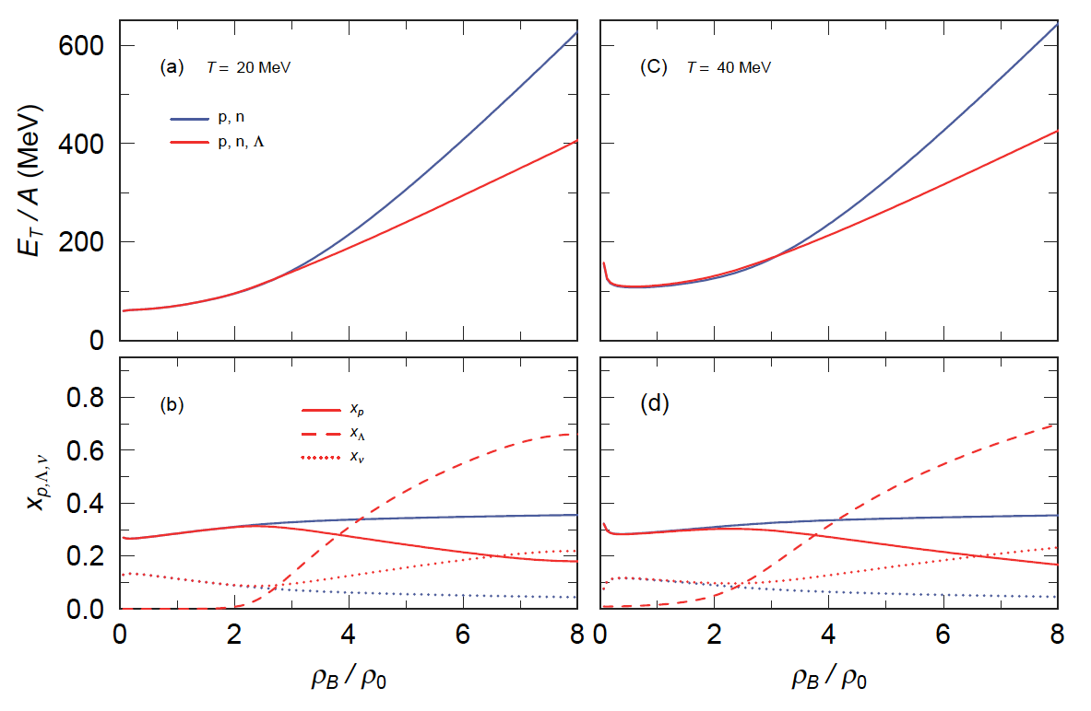
§2-1 EOS of Proto Neutron-Star-Matter in RMF
N, Λ, σ, ω, ρ
4
PM1-L1
SU(3)
T.M, et al.
PTP. 102, p809 (1999)
Charge Neutral （ ） & Lepton Fraction : Y_{L} = 0.4

Slide 5


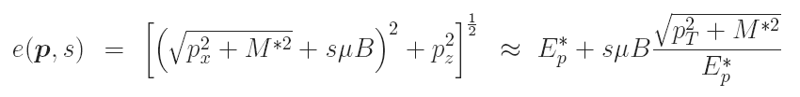

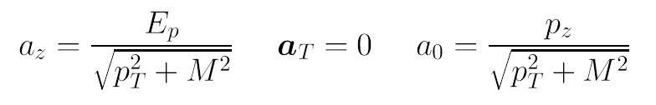
§2-2 Dirac Equation under Magnetic Fields
μ_{N} B << ε_{N} (Chem. Pot) → B can be treated perturbatively
Landau Level can be ignored
B ~ 10¹⁷ G
Lagrangian
Dirac Eq.
Single Part. Eng.
Dirac Spinor
Spin Vector

Slide 6
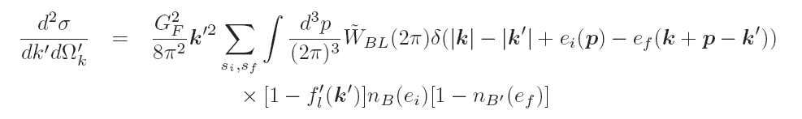
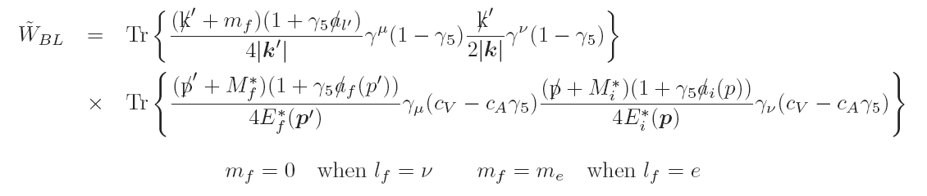

The Cross-Section of Lepton-Baryon Scattering
Fermi
Distribution
Deformed Distribution
Perturbative
Treatment
Non-Magnetic Part
Magnetic Part

Slide 7
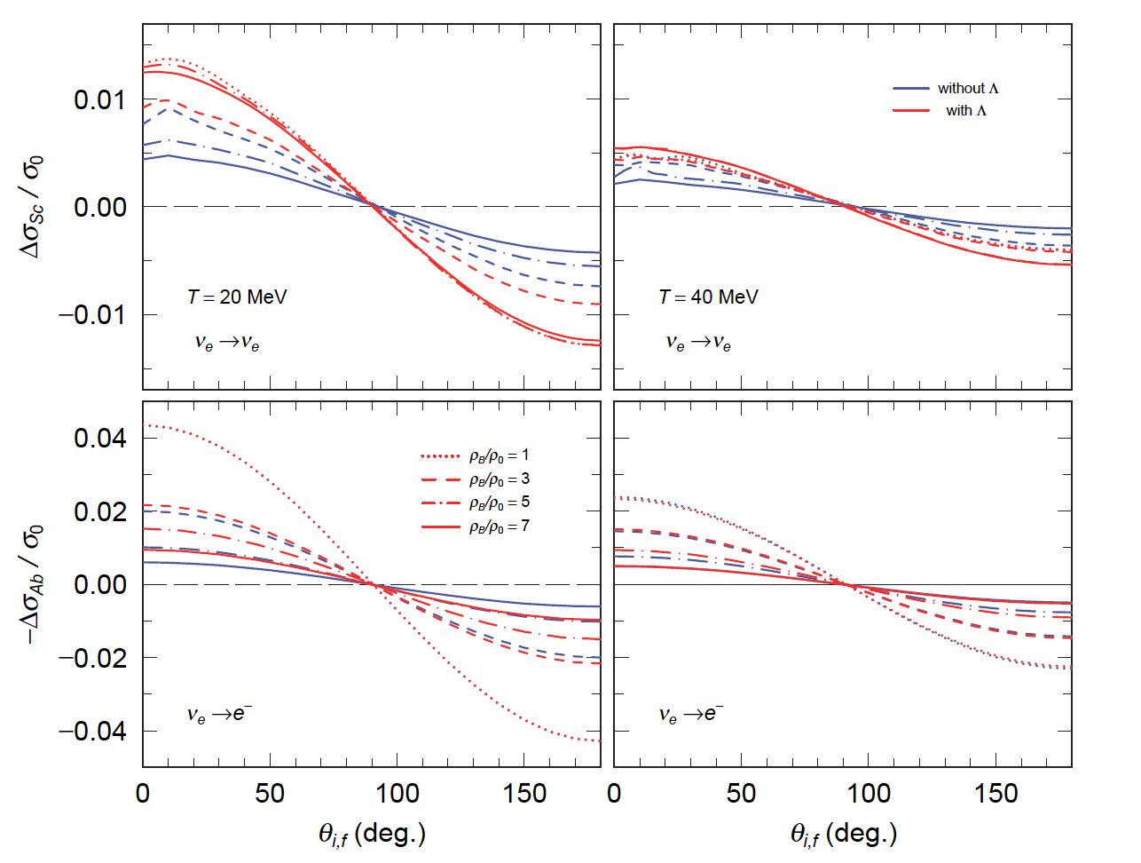
§2-3 Magnetic parts of Cross-Sections
Scat.
Integrating over the initial angle
Increasing ν
in Dir. parallel to B
Absorp.
Integrating over the final angle
7

Slide 8
§2-4 Neutrino Transportation
Neutrino Phase Space Distribution Function
Equib. Part
Non-Equib. Part
Neutrino Propagation ⇒ Boltzmann Eq.
Neutrinos Propagate on Strait Line
only absorption
Solution ⇒

Slide 9
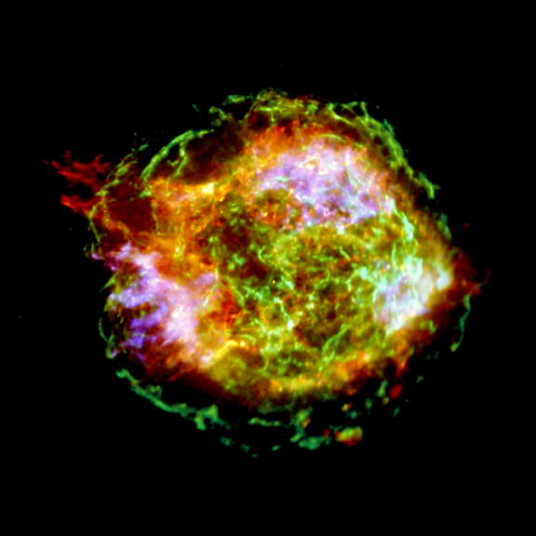
§3 Estimating Pulsar Kick Velocities
of Proto-Neutron Star
CasA
A.G.Lyne, D.R.Lomier, Nature 369, 127 (94)
Asymmetry of Supernova Explosion
kick and translate Pulsar with
Kick Velocity: Average … 400km/s，
Highest … 1500km/s
http://chandra.harvard.edu/photo/
2004/casa/casa_xray.jpg
Explosion Energy ~ 10⁵³ erg
(almost Neutrino Emissions)
1% Asymmetry is sufficient to explain the Pulsar Kick
D.Lai & Y.Z.Qian, Astrophys.J. 495 (1998) L103
Estimating Kick Velocity of PNS with T = 20 MeV and B = 2× 10¹⁷G
Poloidal Magnetic Field 2‐3% Asymmetry in Absorption
9

Slide 10
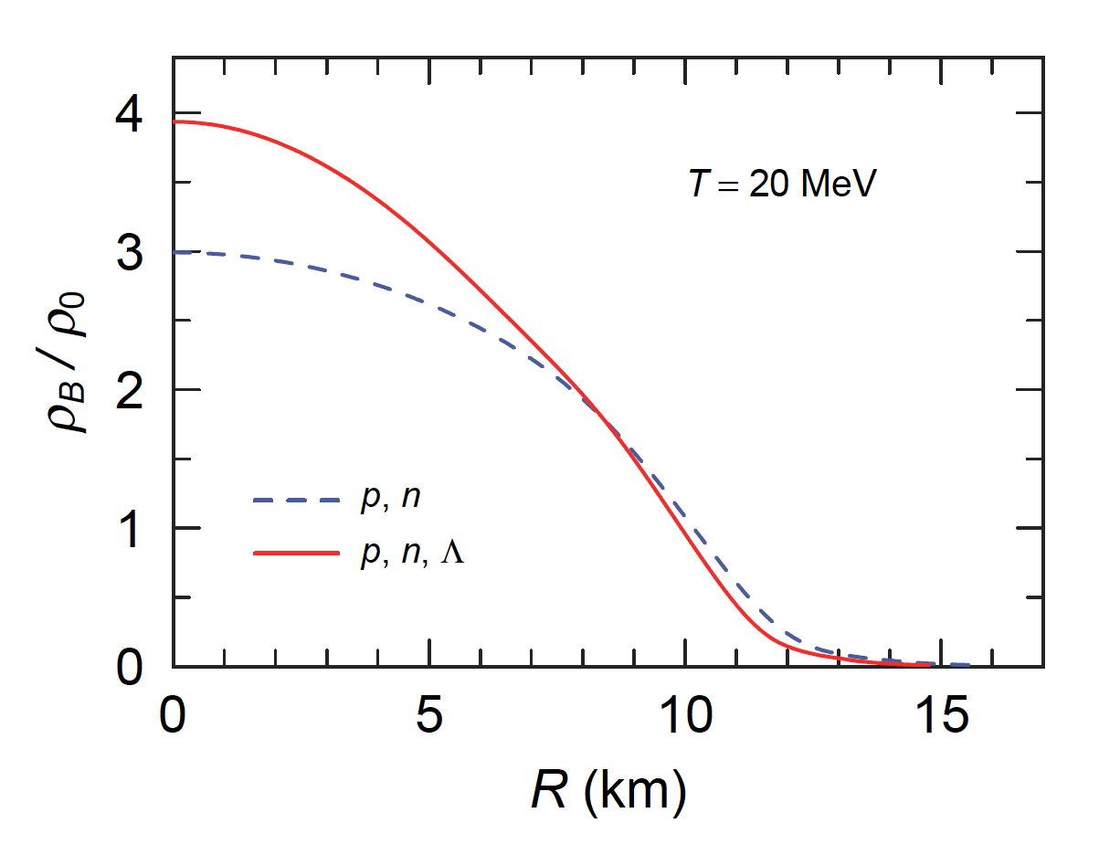
Baryon density in Proto-Neutron Star
M = 1.68M_{solar}
Y_{L} = 0.4
Calculating Neutrino Propagation above ρ_{B} = ρ₀

Slide 11
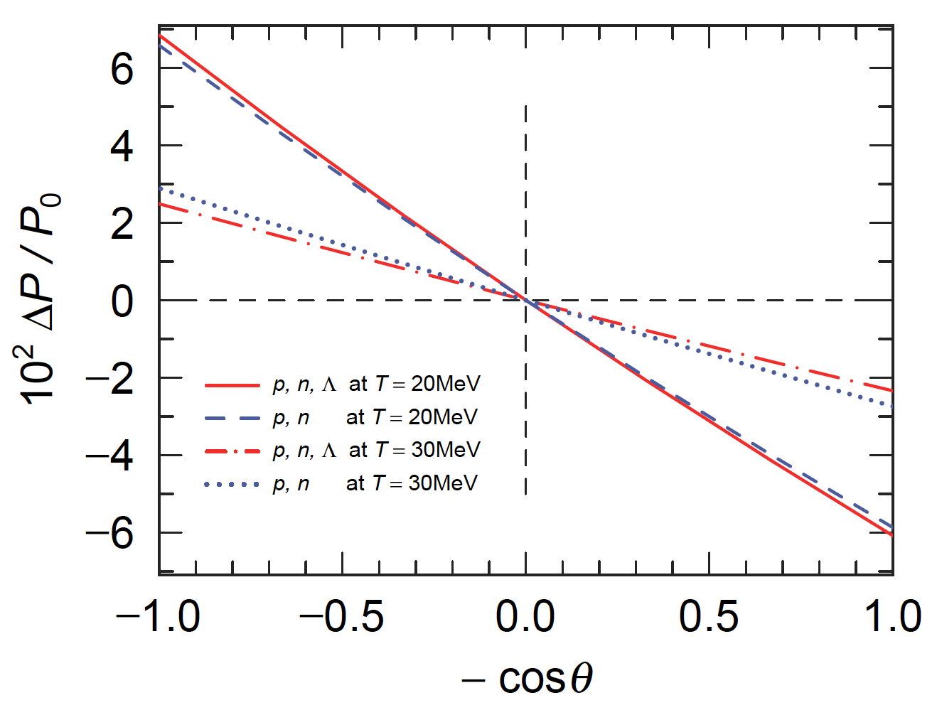
Angular Dep. of Emitted Neutrinos in Uniform Poloidal Mag. Field
T = 20 MeV
T = 30 MeV
T = 20 MeV
T = 30 MeV
Observable Average
… 400km/s，

Slide 12
§4 Angular Deceleration in Toroidal Magnetic Field
Stability of Magnetic Field in Compact Objects
(Braithwaite & Spruit 2004)
Toroidal Magnetic Field is stable !!
Mag. Field
Parallel
to Baryonic Flow
Assym. of ν-Emit.
must decelerate
PNS Spin
12

Slide 13
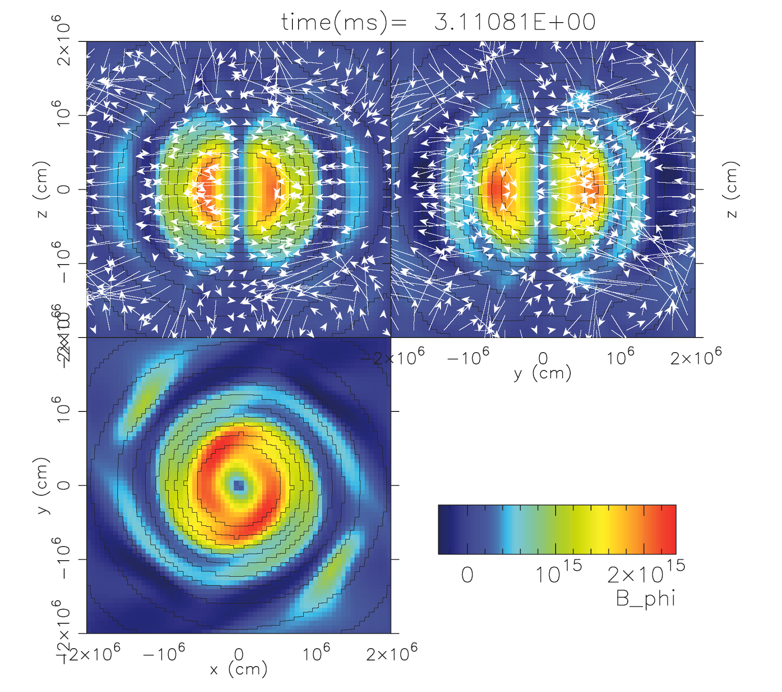
No poloidal Magnetic Field at the beginning
Single Toroidal
by T. Kuroda

Slide 14
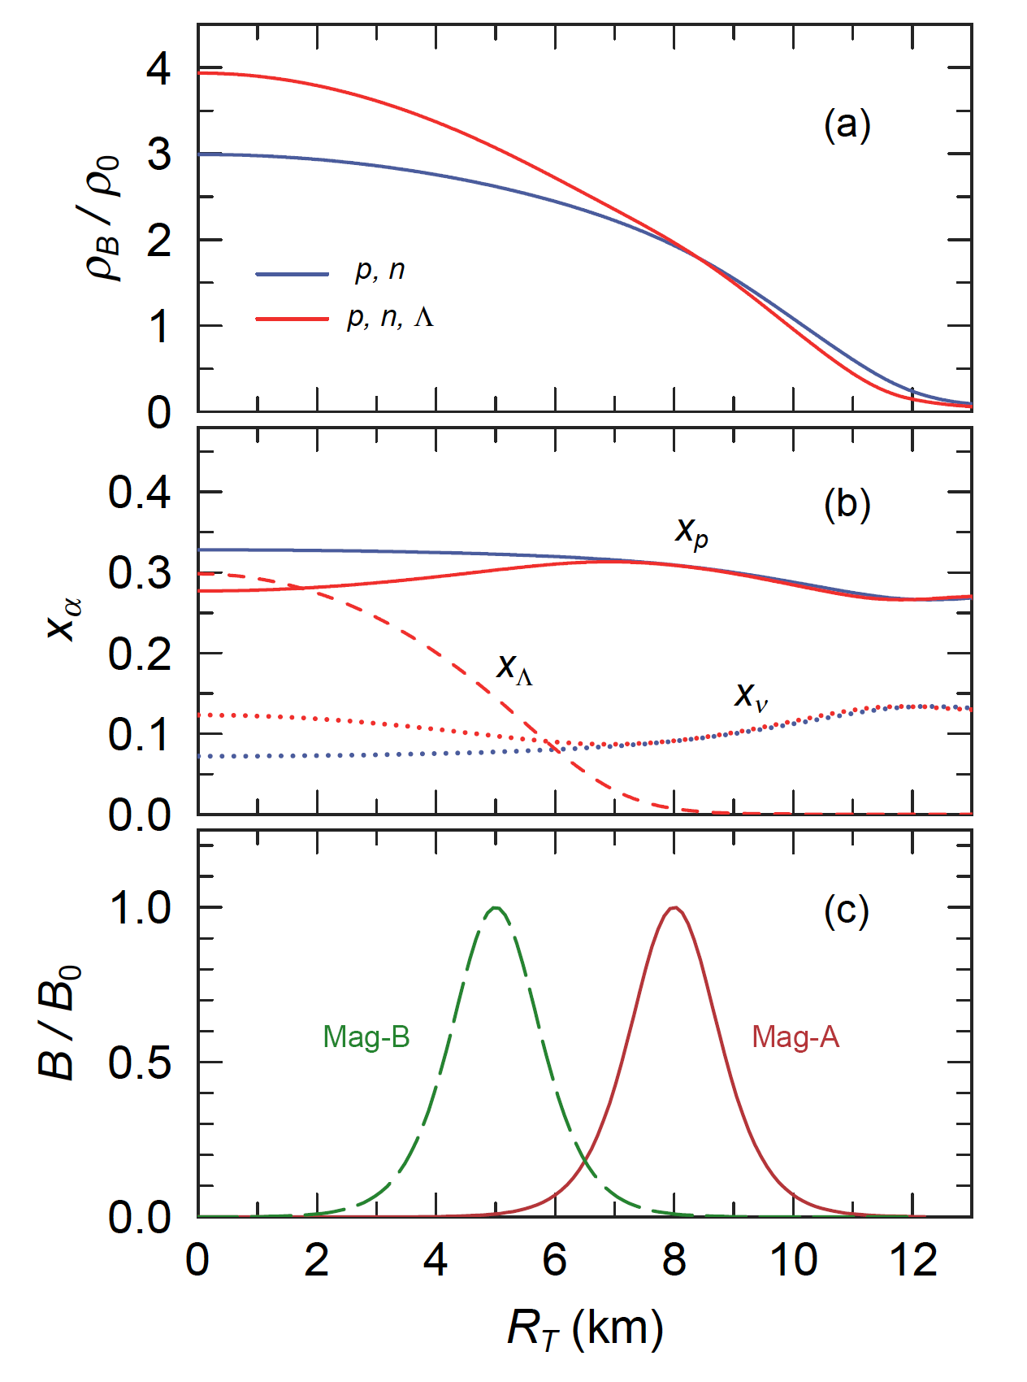
Toroidal Magnetic
Field
T = 20MeV
Δr = 0.5 (km)
R₀ = 8 (km) Mag.‐A
R₀ = 5 (km) Mag.‐B
z = 0

Slide 15
Neutrino Luminosity
(dE_{T}/dt)_{ν} ~ 3×10⁵² erg/s
Magnetic Dipole Radiation (MDR)
15

Slide 16
Results in Asymmetric Neutrino Emmision
Neutrino Luminosity (dE_{T}/dt)_{ν} ~ 3×10⁵² erg/s
Poloidal (B_{pol} = 10¹⁴G) + Toroidal (B₀ = 10¹⁶G)
T. Takiwaki, K.Katake and K. Sato Astro. J 691, 1360 (2009)
Period P = 10ms
Mag Distr. | Bary. | (cm)
 |  |  | (ν emis.) |  | MDR
 |  |  | ρ_{s} = ρ_{０} | ρ_{s} = ρ_{０} /10
p,n | Mag-A | 3.34 | 3.45×10^{－6} | 7.25×10^{－7} | 9.86×10^{－8}
 | Mag-B |  | 4.97×10^{－7} | 3.16×10^{－7}
p,n,Λ | Mag-A | 5.45 | 6.39×10^{－6} | 1.02×10^{－6} | 7.76×10^{－8}
 | Mag-B |  | 4.57×10^{－7} | 2.01×10^{－7}
In Early Stage (～ 10 ms) ν Asymmetric Emission must affect PNS Spin
More Significantly than Magnetic Dipole γ-Radiation
16

Slide 17
§5 Summary
17
EOS of Neutron-Star-Matter with p, n, Λ in RMF Approach
Exactly Solving Dirac Eq. with Magnetic Field in Perturbative Way
Cross-Sections of Neutrino Scattering and Absorption
under Strong Magnetic Field, calculated in Perturbative Way
Neutrinos are More Scattered and Less Absorbed
in Direction Parallel to Magnetic Field
⇒ More Neutrinos are Emitted in Arctic Area
Scattering 1.7 % at ρ_{B}=ρ₀ and at ρ_{B}=3ρ₀
Absorption 4.3 % at ρ_{B}=ρ_{0,} 2.2 % at ρ_{B}=3ρ₀
when T = 20 MeV and B = 2×10¹⁷G

Slide 18
Pulsar Kick in Poroidal Mag. Field
B = 2× 10¹⁷G ⇒ Perturbative Cal.
v_{kick} = 520 km/s ( p,n ) , 580 km/s (p,n,Λ） at T = 20 MeV
400 km/s (Average of Observed Values）
Antarctic Dir.
Spin Deccleration
Estimating Spin-Down Rate of PNS with Toroidal Magnetic Field Configuration
Mag. Field Poloidal 10¹⁴G, Toroidal Max:10¹⁶G
Spin-Down Ratio
P-dot/P ≈ 10⁻⁶ ～ 10⁻⁷ (1/s) for Asym. ν –Emit
≈ 10⁻⁸ (1/s) for MDR
18

Slide 19
Future Plans
Other Effects: ν-Scattering & ν-Production
Iso-Temp. ⇒ Iso-Entropy
Examining Density-Dependence of Symmtery Energy
Exact Solution of Dirac Eq. in Non-Perturbative Cal.
→ Landau Level at least for Electron
Neutrino Propagation in Low Density e‐ + p → ν _{e} + n
Appling Our Method to Double Toroidal Configuration
Making Data Table and Applying it to Supernovae Simulations

Slide 20
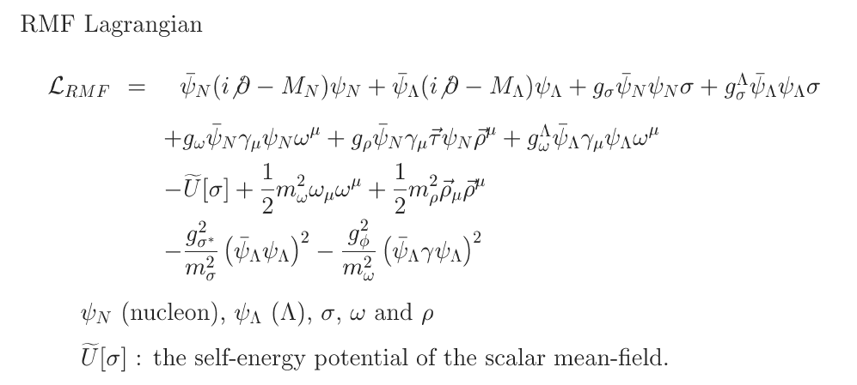
Appendix 1 (T.Maruyama et al, Phys. Rev. D in press)
§1 New RMF Parameter-sets
+
ΛΛ- attractive (S) and repulsive (V)

Slide 21
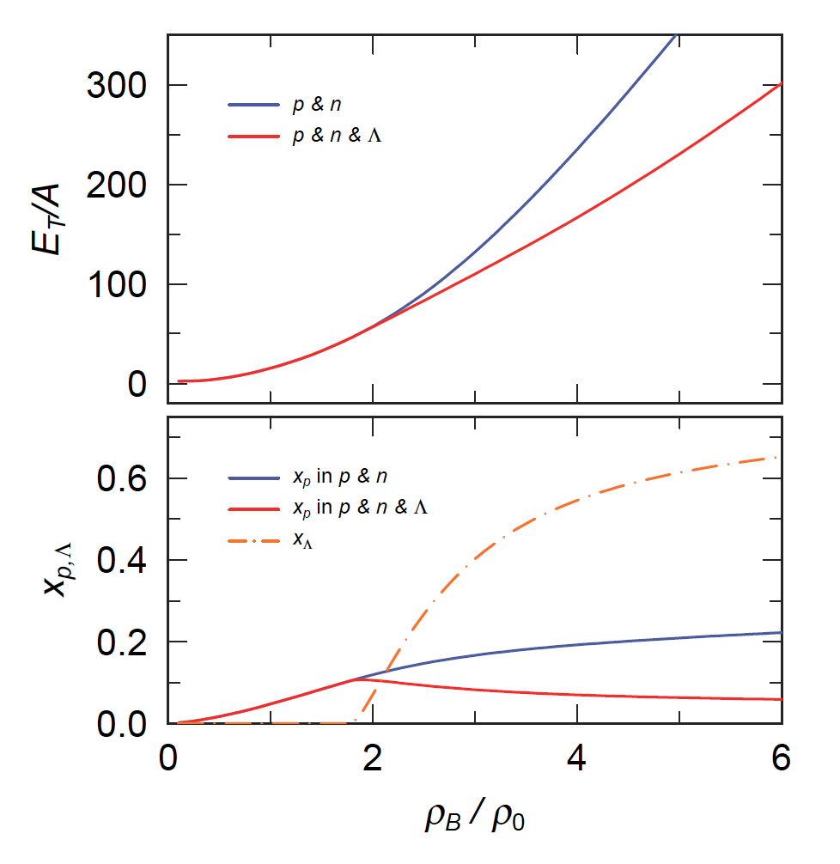
EOS of Neutron-Star-Matter in RMF
21
T = 0
Charge Neutral （ ）
SU(６)

Slide 22
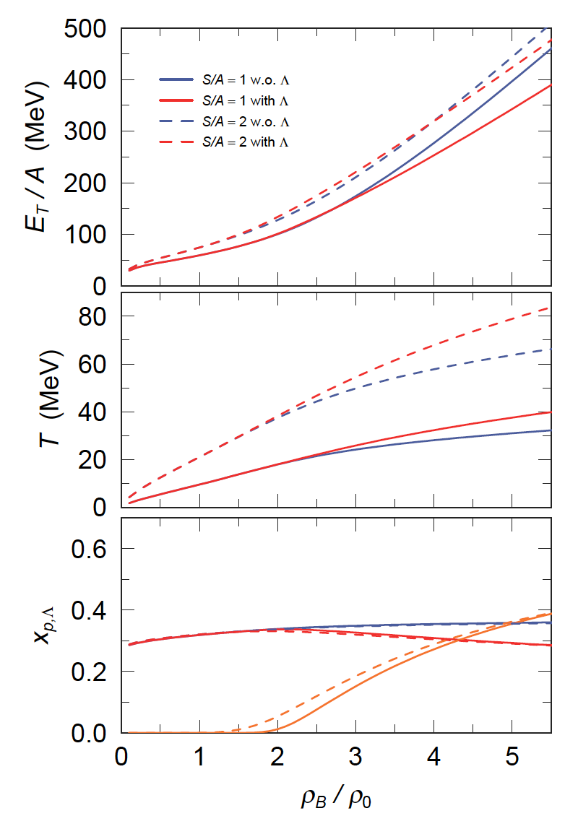
EOS of
Proto Neutron-Star-Matter in RMF
22
p,n, Λ, e ⁻, ν_{e}
+
Anti-particles
Charge Neutral （ ）
& Lepton Fraction : Y_{L} = 0.4

Slide 23
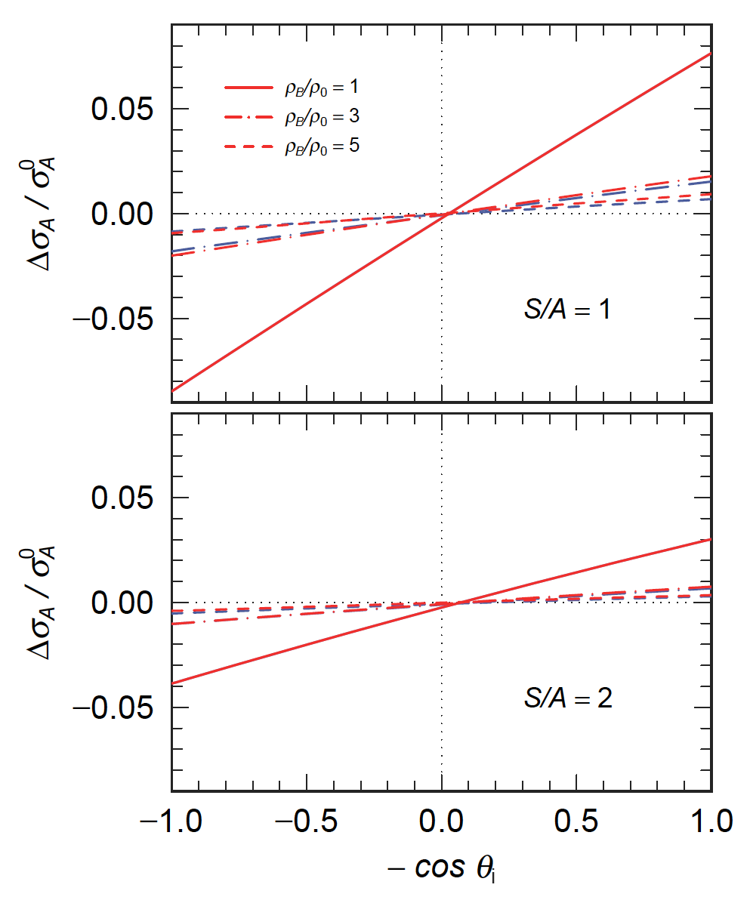
Magnetic parts of Absorption Cross-Sections
Integrating over the final angle
Less Absorption
&
Increasing ν
in Dir. parallel to B
23

Slide 24
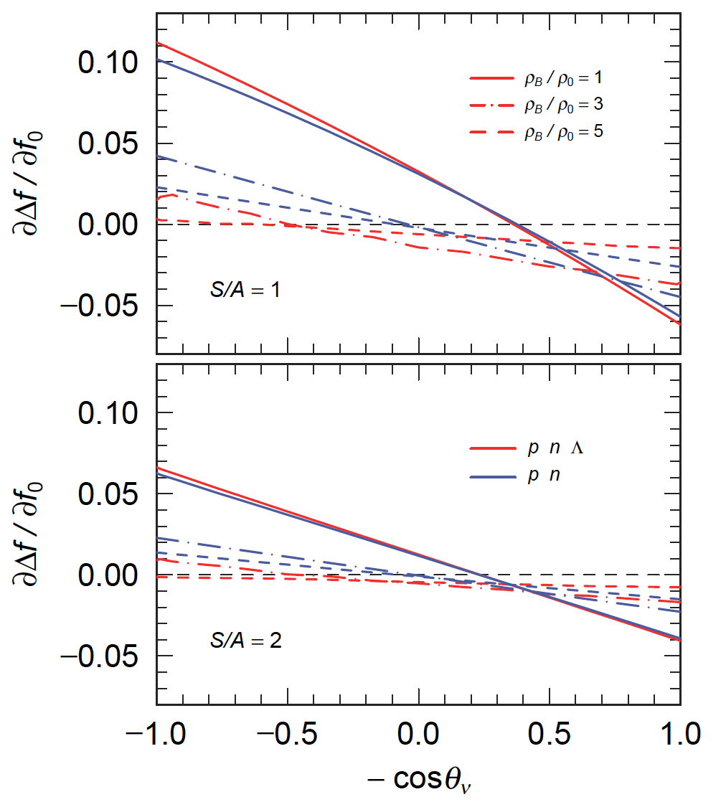
Magnetic parts of Neutrino Production
e⁻ + B → ν_{e} + B’ (DU)

Slide 25
Summary in Appendix 1
25
New Parameter-sets of RMF での 中性子星物質状態方程式
Two Solar Mass NS with p, n, Λ at T = 0
Isothermal ⇒ Iso-Entropy
Neutrino Absorption Cross-sections
increase in Low density Region
Magnetc Parts 8% at ρ_{B} = ρ₀ (B = 10¹⁷G, S/A=1)
2% at ρ_{B} = 3ρ₀
Neutrino Production in DU Process
Arctic Dir. 10% enhance Antarctic Dir. 6% suppressed at ρ_{B} = ρ₀
4% 2 % (p,n) at ρ_{B} = 3ρ₀
2% 1.5% (p,n,Λ) at ρ_{B} = 3ρ₀
Absortption，Scattering，Production (DU) Processes
enhance Neutrino Emission in Arctic Dir. And suppress it in Angtarctic

Slide 26
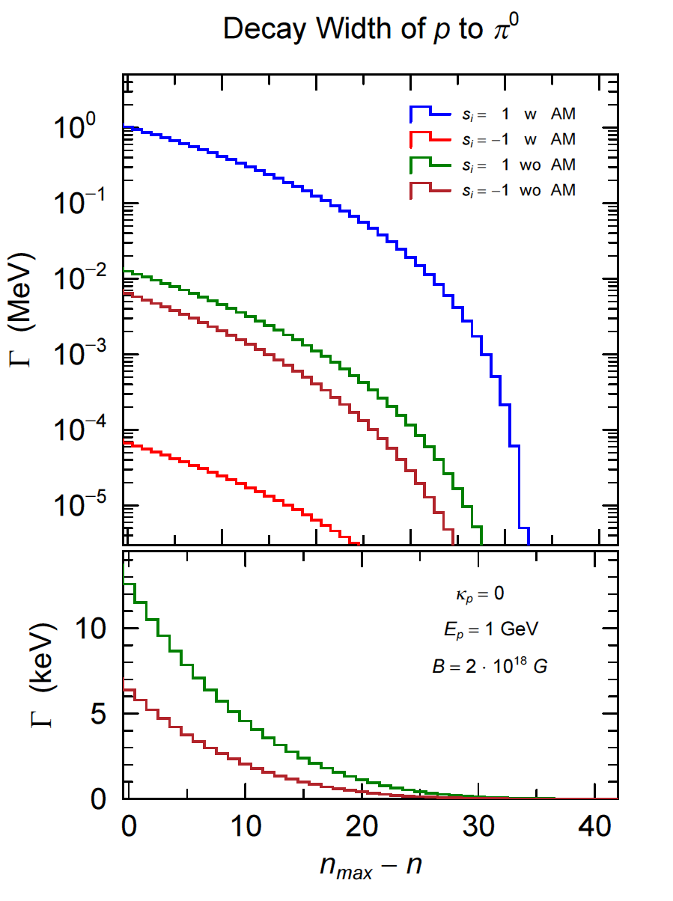
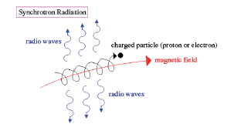
Appendix 2: Proton Synchoron Radiation to Produce Pion through Transition between Landau Level
with Anomalous
Mag. Moment (AM)
without Anomalous
Mag. Moment （ＡＭ）

Slide 27
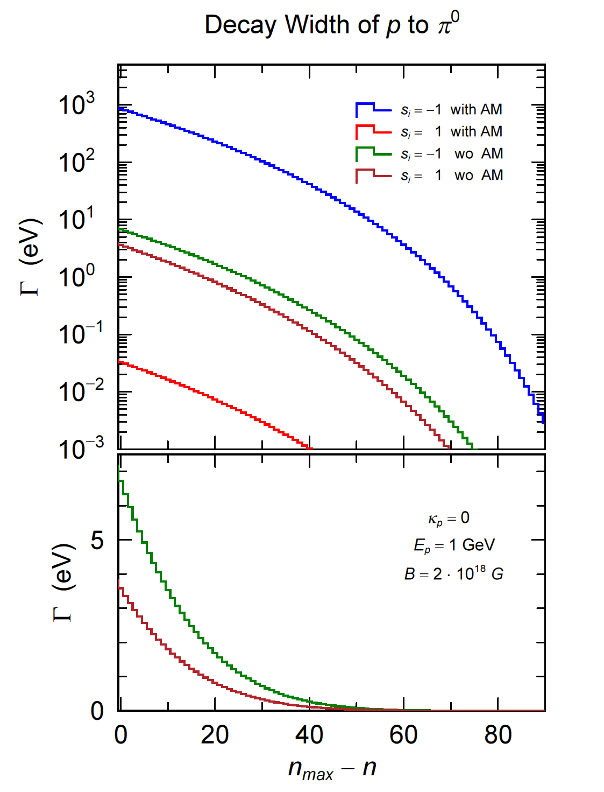
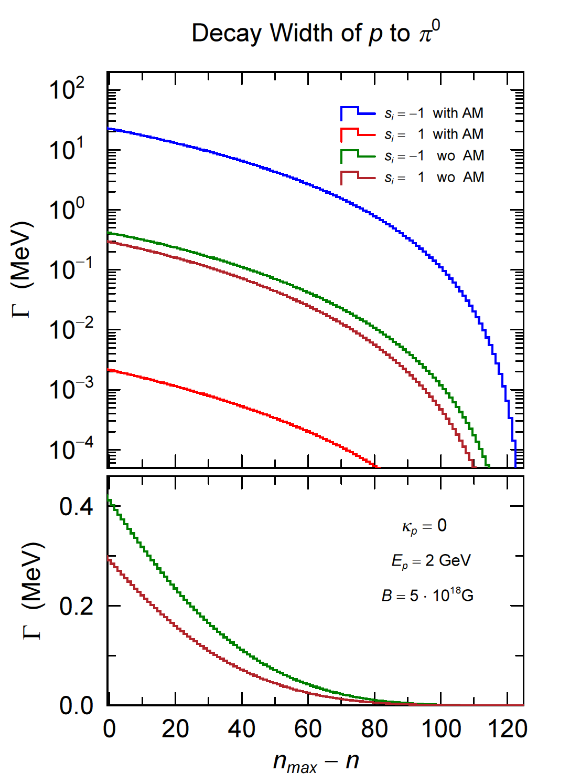

Slide 28
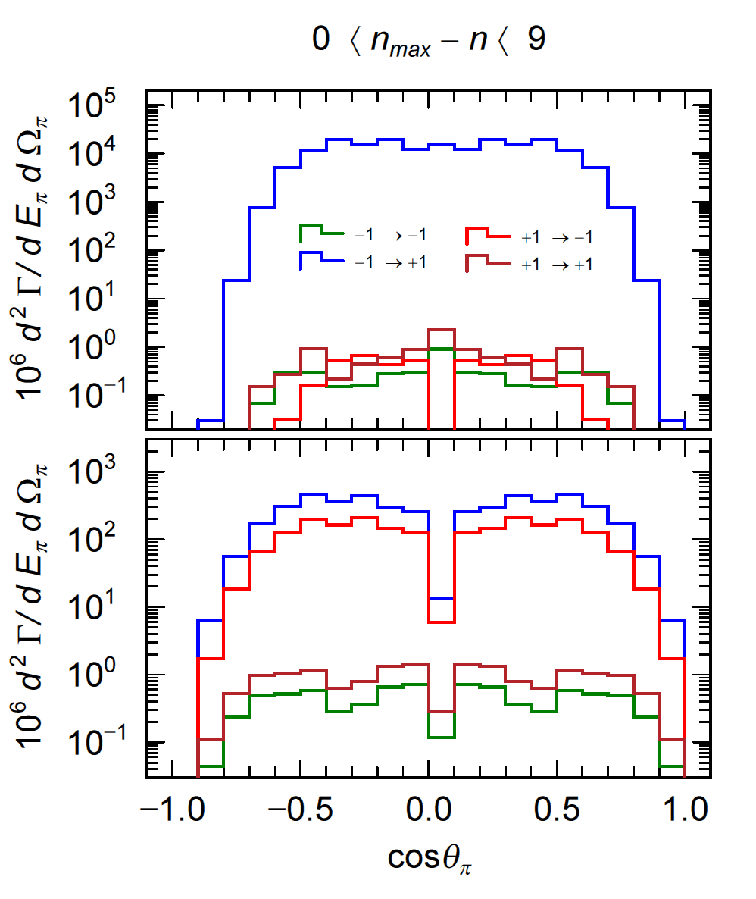
AM
＋1 → －1
Small Mom. Trasns. |Q|
Large Energy Trans E_{π}
no AM
spin flip contribution
is large

