Slide 1
Cooling of Compact Stars with
Color Superconducting Quark Matter
Quarks and Compact Stars
20-22 October 2014, KIAA at Peking University, Beijing, China
Tsuneo Noda (Kurume Institute of Technology)
Collaboration with
N. Yasutake (Chiba Institute of Technology), M. Hashimoto (Kyushu Univ.),
T. Maruyama (JAEA), T. Tatsumi (Kyoto Univ.), M. Y. Fujimoto (Hokkaido Univ.)

Slide 2
Background

Slide 3
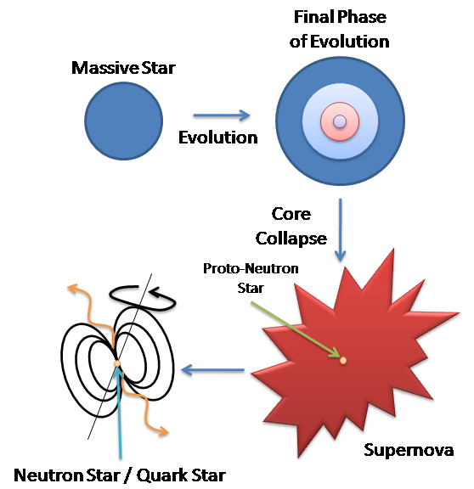
Thermal History of Compact Stars
Compact stars are born from supernovae explosions.
  Born at high temperature (~10¹⁰ K)
No internal heat source
  Emitting thermal energy by neutrinos
  Isolated compact star only cools down.
    t < 10⁵ yr: Neutrino
    t > 10⁵ yr: Photon
Compact Star
Notes:
Let me move to introduction of compact stars.
Massive stars which have heavy mass, more than 8 solar-masses, end their evolution and make supernovae explosions.
Compact stars are created at the phase of core collapse of them, and remains as a small stellar objects.
They are very hot at the beginning, but they have no internal heat sources.
Stars emit their thermal energy out from their interior, the energy is taken out by neutrino emission, mainly.
If stars are isolated, they only cools down.

Slide 4
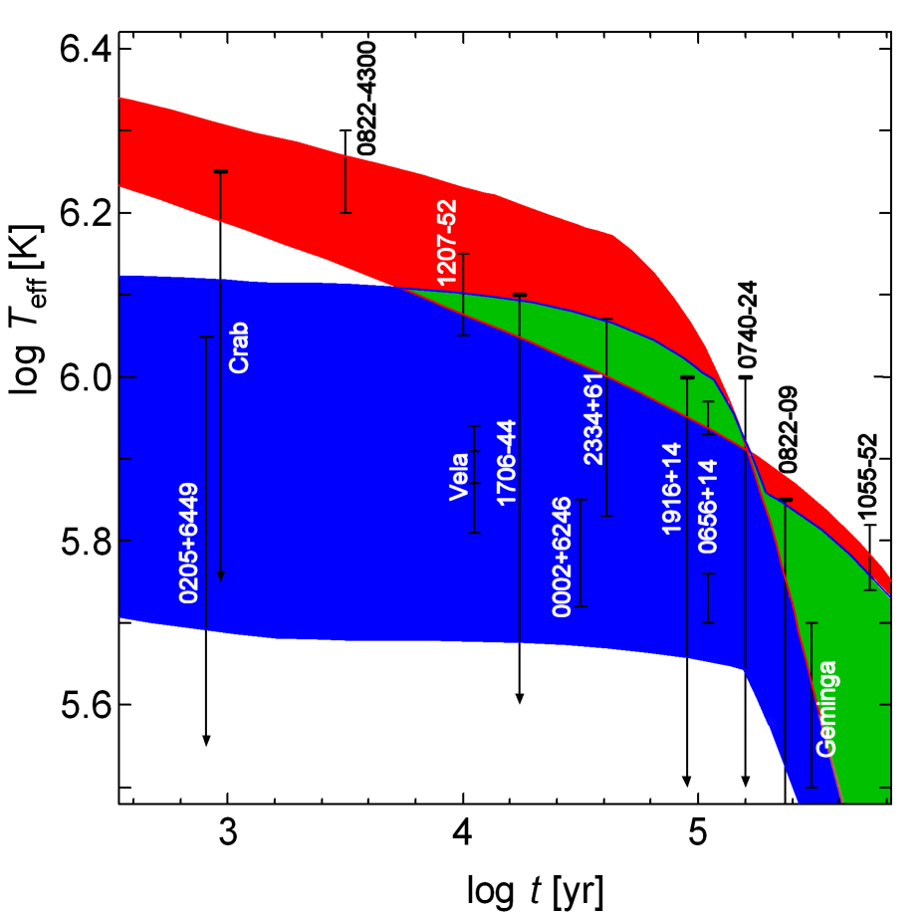
Cooling of Compact Stars
The cooling process of compact stars corresponds the internal matter state
  Normal nuclear matter
  π condensation
  K condensation
  Quark matter
  Superfluidity
  etc…
Exotic phase appears at higher density, and it cools star rapidly.
Isolated compact stars temperature observation give strict constraints.
TN+, PoS (NIC-IX) 153, 2006

Slide 5
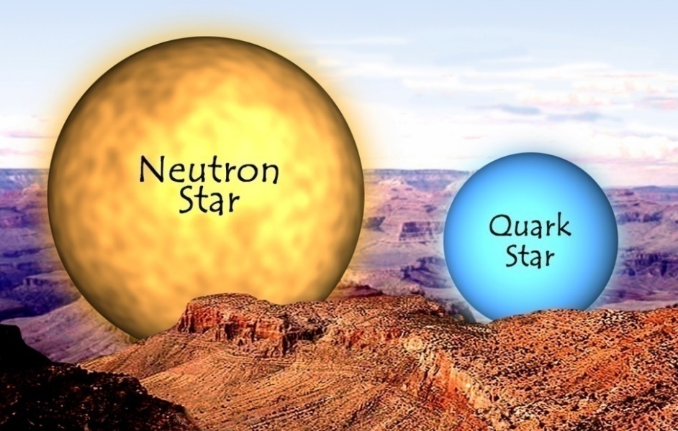
Quark Phase?
QCD phase transition in compact star?
  High density
  Low temperature
  Difficult to examine by colliders
Compact Star with quark matter
  Hybrid star
  Determining quark phase makes strong constraints to nuclear physics
http://chandra.harvard.edu

Slide 6
Important Observation for Cooling
Cassiopaia A
3C58 / Vela
Hot, young and heavy
Isolated compact star with known mass range
Cold compact stars
  Older than Cas A
  Lower temperature
Isolated compact stars
  (mass range unknown)
Should be explained by a single model!

Slide 7
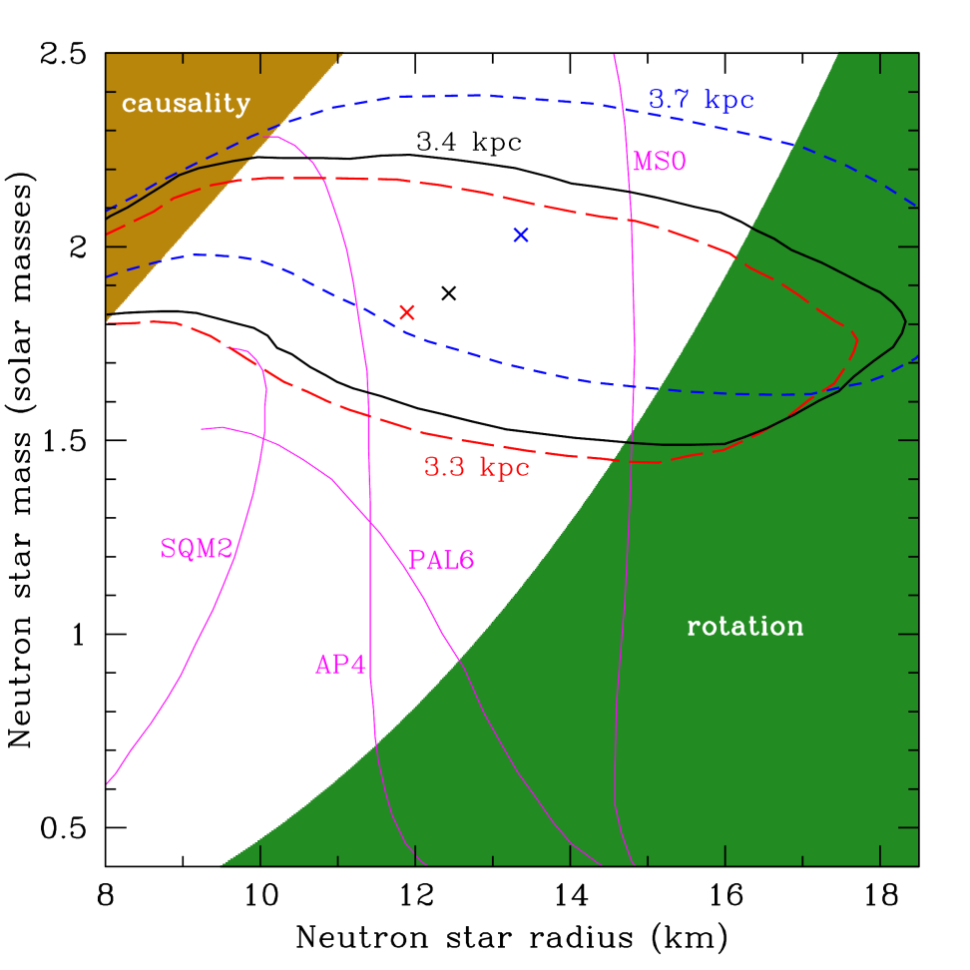
Cassiopeia A
Supernova remnant ~1680
  Central source has been observed by Chandra
Ho & Heinke
Nature 462, 71 (2009)
  2.4 M₈>M>1.5 M₈
  1.75x10⁶ K> T_{eff} > 1.56x10⁶ K
Nature 462, 71 (2009)

Slide 8
Cassiopeia A
Hot & Heavy Compact Star
  M_{Cas A} > 1.5 M₈
  Having large central density
  Keeping warm (comparing with its age)
The mass of Cas A?
  Cas A is a standard neutron star, cooled other are much heavier.
  ⇒ Conflict with other mass observations
  Cas A is heavy, and has an exotic phase, but not cooled down
  ⇒ Color Superconductivity in quark phase

Slide 9
Cassiopeia A
Rapid Cooling?
Heinke & Ho (2010) reported rapid temperature drop
  (ApJL, 719, L167)
  Neutron superfluidity can fit observations
    TN+(2013) (ApJ, 765,1), Shternin+(2011) (MNRAS, 412, L108) etc…
Re-analysis of observational data
  Elshamouty et al. (2013)
    (ApJ, 777, 22)
    Temperature drop is a bit slower
  Posselt et al. (2013)
    (ApJ, 779, 186)
    No statistically significant temperature drop
    Contamination of detectors?
The rapid cooling is question under debate.
Here, we focus onto the mass and temperature (not drop)

Slide 10
Cooling Calculation of Compact Stars

Slide 11
Motivation
Making a consistent model for both of Cas A and other cooled compact stars
  Considering Cas A is heavier than other cooled stars.
  Heavier stars cool slower, and Lighter stars faster.
What we need…? ⇒ Color superconducting quark phase (CSC quark phase)
  Assuming large energy gap (~ tens MeV)
  Appearing higher density
  Suppressing strong quark cooling
Heavy stars with CSC quark phase: slow cooling
Light stars without CSC quark phase: fast cooling

Slide 12
Models
Hybrid Star EoS
  Considering QM-HM Mixed Phase
    Yasutake (2009)
    Phys. Rev. D 80, 123009
    Maruyama (2007)
    Phys. Rev. D 76, 123015
  Soft EoS
  Central Density is easy to rise
  Maximum mass: 1.53M₈
    Lower limit of Cas A
B=100MeV/fm³
  α_{s}=0.2
  σ = 40 MeV/fm²
M=1.5, 1.3, 1.0 M₈

Slide 13
Mixed Phase
Assuming 1st order phase transition
Mixed Phase appears
At each density,
  Wigner-Seitz Cell Radius
  Bag Radius
  Geometric configuration (droplet/rod/slab/tube/bubble)
  Fraction of QM
Multiplying QM fraction to ν -emissivity of quarks
  Strong quark cooling becomes mild

Slide 14
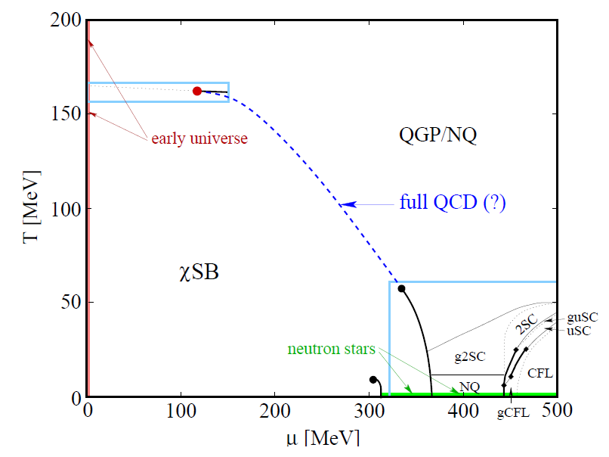
Color Superconductivity (CSC)
Rüster (2006) nucl-th/0612090
Color superconducting quark phase appears at high-dens and low-temp region.
  Pairing patterns
    CFL? 2SC? Or others?
Similar effect to cooling with nucleon superfluidity
  Suppresses ν -emissivity
  Large gap energy Δ (~tens MeV)
Large enough gap energy
  ∝exp(-Δ/k_{B}T)
  ν -emissivity ~0
Assuming CFL paring
Unpaired
2SC Pairing
CFL Pairing
p_{F}
R G B
p_{F}
R G B
p_{F}
R G B
d
d
d
u
u
u
s
s
s

Slide 15
CSC Threshold
Assuming CSC appears at high density region in the quark phase
  The threshold density: ρ_{csc}
  Larger density region: quark cooling suppressed
We use ρ_{csc} as a parameter.
ν
MP with
QM-normal
MP with
QM-CSC
ρ = ρ_{csc}
QM-normal: normal quark phase QM-CSC: CSC quark phase

Slide 16
Star Structure
Small Mass /
Large ρ_{csc}
Large Mass /
Small ρ_{csc}
ν
ν
MP with
QM-normal
MP w/ QM-normal
MP with
QM-CSC
MP with
QM-CSC
QM-normal: normal quark phase QM-CSC: CSC quark phase

Slide 17
Results & Discussions

Slide 18
Results

Slide 19
Results
CSC makes heavier star keeps warm
  Cold stars are lighter stars
  Cas A data can be matched
Problems
  Rapid cooling of Cas A
    Neutron superfluidity?
  Quark cooling is still too strong
    Lower limit of Vela
    Including other uncertainty, quark cooling gets smaller for 1/10 (△)or 1/100 (○)
  Requires fine-tuning

Slide 20

2M₈ Compact Stars
Demorest et al. observed PSR J1614-2230 (NS-WD binary)
  Shapiro delay
  NS mass: $1.97±0.04M_{⊙}$, WD mass: $0.500±0.006M_{⊙}$
Antoniadis et al. observed PSR J0348+0432 (NS-WD binary)
  NS mass: $2.01±0.04M_{⊙}$, WD mass: $0.173±0.003M_{⊙}$
Observed masses make strong constraints for the EoS.
Our previous model cannot reach to 2M₈.
  Need to change the EoS for our calculation.
We try to use an EoS which maximum mass reaches to 2M₈.
  Brueckner-Hartree-Fock (HM) + Dyson-Schwinger (QM)
  Yasutake et al. (2013) (arXiv: 1309.1954)
  Assuming entire QM core is in CSC phase
  Direct URCA works, but suppressed by proton superfluidity

Slide 21
EoS for 2M₈ Compact Stars (2M₈CS-EoS)
Quark Mixed
2.1M₈
2.0M₈
1.4M₈
J0348+0432
Cas A
J1614-2230
Cas A: Ho & Heinke 2009
J1614-2230: Demorest+
J0348+0432: Antoniadis+
Calculation Models

Slide 22

Cooling Processes
Hadron: Modified-URCA & Bremsstrahlung (Low $ρ$)
Direct-URCA with Proton Superfluidity (High $ρ$)
($T_{CR}^{p}≥2×{10}^{9}$ K)
Strong D-URCA cooling suppressed
No Effect of Neutron Superfluidity
Quark: Quark β-Decay with Color Superconductivity
($log Δ≥$ a few tens of MeV)
Strong Quark cooling suppressed
Once quark matter appears, it is in the CSC phase

Slide 23
Cooling Models
We choose 3 models, corresponding the star structure
Hadron
Hadron
Hadron
MP
(Quark)
M-URCA
Brems.
M-URCA
Brems.
M-URCA
Brems.
D-URCA
D-URCA
Heavy
Light
2.1M₈
2.0M₈
1.4M₈

Slide 24
Cooling Results with 2M₈CS-EoS
Cas A
3C58
Vela
Preliminary

Slide 25
Cooling Results with 2M₈CS-EoS
Heavy stars cool slower, and Light stars cool faster.
  Good tendency for Cas A cooling profile
  Cooling curves do NOT cross with 3C58 or Vela data
    Some kind of strong (not too strong) cooling process required
    Candidate: Neutron Superfluidity (³P₂)
We need 3 super- phases?
  Proton Superfluidity to suppress D-URCA
  Neutron Superfluidity to fit the Vela data
  Color Superconductivity to suppress Quark Cooling

Slide 26
Summary
Considering CSC quark phase, heavier stars cool slower, and lighter stars cool faster
  Different from conventional scenario
  Can explain the Cas A temperature and mass
  Still difficult to fit Vela data (with lower limit)
2M₈ EoS
  Preliminary result shows similar tendency
  Need to re-build a realistic model
    Some cold star require stronger cooling.
    (incl. Direct URCA, Neutron Superfluidity, Surface Composition, etc…)
  3 Super- phases?
Cas A rapid cooling
  Wait for further observation/analysis?
Thank you

