Slide 1

Hybrid condensate in the external magnetic field
Kazuya Nishiyama
Kyoto University
Collaborator: Toshitaka Tatsumi, Shintaro Karasawa, Ryo Yoshiike
Quarks and Compact Stars 2014
October 2014, PKU, Beijing

Slide 2
Outline
Introduction
  QCD phase diagram and Inhomogeneous Chiral Phase
  QCD in the External Magnetic field
Inhomogeneous chiral phase in Magnetic field
  Preceding study
  Hybrid condensate
  Results
Summary

Slide 3
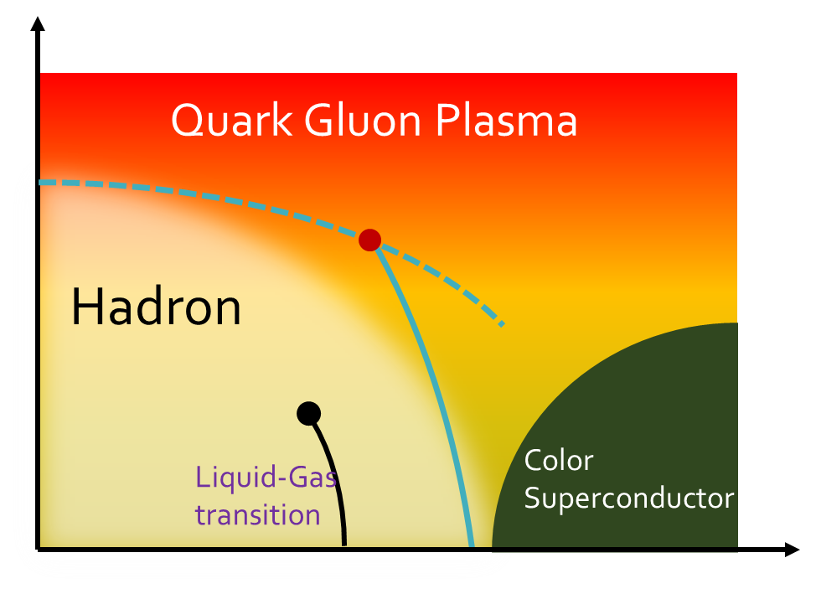
QCD Phase diagram
T
μ
Usually, The QCD phase structure is studied by assuming that the order parameter is temporally and spatially constant.
Is it possible that Non-uniform phase appears in QCD phase diagram?

Slide 4
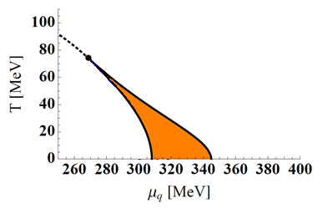
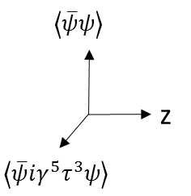
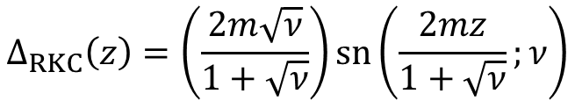


Inhomogeneous Chiral Phase
Inhomogeneous phase appears in QCD
E.Nakano, T.Tatsumi (2005)
D.Nickel (2009)
G.Basar(2008)
…….
・Order parameter
$$Δ(z)= \left\langle \overline{ψ}ψ\right\rangle +i\left\langle \overline{ψ}iγ^{5}τ^{3}ψ\right\rangle$$
・Phase Diagram
■Typical configurations.
・Dual Chiral Density Wave(DCDW)
Phase is inhomogeneous
$$Δ_{DCDW}\left(z\right)=m e^{iqz}$$
Restored
Homogeneous
Broken
RKC
・Real kink Crystal(RKC)
Amplitude is inhomogeneous
Inhomogeneous phase appears
in intermediate μ
$$∆_{RKC}\left(z\right)=\left(\frac{2m\sqrt{ν}}{1+\sqrt{ν}}\right)\operatorname{sn}\left(\frac{2mz}{1+\sqrt{ν}};ν\right)$$

Slide 5
QCD in the External Magnetic Field
Quarks and Hadrons in Strong magnetic field
  Magnetar ～10¹⁵ Gauss
  Heavy Ion Collision ～10¹⁷ Gauss
  Early Universe Much higher
Magnetic field causes various phenomena
  Magnetic Catalysis, Magnetic Inhibition
  Chiral magnetic effect
  Charged vector meson condensation
  ….
V.P.Gusynin, et. al.(1994)
G.S.Bali, et, al. (2011)
K.Fukushima, et. al (2008)
QCD phase structure must be changed
by taking account to both of Inhomogeneity and magnetic field.

Slide 6
Inhomogeneous Chiral Phase in the Magnetic Field

Slide 7
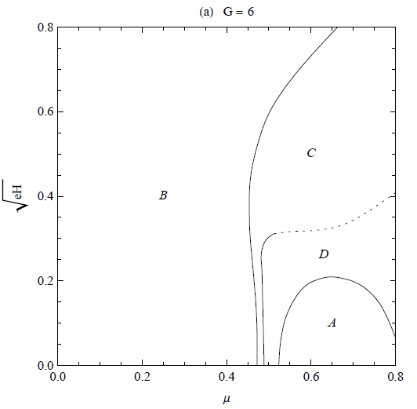
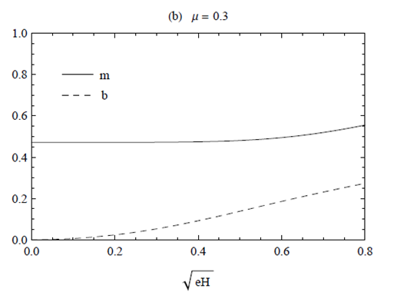

Preceding study and problem
DCDW in the external magnetic field
I. E. Frolov,et.al. Rev. D 82, 076002 (2010)
$$Δ_{DCDW}\left(z\right)=m e^{iqz}$$
μ=0.3
q/2
A: Restored phase
B,C,D: DCDW phase
→DCDW grows by magnetic field
However, RKC is more favorable than DCDW without magnetic field
Purpose of the current study
  What inhomogeneous phase is favored in magnetic field
  How mechanism of growth of DCDW in magnetic field

Slide 8



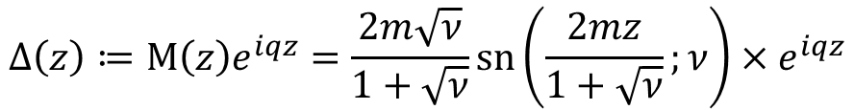


Setting
Model
Mean field NJL model in the external magnetic field.
$$L=\overline{ψ}iD_{μ}γ^{μ}ψ+2G\left[\left\langle \overline{ψ}ψ\right\rangle \left(\overline{ψ}ψ\right)+\left\langle \overline{ψ}iγ^{5}τ^{a}ψ\right\rangle \left(\overline{ψ}iγ_{5}τ^{a}ψ\right)\right]−G[{\left\langle \overline{ψ}ψ\right\rangle }^{2}+{\left\langle \overline{ψ}iγ^{5}τ^{a}ψ\right\rangle }^{2}]$$
$$Δ(z)=−2G[\left\langle \overline{ψ}ψ\right\rangle +i\left\langle \overline{ψ}iγ^{5}τ^{3}ψ\right\rangle ]$$
We assume that magnetic field is parallel to modulation of order parameters.
Hybrid Configuration
More general type condensate which includes DCDW and RKC
$$Δ\left(z\right)≔M\left(z\right)e^{iqz}=\frac{2m\sqrt{ν}}{1+\sqrt{ν}}\operatorname{sn}\left(\frac{2mz}{1+\sqrt{ν}};ν\right)×e^{iqz}$$
RKC
DCDW
$ν→$1
$$q→0$$
$$Δ_{DCDW}(z)$$
$$Δ\left(z\right)$$
$$∆_{RKC}\left(z\right)$$
This configuration is characterized by q,ν,m

Slide 9
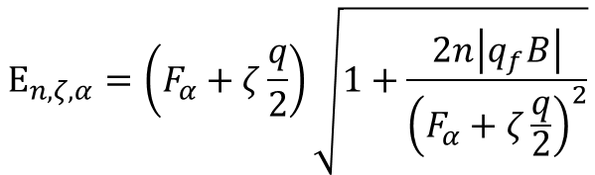
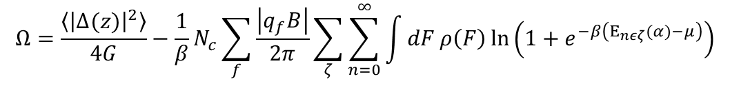
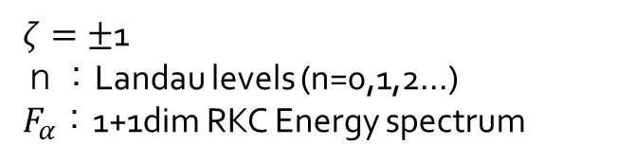

Energy Spectrum and Free Energy
1 particle Energy Spectrum
$$E_{n,ζ,α}=\left(F_{α}+ζ\frac{q}{2}\right)\sqrt{1+\frac{2n\left|q_{f}B\right|}{{\left(F_{α}+ζ\frac{q}{2}\right)}^{2}}}$$
n=1,2,…..
$ζ=±$1
ｎ：Landau levels (n=0,1,2…)
$F_{α}$：1+1dim RKC Energy spectrum
$$E_{n=0,α}=F_{α}+\frac{q}{2}$$
n=0
n=0, Energy spectrum is asymmetric.
Free energy
$$Ω=\frac{\left\langle {\left|Δ(z)\right|}^{2}\right\rangle }{4G}−\frac{1}{β}N_{c}\sum_{f}{\frac{\left|q_{f}B\right|}{2π}}\sum_{ζ}{\sum_{n=0}^{∞}{\int{dF}ρ\left(F\right)\ln\left(1+e^{−β\left(E_{nεζ}(α)−μ\right)}\right)}}$$
Phase structure is determined by Stationary conditions $\frac{∂Ω}{∂m}=\frac{∂Ω}{∂ν}=\frac{∂Ω}{∂q}=0$

Slide 10
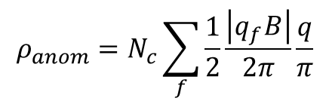
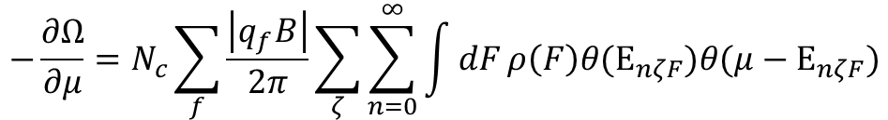

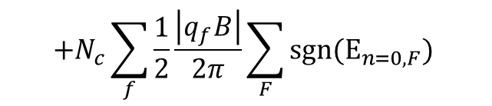
Anomalous Quark density
T.Tatsumi, K.N, S.Karasawa arXiv:1405.2155
Quark Density at T=0
$$−\frac{∂Ω}{∂μ}=N_{c}\sum_{f}{\frac{\left|q_{f}B\right|}{2π}}\sum_{ζ}{\sum_{n=0}^{∞}{\int{dF}ρ\left(F\right)θ(E_{nζF})θ({μ−E}_{nζF})}}$$
$$+N_{c}\sum_{f}{\frac{1}{2}\frac{\left|q_{f}B\right|}{2π}}\sum_{F}{sgn(E_{n=0,F}) }$$
E
Anomalous Quark Number Density
by Spectral Asymmetry
μ
q/2+m
A.J.Niemi (1985)
For DCDW (m>q/2)
0
$$ρ_{anom}=N_{c}\sum_{f}{\frac{1}{2}\frac{\left|q_{f}B\right|}{2π}}\frac{q}{π}$$
q/2-m
$$Ω_{anom}∝eBqμ$$
This term is first order of q
→q=0 is not minimum point
→Inhomogeneous phase is more favorable than homogeneous broken phase.

Slide 11
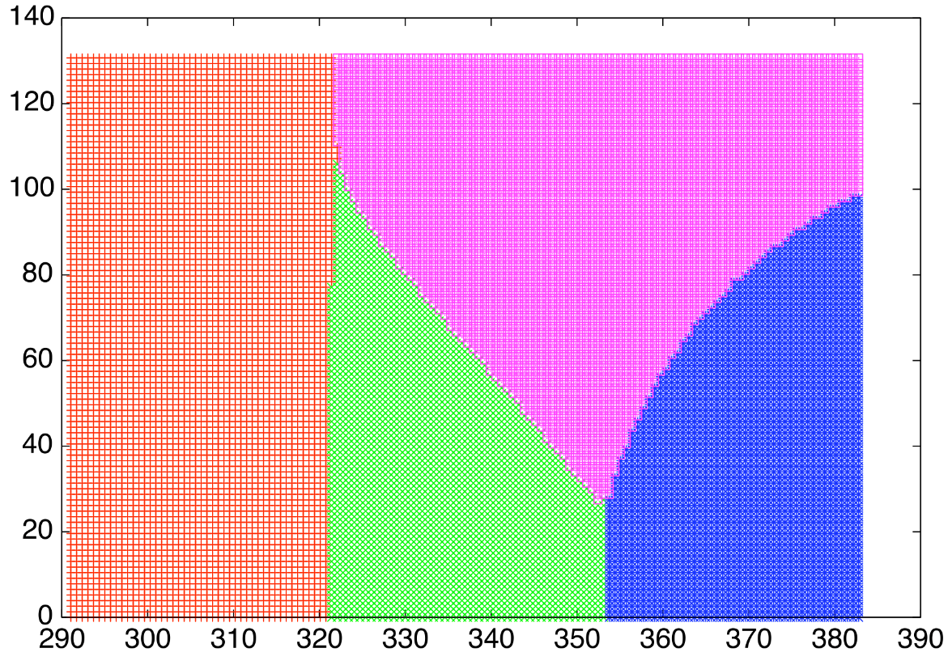


Phase diagram
Phase Diagram at T=0
A: Weak DCDW phase
B: Hybrid
C: Strong DCDW phase
D Restored
C
$\sqrt{eB}$[MeV]
A
B
D
$μ$[MeV]
B=0, the order parameter is real. Homogeneous phase and RKC phase appear.
Weak B, the order parameter is complex but q is small
Strong B, DCDW is favored everywhere.

Slide 12
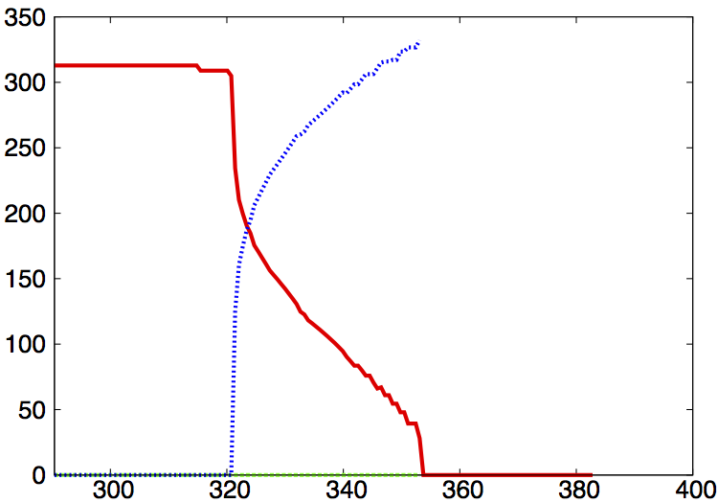
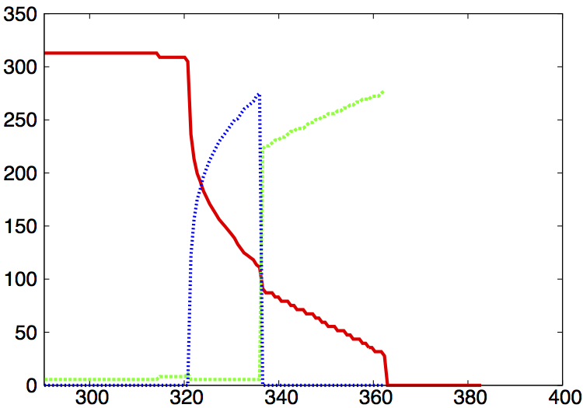
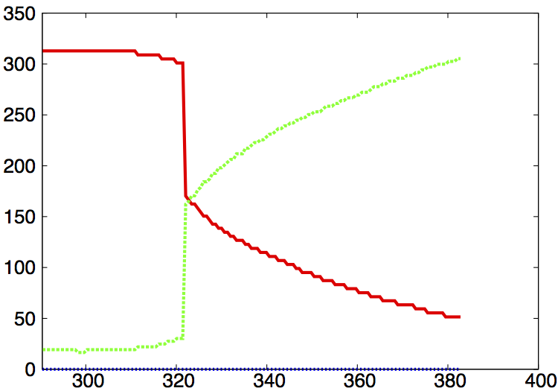






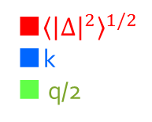




Order Parameter
(a) $B=0$
(b)$\sqrt{eB}=70$MeV (～5×10¹⁶ Gauss)
■${\left\langle {\left|∆\right|}^{2}\right\rangle }^{1/2}$
■k
■ q/2
■${\left\langle {\left|∆\right|}^{2}\right\rangle }^{1/2}$
■k
■q/2
Homo.
Broken
DCDW
DCDW
RKC
Restored
Restored
Hybrid
$μ$[MeV]
$μ$[MeV]
k is wavenumber of amplitude modulation
$$k=2\left(1+\sqrt{ν}\right)K(ν)/m$$
(b)$\sqrt{eB}=120$MeV (～1.4×10¹⁷ Gauss)
■${\left\langle {\left|∆\right|}^{2}\right\rangle }^{1/2}$
■k
■ q/2
(c)
DCDW
DCDW
(b)
(a)
$μ$[MeV]

Slide 13
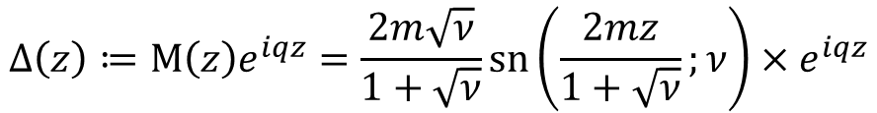
Summary and outlook
Summary
  Hybrid type configuration is used
  In magnetic field, DCDW is favored due to Spectral asymmetry
  Magnetic field causes inhomogeneity of phase
  Hybrid phase appears in the magnetic field
  Broken Phase expands by magnetic field
Outlook
  Phase diagram at T≠0
  Strangeness
  Isospin chemical potential
$$Δ\left(z\right)≔M\left(z\right)e^{iqz}=\frac{2m\sqrt{ν}}{1+\sqrt{ν}}\operatorname{sn}\left(\frac{2mz}{1+\sqrt{ν}};ν\right)×e^{iqz}$$

Slide 15
Back up

Slide 16
Generalized Ginzburg-Landau approach

Slide 17

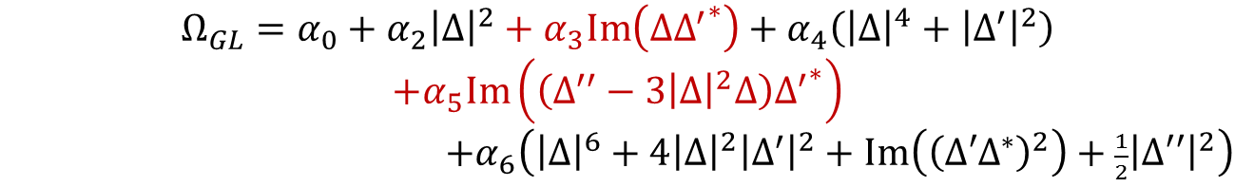


Generalized Ginzburg Landau Expansion
・B=0 case
Hamiltonian has $Δ→∆^{∗}$symmetry
$$Ω_{GL}=α_{0}+α_{2}{\left|Δ\right|}^{2}+α_{4}\left({\left|Δ\right|}^{4}+{\left|Δ^{′}\right|}^{2}\right)$$
$+α_{6}\left({\left|Δ\right|}^{6}+4{\left|Δ\right|}^{2}{\left|Δ^{′}\right|}^{2}+Im\left({\left(Δ′Δ^{∗}\right)}^{2}\right)+\frac{1}{2}{\left|Δ′′\right|}^{2}\right)$
$α_{2}=α_{4}=0$ is Lifshitz point
・B≠0 case
$Δ→∆^{∗}$symmetry is broken.
→Odd order term appears
$$Ω_{GL}=α_{0}+α_{2}{\left|Δ\right|}^{2}+α_{3}Im\left(Δ{Δ^{′}}^{∗}\right)+α_{4}\left({\left|Δ\right|}^{4}+{\left|Δ^{′}\right|}^{2}\right)$$
$$+α_{5}Im\left(\left(Δ^{′′}−3{\left|Δ\right|}^{2}Δ\right){Δ^{′}}^{∗}\right)$$
$+α_{6}\left({\left|Δ\right|}^{6}+4{\left|Δ\right|}^{2}{\left|Δ^{′}\right|}^{2}+Im\left({\left(Δ′Δ^{∗}\right)}^{2}\right)+\frac{1}{2}{\left|Δ′′\right|}^{2}\right)$
B=0 or μ=0 →Odd term vanishes
New Lifshitz point appears at $α_{2}=α_{3}=0$

Slide 18
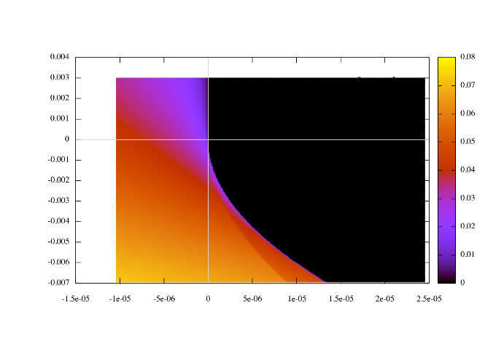
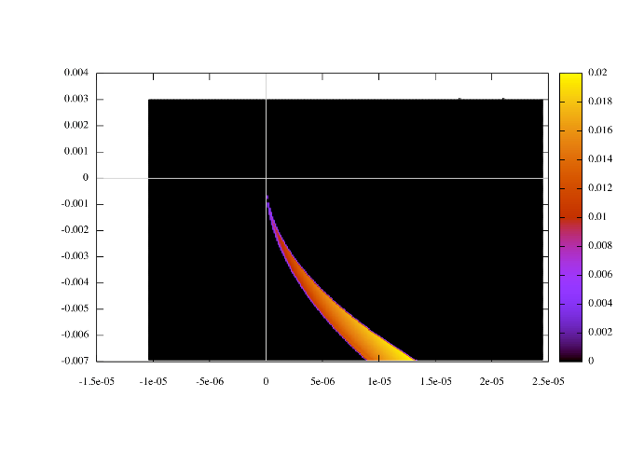
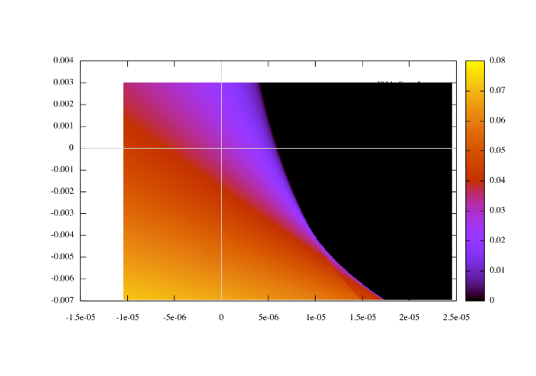
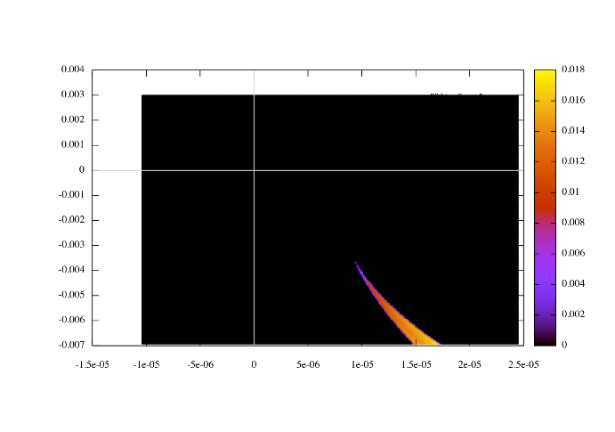
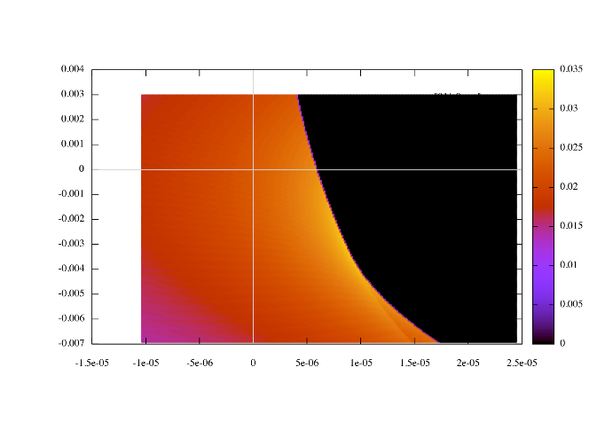








gGL phase diagram
$$B=0$$
$${\left\langle {\left|Δ\right|}^{2}\right\rangle }^{1/2}$$
$$L^{−1}$$
$q$ =0 everywhere
L: period of amplitude modulation
$\sqrt{eB}=80$MeV
$${\left\langle {\left|Δ\right|}^{2}\right\rangle }^{1/2}$$
$$L^{−1}$$
$$q$$
Broken phase expands by magnetic field
Phase modulation grows near the “Critical Point”

Slide 19
Quark Gluon Plasma
Hadron
Liquid-Gas
transition
Color
Superconductor

